Slide 1
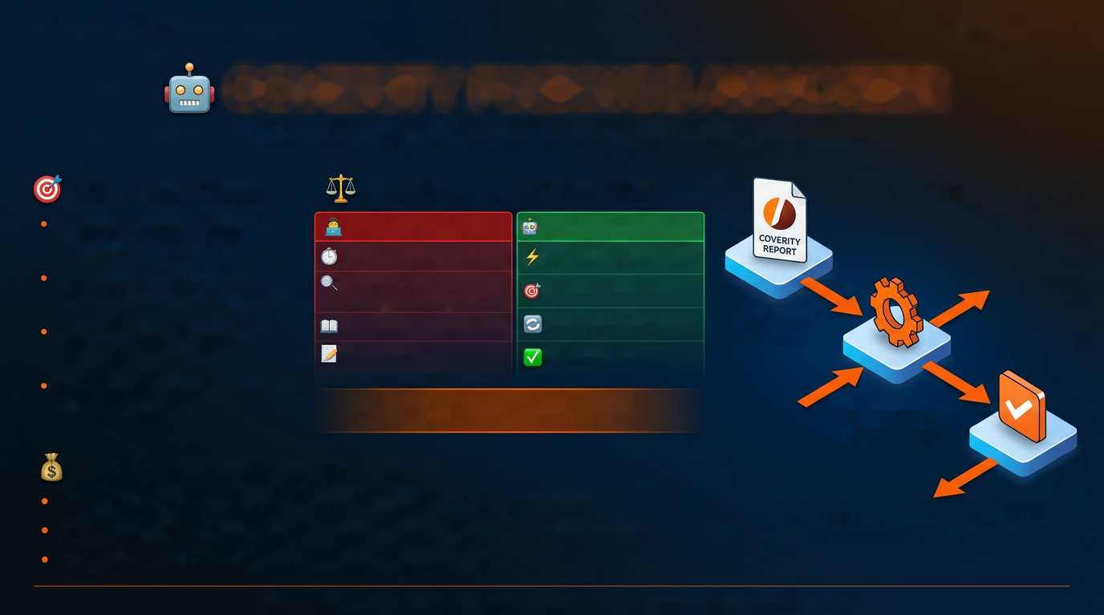
Honeywell Aerospace
CNS AI Day 2026
COVERITY FINDINGS ANALYZER
AI-Developed, Rule-Based Static Analysis for Aerospace
CORE FEATURES
MANUAL vs AUTOMATED
* AI used to DEVELOP,
analysis is RULE-BASED
Aerospace Compliance
MANUAL PROCESS
AUTOMATED PROCESS
- DO-178C, MISRA, CERT
10-15 minutes per defect
1-2 minutes per defect
100% Secure & Offline
Source Code
- Source never leaves machine
Investigation Required
Automated Analysis
Context Analysis Required
One Controlled Flow
HTML/Excel
No AI Tokens Required
Reports
- Runs 100% offline
Disposition &
Higher Quality
Reduces SME Dependency
Documentation Required
- 80% reduction
~90% Time Reduction
Rules Engine
AI Developed
20+ Checker Rules
COST SAVINGS PER PROGRAM
RL1 (1,000 defects): 250 hrs → 33 hrs = 217 hrs SAVED
Smart
AI used to DEVELOP,
Dispositions
Program (4,000 defects): 1000 hrs → 133 hrs = 867 hrs SAVED
analysis is RULE-BASED
Cost: $7,595 - $30,345 per release (at $30/hr)
Rakesh Boya | Tool Owner & Developer | Honeywell Aerospace | CNS AI Day 2026 | Confidential

