Slide 1
Coverity Findings Analyzer
Presented By:
Rakesh Boya
Tool Owner & Developer
July 30, 2026

Slide 2
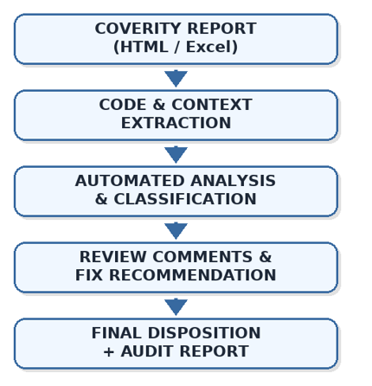
Rakesh Boya
Why This Tool?
Automate the Repetitive Tasks, Empower the Engineer
Automated Report
Intelligent Source-Code Discovery
Automated Finding Classification
Engineer-Grade Recommendations
Complete Audit Traceability
What is Coverity?
Static Analysis for C/C++
Coverity SAST(Static Application Security Testing) is a static analysis solution used to support DO-178C, MISRA, and CERT compliance by detecting software defects and security weaknesses early in the software development lifecycle.
Coverity Findings Analyzer Tool does not replace the engineer — it removes the busywork so the engineer can focus on judgment.
Why scan the build?
"We run Coverity on every build because catching bugs at compile time is cheaper than fixing them in the field."
Why Manual Analysis Is Painful
Source Code Investigation Required
Context Analysis Required
Disposition & Documentation Required
Compliance & Audit Tracking Required

Slide 3
Projected Saving
Rakesh Boya
Task | Manual Analysis | With Tool | Saved
Parse report + locate source | ~2 min / defect | Automated | 100%
Read code + understand context | ~5–8 min / defect | AST-extracted + summarized | ~90%
Write disposition + comment | ~3–5 min / defect | Auto-generated | ~95%
Propose fix | ~2–4 min / defect | Context-aware template | ~90%
10–15 min
1–2 min
~90%
Per defect manually
Per defect with tool
Time reduction
Reb Label | Manual Analysis | With Tool | Saved
RL1 (1,000 defects)
For a typical program with 4 Red Label releases and 1,000+ findings per release, Coverity Findings Analyzer can reduce review effort from 667–1,000 hours to 67–133 hours, saving approximately 534–867 engineering hours while improving consistency and traceability.
250 hrs
33 hrs
217 hrs
$7,595
Program Level | Manual Analysis | With Tool | Saved
RL1,2,3,4 (4,000 defects)
1000 hrs
133 hrs
867 hrs
$30,345

Slide 4
Coverity Platform vs Coverity Findings Analyzer
Activity | Coverity Platform | Coverity Findings Analyzer
Detects software defects | Yes | Uses Coverity findings as input
Displays defect details | Yes | Yes
Source code navigation | Manual | Automated
Function extraction | Manual | Automatic
Context gathering | Manual | Automatic
Caller/Callee identification | Manual | Automatic
Defect classification | Engineer driven | Suggested automatically
Review comments | Manual creation | Auto-generated
Fix recommendations | Engineer created | Context-based suggestions
Audit records | Manual effort | Automatically generated
Bulk finding triage | Time intensive | Streamlined
Review consistency | Reviewer dependent | Standardized

