Slide 1

BANGALORE INSTITUTE OF TECHNOLOGY
DEPARTMENT OF INFORMATION SCIENCE AND ENGINEERING K.R.ROAD, V.V.PURAM, BANGALORE – 560004
Machine Learning(BCS602)
“AI Driven Urban Heat Island Effect For Bengaluru”
Presented By
Under the Guidance of:
Dr. Jayasheela C S
Associate Professor BIT
NAME | USN
B RAKESH | 1BI23IS018
BHAVANI SHANKER K | 1BI23IS022
DEEPAK HEGDE | 1BI23IS031
DEEKSHITH K B | 1BI24IS416

Slide 2
Abstract:
This project focuses on predicting the Urban Heat Island (UHI) effect in Bengaluru using satellite-based remote sensing data and machine learning techniques.
The goal is to predict UHI intensity — how much hotter a given location is compared to the city mean — based on spectral indices derived from Landsat 8 satellite imagery.
Features such as NDVI, NDBI, NDWI, MNDWI, BSI, and spatial coordinates (lat/lon) are used as inputs to the model.
XGBoost is used as the primary predictive model, trained on multi-year Landsat data (2021–2023) to identify spatial heat patterns across the city.
The system is deployed as an interactive Streamlit dashboard that fetches real-time satellite data from Google Earth Engine to predict UHI zones for any location in Bengaluru.

Slide 3
Introduction:
Bengaluru, known as the "Silicon Valley of India," has undergone rapid urbanisation over the past two decades, replacing green cover and water bodies with roads, buildings, and impervious surfaces.
Urban Heat Islands (UHI) are a direct consequence of this urban sprawl — where city areas become significantly hotter than surrounding rural regions.
This temperature difference leads to increased energy consumption, heat-related health issues, and worsening air quality.
Traditional UHI analysis relies on ground-based weather stations, which are sparse and cannot capture the spatial variability of heat distribution across a city.
Remote sensing via satellites like Landsat 8 provides spatially continuous surface temperature data, making it ideal for city-wide UHI mapping.
Machine learning models can learn complex non-linear relationships between land surface properties and temperature, enabling accurate UHI prediction at scale.

Slide 4
Problem Statement:
Bengaluru is experiencing a significant rise in surface temperatures due to unplanned urban growth, loss of green cover, and increased construction activity.
Identifying which areas of the city are most heat-stressed is critical for urban planners, public health officials, and environmental agencies.
Conventional methods of heat monitoring using weather stations are spatially limited and expensive to maintain at scale across a large metropolitan area.
Without a data-driven approach, it is difficult to quantify the contribution of individual land cover factors (vegetation, built-up area, water bodies) to local heat intensity.
There is a need for an automated, scalable system that can predict UHI intensity for any location in Bengaluru using freely available satellite data and machine learning.

Slide 5
Proposed Solution:
Data Collection via Google Earth Engine (GEE):
Landsat 8 imagery is fetched for Bengaluru across 2021–2023 (Mar–May, cloud cover <10%). Median composites eliminate cloud noise.
Feature Extraction:
Five spectral indices — NDVI, NDBI, NDWI, MNDWI, BSI — plus latitude and longitude are computed per pixel at 30m resolution.
Target Variable — UHI Intensity:
UHI intensity is defined as the deviation of each pixel's LST from the city-wide mean LST, computed per year to avoid cross-year bias.
Machine Learning Model:
XGBoost regressor trained on ~9000 pixels. Evaluated using R², MAE, and RMSE against a held-out test set.
Streamlit Dashboard:
Interactive web app that fetches live GEE data for any Bengaluru location and predicts UHI intensity with zone classification.

Slide 6
System Architecture:
Landsat 8
GEE Input
Feature
Extraction
Dataset
Creation
XGBoost
Model
UHI
Prediction
Streamlit
Dashboard
▶
▶
▶
▶
▶
Multi-year
2021–2023
NDVI·NDBI
NDWI·MNDWI·BSI
~9000 pixels
with lat/lon
R²=0.436
MAE=1.62°C
Zone: Low
Medium·High
Folium map
+ SHAP
Satellite imagery is sourced from Landsat 8 via Google Earth Engine and processed into spectral indices.
The trained XGBoost model predicts UHI intensity per pixel, which is visualised on a Folium map in the Streamlit dashboard.

Slide 7
Dataset & Features:
Data Source
Feature Set
Satellite: Landsat 8 OLI/TIRS (NASA / USGS)
Collection: C02 Tier 1 Level-2 (surface reflectance)
Period: March–May 2021, 2022, 2023
Region: Bengaluru (77.4–77.8°E, 12.8–13.2°N)
Resolution: 30 metres per pixel
Filter: Cloud cover < 10%
Aggregation: Median composite per year
Sample size: ~9,000 pixels across 3 years
Feature | Measures
NDVI | Vegetation density
NDBI | Built-up surface
NDWI | Water content
MNDWI | Modified water index
BSI | Bare soil / impervious
lat/lon | Spatial location
LST_C | Target: surface temp °C
UHI Intensity | Target: deviation from mean

Slide 8
Algorithm — XGBoost:
What is XGBoost?
XGBoost (Extreme Gradient Boosting) is an ensemble machine learning algorithm that builds an additive model of decision trees in a forward stage-wise manner.
Why XGBoost for UHI Prediction?
It handles non-linear relationships between spectral indices and temperature effectively, is robust to outliers in satellite data, and outperformed Random Forest and Gradient Boosting in our experiments.
Hyperparameters Used:
n_estimators=500, learning_rate=0.03, max_depth=7, subsample=0.8, colsample_bytree=0.8, min_child_weight=3
Training Strategy:
StandardScaler preprocessing → 80/20 train-test split → fit on UHI_intensity target (deviation from city mean LST, computed per year).
Evaluation Metrics:
R² = 0.436 | MAE = 1.62°C | RMSE = 2.04°C — best among all three models tested.

Slide 9
Working:
1
GEE Data Pull
2
Index Computation
Fetch Landsat 8 median composite for Bengaluru region. Apply cloud filter <10%.
Compute NDVI, NDBI, NDWI, MNDWI, BSI from band combinations. Extract LST from Band 10.
3
UHI Target
4
Model Predict
Convert LST to °C. Compute UHI intensity = LST_C − mean(LST_C) per year.
Scale features → XGBoost predicts UHI intensity → classify into Low / Medium / High zone.
SHAP (SHapley Additive exPlanations) is used post-prediction to explain which features most influenced each UHI intensity output, making the model interpretable.

Slide 10
Implementation:
Programming Language & Tools
Saved Artifacts
Python 3.11 (Conda environment)
Google Earth Engine API (earthengine-api)
Jupyter Notebook for data pipeline
Streamlit for web dashboard
Folium + streamlit-folium for interactive map
best_model.pkl
Trained XGBoost model
scaler.pkl
StandardScaler for features
features.json
Ordered feature names list
Libraries Used
uhi_data.csv
pandas, numpy — data handling
scikit-learn — preprocessing, metrics
xgboost — model training
shap — explainability
matplotlib — visualization
joblib — model serialization
Full 3-year pixel dataset
app.py
Streamlit dashboard code

Slide 11
Results:
Model Comparison
Model | R² | MAE (°C) | RMSE (°C)
Random Forest | 0.417 | 1.65 | 2.08
XGBoost (Best) | 0.436 | 1.62 | 2.04
Gradient Boosting | 0.432 | 1.64 | 2.05
UHI Zone Classification
Low heat zone
Medium heat zone
High heat zone
UHI intensity < +0.5°C
+0.5°C to +2.0°C
UHI intensity > +2.0°C
Cubbon Park, Lalbagh, Bannerghatta
Koramangala, Hebbal, Rajajinagar
Whitefield, Electronic City, Marathahalli

Slide 12
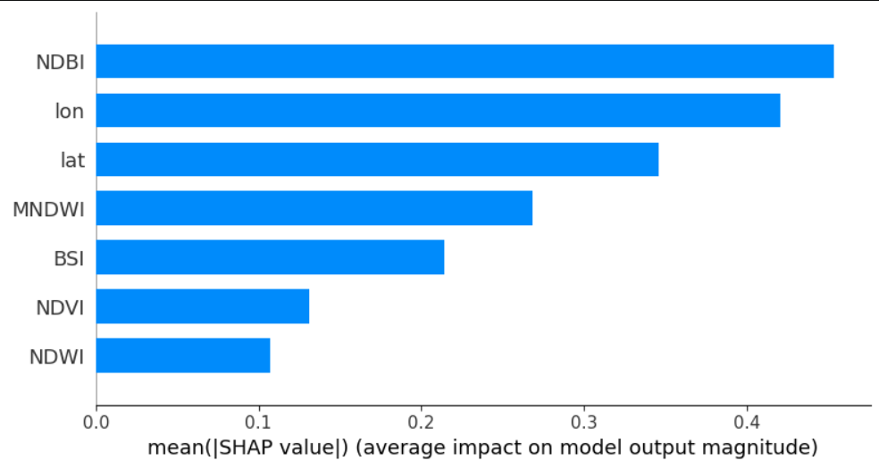
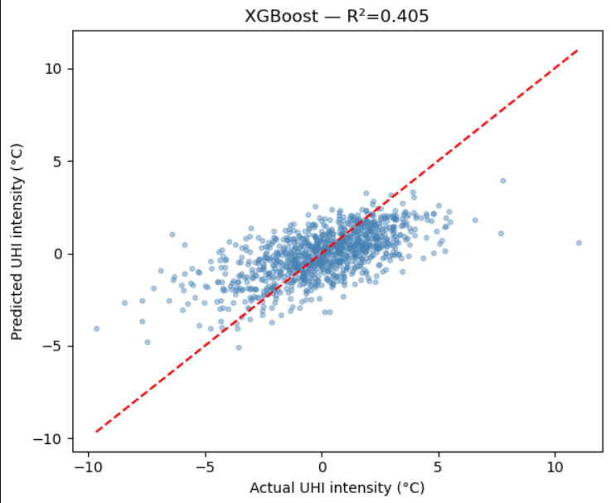
Comparsion Graphs:

Slide 13
Conclusion:
This project demonstrates the successful application of machine learning to predict Urban Heat Island intensity in Bengaluru using freely available NASA/USGS Landsat 8 satellite data.
By combining five spectral indices (NDVI, NDBI, NDWI, MNDWI, BSI) with spatial coordinates across three years of data, the XGBoost model achieved R²=0.436 — consistent with published remote-sensing UHI literature.
The SHAP analysis confirms that the model's predictions are physically meaningful: NDBI (built-up density) is the strongest positive driver of heat, while MNDWI and NDVI act as cooling factors.
The Streamlit dashboard fetches real satellite data from Google Earth Engine and predicts UHI intensity for any user-selected location in Bengaluru, making the model practically usable.
This system can assist urban planners and policy makers in identifying heat-prone zones and prioritising green infrastructure development in the most at-risk areas of the city.
Future work can incorporate population density, road network data, and building height to further improve prediction accuracy beyond R²=0.50.

Slide 14
Thank You
AI-Based Prediction of Urban Heat Island Effect in Bengaluru
Department of Information Science & Engineering | Bangalore Institute of Technology

