Slide 1
Flutter CRUD App with Back4App (BaaS)
Task Manager App – A Flutter-Based CRUD Application Using Back4App (BaaS)
Student NAME: Rakesh Chowdhury
BITS ID: 2022MT70191
SUB: Cross Platform Application Development (SEMTZG585)

Slide 2
Description
Project Title:
Task Manager App – A Flutter-Based CRUD Application Using Back4App (BaaS)
Project Overview:
This project is a Flutter-based Task Manager Application that utilizes Back4App as a Backend-as-a-Service (BaaS). Students will develop an app that enables user authentication and task management using a cloud backend without needing to build a custom server.
Key Features:
✔ User Authentication – Register and login using a student email ID. ✔ CRUD Operations on Tasks – Users can Create, Read, Update, and Delete tasks. ✔ Backend as a Service (BaaS) – No need to write backend code, as Back4App handles data storage. ✔ Real-Time Database Syncing – Task updates are reflected dynamically. ✔ Secure Logout – Users can safely log out.
Technology Stack:
Frontend: Flutter (Dart)
Backend: Back4App (Parse Server)
Database: Back4App Cloud Database
Version Control: GitHub
Hosting: Local device for development

Slide 3
Resources:
YouTube Link: https://youtu.be/yz54wb_C-7k?si=qzJGIDjBUtLTVXYE
GitHub Link: https://github.com/Rakesh09876/Flutter-CRUD-App

Slide 4




Flow Diagram
Database
Back4App
Backend
Manage

Slide 5
Flow Diagram
User Registration & Login:
Start
1. Users can create tasks with a title and description.
2. Tasks are stored in Back4App’s cloud database.
3. Users can edit or delete tasks, and the app will sync with the backend in real time.
Registered?
Log Out
No
Display Registration Form
Yes
Log in Form

Slide 6
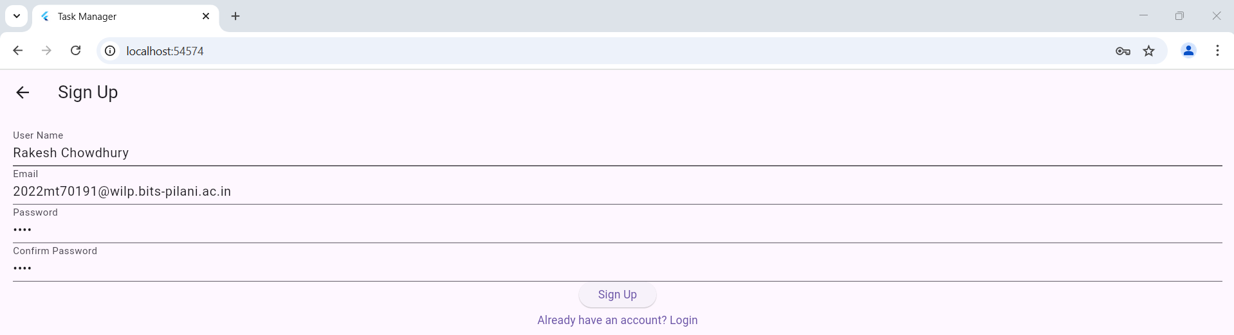

Sign Up Page

Slide 7
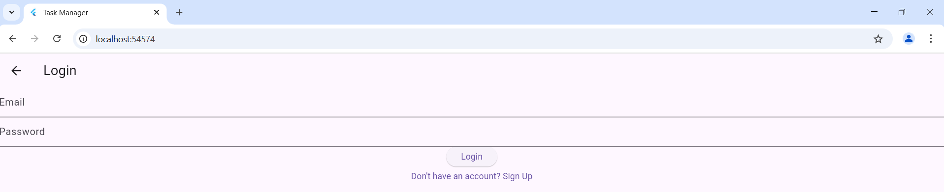
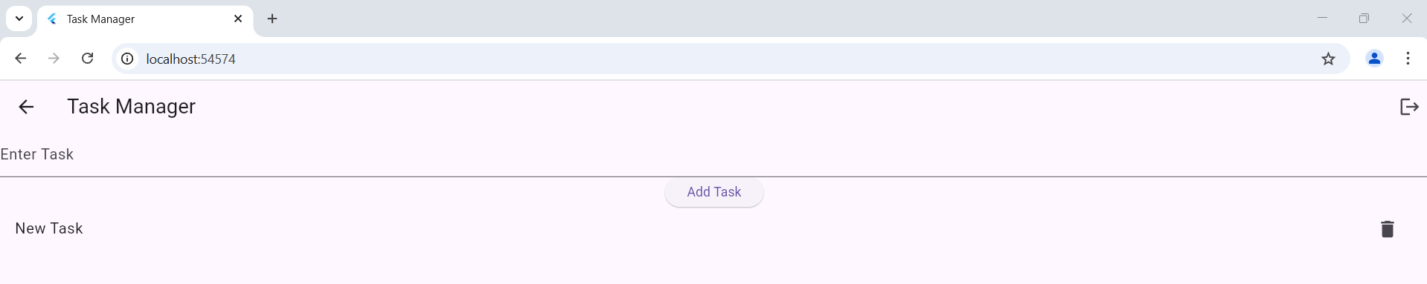
Log in Page
Enter User Id
Enter Password
Task Creation Page
Enter Task

Slide 8
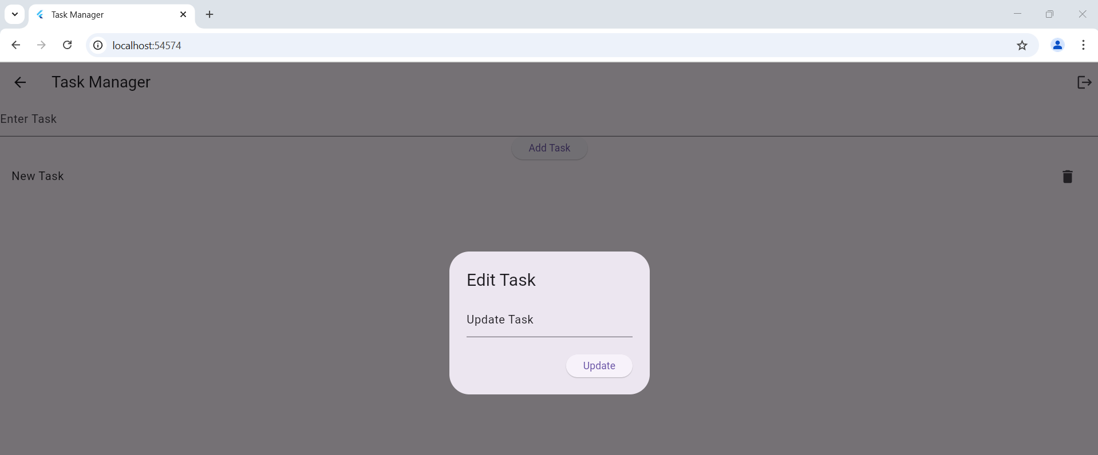

Update Task

Slide 9
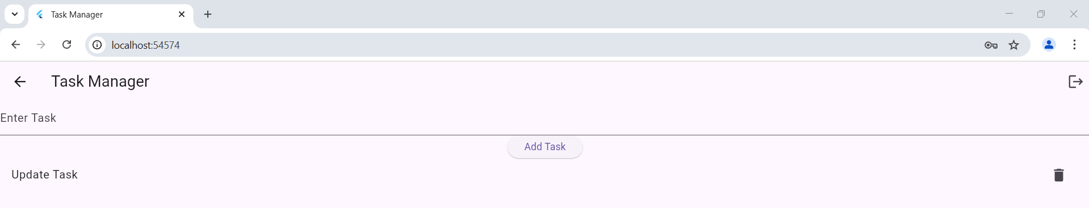
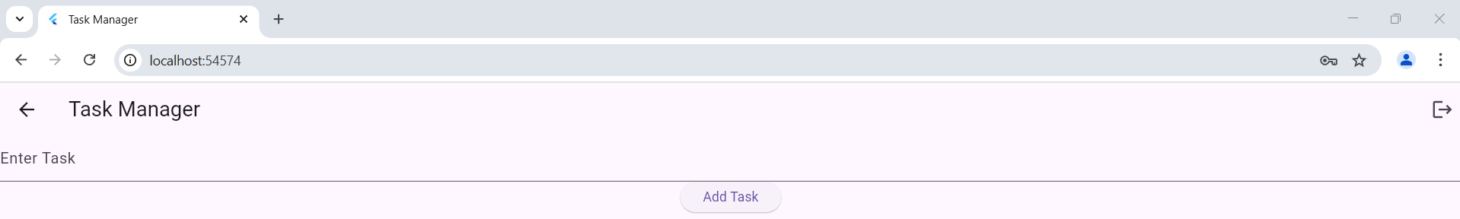
Delete Task
Log Out

Slide 10
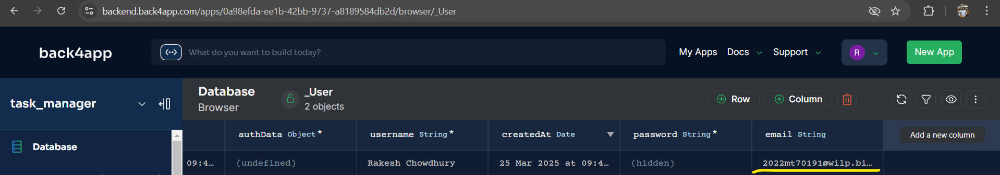
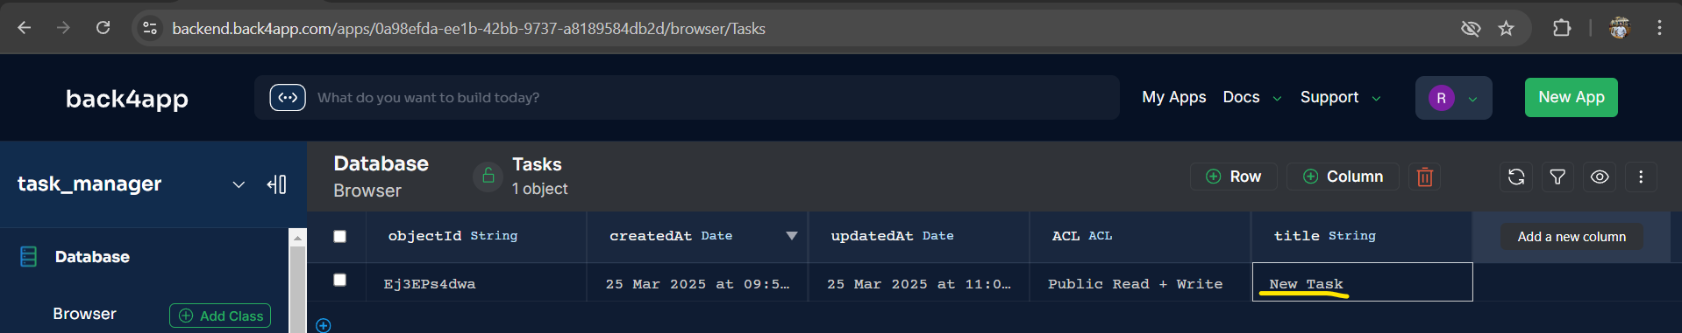
User Successfully Created In Back4App
Task Successfully Created In Back4App

Slide 11
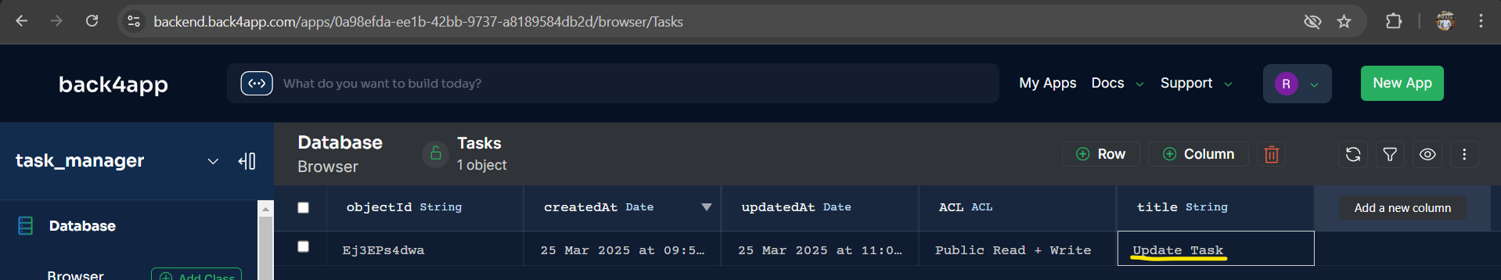
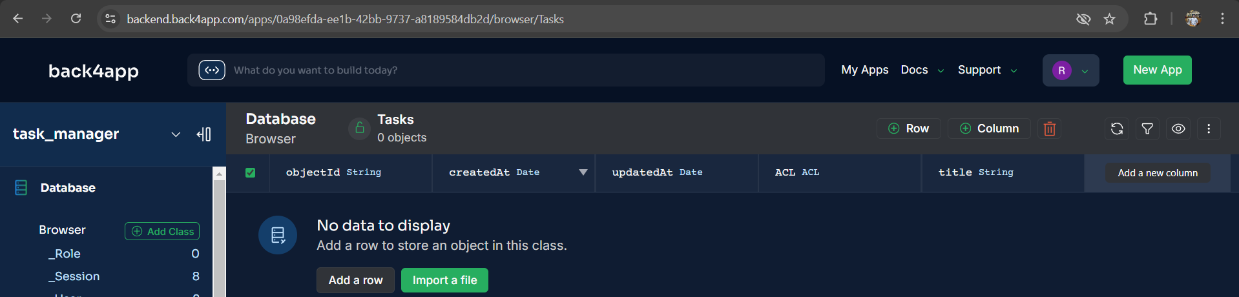
Task Successfully Updated In Back4App
Task Successfully Deleted In Back4App

Slide 12
Learnings From The Assignment
Understanding Flutter Framework:
Gain hands-on experience with Flutter, a popular framework for building cross-platform applications.
Learn to write and structure code in Dart, Flutter's programming language.
Backend Integration with Back4App:
Understand how to integrate a Backend-as-a-Service (BaaS) like Back4App with a Flutter application.
Learn to utilize Back4App's features for user authentication and data storage without writing custom backend code.
CRUD Operations:
Implement Create, Read, Update, and Delete (CRUD) operations in a real-world application.
Learn to manage data effectively using Back4App's cloud database.
User Authentication:
Implement secure user registration and login functionalities.
Understand the importance of secure authentication and how to manage user sessions.
Real-Time Data Syncing:
Learn to handle real-time data updates and ensure that changes are reflected dynamically in the app.
Understand the benefits of real-time data syncing for user experience.
Problem-Solving and Debugging:
Enhance problem-solving skills by debugging and resolving issues that arise during development.
Learn to use debugging tools and techniques effectively.

Slide 13
Acknowledgement
I would like to extend my sincerest appreciation to Dr. Chandan R N, our esteemed mentor and Professor-in-charge of Cross Platform Application Development, for his invaluable guidance and support throughout the semester. His expert advice and insightful suggestions played a pivotal role in the successful completion of my project, ‘Task Manager App – A Flutter-Based CRUD Application Using Back4App (BaaS).’ I am deeply grateful for the time and effort he invested in me, and I acknowledge the significant impact his mentorship had on my learning experience. I would also like to confirm that the project was entirely my own work, and I take full responsibility for its content and completion.

