Slide 1

STOCK MARKET PRICE PREDICTION
Team:
200050062 - K Namitha
2000500104 - P Sai Pavan
2000500120 - R Rakesh Kumar
200050057 - KS Vishwesh

Slide 2
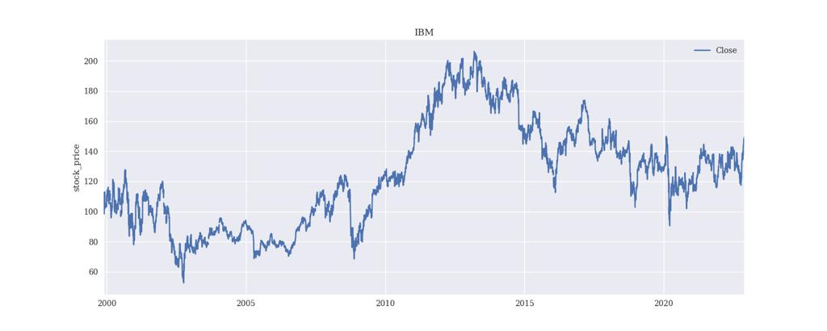
DATASET
We have used stock prices of famous corporates IBM
We used the data from around 20 years and used 4:1 train to test split.

Slide 3
EXPERIMENTED MODELS
Linear-ReLU-Linear (lrl).
Long short-term memory (lstm).
Modified version of lstm (lstm with lrl).
Gated recurrent units (gru).

Slide 4
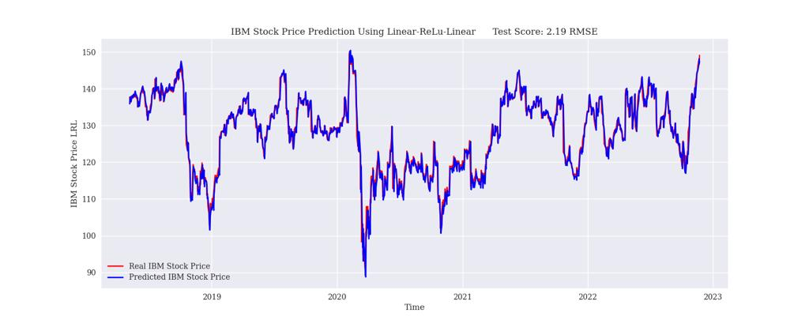
LINEAR RELU LINEAR

Slide 5
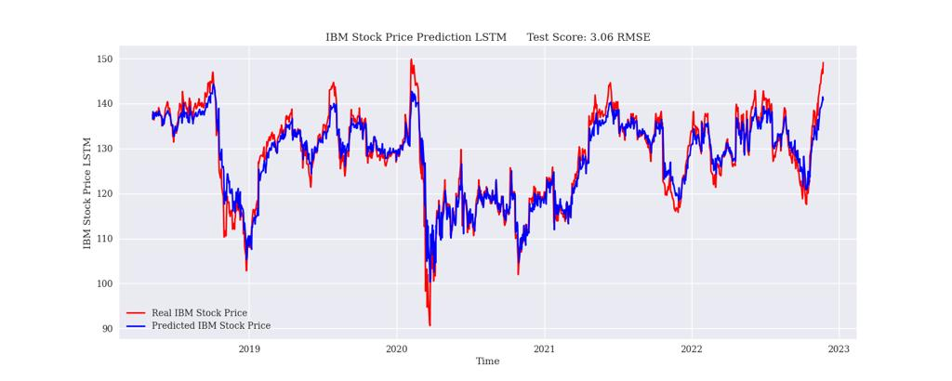
LONG SHORT-TERM MEMORY MODEL

Slide 6
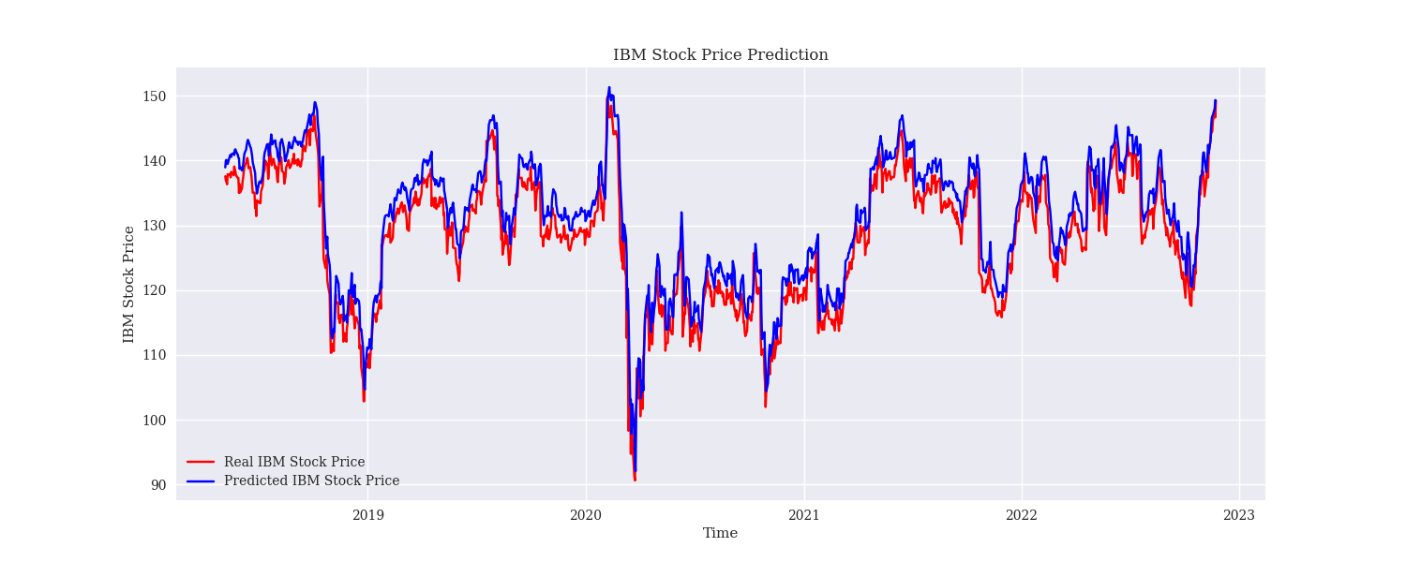
LSTM WITH LRL

Slide 7
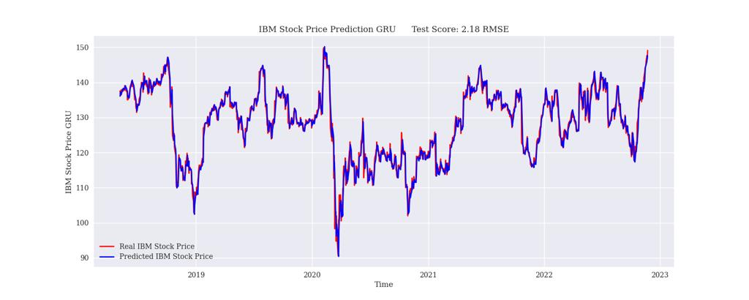
GATED RECURRENT UNITS

Slide 8
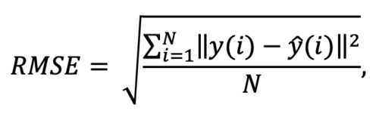
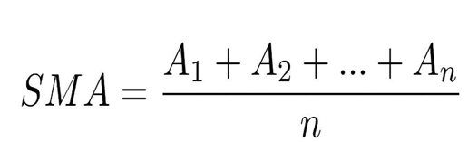
EVALUATION METRICES
Root mean squared error (RMSE).
Moving average (MA).

Slide 9
CONCLUSIONS
After trying the normal feed forward neural networks we found LSTM and GRU better for time series models.

