Slide 1


Department of
Artificial Intelligence and Data Science
Mini Project – Review I
TITLE
CAREMIND :HEALTHCARE AUTOMATION
Batch No:12
Team Members:
RAKESH B-113123UG08081
SUGAN SELVA S-113123UG08108
SARAVANAN S-113123UG08094
SYAM DHARSHAN-113123UG08111
Guided by,
Mr.A.Mathan Kumar,
Assistant Professor,
Dept of AI&DS

Slide 2
Abstract
Limited access to qualified doctors in rural areas leads to frequent misdiagnosis and delayed treatment of serious diseases.
CareMind is an AI-based healthcare automation system designed for early disease detection and clinical decision support.
The system collects patient symptoms, medical history, and symptom progression through
a mobile or web application.
Machine Learning and Deep Learning models analyze clinical data to predict diseases with confidence scores.
A confidence-based referral mechanism ensures timely specialist consultation and patient safety.
Explainable AI provides transparent diagnosis by highlighting key symptoms influencing predictions.
The system includes AI-assisted prescription guidance, a healthcare chatbot, and offline support for rural environments.

Slide 3
Objective
To develop an AI-based healthcare automation application for early and accurate disease diagnosis.
To assist healthcare workers in rural and resource-limited areas with clinical decision support.
To analyze patient symptoms, medical history, and progression data using ML/DL models.
To provide confidence-based diagnosis and recommend specialist referrals when necessary.
To ensure transparent and trustworthy predictions using Explainable AI techniques.
To offer safe, AI-assisted prescription and preventive healthcare guidance.
To improve patient interaction and awareness through an intelligent healthcare chatbot.

Slide 4
Existing System
Healthcare diagnosis in rural areas is largely manual and symptom-based, relying on limited clinical expertise.
Serious diseases are often misdiagnosed as common fever or viral infections due to lack of diagnostic support.
Patient records are maintained manually or in isolated systems, leading to poor data continuity.
No intelligent decision support system is available to assist healthcare workers during diagnosis.
Referrals to specialists are delayed, usually occurring only after the condition worsens.
Existing systems lack transparency, preventive guidance, and real-time patient interaction.
Dependence on physical visits increases time, cost, and risk for patients.

Slide 5
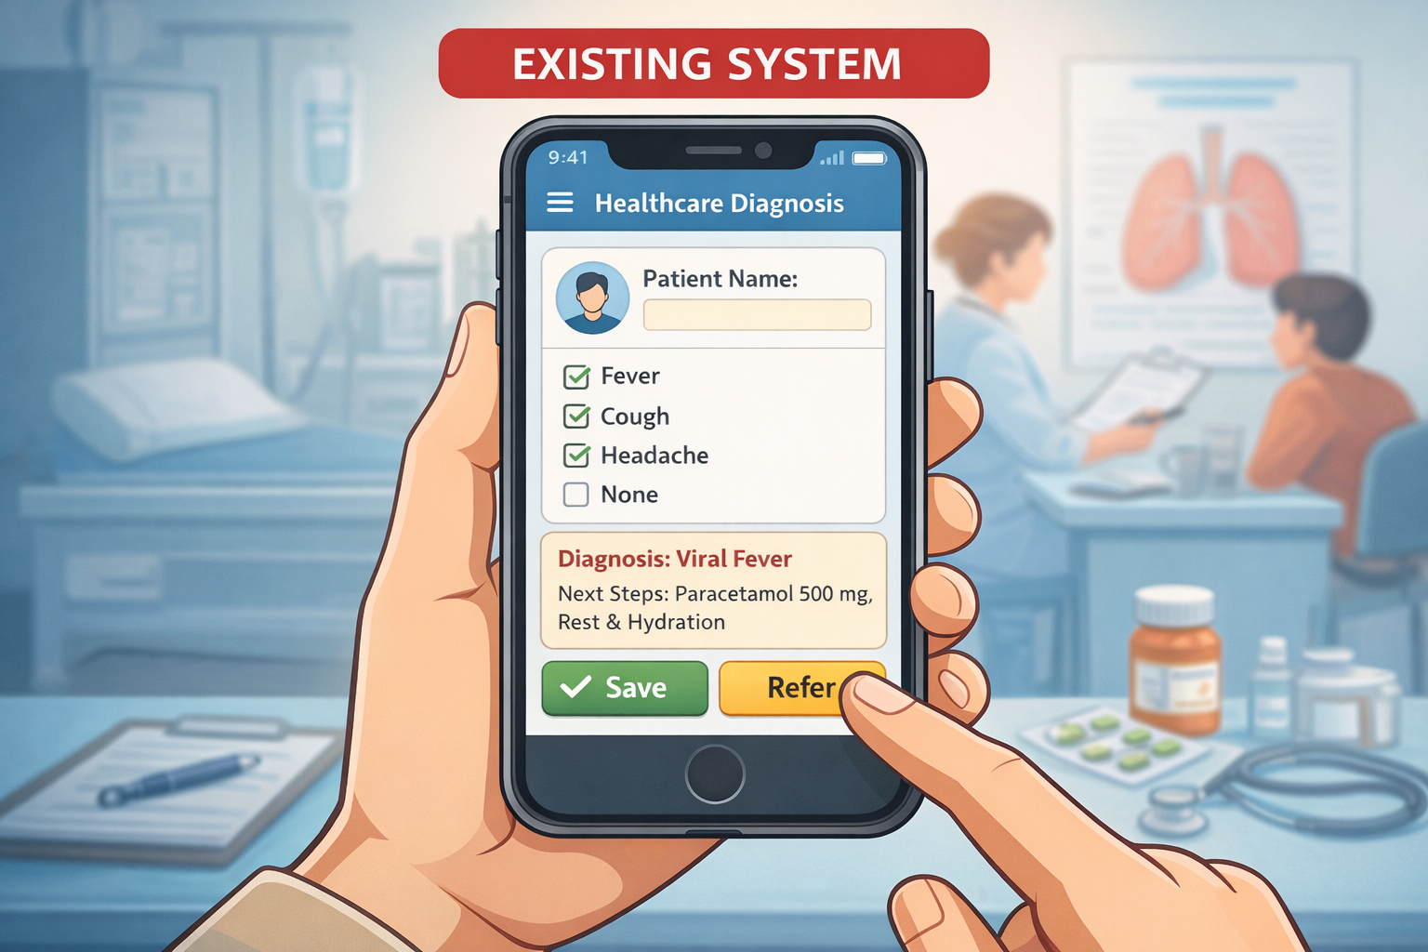

Slide 6
Disadvantages
Diagnosis is based mainly on basic symptoms, leading to frequent misdiagnosis.
Serious diseases such as TB are often identified at later stages.
Lack of intelligent decision support for healthcare workers.
Manual record keeping causes data loss and inconsistency.
No confidence or risk assessment during diagnosis.
Absence of preventive care and routine health guidance.
Requires repeated physical visits, increasing time and cost for patients.

Slide 7
Proposed system
CareMind is an AI-based healthcare automation system for early disease diagnosis and clinical decision support.
Patient symptoms, medical history, and progression data are collected through a mobile or web application.
Machine Learning and Deep Learning models analyze the data to predict diseases with confidence scores.
A confidence-based referral mechanism recommends specialist consultation when diagnostic certainty is low.
Explainable AI provides transparent diagnosis by highlighting key symptoms influencing predictions.
AI-assisted prescription guidance with safety validation helps prevent unsafe medication usage.
The system includes an AI chatbot, preventive care guidance, and offline support for rural environments

Slide 8
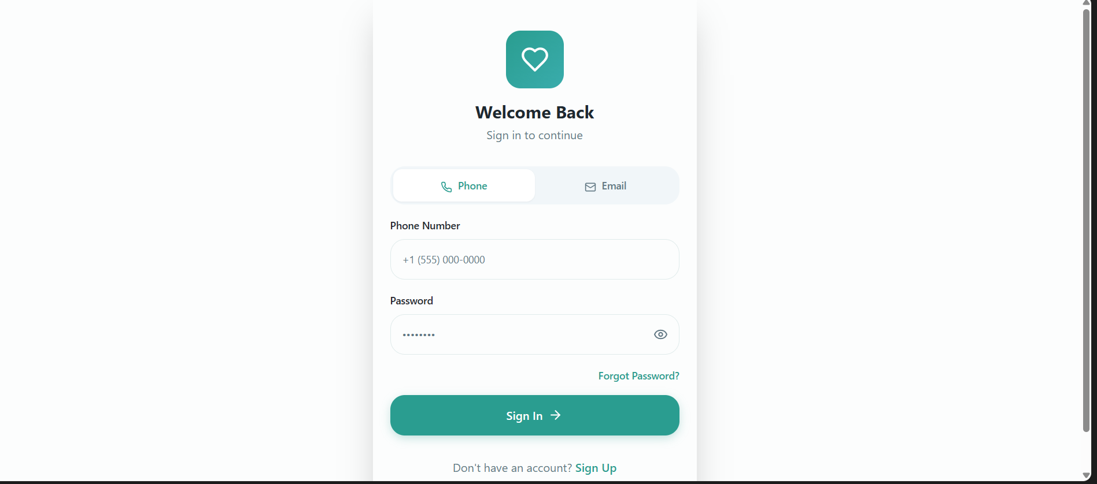

Slide 9
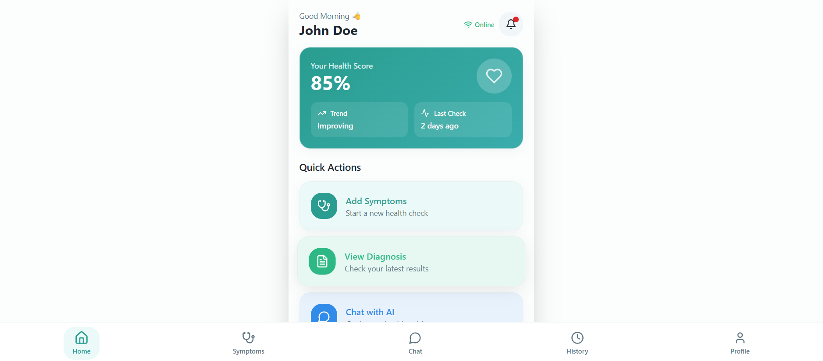

Slide 10
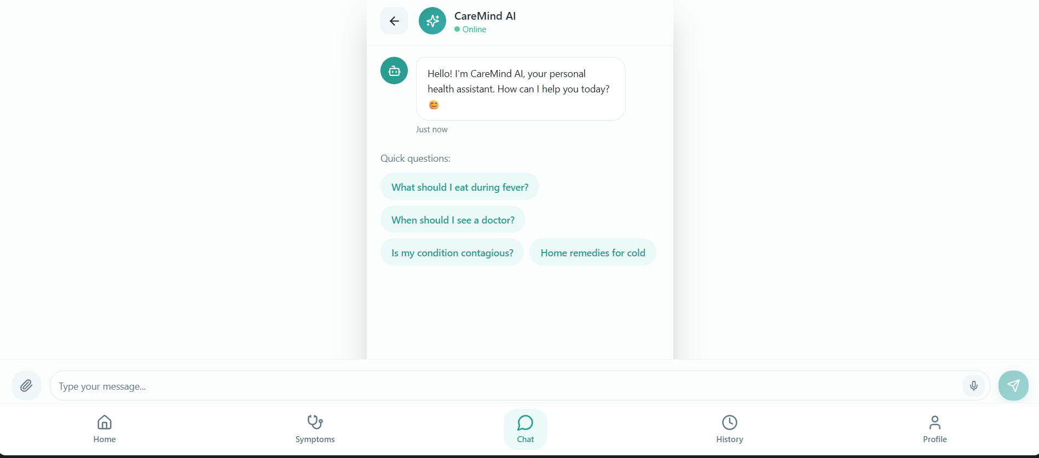

Slide 11
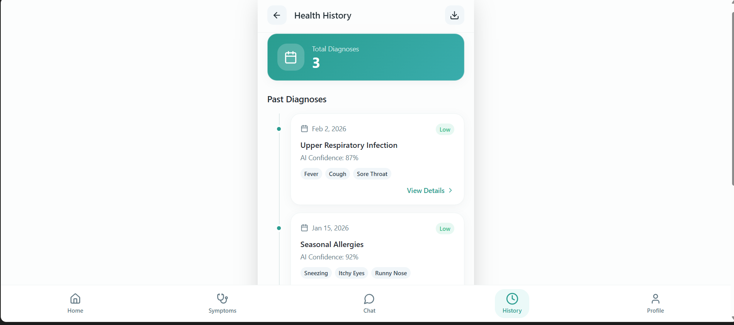

Slide 12
Comparison of Proposed and Existing method(s)
Aspect | Existing Method | Proposed Method (CareMind)
Diagnosis Approach | Manual, symptom-based | AI-assisted, data-driven
Accuracy | Depends on doctor experience | ML/DL-based prediction
Early Disease Detection | Limited | Enabled via symptom progression analysis
Decision Support | Not available | Intelligent clinical decision support
Transparency | No explanation | Explainable AI (XAI)
Referral Process | Delayed | Confidence-based referral
Prescription Safety | Manual | AI-assisted with safety validation
Patient Interaction | Physical visits only | AI chatbot & digital guidance
Data Management | Manual or isolated records | Centralized digital records
Rural Accessibility | Internet & doctor dependent | Offline-first support

Slide 13
Advantages
Enables early and accurate disease diagnosis using AI models.
Reduces misdiagnosis through data-driven and confidence-based decisions.
Supports rural healthcare with offline-first functionality.
Provides explainable AI outputs, increasing trust and transparency.
Ensures safer treatment through AI-assisted prescription validation.
Improves patient awareness with preventive care and routine guidance.
Enhances accessibility via an AI chatbot for instant interaction.

Slide 14
References
World Health Organization (WHO), Tuberculosis Diagnosis and Treatment Guidelines. https://www.who.int/teams/global-tuberculosis-programme
Kaggle, Disease Symptom Prediction Dataset. https://www.kaggle.com/datasets/itachi9604/disease-symptom-description-dataset
UCI Machine Learning Repository, Medical and Healthcare Datasets. https://archive.ics.uci.edu/ml/datasets
S. Kumar et al., AI-Based Clinical Decision Support Systems in Healthcare, IEEE Access, 2024. https://ieeexplore.ieee.org
Z. Chen et al., Explainable Artificial Intelligence for Medical Diagnosis, Expert Systems with Applications, Elsevier, 2022. https://www.sciencedirect.com
J. Wang et al., Machine Learning Techniques for Disease Prediction, International Journal of Medical Informatics, 2023.

Slide 15
THANK YOU

