Slide 1

MINESWEEPER
Developed by:
Rakesh Tiwari
Digvijay Singh

Slide 2
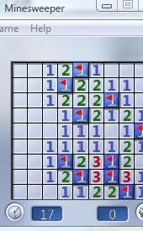
Rules
There are certain number of mines hidden in the game. Our goal is to expose all the all the cells which do not contains mine.
To expose these mines, we are given hints such that the cells contain a number which depicts how many mines are there surrounding it.
If we expose the cell containing mines than we lose the game.
If we clear all boxes and find all the mines we win, the game.

Slide 3

LOGIC:
There are two boards in the game mybaord and realboard. Myboard contains the user game play and it gets updated as user make a move but realboard remains the same.
Realboard contains all the mine. And it is not shown to the user.

Slide 4

GitHub Link
https://github.com/dsprajput/FDS-MiniProject

