Slide 1
UPDATING PASSWORD AND MAIL NOTIFICATION
G.Rakesh

Slide 2
FUNCTION ANALASIS
UPDATING PASSWORD:
MAIL ALLERT:
Afrter Adding Into the Database.
The Function Will Throw one Mail
To Registered Mail.
Ex➔You Password has been
Changed or Updated.
1.Utilize the "Forgot Password" option on the login page.
2.Check your email for password reset instructions or links.
3.Contact customer support for assistance if needed.
4.Try answering security questions for password recovery.
5.Access passwords stored in a password manager if applicable.

Slide 3
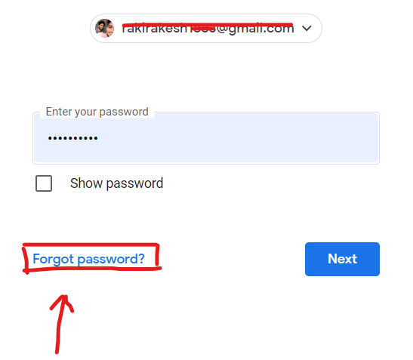
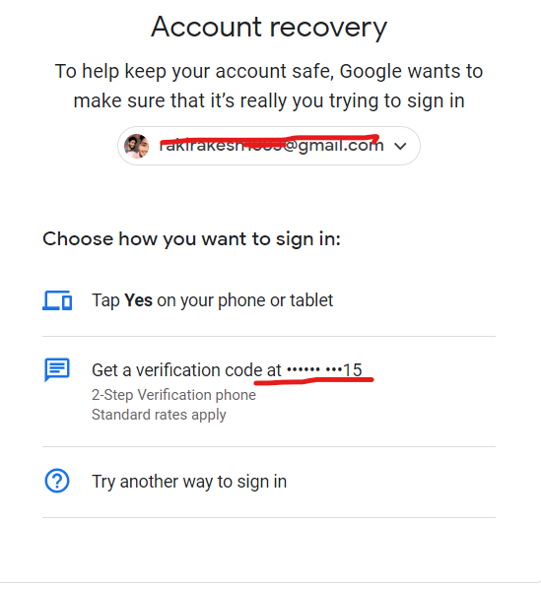
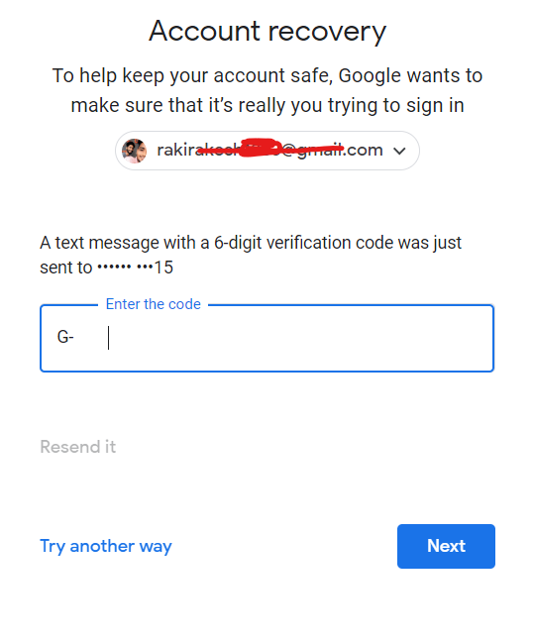
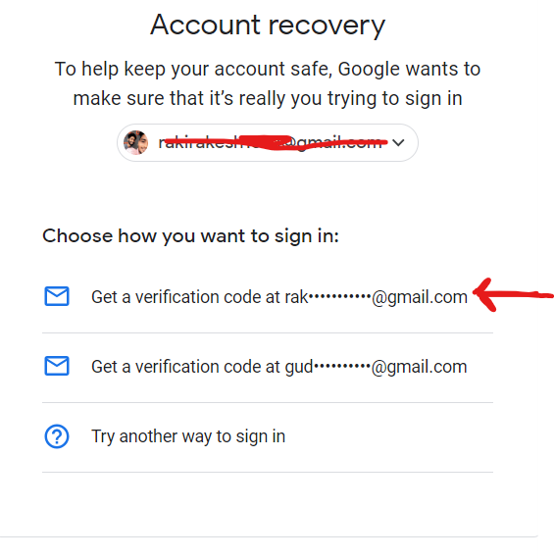

Slide 4
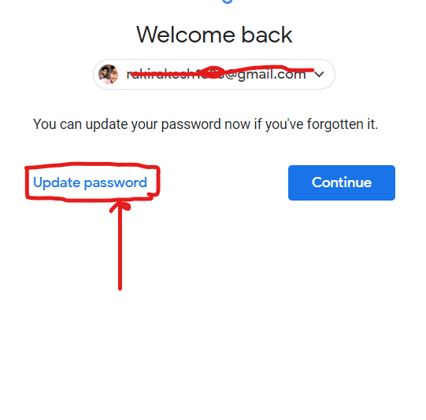
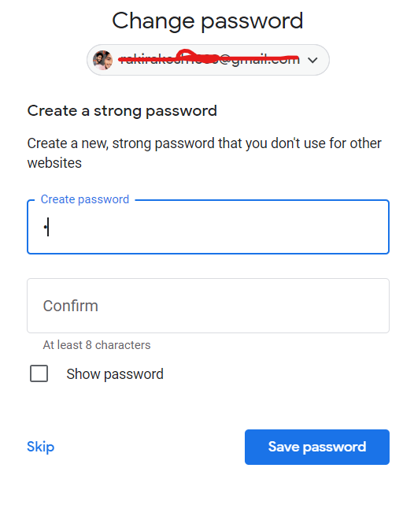
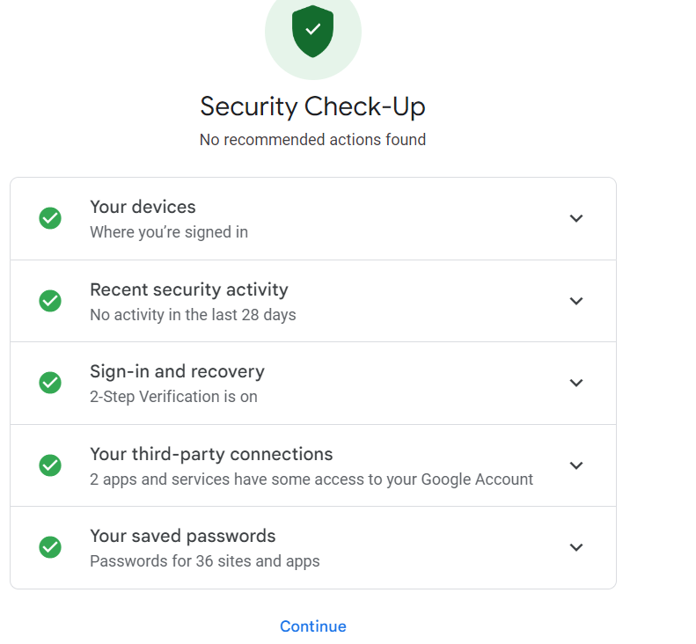
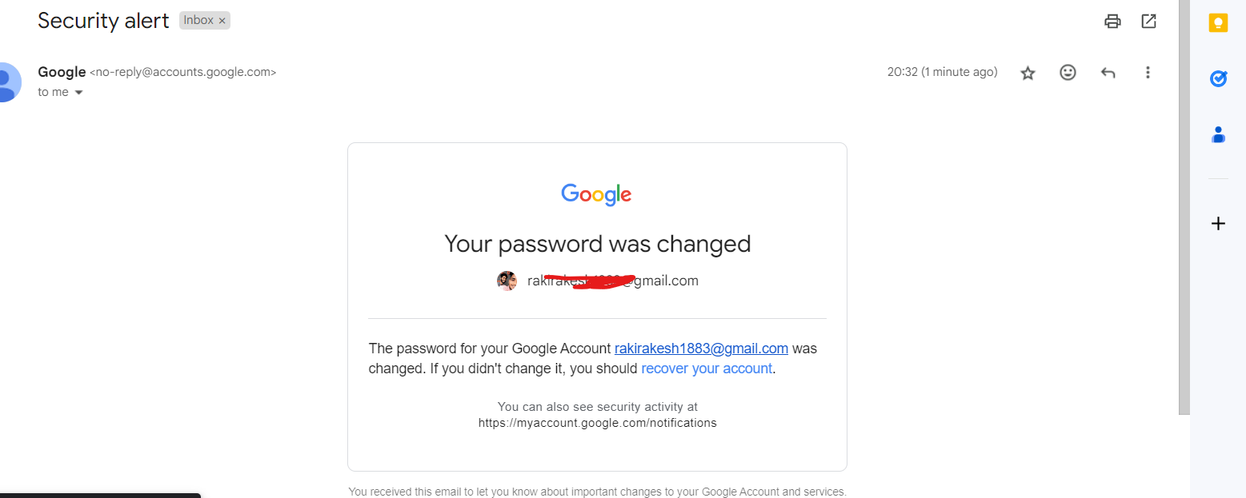

Slide 5
TECHNICAL ANALASIS
➔Language:Python
➔Class and Object methods(Instance Methods) → Update Password( ) and Message_Alert( ).
➔Decorators → By Using SignIn Function and Add Additional Functionalities.
➔Exception Handling →Giving Alternative Way to SignIn.
➔WEB API’S → For Inter Communication From Python Application to Web Application.→POST
➔DB Connections → For Updating password.

