Slide 1
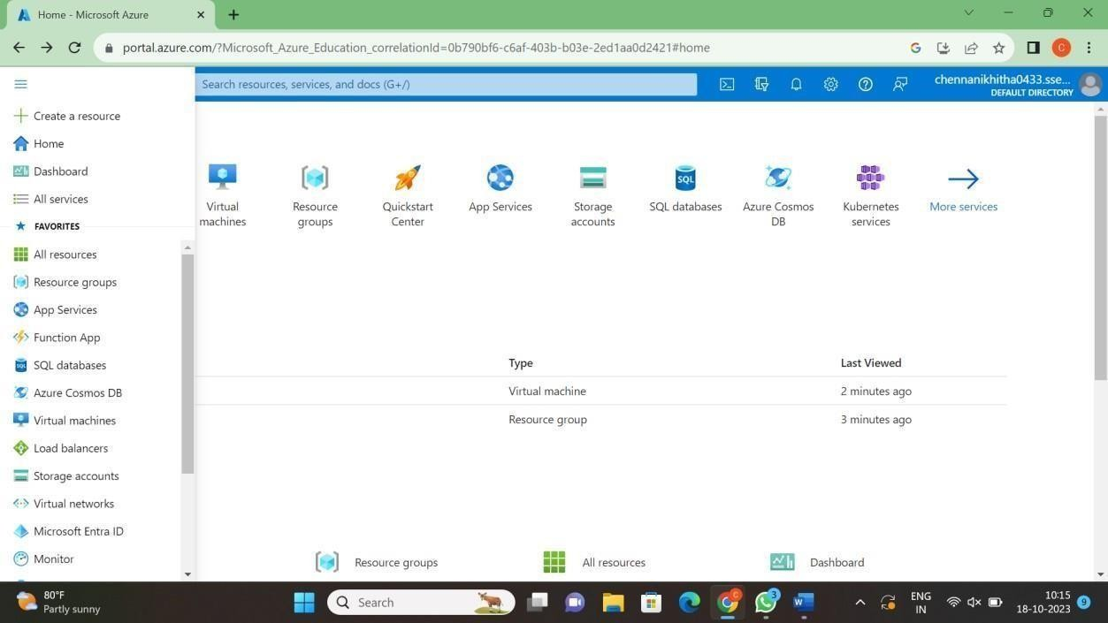
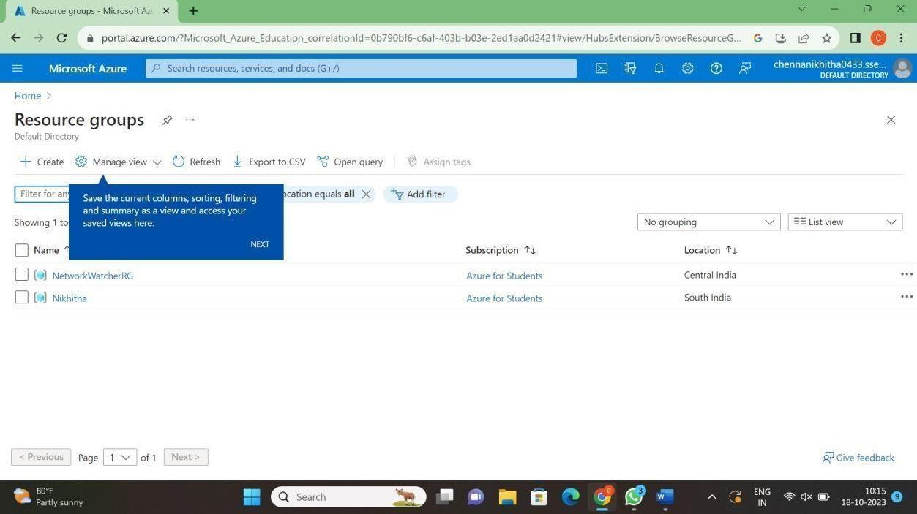
Experiment-12
Demonstrate Infrastructure as a Service (IaaS) by creating a resources group using a Public Cloud Service Provider (Azure), configure with minimum CPU, RAM, and Storage.
xper

Slide 2
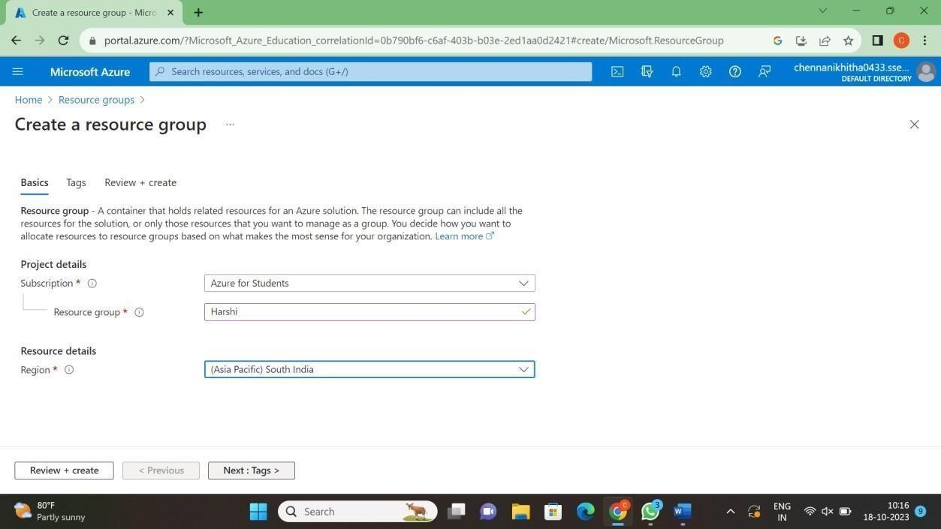
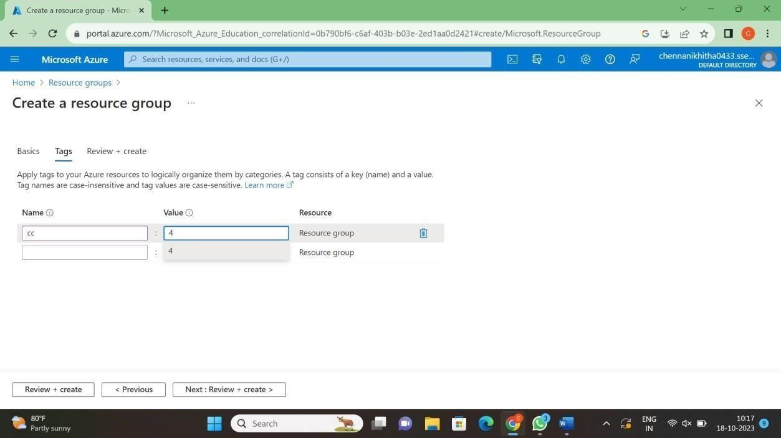

Slide 3
