Slide 1
MILA ACTIVITY
(Multiple Interactive Learning Algorithm Activity )
Game Based Activity
SLOT A
Presented By:
Shaik Rafiqhuddin-192525129 Kothakota Rakesh-192525075
MLA0403– DEEP LEARNING
Faculty : Dr.A.M.ARUL RAJ

Slide 2
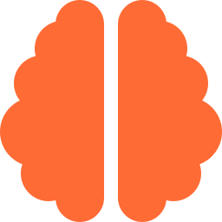


CNN ARCHITECTURE RACE
ResNet vs AlexNet
A head-to-head look at two landmark convolutional neural network designs — and which one fits your next computer-vision project.
Convolutional Neural Network
Built for computer vision
Learns visual features automatically

Slide 3
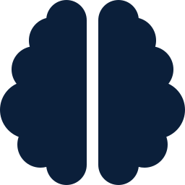



What Makes a CNN Tick
The building blocks behind AlexNet and ResNet alike
Convolutional Neural Network
"CNN" — a deep learning architecture purpose-built for visual data.
TIMELINE
2012
Image classification & vision
AlexNet
Mainly used for image classification and broader computer-vision tasks.
ImageNet breakthrough — sparks the deep-learning era
Automatic feature learning
2015
CNNs learn visual features directly from raw pixels — no manual engineering.
ResNet
Residual connections enable ultra-deep networks
The objective
Identify which architecture — AlexNet or ResNet — best fits a given application.
Both classify images into categories — the difference is how deep, accurate, and efficient they are.

Slide 4





Key Characteristics
Conv + pooling + fully connected
AlexNet
Stacks convolutional layers, pooling layers, and fully connected layers in sequence.
2012 · The breakthrough
ReLU activation
One of the major breakthroughs in deep learning — it achieved excellent results in the ImageNet competition and helped ignite the modern deep-learning boom.
Uses ReLU activation for faster, more stable training than earlier sigmoid/tanh nets.
Dropout regularization
Uses dropout to reduce overfitting on the fully connected layers.
8
trainable layers
Great for learning fundamentals
Its simple, linear structure makes it ideal for understanding how CNNs work.
~60M
parameters
Solid for basic classification
15.3%
top-5 error (ILSVRC '12)
Well suited to basic image-classification tasks that don't demand extreme accuracy.

Slide 5





Key Characteristics
Residual (skip) connections
Shortcuts let gradients flow through very deep stacks without vanishing.
ResNet
2015 · The deep leap
Extreme depth, stable training
Scales to 34, 50, 101, even 152 layers while remaining trainable.
Introduced residual ("skip") connections that let networks go far deeper than before — without the accuracy loss that used to come with extra depth.
State-of-the-art accuracy
Delivered a step-change accuracy jump over AlexNet-era architectures.
Batch normalization
layers in the deepest variant
152
Normalizes activations between layers, speeding convergence at depth.
top-5 error (ILSVRC '15)
3.57%
Built for demanding vision tasks
The go-to choice when an application needs maximum classification accuracy.
to beat human-level accuracy
1st

Slide 6

Choosing Your Fighter
AlexNet vs ResNet, side by side
Category | AlexNet | ResNet
Introduced | 2012 | 2015
Depth | 8 layers | Up to 152 layers
Key innovation | ReLU + dropout | Residual (skip) connections
Top-5 error | 15.3% | 3.57%
Best for | Learning fundamentals, light tasks | High-accuracy production vision
Verdict: Pick AlexNet to learn CNN fundamentals or run lightweight classification. Pick ResNet when the application demands top-tier accuracy on complex, large-scale image data.

