Slide 1
Dublin Bikes Integrated System
Providing static Route MAP and Distance between Near By stations
By - Rakesh Neginhal -10506981 and ARDEN DIAS -10510105

Slide 2
Introduction To Dublin Bikes
Dublin Bikes are one of the one of the most used transport systems in Dublin and it provides connectivity to different parts of the city.
There are currently 114 bikes stations across the city where users can rent the bike & till March 21st ,2018 over 67,900 users are subscribed to bike service
To use the bikes users need to take out subscription, which allows the subscriber an unlimited number of rentals.

Slide 3
Problem Statements
Each dublinbikes stations has a machine(kiosk) which has an interface to interact with end-user
From the user interface users can see available bikes and near by bike stations. If there are no bikes available or empty stands available, then they will check for the near by stations which displays station names along with Bikes available and stands available.
But there is no feature of Map view to see these near by stations and the user don’t have an idea about how far the near by station is in terms of distance.
In order to address these two drawbacks we have developed a web application which acts like a dublinbikes kiosk machine.

Slide 4
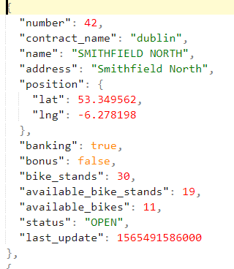
Design & Implementation
The functionalities are implemented by using JCDecaux dublinbikes services. The company provides an open data API which contains real time information of all the stations and their details.
We need to register on the developer's site of JCDecaux to get the API Key. After registering the API key is used call the HTTP service.
URL : https://api.jcdecaux.com/vls/v1/stations?contract=dublin&apiKey=224f0a5503a4603d78371d84426426bf923e79e4
After passing this API key the service responds with real time data
Sample JSON :

Slide 5
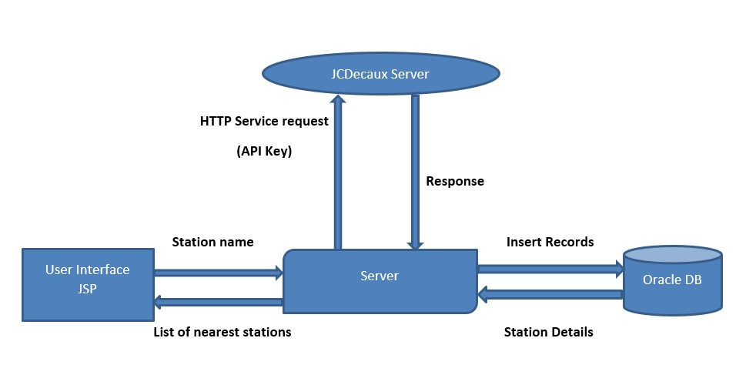
Design & Implementation Cont..
As part of technology stack we are using Spring MVC framework which is used to build web application. Its a Model-View-Controller design pattern. The presentation layer is built on JSP.
Architectural Design

Slide 6
Design & Implementation Cont..
Initially user must select source station name from the drop down provided. This selected station name is passed as a parameter to backend layer using Request mapping annotation.
Next ,to find the near by stations a call to external HTTP service is made and on successful response the data of all the stations is parsed to get the parameters like name , number, Geo location , available bikes and available stands. From the response the station name selected by user is matched to get the source station latitude and longitude.
These above obtained geo locations, distance between source and destination is calculated & if the distance is well within the 500 meters radius then all the parameters are inserted into Oracle DB
Now all these parameters including the distance from the DB are retrieved and displayed on the UI

Slide 7
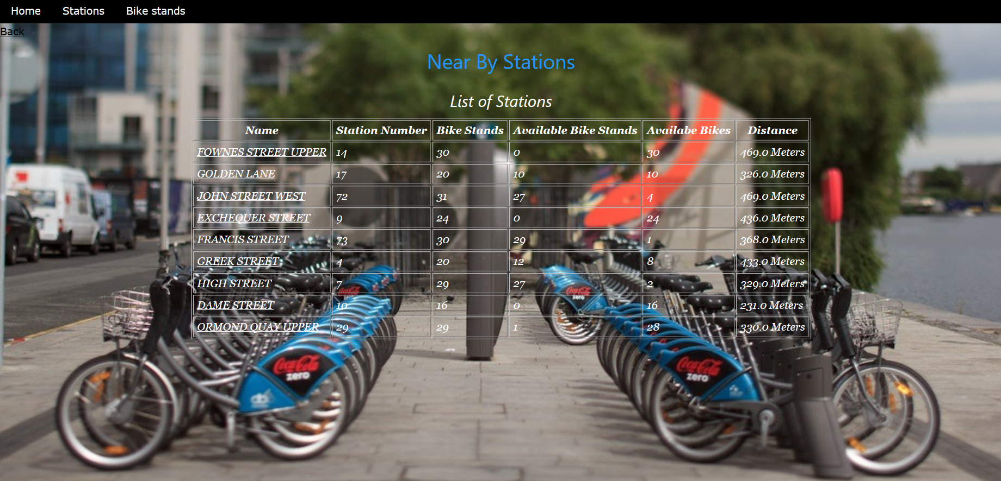

Slide 8
Conclusion
The application provides a user-friendly interface where users will surely make use of these feature to ease their problems. In this project we have successfully obtained the results where the application will display near by stations and their distance.
Our next objective is to propose these features to the developers of dublinbikes which will be a big achievement for us, and we believe that these features would help the end users to a great extent.

Slide 9
Thank You!!

