Slide 1

ExFreshers
Application Name:TonLink

Slide 2
Problem Statement: Decentralized Social Media Platform
Title: Challenges in Current Social Media Platforms
1)Lack of Financial Integration: No seamless way to transact within platforms.
2)Centralized Control: User data and content are owned by platforms.
3)Disconnected Charity Platforms: Limited integration for transparent giving.

Slide 3
Features
01
02
01
03
Decentralized Marketplace
Charity Hub
Seamless donations to verified causes
Users can trade goods and services directly without intermediaries.
Payment Service
Enables fast, low-fee peer-to-peer transfers

Slide 4
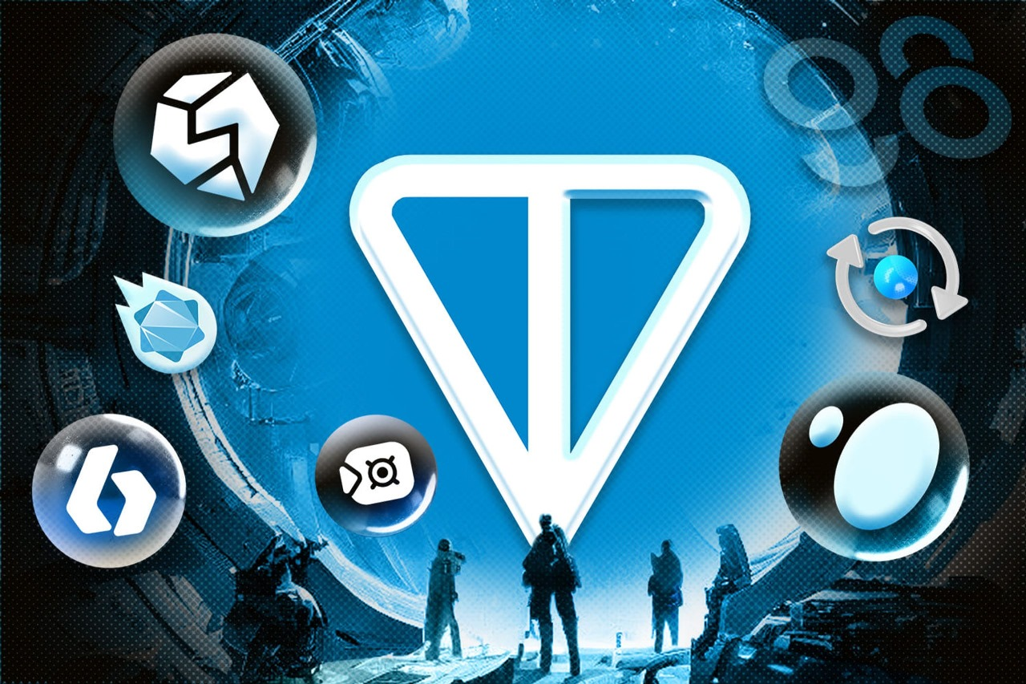
Decentralized MarketPlace
Buying and Selling Products: Users pay for products or services .
Listing Fees: Charge a small fee in tons for listing products/services on the marketplace.
Affiliate Rewards: Reward users for bringing in sales through affiliate links.
Bidding System: Implement auctions where users can bid for products/services in Ton.
Escrow Service: Use smart contracts to hold funds until both buyer and seller confirm the transaction.

Slide 5

Charity Hub
Seamless Donations: Ton
link allows users to easily contribute to verified charitable causes directly within the platform. Users can browse through various causes like natural calamities and donate meTokens to those they wish to support.
Blockchain Transparency: Every donation is recorded immutably on the blockchain, ensuring complete transparency. Users can track where their contributions go, making the donation process more trustworthy.
No Middlemen in Charity: By using blockchain, TonLink eliminates intermediaries, so all funds donated go directly to the recipients, ensuring that the full amount reaches the cause without hidden fees or delays.

Slide 6

Payment Service
Seamless Transfers Between Users:
TonWallet enables instant peer-to-peer transfers of meTokens between users, whether for personal reasons or business purposes. The TON blockchain guarantees that these transfers are executed almost immediately, with minimal fees, thanks to its high throughput and low latency.
Secure and Transparent Transactions:
Each transfer is processed securely on the blockchain, ensuring that funds are not only sent but also verified. TON's decentralized nature means that no intermediary or third-party controls the flow of funds, reducing risks such as fraud or account breaches.

Slide 7
Tech Stack
Identity Management
Frontend Development
uPort
Ceramic Network
React.js
Next.js
TON SDK
Block
Chain
Backend Infrastructure
Identity
Managem-ent
Frontend Development
Blockchain Layer
Backend Infrastructure
TON Blockchain
TON SDK
TON Smart Contract SDK (FunC)
Node.js
Python
IPFS

Slide 8
Tech Stack
Payment & Token Integration
NFT Integration
TON SDK (For Token Transactions)
TON Blockchain
TON NFT Standard
Encryption & Privacy Tools
Hosting & Deployment
Payment & Token Integration
NFT Integration
Encryption & Privacy Tools
Hosting & Deployment
Libsodium (Encryption)
zk-SNARKs
Fleek
Skynet Labs

Slide 9
Conclusion:
TonLink is a decentralized social media platform built on the TON Blockchain, focusing on security, transparency, and user control. With features like TonWallet for seamless payments, **meMarket** for a dynamic marketplace, and **meNetwork** for cross-platform charity, TonLink empowers users to connect, transact, and manage their digital lives securely and efficiently.
By leveraging TON Blockchain's fast, low-cost transactions and integrating smart contract and decentralized identity management, onLink ensures a decentralized, user-centric experience. Join TonLink to reshape the future of online interaction and digital engagement.

