Slide 1


SMART INDIA HACKATHON 2024
TITLE PAGE
Problem Statement ID –
Problem Statement Title-
Theme-
PS Category- Software/Hardware
Team ID-
Team Name (Registered on portal)

Slide 2
IDEA TITLE
Your Team Name
Proposed Solution (Describe your Idea/Solution/Prototype)
Detailed explanation of the proposed solution
How it addresses the problem
Innovation and uniqueness of the solution

Slide 3
TECHNICAL APPROACH
Your Team Name
Technologies to be used (e.g. programming languages, frameworks, hardware)
Methodology and process for implementation (Flow Charts/Images/ working prototype)

Slide 4
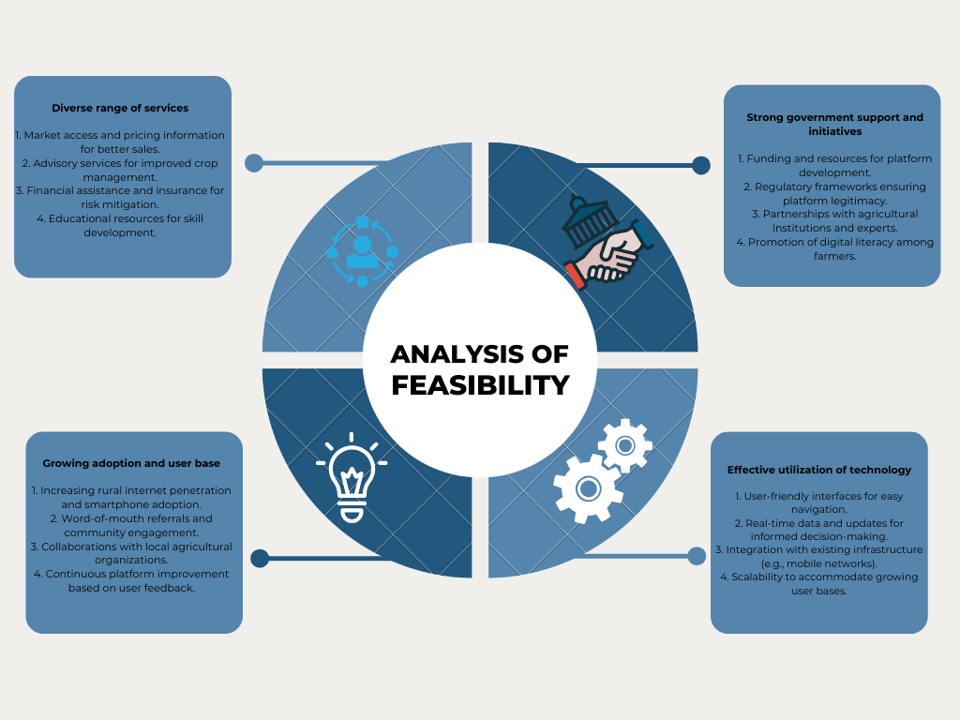
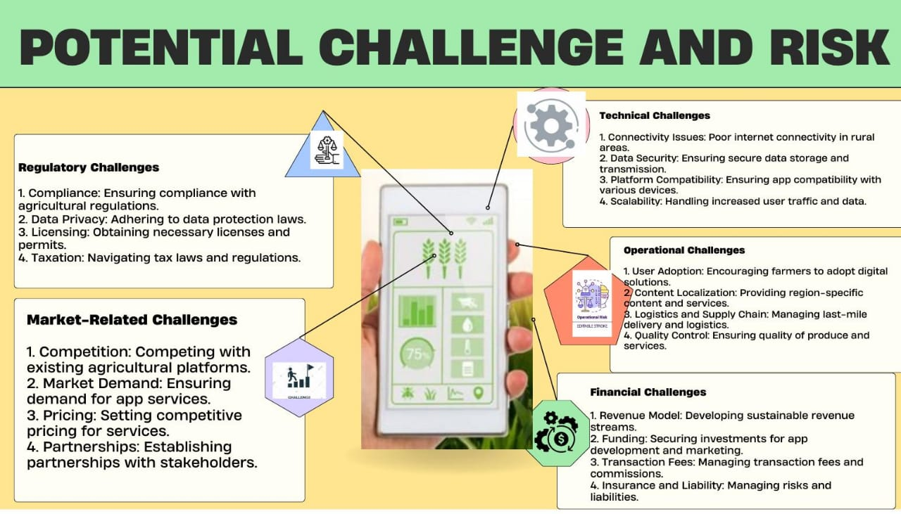
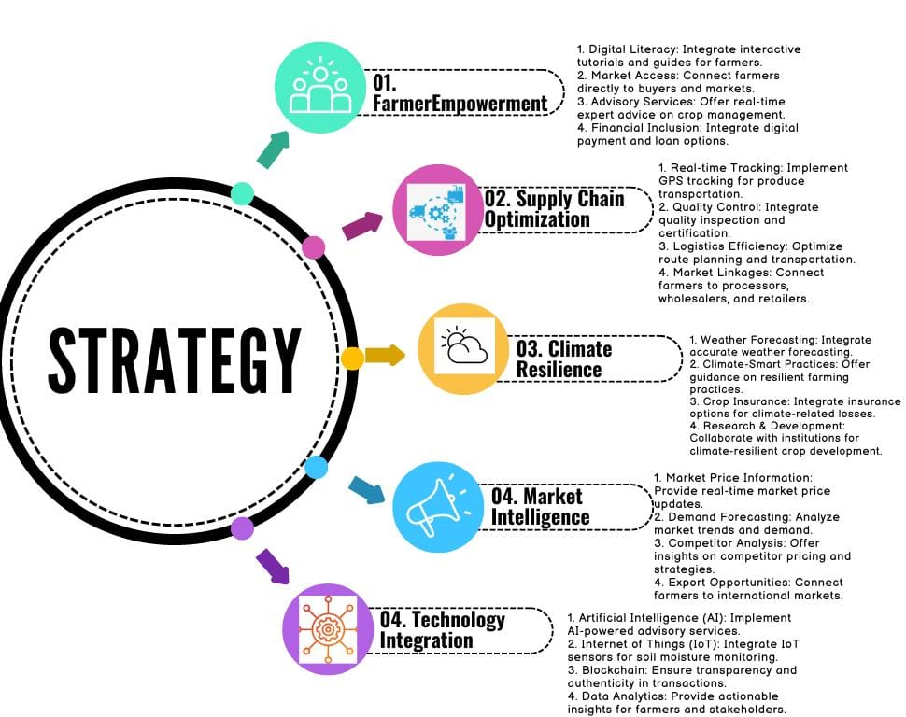
FEASIBILITY AND VIABILITY
Celestial

Slide 5
IMPACT AND BENEFITS
Your Team Name
Potential impact on the target audience
Benefits of the solution (social, economic, environmental, etc.)

Slide 6
RESEARCH AND REFERENCES
Your Team Name
Details / Links of the reference and research work

Slide 7
IMPORTANT INSTRUCTIONS
Please ensure below pointers are met while submitting the Idea PPT:
Kindly keep the maximum slides limit up to six (6). ( Including the title slide)
Try to avoid paragraphs and post your idea in points /diagrams / Infographics /pictures
Keep your explanation precise and easy to understand
Idea should be unique and novel.
You can only use provided template for making the PPT without changing the idea details pointers (mentioned in previous slides).
You need to save the file in PDF and upload the same on portal. No PPT, Word Doc or any other format will be supported.
Note - You can delete this slide (Important Pointers) when you upload the details of your idea on SIH portal.

