Slide 1


SMART INDIA HACKATHON 2024
TITLE PAGE
Problem Statement ID –SIH 1601
Problem Statement Title – Student Innovation
Theme - Toys and Games
PS Category- Software
Team ID - 31940
Team Name – Team _ Celestials

Slide 2
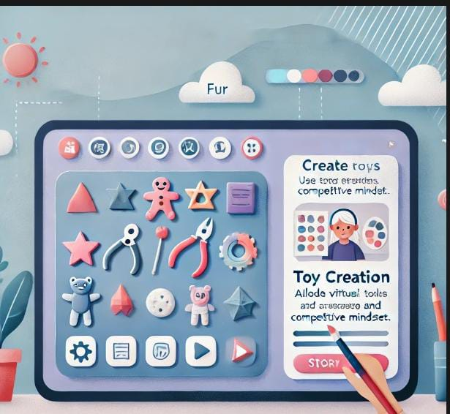
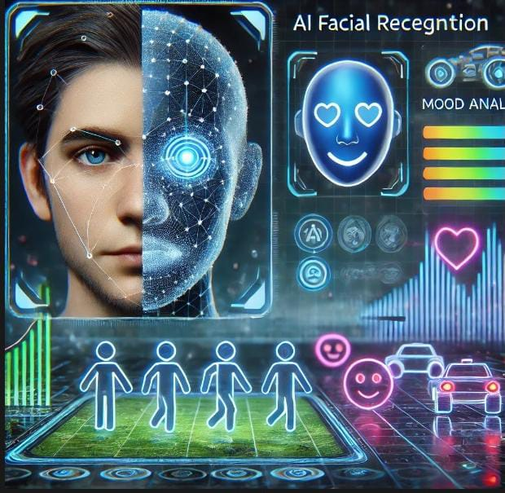
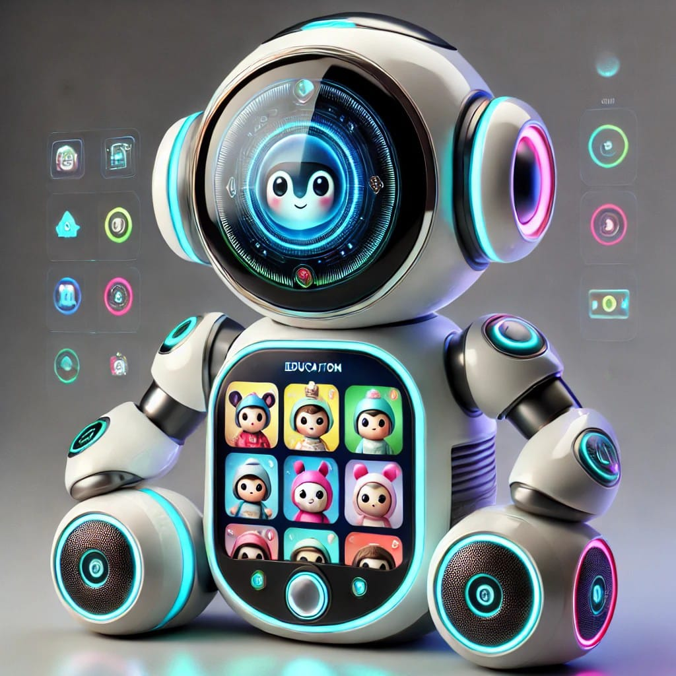


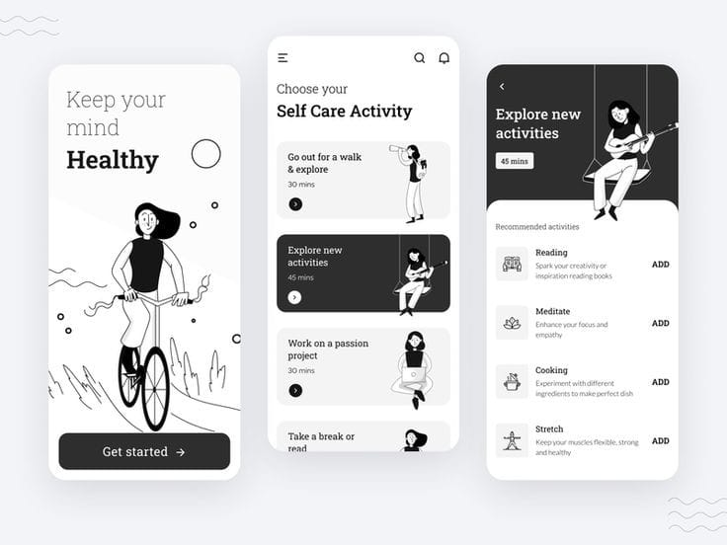

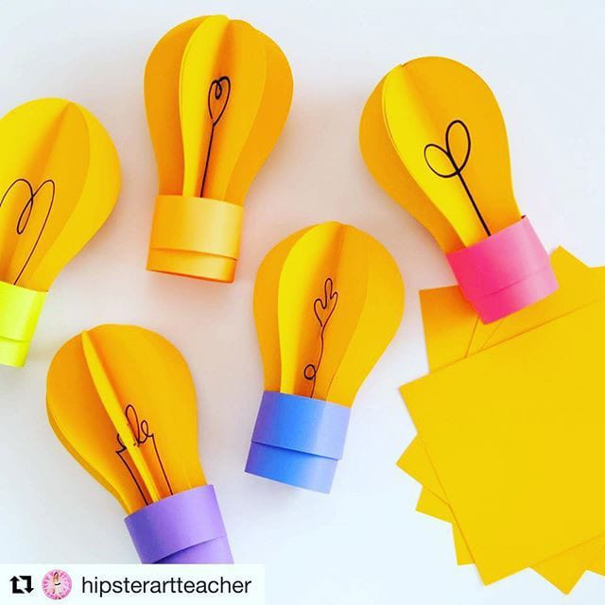


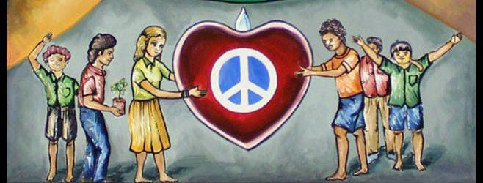
“Growth Quest- Let’s learn together”
Celestials
Create a story of our own and toys of your own
Stories have no comparison(Rich , poor) and try to get rid of fear .
AI featured face recognition to depict mood of a user and to provide games to turn on their mood.
Growth – quest
Know your hobbies through
Games and connect with like minded people.
innovative Educative toy
Enables learner to learn the difficult topics by enabling voice- recognition by a toy and it will create visual 3D stories on the topics.
Last in mind for long period of time.
Huge shift in method of studying in creative and innovative way.
Giving practical tasks to make child to understand the values , relationships , emotions and Humanity.
Pitch your ideas through our app
To become innovative and creative and get rewards.
Games to understand the importance of team management and time management
Games that will eradicate the unhealthy competition and provide competition for no competition.

Slide 3
TECHNICAL APPROACH
Your Team Name
Technologies to be used (e.g. programming languages, frameworks, hardware)
Methodology and process for implementation (Flow Charts/Images/ working prototype)

Slide 4
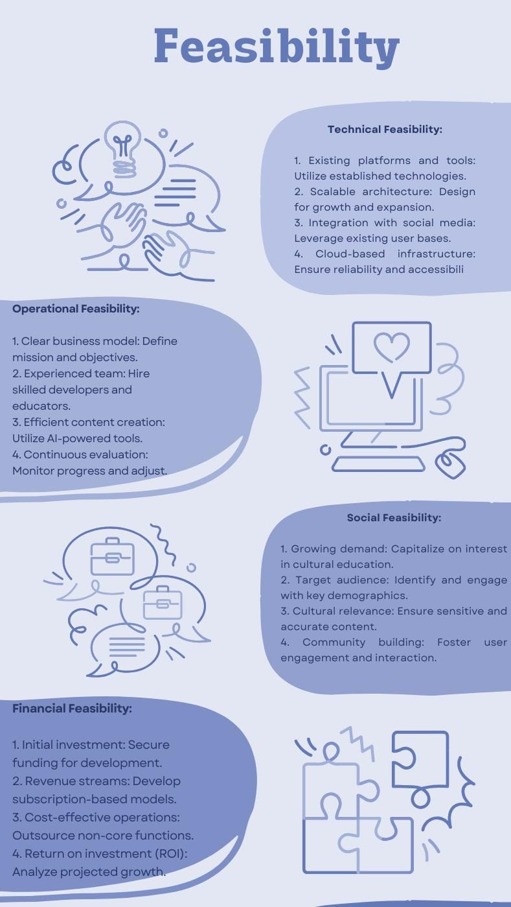
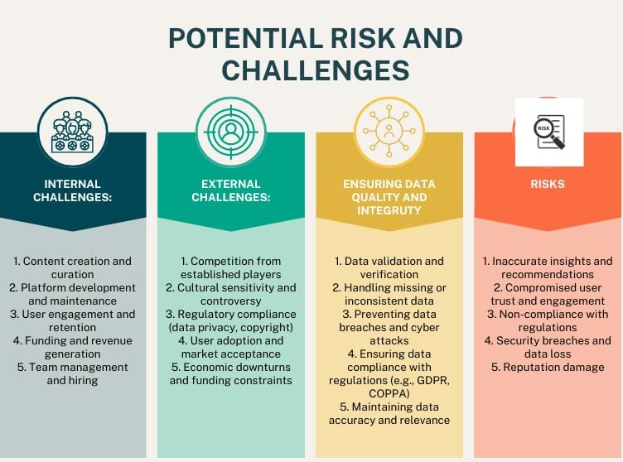
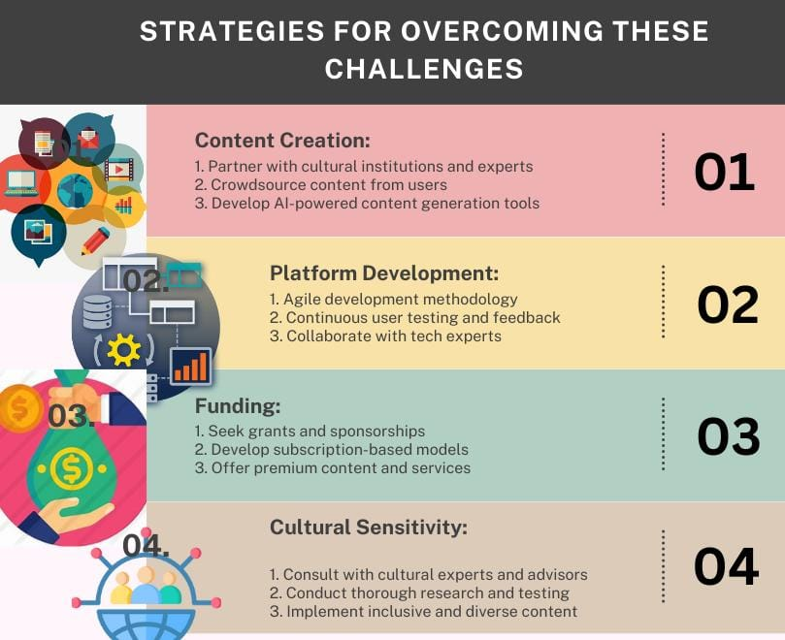
FEASIBILITY AND VIABILITY
Celestials
Why our toy?
Cultural Education: Interactive learning experiences teaching diverse cultures, traditions, and values.
Immersive Play: Engaging VR/AR games, puzzles, and activities promoting social-emotional learning and cognitive development.
Personalized Learning: AI-driven content recommendations adapting to individual learning styles, pace, and interests.
Interactive Storytelling: Immersive narratives exploring global cultures, histories, and perspectives.
Holistic Development: Integrated framework fostering empathy, creativity, critical thinking, and global citizenship.
How our toy is different from others?
Personalized learning paths
AI-powered cultural content
Interactive storytelling
Immersive VR/AR experiences
Social-emotional learning
Real-world applications
Collaborative gameplay
Adaptive difficulty
Offline accessibility
Integrated educational framework

Slide 5
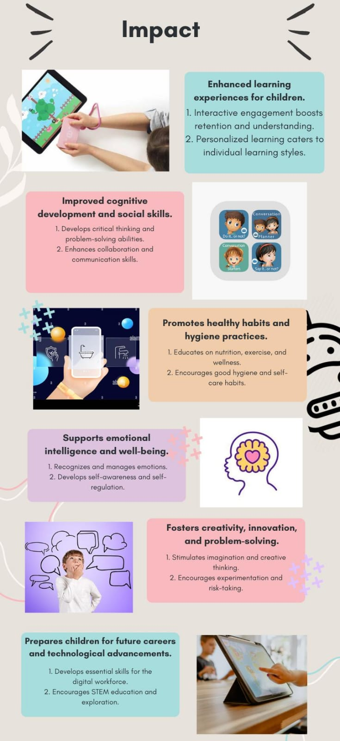
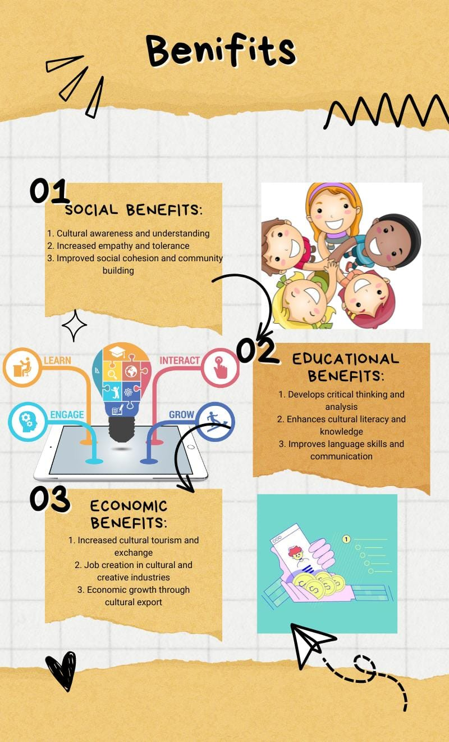
IMPACT AND BENEFITS
Celestials
Impact and Benefits Overview
Enhanced learning experiences through interactive engagement and personalized learning.
Improved cognitive development, social skills, and emotional intelligence.
Increased accessibility and inclusivity for underserved communities.
Promotes healthy habits, creativity, and problem-solving skills.
Fosters global citizenship, cultural awareness, and empathy.
Develops critical thinking, language skills, and lifelong learning.
Supports economic growth through cultural tourism, export, and innovation.
Encourages social responsibility, activism, and human rights.
Breaks down cultural and social barriers, promoting peace and cooperation.
Yields long-term benefits, including increased GDP, productivity, and sustainable development.

Slide 6
RESEARCH AND REFERENCES
Your Team Name
Details / Links of the reference and research work

Slide 7
IMPORTANT INSTRUCTIONS
Please ensure below pointers are met while submitting the Idea PPT:
Kindly keep the maximum slides limit up to six (6). ( Including the title slide)
Try to avoid paragraphs and post your idea in points /diagrams / Infographics /pictures
Keep your explanation precise and easy to understand
Idea should be unique and novel.
You can only use provided template for making the PPT without changing the idea details pointers (mentioned in previous slides).
You need to save the file in PDF and upload the same on portal. No PPT, Word Doc or any other format will be supported.
Note - You can delete this slide (Important Pointers) when you upload the details of your idea on SIH portal.

