Slide 1

Jenkins
By
Kerkere Mallikarjun
Satyaprakash Rath
Rakesh Kumar

Slide 2

Agenda
What is Jenkins?
Why need Jenkins?
Jenkins Architecture
Jenkins features
Jenkins installation
Jobs in Jenkins
Pipeline concepts
Build Triggers in Jenkins
Master & slaves conceptes
Demo

Slide 3

What is Jenkins?
An open-source automation server which enables developers around the world to reliably build, test, and deploy their software

Slide 4
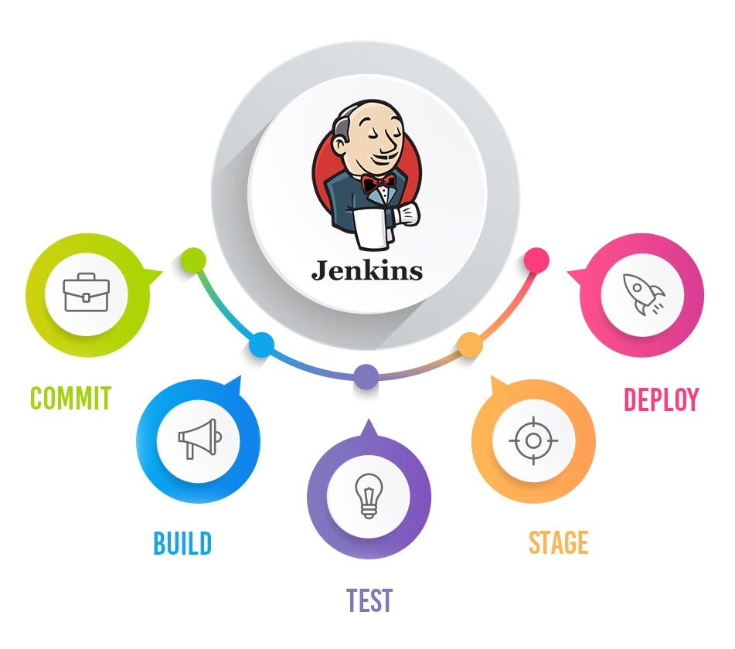
What is Jenkins?

Slide 5
Why we need to learn Jenkins?
Problem?
Developers keep merging code to VCS several times a day. All the code collected from different developers would have generated conflicts and bugs.
Code Merged from a long time when built throws Conflicts, Bugs, and errors. All these conflicts, bugs & errors need to be resolved, which takes a very long time and halts development.

Slide 6
Why we need to learn Jenkins?
Runs Automated Test Suites
Run your Web, Mobile Automation SUITE
API Monitoring
Report and Email Notification
Trends and detailed failures that can be shared.
You can use slave to make build and run fast.

Slide 7
Jenkins Architecture
Developers commit changes to the source code, found in the repository.
The Jenkins CI server checks the repository at regular intervals and pulls any newly available code.
The Build Server builds the code into an executable file. In case the build fails, feedback is sent to the developers.
Jenkins deploys the build application to the test server. If the test fails, the developers are alerted.
If the code is error-free, the tested application is deployed on the production server.

Slide 8
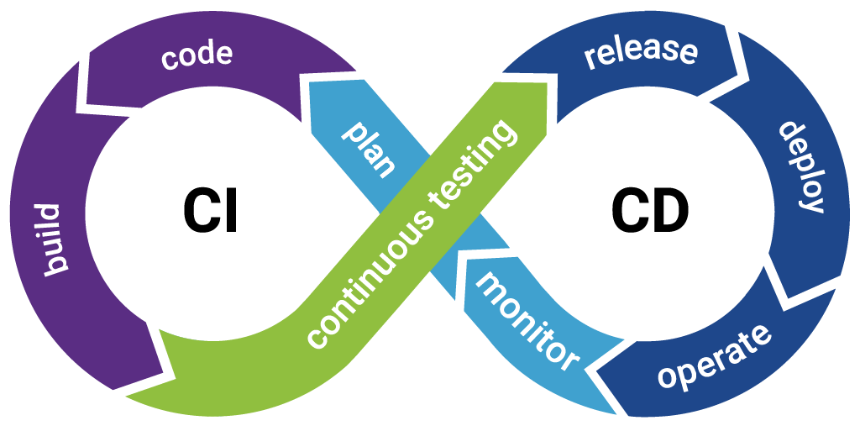
CI/CD with Jenkins

Slide 9
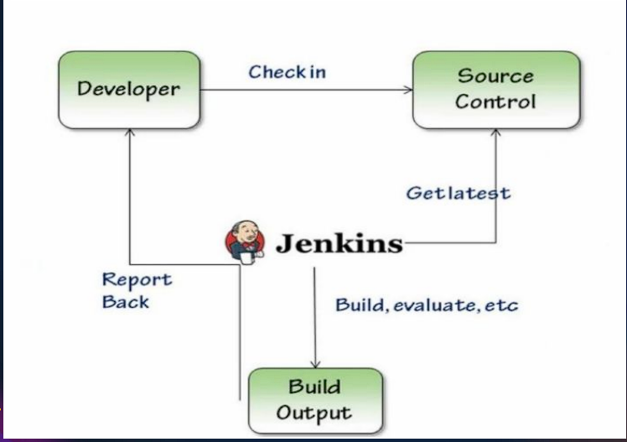
CI with Jenkins

Slide 10
Jenkins Features
Easy Installation
Easy Configuration
Available Plugins
Extensible
Easy Distribution
Free Open Source

Slide 11
Jenkins Installation
Java- JRE, JDK – Java 8
Any OS – Window, Linux, MacOS

Slide 12
Jobs In Jenkins
Freestyle Projects
Pipeline Jobs
Use GUI to add different stages and steps
More suitable for less complex scenarios
Good for people who are starting to use Jenkins/ CI solutions
Can become hard to achieve what you want when your scenario become more complex
Use code (Groovy language - this is a Java-like language) for giving instructions
Since, everything in one script you can keep that in the source control and have ability to revert back to an earlier version at any time or keep track of changes made to the script
Entire, pipeline consists of steps (ex: build, test, deploy, etc..)
Created using a Jenkinsfile

Slide 13
Pipeline Concepts
Pipeline
Pipeline is a suite of plugins which supports implementing and integrating continuous delivery pipelines into Jenkins.
Agent
An agent is typically a machine, or container, which connects to a Jenkins controller and executes tasks when directed by the controller.
Stage
It contains a collection of states such as build, deploy, test and release.
Step
Jenkins Pipeline allows you to compose multiple steps in an easy way that can help you model any sort of automation process.

Slide 14
Pipeline
pipeline { agent { label "master" } tools { maven "Maven" } environment { NEXUS_VERSION = "nexus3" } stages { stage("Clone code from VCS") { ………. } } } | pipeline { agent any stages { stage('Stage 1') { steps { echo 'Hello world!' } } } }

Slide 15
Build Triggers in Jenkins
A Build trigger automatically starts a build whenever you make any changes to your source code.
Git-Webhook
Poll SCM
Scheduled Jobs
Remote Triggers

Slide 16
Master & slave node in Jenkins
Problem?
In Jenkins, We can build all our applications on a single server. As the requirement grows and changes, we will come cross many issues like what if there are thousands build which needs to be done, what if different builds need to be done on different flavor of OS.
In such cases the master-slave architecture comes in picture which takes care of all such odd requirements.

Slide 17
Master & slave node in Jenkins
Jenkins Master
The Jenkins master acts to schedule the jobs, assign slaves, and send builds to slaves to execute the jobs. It will also monitor the slave state (offline or online) and get back the build result responses from slaves and display build results on the console output.
Jenkins Slave
Slave is a java executable which receives the build instructions from the central master node.

Slide 18
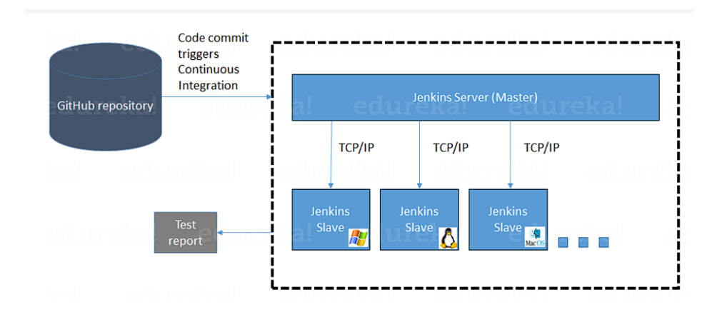
Master & slave node in Jenkins

Slide 19
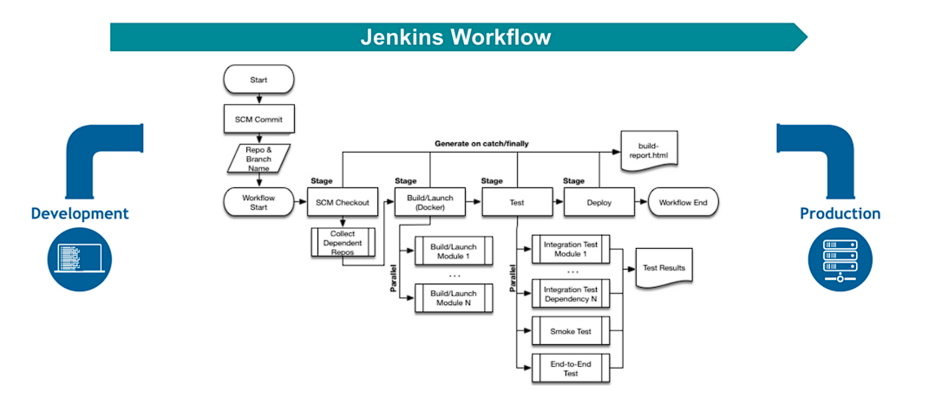
Jenkins workflow

Slide 20

Thank you

