Slide 1

INTRO TO DATA SCIENCE PROJECT 1
Baltimore City Employee Salaries
- An Insight into the Workforce of Baltimore City

Slide 2
Introduction
The dataset provides a comprehensive view of Baltimore City employee salaries and gross pay spanning from fiscal year 2011 to the most recent fiscal year.
Time Span: From 2011 till the recent fiscal year
Who's Included: Workers on board as of June 30 of the last year
Data Source: Baltimore City Dataset
Why Look Into This:
Get a peek into city job trends
Keep an eye on city spending on salaries
Help in city job planning and budgeting

Slide 3
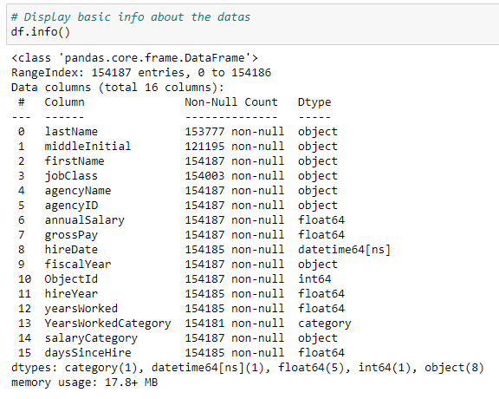
Dataset Overview

Slide 4
Data cleaning conclusions
Some columns have missing values.
middle initial has the most.
Job class, last name, and hire date also have missing entries.
Removed all rows with any missing values to ensure accuracy.
The ‘MiddleInitial’ column has an optional high missing count.
The dataset has a wide variety of records:
For instance, there are 147,491 unique gross pay values.
Each ‘agency’ matches with a unique agency name.

Slide 5
Data Visualizations

Slide 6
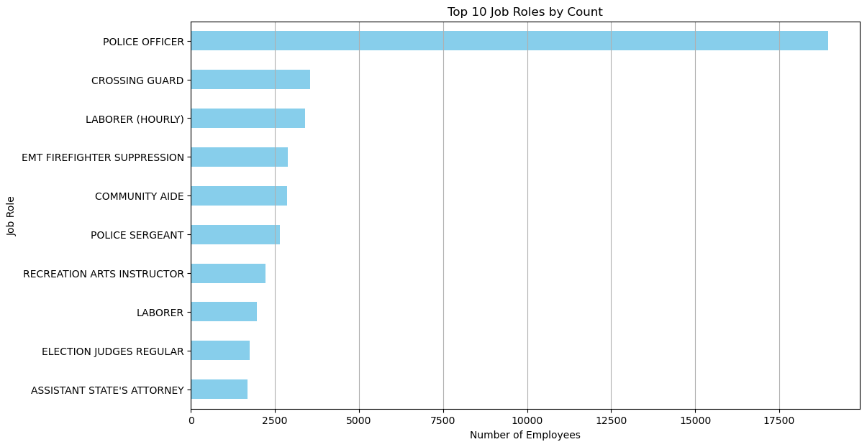
Job roles Analysis
The job role at the top of the graph is the most common, with the highest number of employees.
There's a notable variation in the number of employees across these top 10 roles.

Slide 7
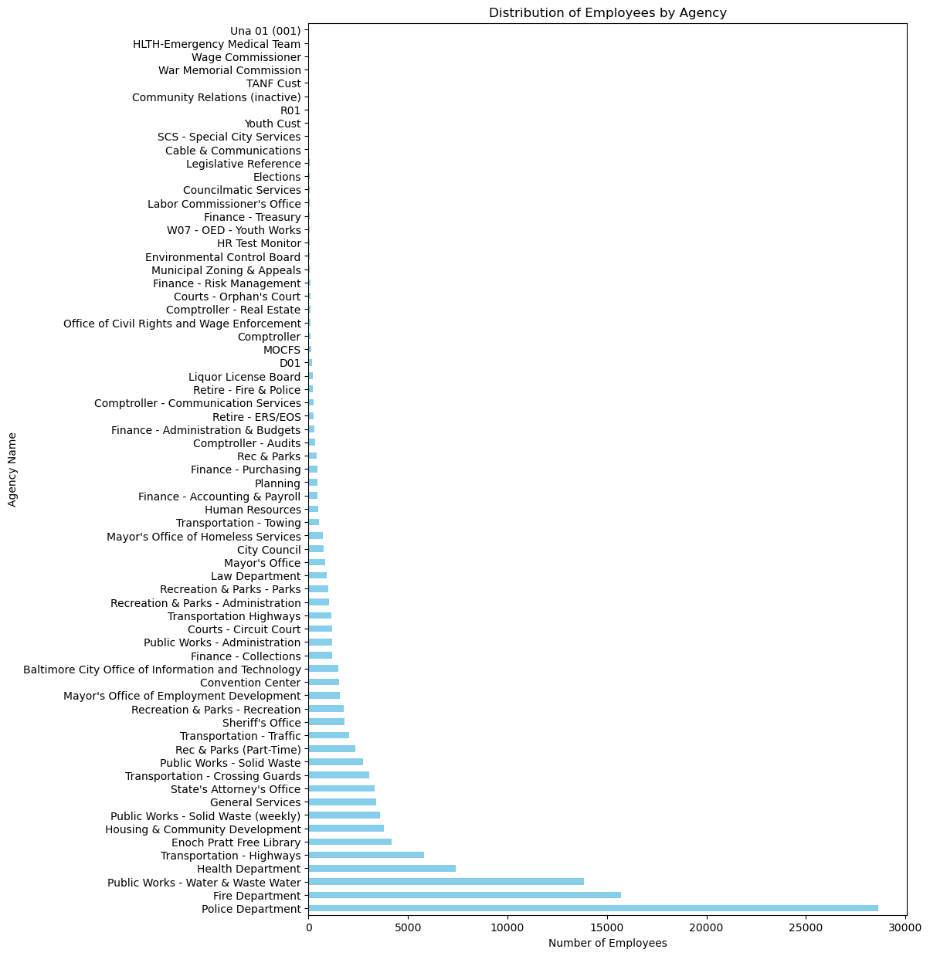

Slide 8
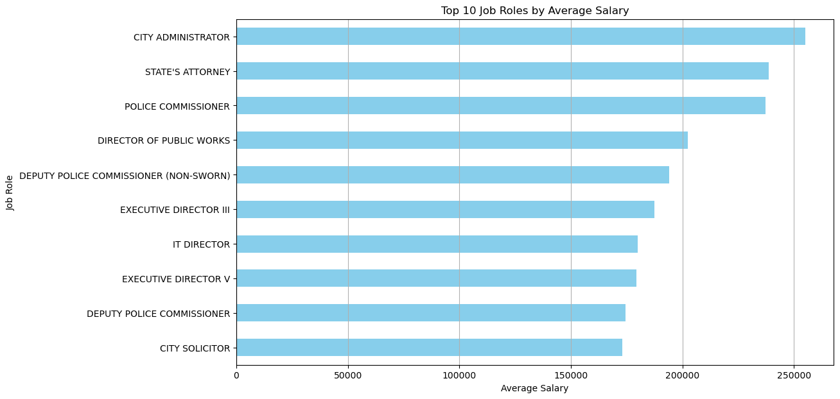
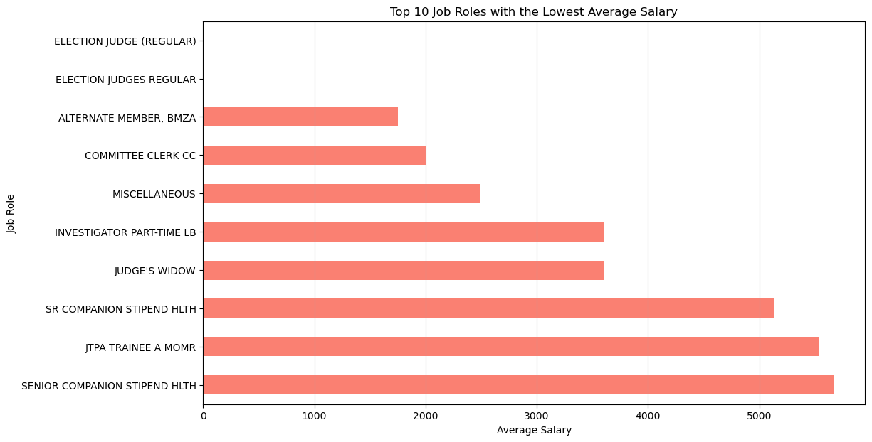
Average Salary

Slide 9
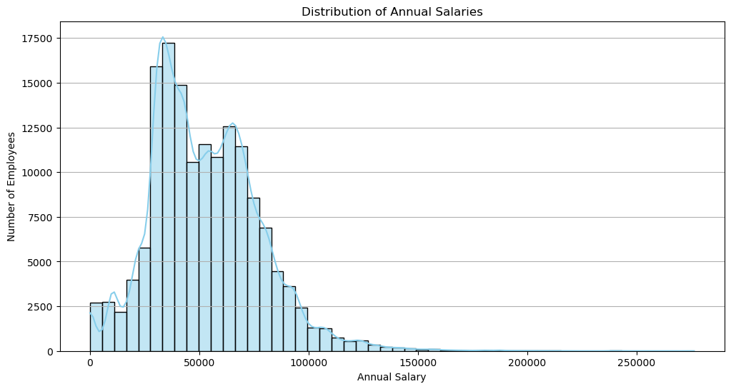
Annual Salaries Analysis
Most employees fall within a specific salary range, forming a peak in the histogram.
There are fewer employees on the extremes, showing fewer very low or very high salaries.

Slide 10
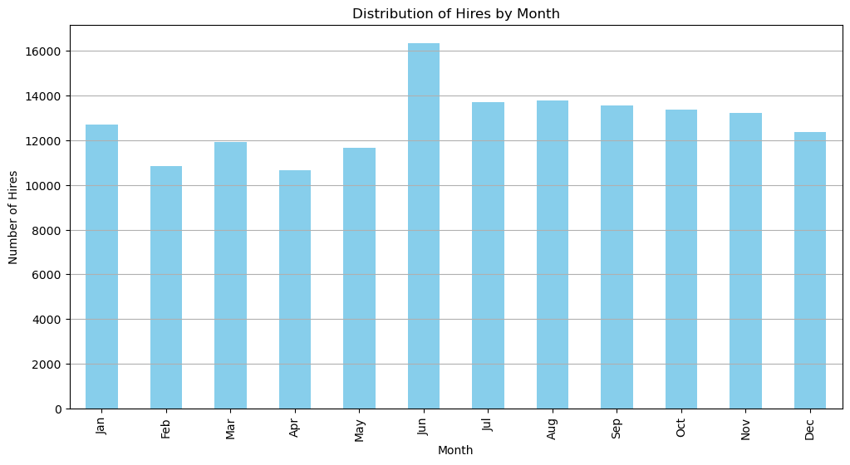
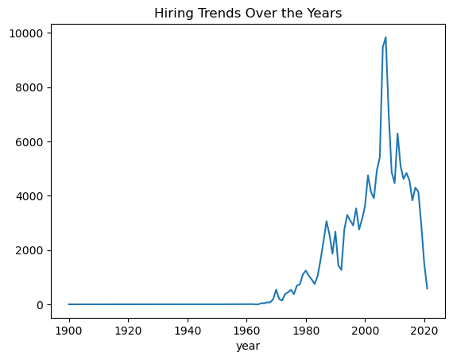
Hiring Trends

Slide 11
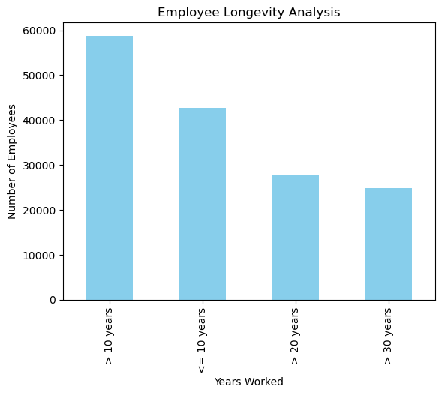
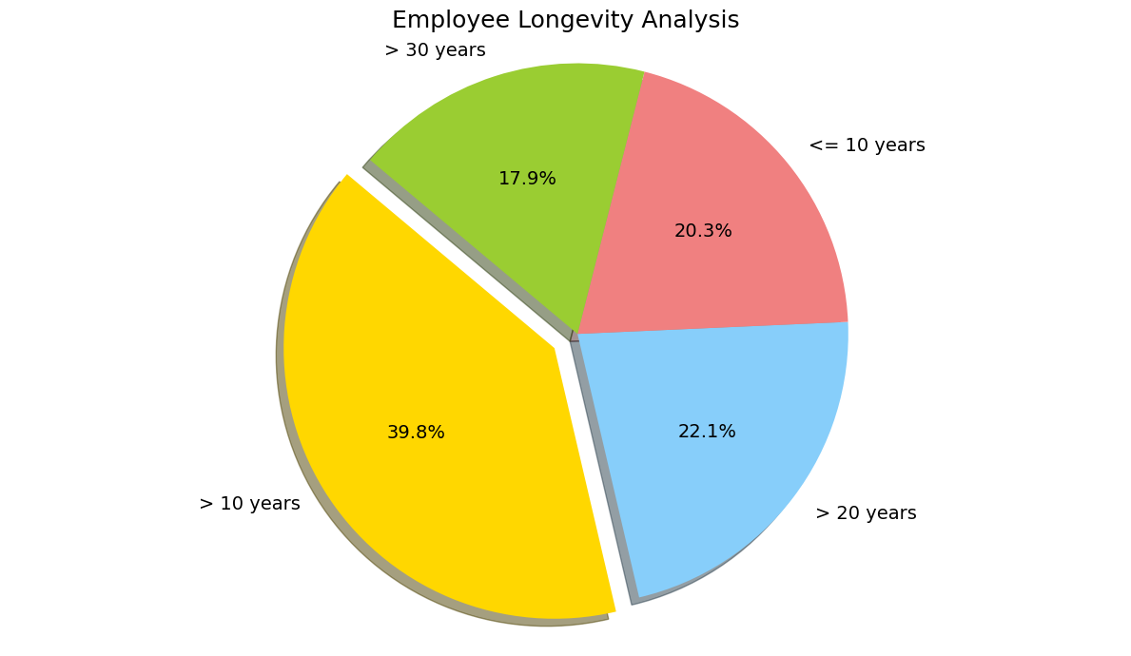
Years worked by Employees

Slide 12
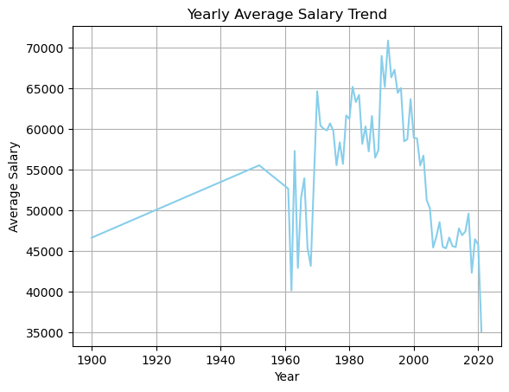
Yearly Average Salary Trend
The average salary of employees has shown a general upward trend over the years.
There are certain years with significant spikes or drops, indicating changes in pay scales or organizational changes during those times.

Slide 13
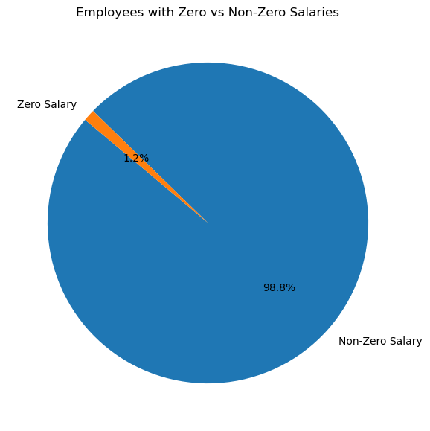
Some employees might be unpaid like interns or volunteers.
$0.0 could be a mistake in the data.
Some roles are short-term and might not have a yearly salary.
$0.0 might just be a placeholder for missing info.
We should double-check these $0.0 salary entries.
These entries can change our overall data results.

Slide 14
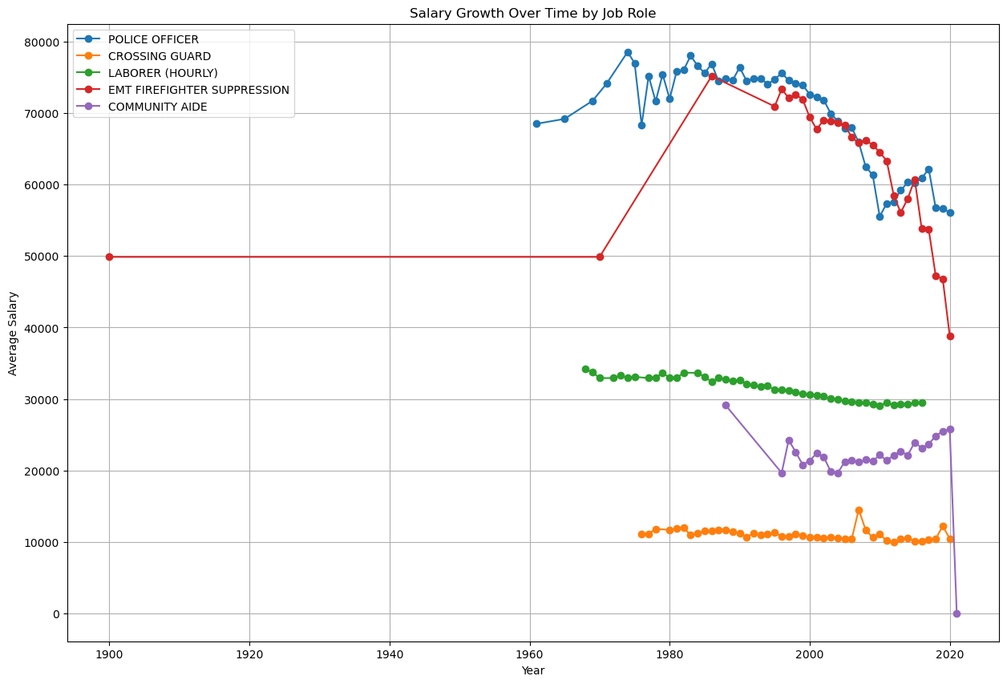

Slide 15
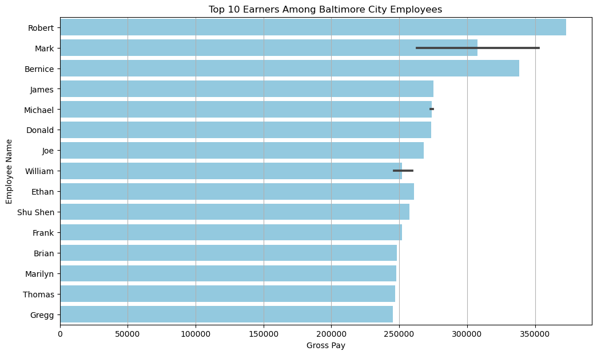

Slide 16
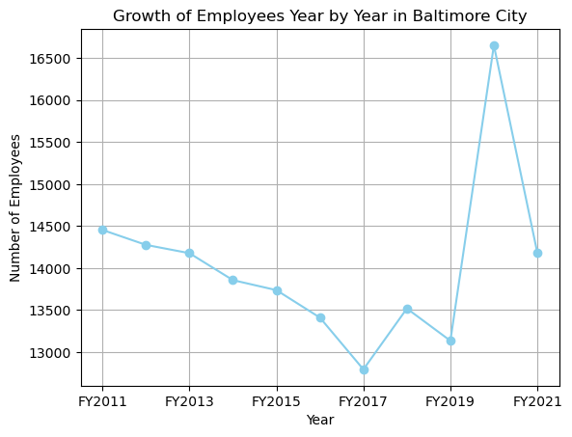

Slide 17
Conclusion
Baltimore Employee Data: The analysis provides a clear view of the Baltimore City employee salary distribution from 2011 to 2021.
Top Roles: Jobs like "911 OPERATOR" and "LABORER" are among the most common in the city.
Salary Trends: Over the years, average salaries have shown some changes.
Data Quality: Some employees have a $0.0 salary, suggesting possible data issues or unpaid roles.
Work Experience: Many employees have varying lengths of service, with some serving for several decades.
Salary Distribution: A large number of employees earn around the average salary, but there are exceptions.
Data Cleaning: The dataset needed some cleaning, like handling missing values, before diving deep into the analysis.
To wrap up, this data gives a deep insight into the working structure, pay scales, and trends of Baltimore City employees. It's essential to treat this data responsibly, remembering that every number represents a person's livelihood.

