Slide 1
Image Generation using GAN
SUBMITTED BY
RAKESH B
NM ID: au711721243075
KGiSL INSTITUTE OF TECHNOLOGY

Slide 2

AGENDA
PROBLEM STATEMENT
PROJECT OVERVIEW
END USERS
SOLUTION AND PROPOSITION
KEY FEATURES
MODELLING APPROACH
RESULT

Slide 3

PROBLEM STATEMENT
To develop a GAN-based image generation framework that can augment the CIFAR-10 dataset for data augmentation tasks, facilitate domain adaptation, and serve as a tool for creative exploration and synthesis in computer vision applications. The objective is to create a GAN architecture capable of learning the underlying data distribution of CIFAR-10 images and generating high-quality, visually coherent samples that exhibit characteristics similar to the original dataset.

Slide 4
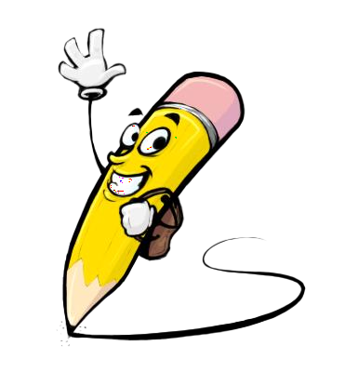
PROJECT OVERVIEW
This project aims to leverage Generative Adversarial Networks (GANs) to generate synthetic images resembling the CIFAR-10 dataset. CIFAR-10 is a benchmark dataset widely used in machine learning and computer vision, containing 60,000 32x32 color images across 10 classes. The generated images will be of high quality and indistinguishable from real CIFAR-10 images, serving as a tool for data augmentation and expanding the dataset for training deep learning models.

Slide 5
WHO ARE THE END USERS?
Researchers in Machine Learning and Computer Vision: Researchers exploring novel techniques in generative modeling, deep learning, and image synthesis could be end users.
Software Developers: Developers working on applications that require large amounts of labeled image data, such as training datasets for deep learning models, could use the synthetic images to augment their datasets.
Educators and Students: Educators teaching courses in machine learning, computer vision, or deep learning could use the project as educational material.

Slide 6
ITS VALUE PROPOSITION
Solution: Our GAN model generates realistic images akin to CIFAR-10 dataset.
Value: Enhanced Data Quality: High-quality synthetic images improve machine learning model performance.
Cost Savings: Reduces expenses by eliminating the need for manual data collection and labeling.
Increased Model Robustness: Diverse images enhance model generalization and reliability.
Versatility: Adaptable across various domains and applications.
Innovation and Creativity: Fosters creativity and exploration in design and visual storytelling.
Scalability and Accessibility: Suitable for organizations of all sizes, democratizing access to advanced AI technologies.

Slide 7
THE WOW IN YOUR SOLUTION
Realism: Our solution creates photorealistic images using GANs, enhancing data augmentation and image generation.
Cost-Efficiency: By eliminating manual data collection, it saves time and resources, making AI accessible to all.
Versatility: Suitable for diverse applications, it adapts seamlessly to various domains and industries.
Democratizing AI: It empowers organizations of all sizes to leverage advanced AI technologies for innovation and growth.
Revolutionizes Design: Transforms prototyping and visualization, elevating product innovation to new heights.
Scalability: Our solution effortlessly handles large datasets and complex tasks, ensuring reliable performance across diverse applications.

Slide 8
MODELLING
In our solution, we employ sophisticated modeling techniques, primarily Generative Adversarial Networks (GANs), to generate high-quality images resembling those in the CIFAR-10 dataset. GANs consist of two neural networks, the generator and the discriminator, which engage in a competitive training process.
Generator: The generator network learns to generate synthetic images from random noise vectors. It transforms input noise into images that are increasingly realistic, aiming to fool the discriminator.
Discriminator: The discriminator network learns to distinguish between real CIFAR-10 images and synthetic images produced by the generator. It provides feedback to the generator, helping it improve its image generation capabilities over time.

Slide 9
Generative Adversarial Networks (GANs): Two neural networks, generator and discriminator, trained adversarially for image generation.
Convolutional Neural Networks (CNNs): CNNs form the backbone architecture for both generator and discriminator networks, adept at capturing spatial dependencies in images.
Loss Functions: Adversarial loss functions, like minimax loss, drive training. Generator minimizes this loss by fooling discriminator, while discriminator maximizes it by correctly classifying real and fake images.
Regularization Techniques: Methods like gradient penalty, spectral normalization, and feature matching stabilize training, preventing issues like mode collapse.
Normalization: Techniques like batch normalization stabilize and accelerate training, ensuring consistent input ranges for more efficient convergence.
Hyperparameter Optimization: Fine-tuning learning rates, batch sizes, and network architectures optimizes GAN performance, enabling fast convergence and high-quality image generation.
Evaluation Metrics: Quantitative metrics such as Inception Score (IS) and Frechet Inception Distance (FID) objectively assess generated image quality and diversity, guiding training for optimal results.

Slide 10
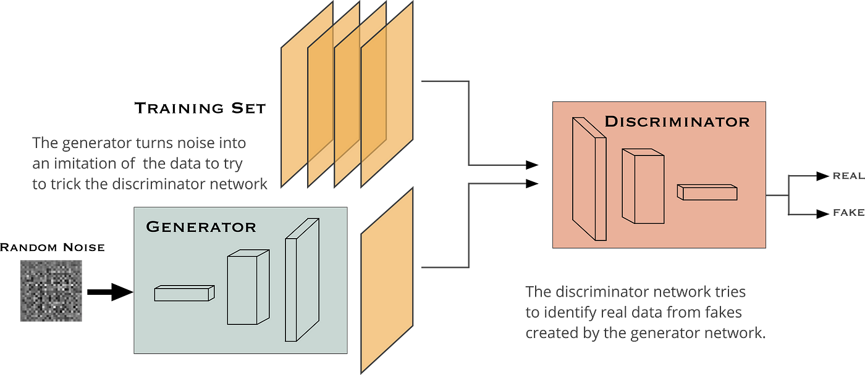
Image Generation using GAN

Slide 11
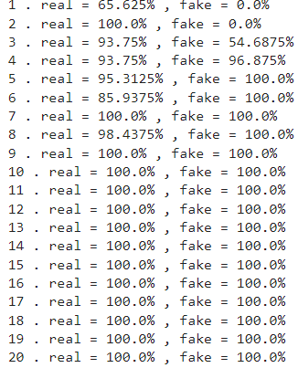
RESULTS
High Fidelity: Images closely resemble real CIFAR-10 images.
Diverse Outputs: Model produces varied outputs across classes.
Quality Metrics: Metrics confirm high image quality and realism.
Stable Training: Training process shows stability and consistent improvement.
Successful Applications: Users report successful data augmentation and creative endeavors.
Educational Impact: Model aids learning and experimentation.
Innovation Potential: Results inspire further AI innovation and exploration.

