Slide 1
INDIA AIR POLLUTION
Milestone Presentation
From pollution measurement to evidence-based intervention priorities
POWER BI • ENVIRONMENTAL RISK INTELLIGENCE
Milestone scope
Six-dashboard narrative
Detect → Assess → Explain → Track → Secure → Act
Team 3
Rushikesh Shirwalkar
Ajay Seepana
Rakesh Bommala
03 September 2026
Notes:
Open by explaining that this milestone is not simply a collection of charts; it is an environmental-risk intelligence workflow that moves from measurement and detection to evidence quality and action.

Slide 2
The project is designed as one decision story
Six dashboards • one continuous narrative from situational awareness to action
01
02
03
04
05
06
What is happening?
→
Where is the burden concentrated?
→
What context is associated with higher pollution?
→
How is pollution changing?
→
How strong is the evidence?
→
What realistic interventions should be considered?
India Environmental Risk Overview
Pollution Risk Landscape
Industrial & Urban Risk Profile
Historical Pollution Risk & Escalation
Environmental Risk & Decision Security
Pollution Reduction Strategy & Action Plan
SITUATIONAL AWARENESS
HOTSPOT DETECTION
RISK CONTEXT
THREAT TRAJECTORY
CONFIDENCE / UNCERTAINTY
DECISION & ACTION
DETECT
EXPLAIN + TRACK
SECURE + ACT
Establish the national situation and identify where the burden is concentrated.
Dashboards 1–2 convert a large monitoring dataset into a focused risk landscape.
Use area type, state, season and long-term trends to explain differences and track escalation.
Dashboards 3–4 provide context and trajectory.
Make uncertainty visible before turning evidence into candidate interventions and decision priorities.
Dashboards 5–6 protect decision quality.
Narrative spine
What → Where → Context → Change → Confidence → Action
Notes:
Explain the six-stage storyline. Emphasize that each dashboard answers a different decision question and feeds the next one, avoiding repetition.

Slide 3
Data foundation and analytical guardrails
The milestone is built on a cleaned monitoring dataset and a deliberately conservative analytical framework
RECORDS
LOCATIONS
STATES
COVERAGE
OVERALL COMPLETENESS
432K
301
34
1987–2015
86.1%
CORE ANALYTICAL RULES
CURRENT EVIDENCE SIGNAL
SO₂, NO₂, RSPM and SPM form the main long-coverage pollutant story.
NO₂
99.98%
STRONG
PM2.5 is treated as a limited-coverage supporting indicator, not the historical backbone.
SO₂
99.98%
STRONG
Average concentration is used for pollutant intensity; concentrations are never summed.
RSPM
98.58%
STRONG
Unknown values are retained when they cannot be reliably inferred.
SPM
45.83%
LIMITED
stn_code is not used for station metrics until explicitly validated.
WHY THIS MATTERS
Strong evidence for SO₂, NO₂ and RSPM supports interpretation; substantially lower SPM completeness increases decision caution.
Notes:
Use this slide to establish the guardrails. The key milestone finding is that completeness differs sharply by pollutant, which later shapes the confidence and action story.

Slide 4
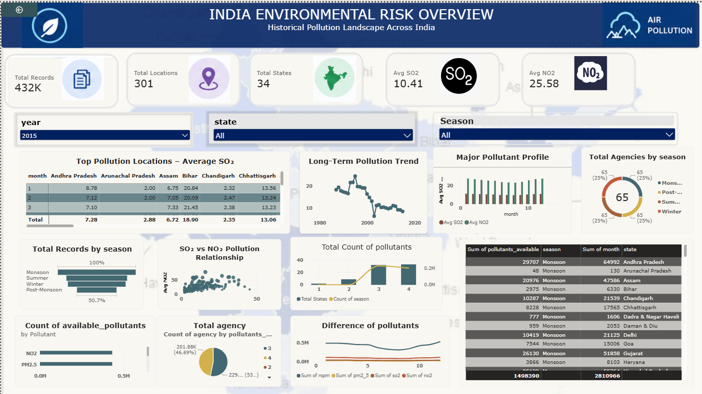
01 • India Environmental Risk Overview
Situational awareness: establish the national pollution picture
WHAT THIS DASHBOARD ESTABLISHES
National monitoring scale: ~432K records, 301 locations, 34 states.
High-level pollutant and seasonal views create a national starting point.
Interactive year, state and season filters support situational exploration.
MILESTONE MESSAGE
We begin broad: before asking where to act, establish the scale and shape of the pollution problem.
SITUATIONAL AWARENESS
Notes:
Presenter cue: “We start with the national picture. The purpose is orientation, not diagnosis. This dashboard tells us what is happening before we narrow the field.”

Slide 5
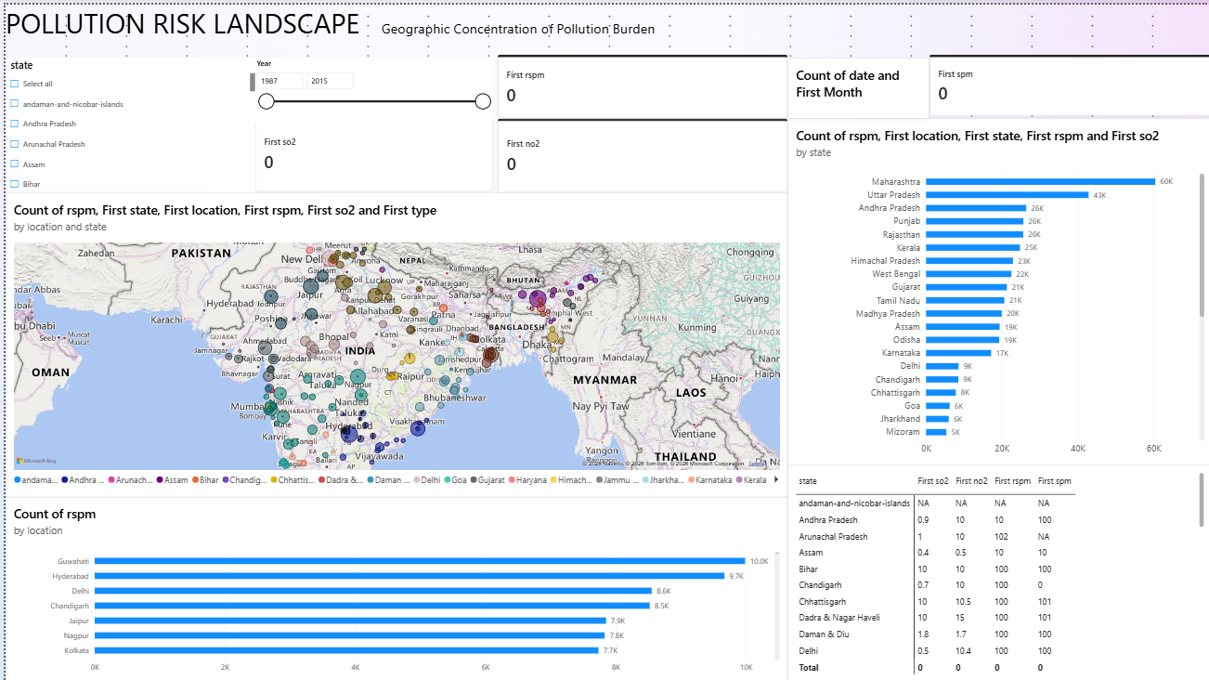
02 • Pollution Risk Landscape
Hotspot detection: move from national picture to geographic concentration
HOW THE STORY MOVES FORWARD
The map shifts the question from “what?” to “where?”.
State-level ranking highlights where observation burden is concentrated.
Location-level ranking provides the bridge to contextual analysis.
NEXT QUESTION
Once hotspots are identified, Dashboard 3 asks what context is associated with higher pollution.
HOTSPOT DETECTION
Notes:
Presenter cue: “The hotspot dashboard narrows the problem spatially. The key output is a shortlist of locations and states that deserve deeper contextual analysis.”

Slide 6
03 • Industrial & Urban Risk Profile
Context: explain why pollution patterns differ across area type, geography and season
CORE VISUAL LOGIC
WHAT THE DASHBOARD CONTRIBUTES
AREA TYPE
Industrial • Residential • Sensitive
Area-type comparison answers “what context is associated with higher pollution?”.
↓
State × type heatmap identifies combinations that stand out.
STATE × TYPE
Where combinations stand out
↓
Seasonal profile exposes recurring contextual patterns.
SEASON
Winter • Summer • Monsoon • Post-Monsoon
Decomposition Tree provides interactive drill-down rather than another simple ranking.
↓
DRILL-DOWN
State → Type → Season → Location → Year
PRESENTATION LINE
“We are not claiming causation; we are identifying the contexts associated with higher pollution so later actions can be targeted responsibly.”
RISK CONTEXT
Notes:
Presenter cue: “Dashboard 3 is the explain stage. We compare contexts and seasons and use the decomposition tree to drill from state to location and year. We deliberately avoid causal claims.”

Slide 7
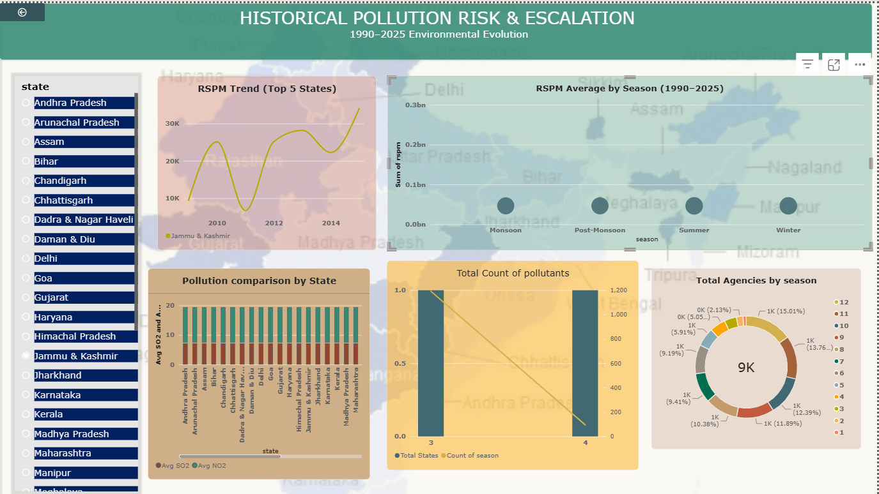
04 • Historical Pollution Risk & Escalation
Trajectory: use long-term patterns to distinguish persistence from short-term variation
WHAT THIS DASHBOARD IS MEANT TO ANSWER
How has the selected long-coverage pollutant changed over time?
Which states show stronger or more persistent trajectories?
Which seasons recur as high-intensity combinations?
VALIDATION NOTE
The current visual is a milestone draft. Historical trend measures and axes should be validated to ensure averages—not summed concentrations—drive the final story.
THREAT TRAJECTORY
Notes:
Presenter cue: “Dashboard 4 is where the time dimension becomes central. For the final version, the trend and state comparisons must use average concentration and the long-coverage pollutants.”

Slide 8
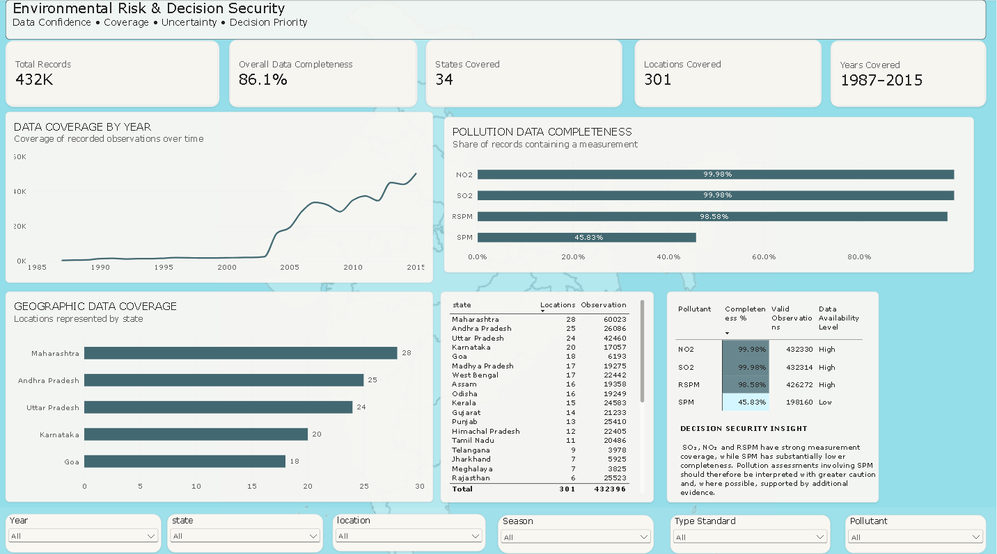
05 • Environmental Risk & Decision Security
Confidence: make data coverage and uncertainty visible before recommending action
CURRENT EVIDENCE SIGNAL
Overall data completeness: 86.1%.
NO₂ 99.98%, SO₂ 99.98%, RSPM 98.58% completeness.
SPM 45.83% completeness → materially weaker evidence base.
DECISION SECURITY INSIGHT
High pollution with weaker data availability should trigger validation and caution—not a claim of physical-security threat.
EVIDENCE CONFIDENCE
Notes:
Presenter cue: “This dashboard changes the question. Before action, we ask how strong the evidence is. SPM is the clearest example of why confidence has to be visible.”

Slide 9
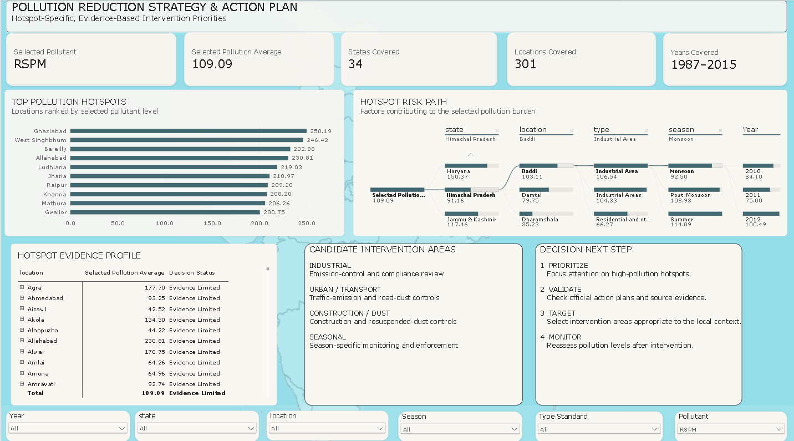
06 • Pollution Reduction Strategy & Action Plan
Action: convert hotspots, context and evidence quality into candidate interventions
ACTION FRAMEWORK
1
PRIORITIZE
Focus attention on high-pollution hotspots.
2
VALIDATE
Check official action plans and source evidence.
3
TARGET
Select interventions appropriate to local context.
4
MONITOR
Reassess pollution levels after intervention.
GOVERNANCE RULE
Ambient pollution data identifies candidate intervention areas; hotspot-specific actions should be grounded in official local action plans or source-apportionment evidence.
DECISION & ACTION
Notes:
Presenter cue: “The final page does not pretend the dataset proves causality. It provides a disciplined route from hotspot to validation to targeted intervention and monitoring.”

Slide 10
Milestone position and next phase
What is complete, what needs validation, and how the final story will be closed
CURRENT MILESTONE
FINALISATION PRIORITIES
Six-dashboard narrative established
Validate Dashboard 4 historical measures / axes
Core Power BI structure built through Dashboard 6
Ensure Dashboard 2–4 outputs feed Dashboard 6 consistently
Pollutant selector and core measures established
Use official CPCB / CAQM / state or city evidence for named hotspots
Area-type standardization and season ordering addressed
Replace any placeholder action logic with hotspot-specific evidence
Dashboard 5 evidence-confidence layer built
Dashboard 6 action framework drafted
Final filter / tooltip / interaction QA and presentation rehearsal
FINAL STORY
What → Where → Context → Change → Confidence → Action
MILESTONE READY FOR TEAM VALIDATION
Notes:
Close with the message that the project is now coherent end-to-end. Remaining work is validation, external evidence, and final QA rather than a redesign of the narrative.

