Slide 1
MiniProjectIII_Story_GlobalID
File created on: 17-Oct-22 1:30:08 AM

Slide 2
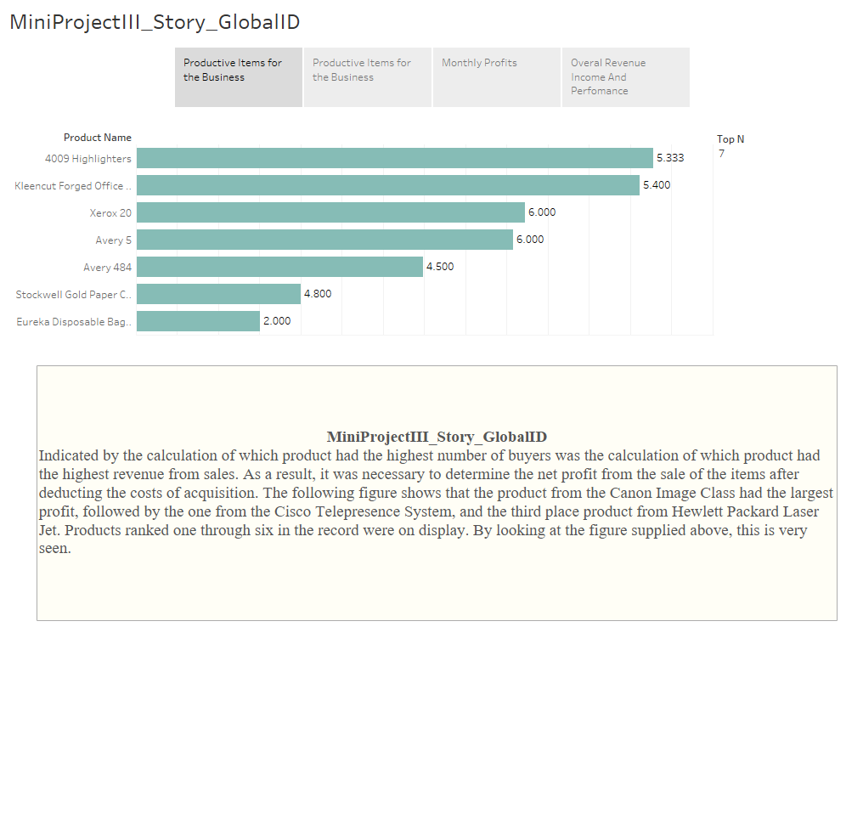

Slide 3
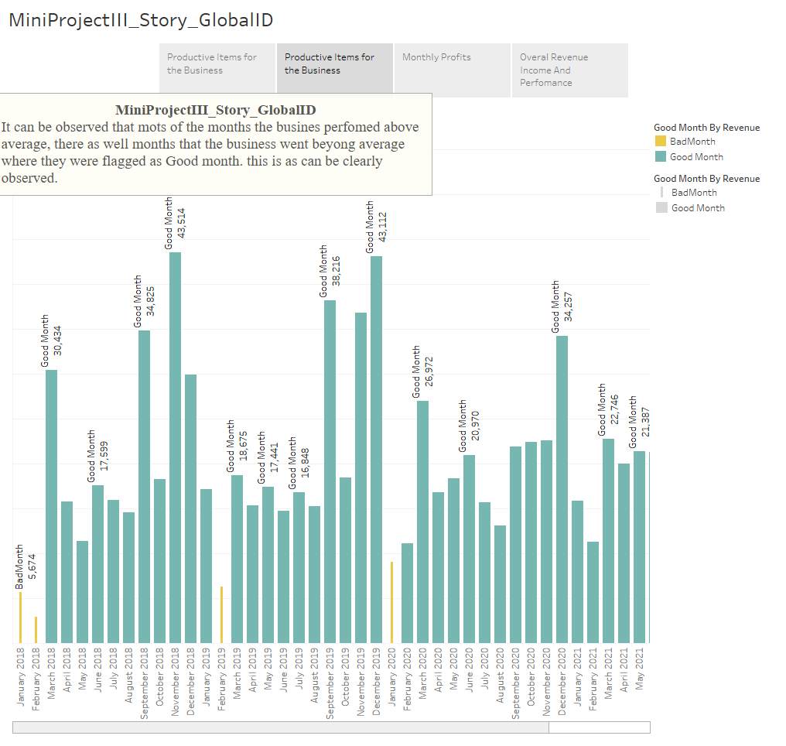

Slide 4
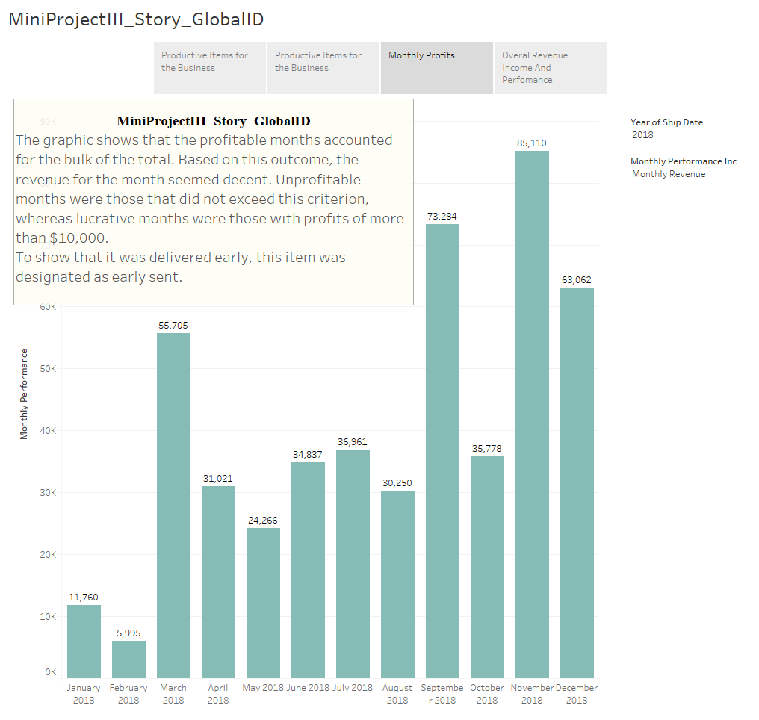

Slide 5
