Slide 1
Credit Score Classification:
Discovering Valuable
Customers
Presented By: Rakesh Hansrajani
Date: 17/08/2023
Github link: https://github.com/RakeshHansrajani/Credit_Score_Classification

Slide 2
Content
Problem Statement
Data Understanding
Data Preprocessing
Exploratory Data Analysis (EDA)
Feature Engineering
Model Preprocessing
Model Development
Model Comparison
Results and Insights

Slide 3
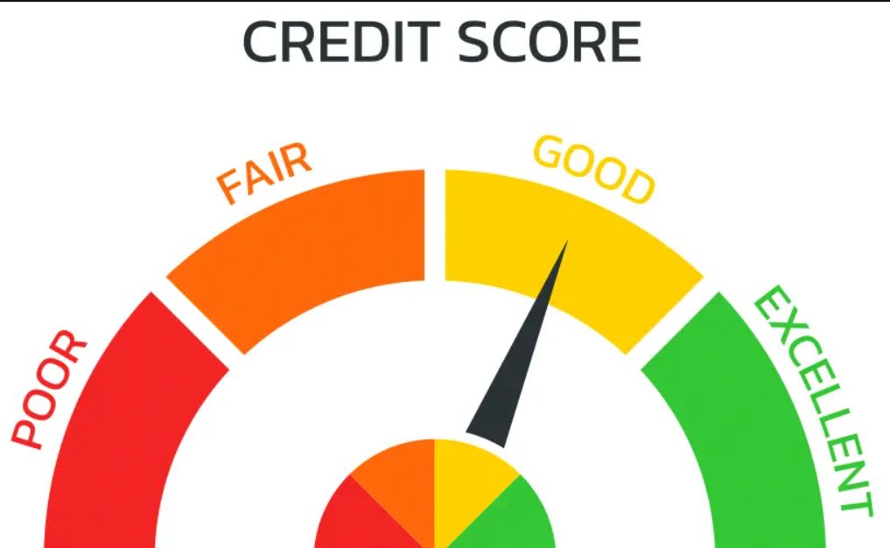
Problem Statement
This project seeks to develop an accurate credit score classification model using machine learning techniques. The challenge involves preprocessing diverse financial data, engineering meaningful features, and selecting optimal algorithms to predict credit scores class.
The goal is to help financial institutions find responsible customers with a dependable tool for informed lending decisions and risk assessment, promoting responsible lending practices and enhancing financial inclusion.

Slide 4
Data Understanding
ID
Customer_ID
Month
Name
Age
SSN
Occupation
Annual_Income
Monthly_Inhand_Salary
Num_Bank_Accounts
Num_Credit_Card
Interest_Rate
Num_of_Loan
Type_of_Loan
Delay_from_due_date
Num_of_Delayed_Payment
Changed_Credit_Limit
Num_Credit_Inquiries
Credit_Mix
Outstanding_Debt
Credit_Utilization_Ratio
Credit_History_Age
Payment_of_Min_Amount
Total_EMI_per_month
Amount_invested_monthly
Payment_Behaviour
Monthly_Balance
Credit_Score

Slide 5
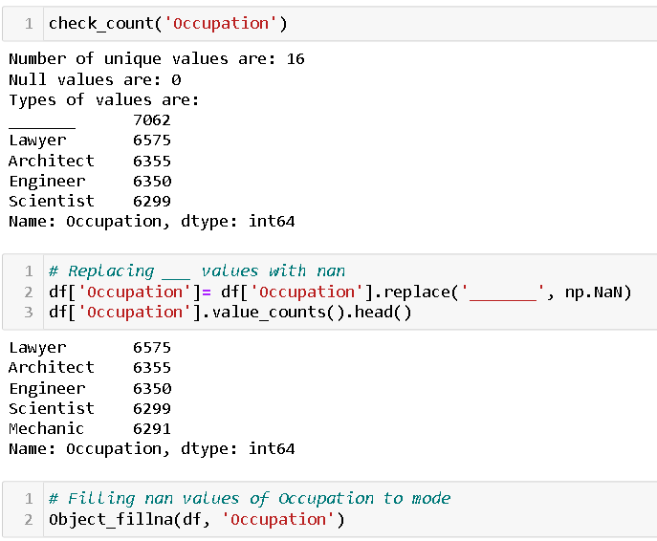
Data Preprocessing
Checking unique values in a column.
Filling null values.
Filling values that have irregular values eg. #F%$D@*&8 based on customer id.
Changing data type to numeric.
Removing null values.
Checking for duplicated values.

Slide 6
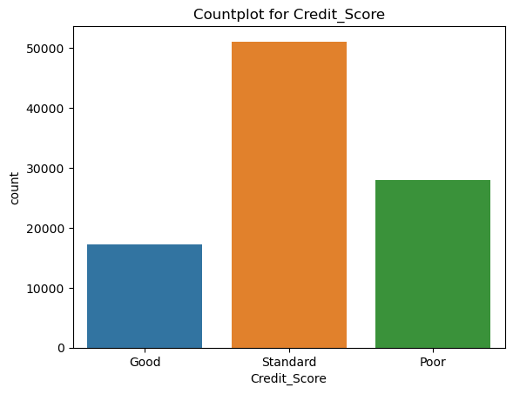
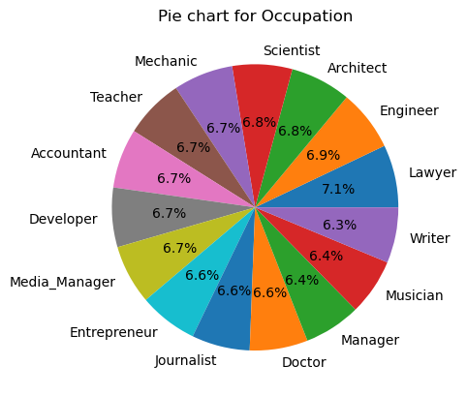
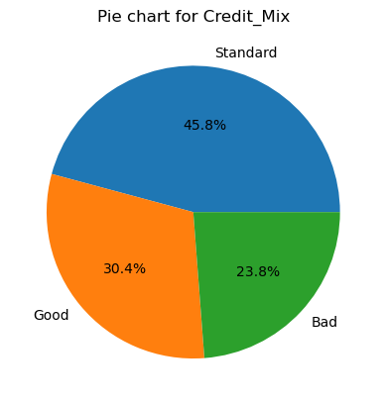
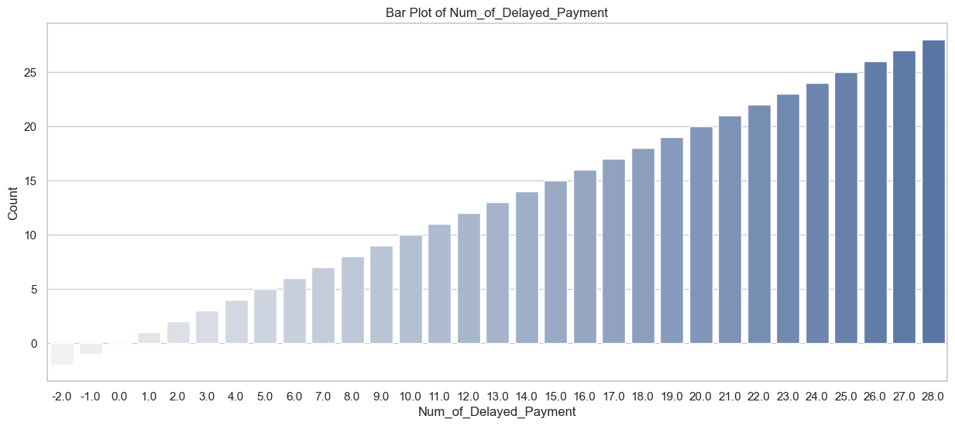
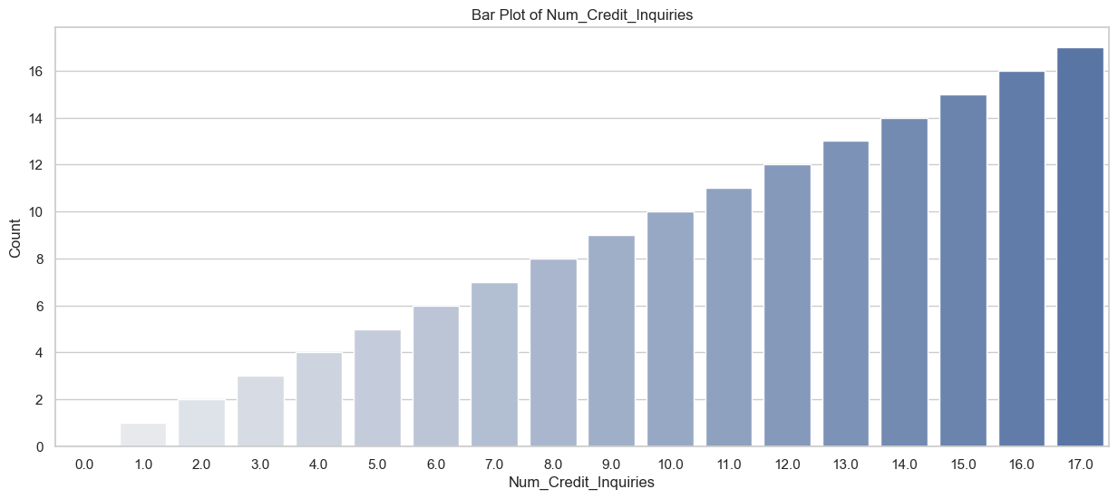
Exploratory Data Analysis
Univariate Analysis

Slide 7
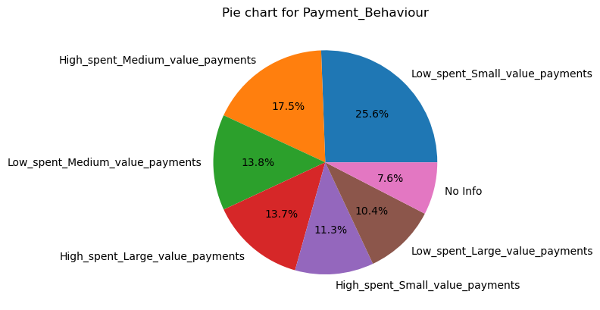
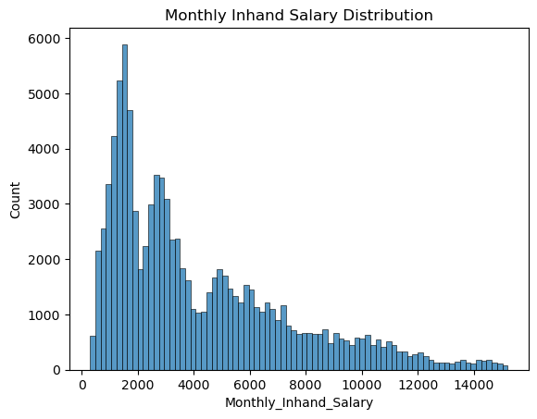
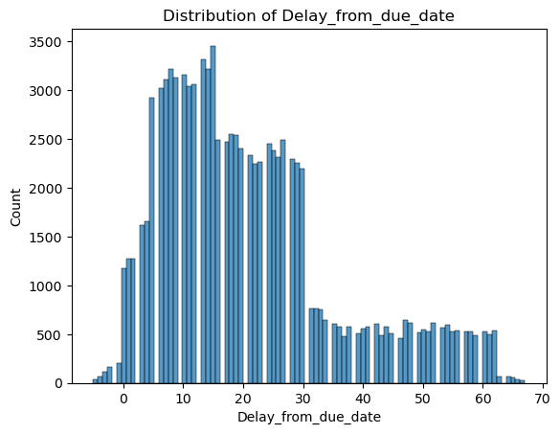
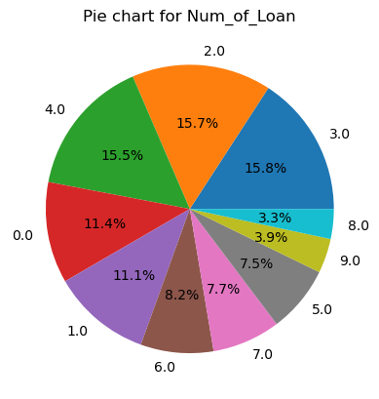
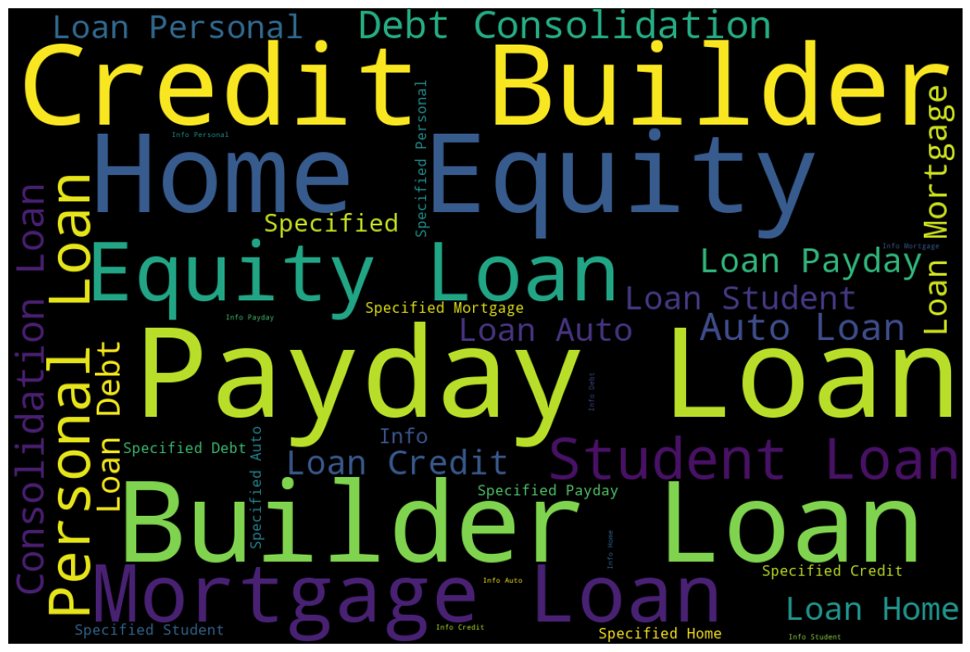
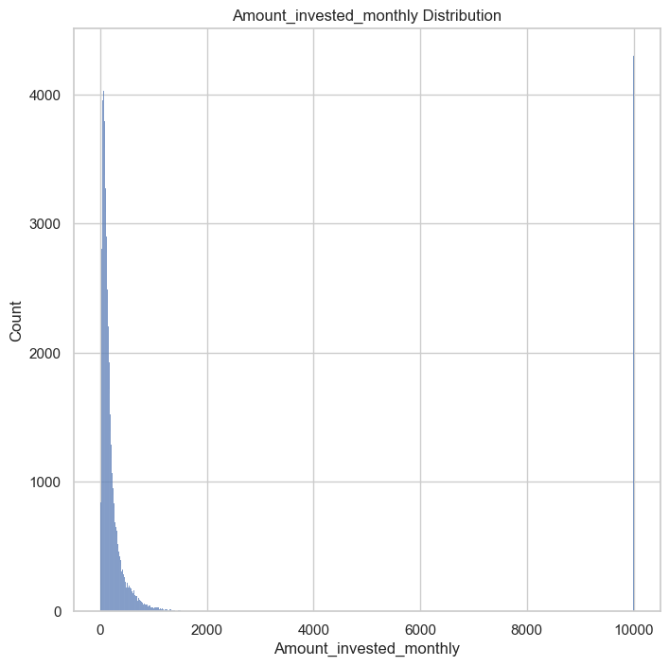

Slide 8
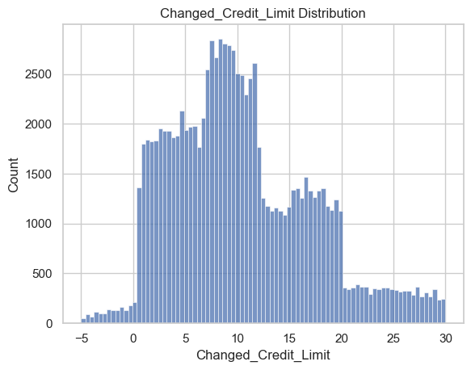
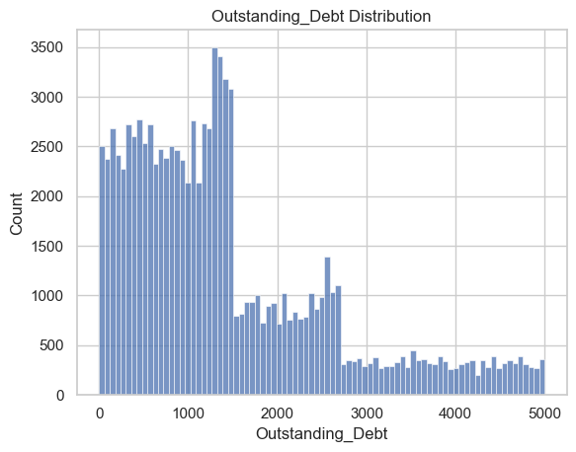
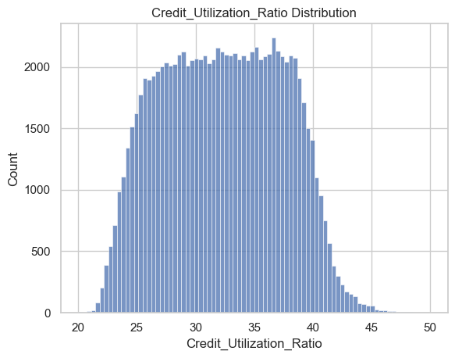
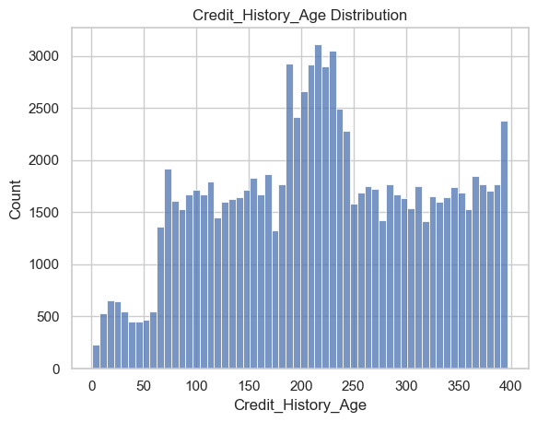
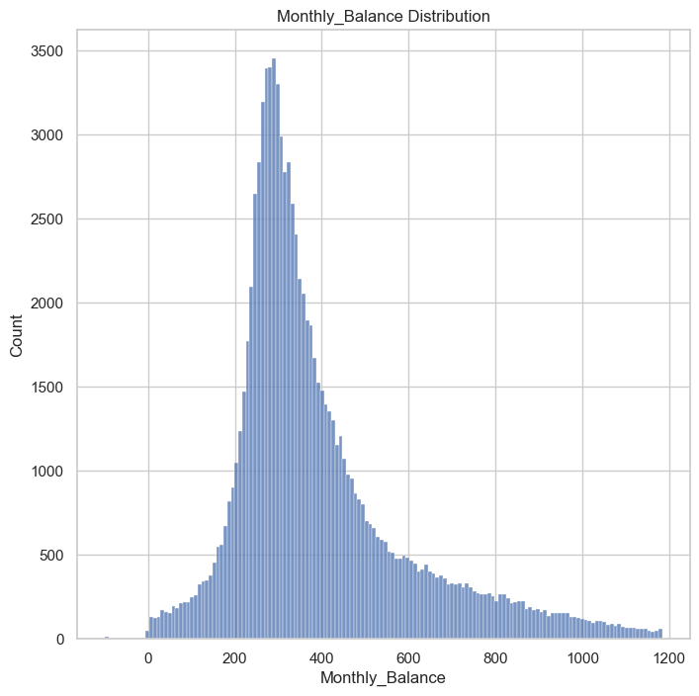

Slide 9
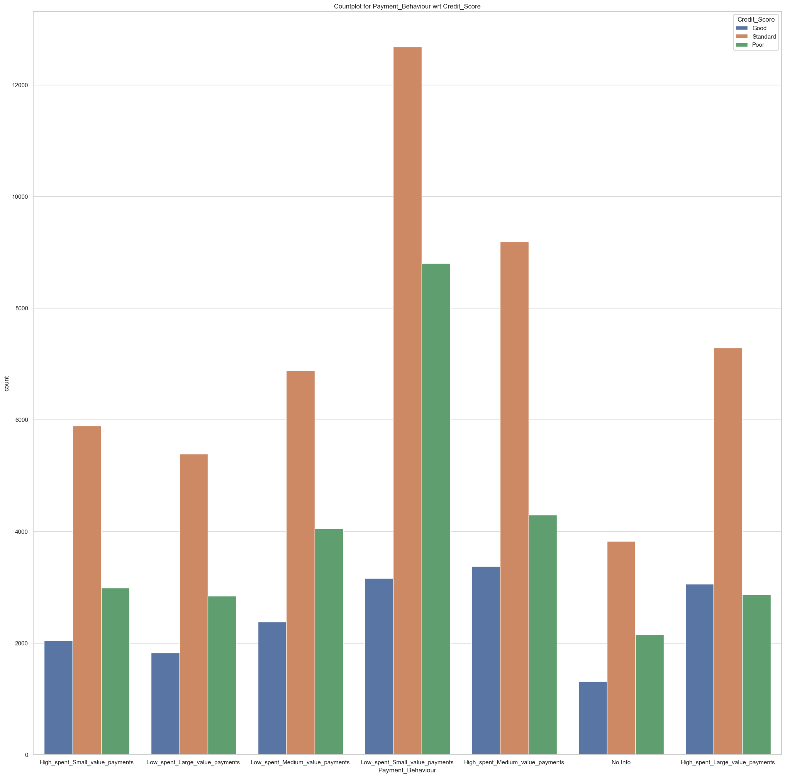
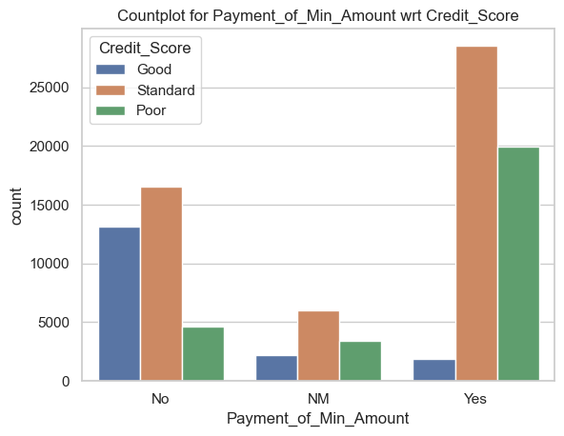
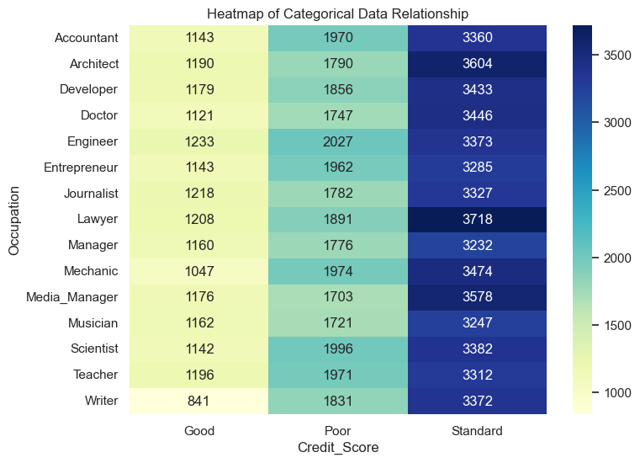
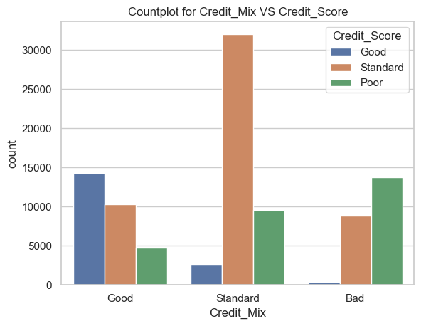
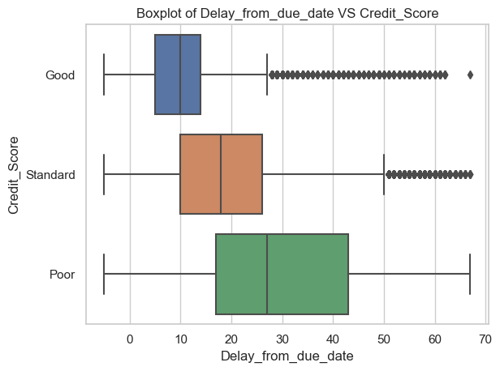
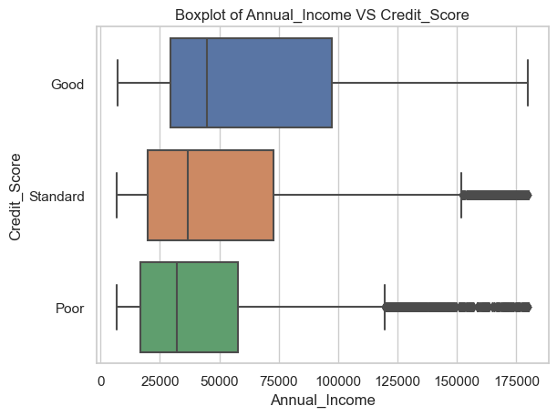
Exploratory Data Analysis
Bivariate Analysis

Slide 10
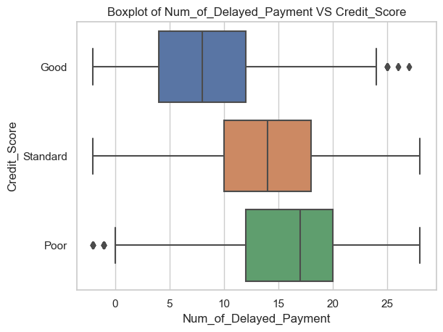
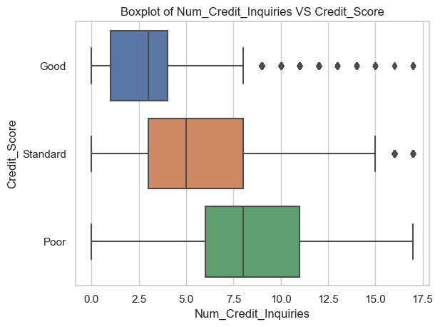
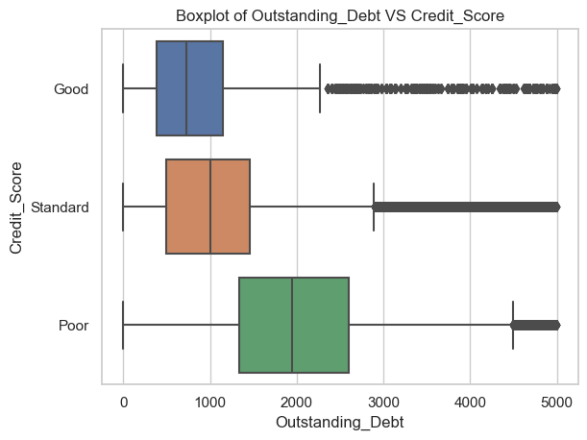
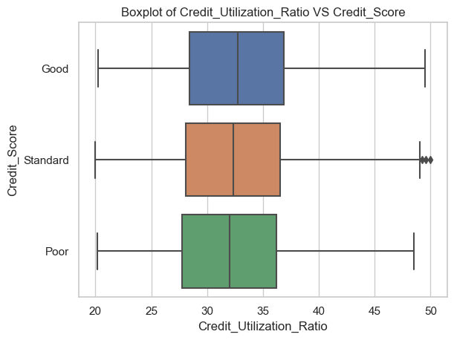
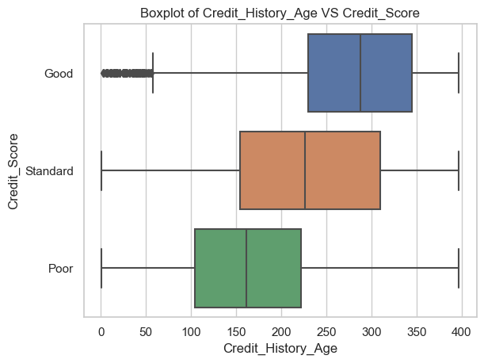
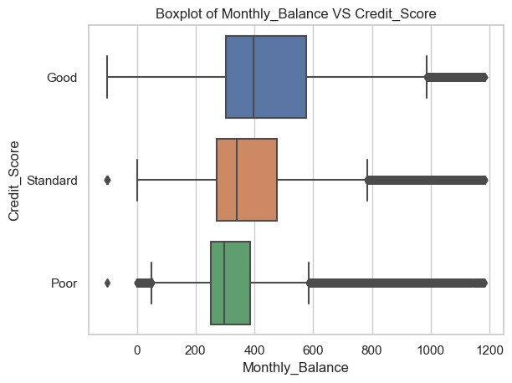

Slide 11
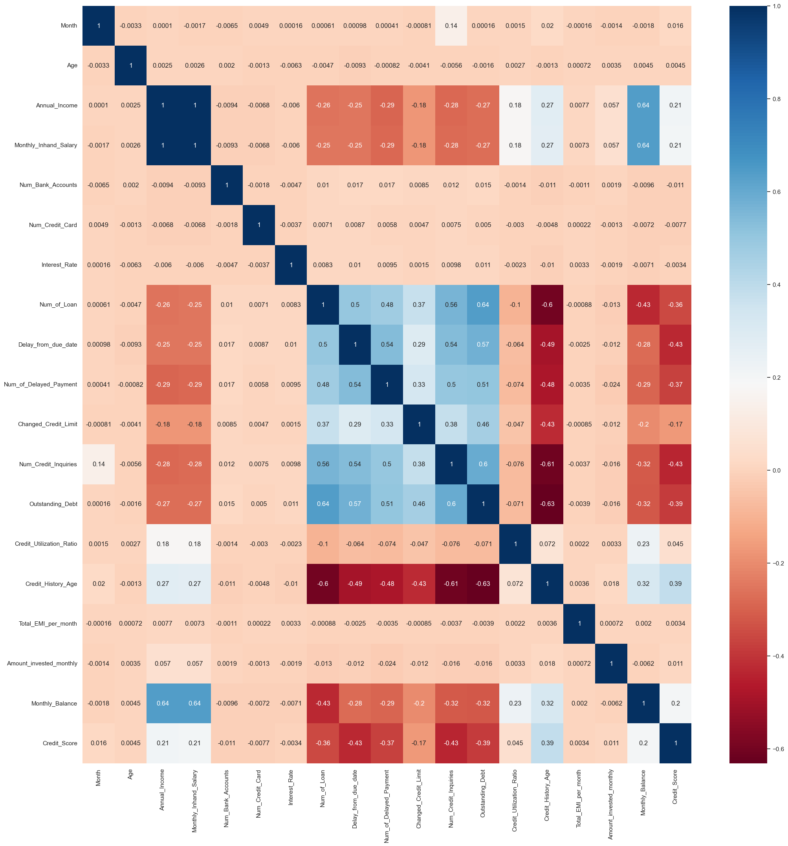
Exploratory Data Analysis
Multivariate Analysis

Slide 12
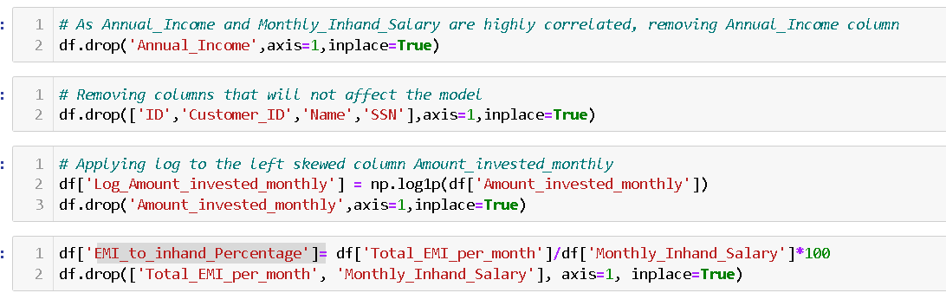
Feature Engineering
Removing Highly correlated columns
Removing columns that will not affect model
Applying log transformation to left skewed column
Creating EMI to inhand salary column to understand debt burden of the customer.
Removing the columns that are included in created one.
Encoding categorical columns.

Slide 13
Model Preprocessing
Creating user defined function:
To fit the model and check important parameters like train, test score, confusion matrix.
Plotting ROC-AUC curve
Updating scorecard to add details like model name, train score, test score, Precision, recall, F1 score
Separating credit score column and assigning to y, dropping from x.
Splitting train & Test data

Slide 14
Model Development
Logistic Regression
Decision Trees (with and without pruning)
Random Forest (with and without pruning)
Bagging Ensemble
Adaboost Ensemble
XG Boost Ensemble
Naive Bayes Classifier
k-Nearest Neighbors (with and without pruning)

Slide 15
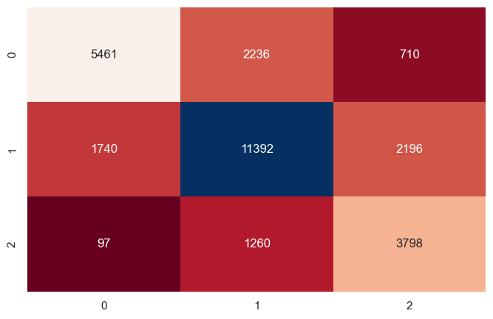
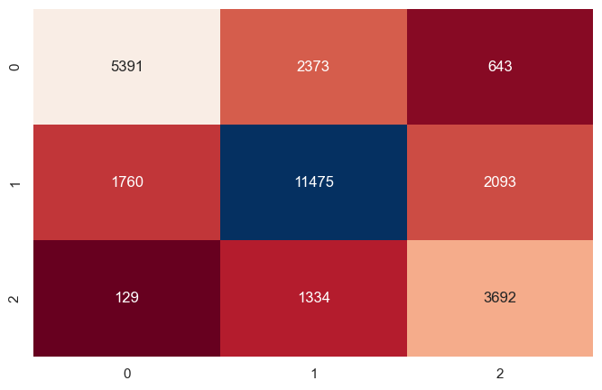
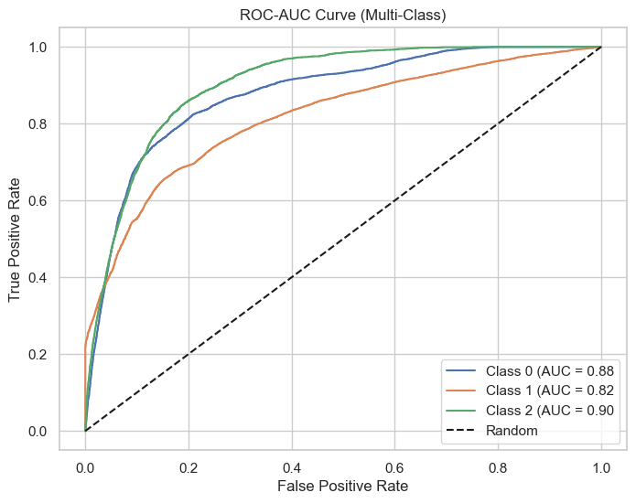
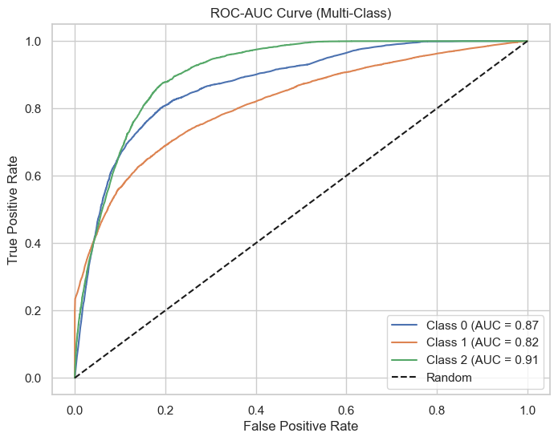
Random Forest (with pruning)
XG Boost Ensemble

Slide 16
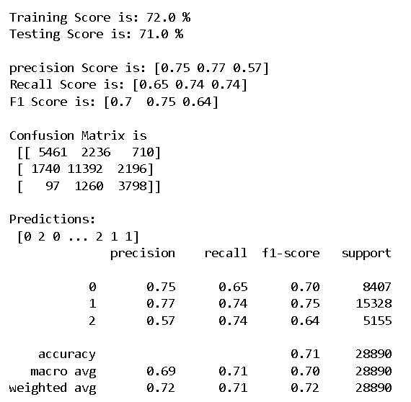

Random Forest (with pruning)
XG Boost Ensemble

Slide 17
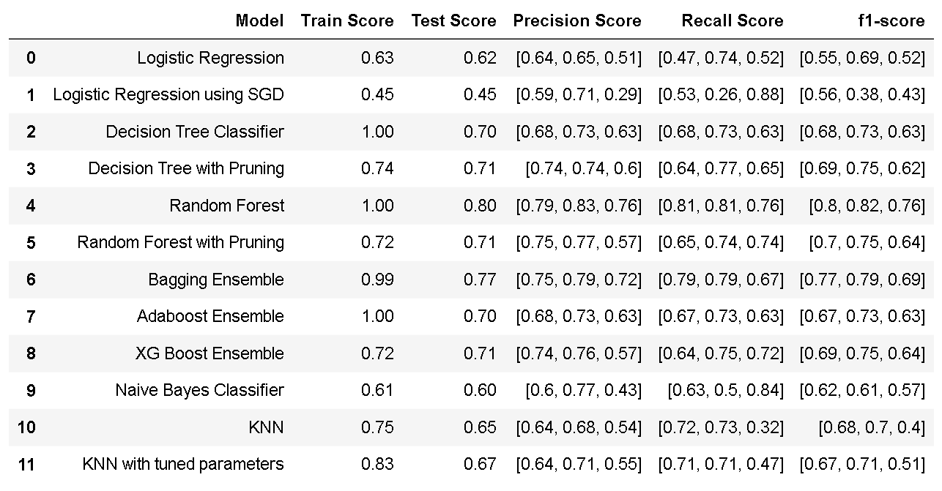
Model Comparison

Slide 18
Thank You!
Let’s go ahead with
questions and discussion.

