Slide 1
Problem Statement:
Predicting job callback rates based on various job and candidate attributes
Presented by: Rakesh Hansrajani
Date: 08/07/2023

Slide 2
Understanding Data:
Column Name | Data type | Values
job_city | object | Chicago, Boston
job_industry | object | other_service, business_and_personal_service, wholesale_and_retail_trade, manufacturing, finance_insurance_real_estate, transportation_communication
job_type | object | Secretary, retail_sales, sales_rep, manager, clerical, supervisor
job_equal_opp_employer | int64 | 0,1
job_req_any | int64 | 0,1
job_req_communication | int64 | 0,1
job_req_education | int64 | 0,1
job_req_min_experience | object | 0.5,1,2,3,4,5,6,7,8,9,10
job_req_computer | float64 | 0,1
job_req_organization | int64 | 0,1
job_req_school | object | none_listed, some_college, college, high_school_grad

Slide 3
Column Name | Data type | Values
race | object | black, white, brown
gender | object | Male, female
years_college | Int64 | 0, 1,2,3,4
college_degree | Int64 | 0,1
honors | Int64 | 0,1
worked_during_school | int64 | 0,1
years_experience | int64 | 1-44
computer_skills | int64 | 0,1
special_skills | int64 | 0,1
volunteer | int64 | 0,1
military | int64 | 0,1
employment_holes | int64 | 0,1
has_email_address | int64 | 0,1
resume_quality | object | High, low
received_callback | int64 | 0,1

Slide 4
Data Preprocessing:
Importing all the required libraries.
Creating dataframe from dataset.
Checking data set information
Dropping ‘firstname' and ‘job_ad_id' column as it will not affect the model performance.
Dropping column 'job_ownership' and 'job_fed_contractor' as it is not much important and have more than 35% missing values.
Removing duplicated columns.
Removing rows with null Values.
‘job_req_min_experience’ column has ‘some’ value, replacing it with 0,1,2

Slide 5
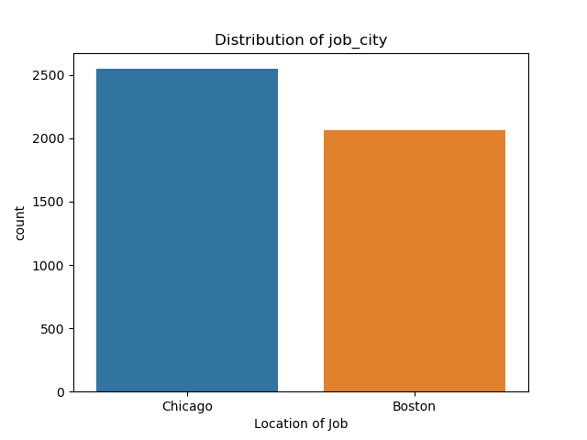
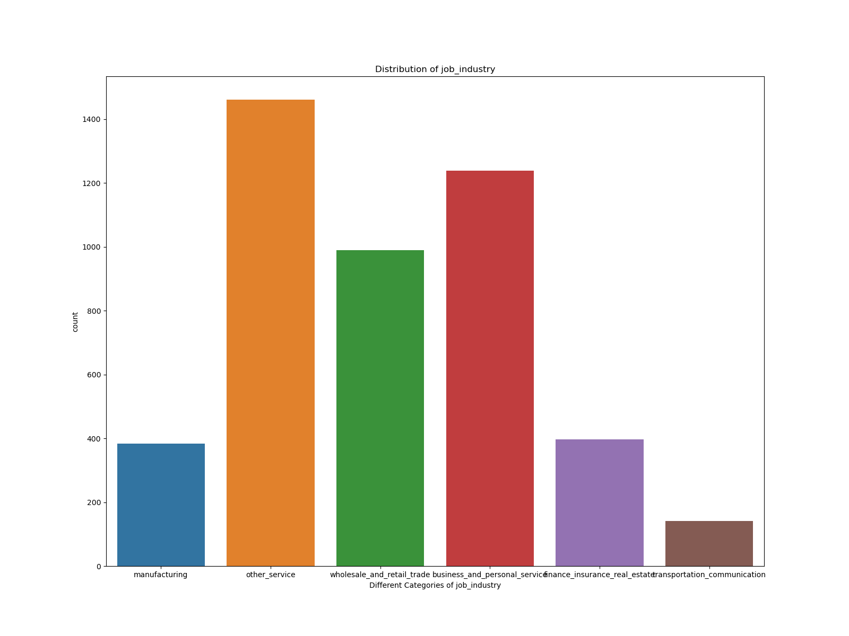
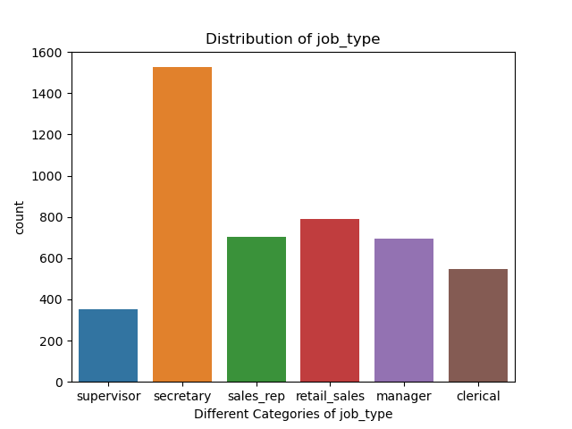
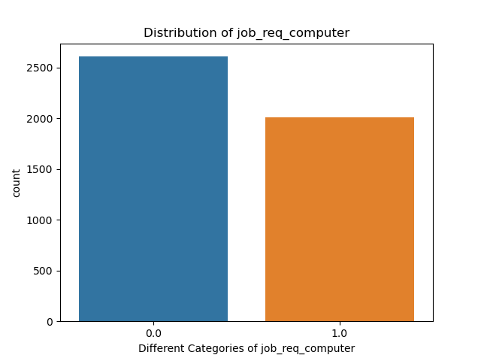
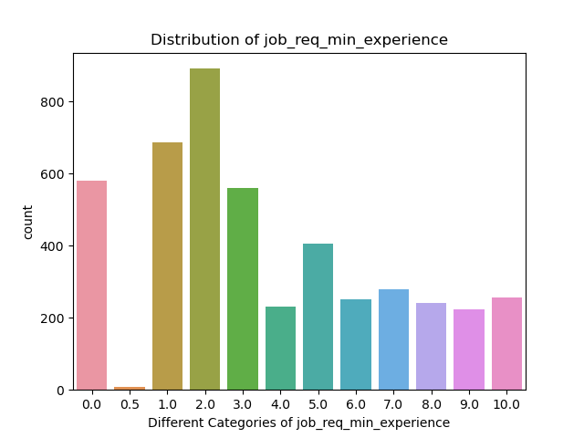
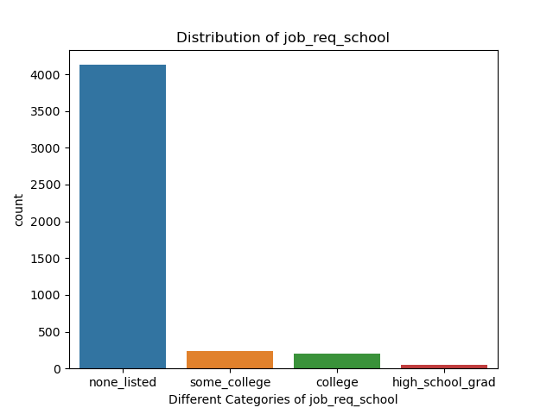
Exploratory Data Analysis for Jobs:

Slide 6
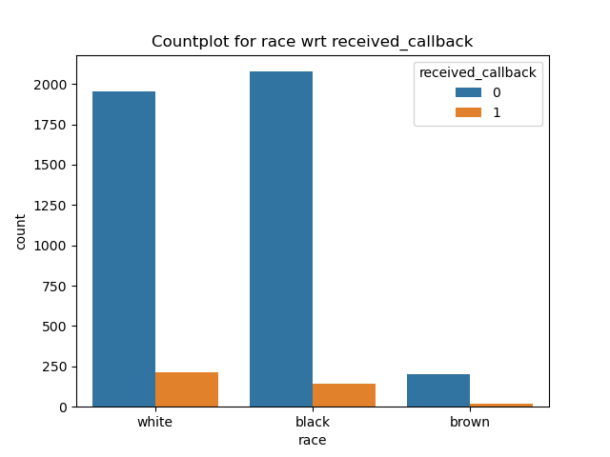
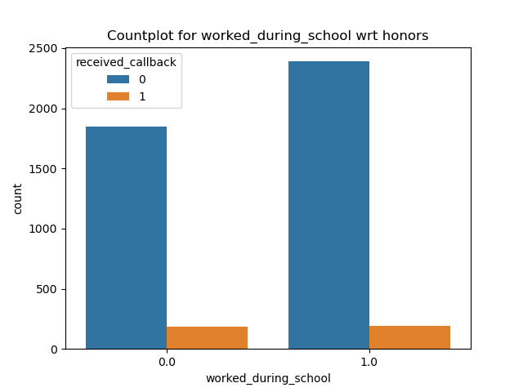
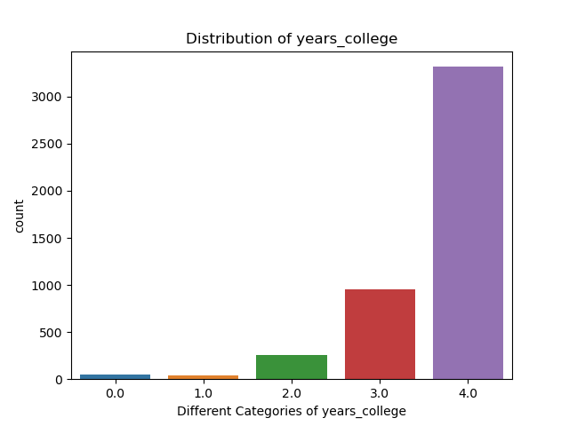
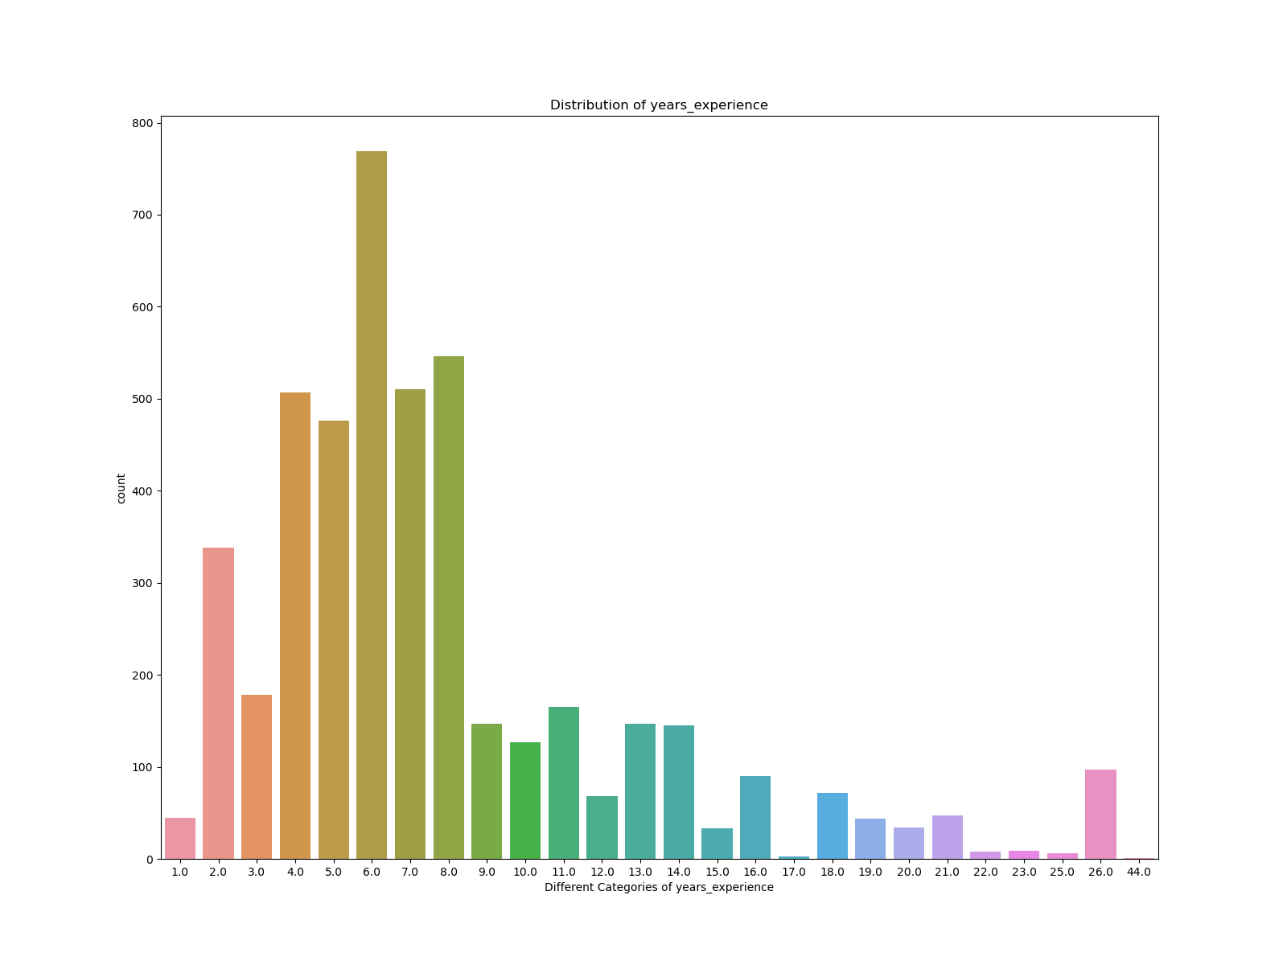
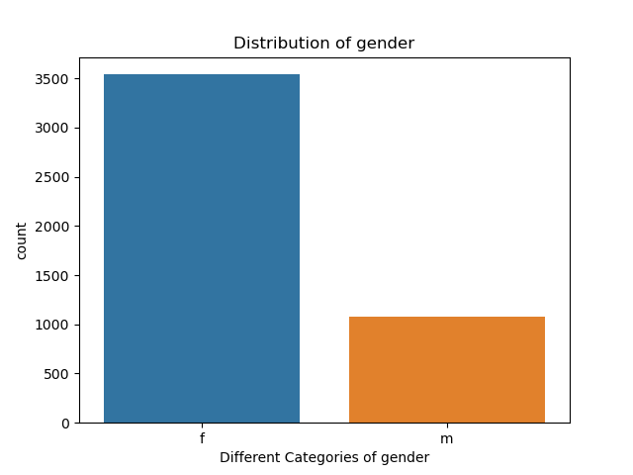
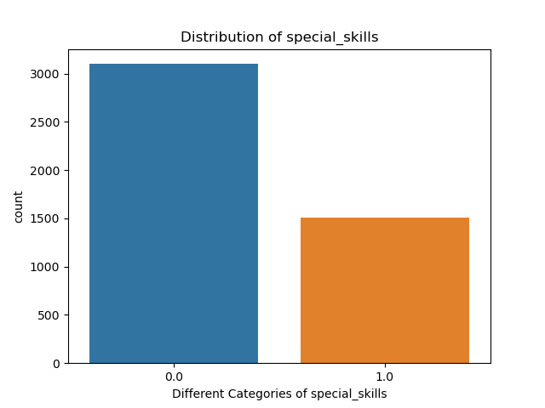
Exploratory Data Analysis for Applicant:

Slide 7
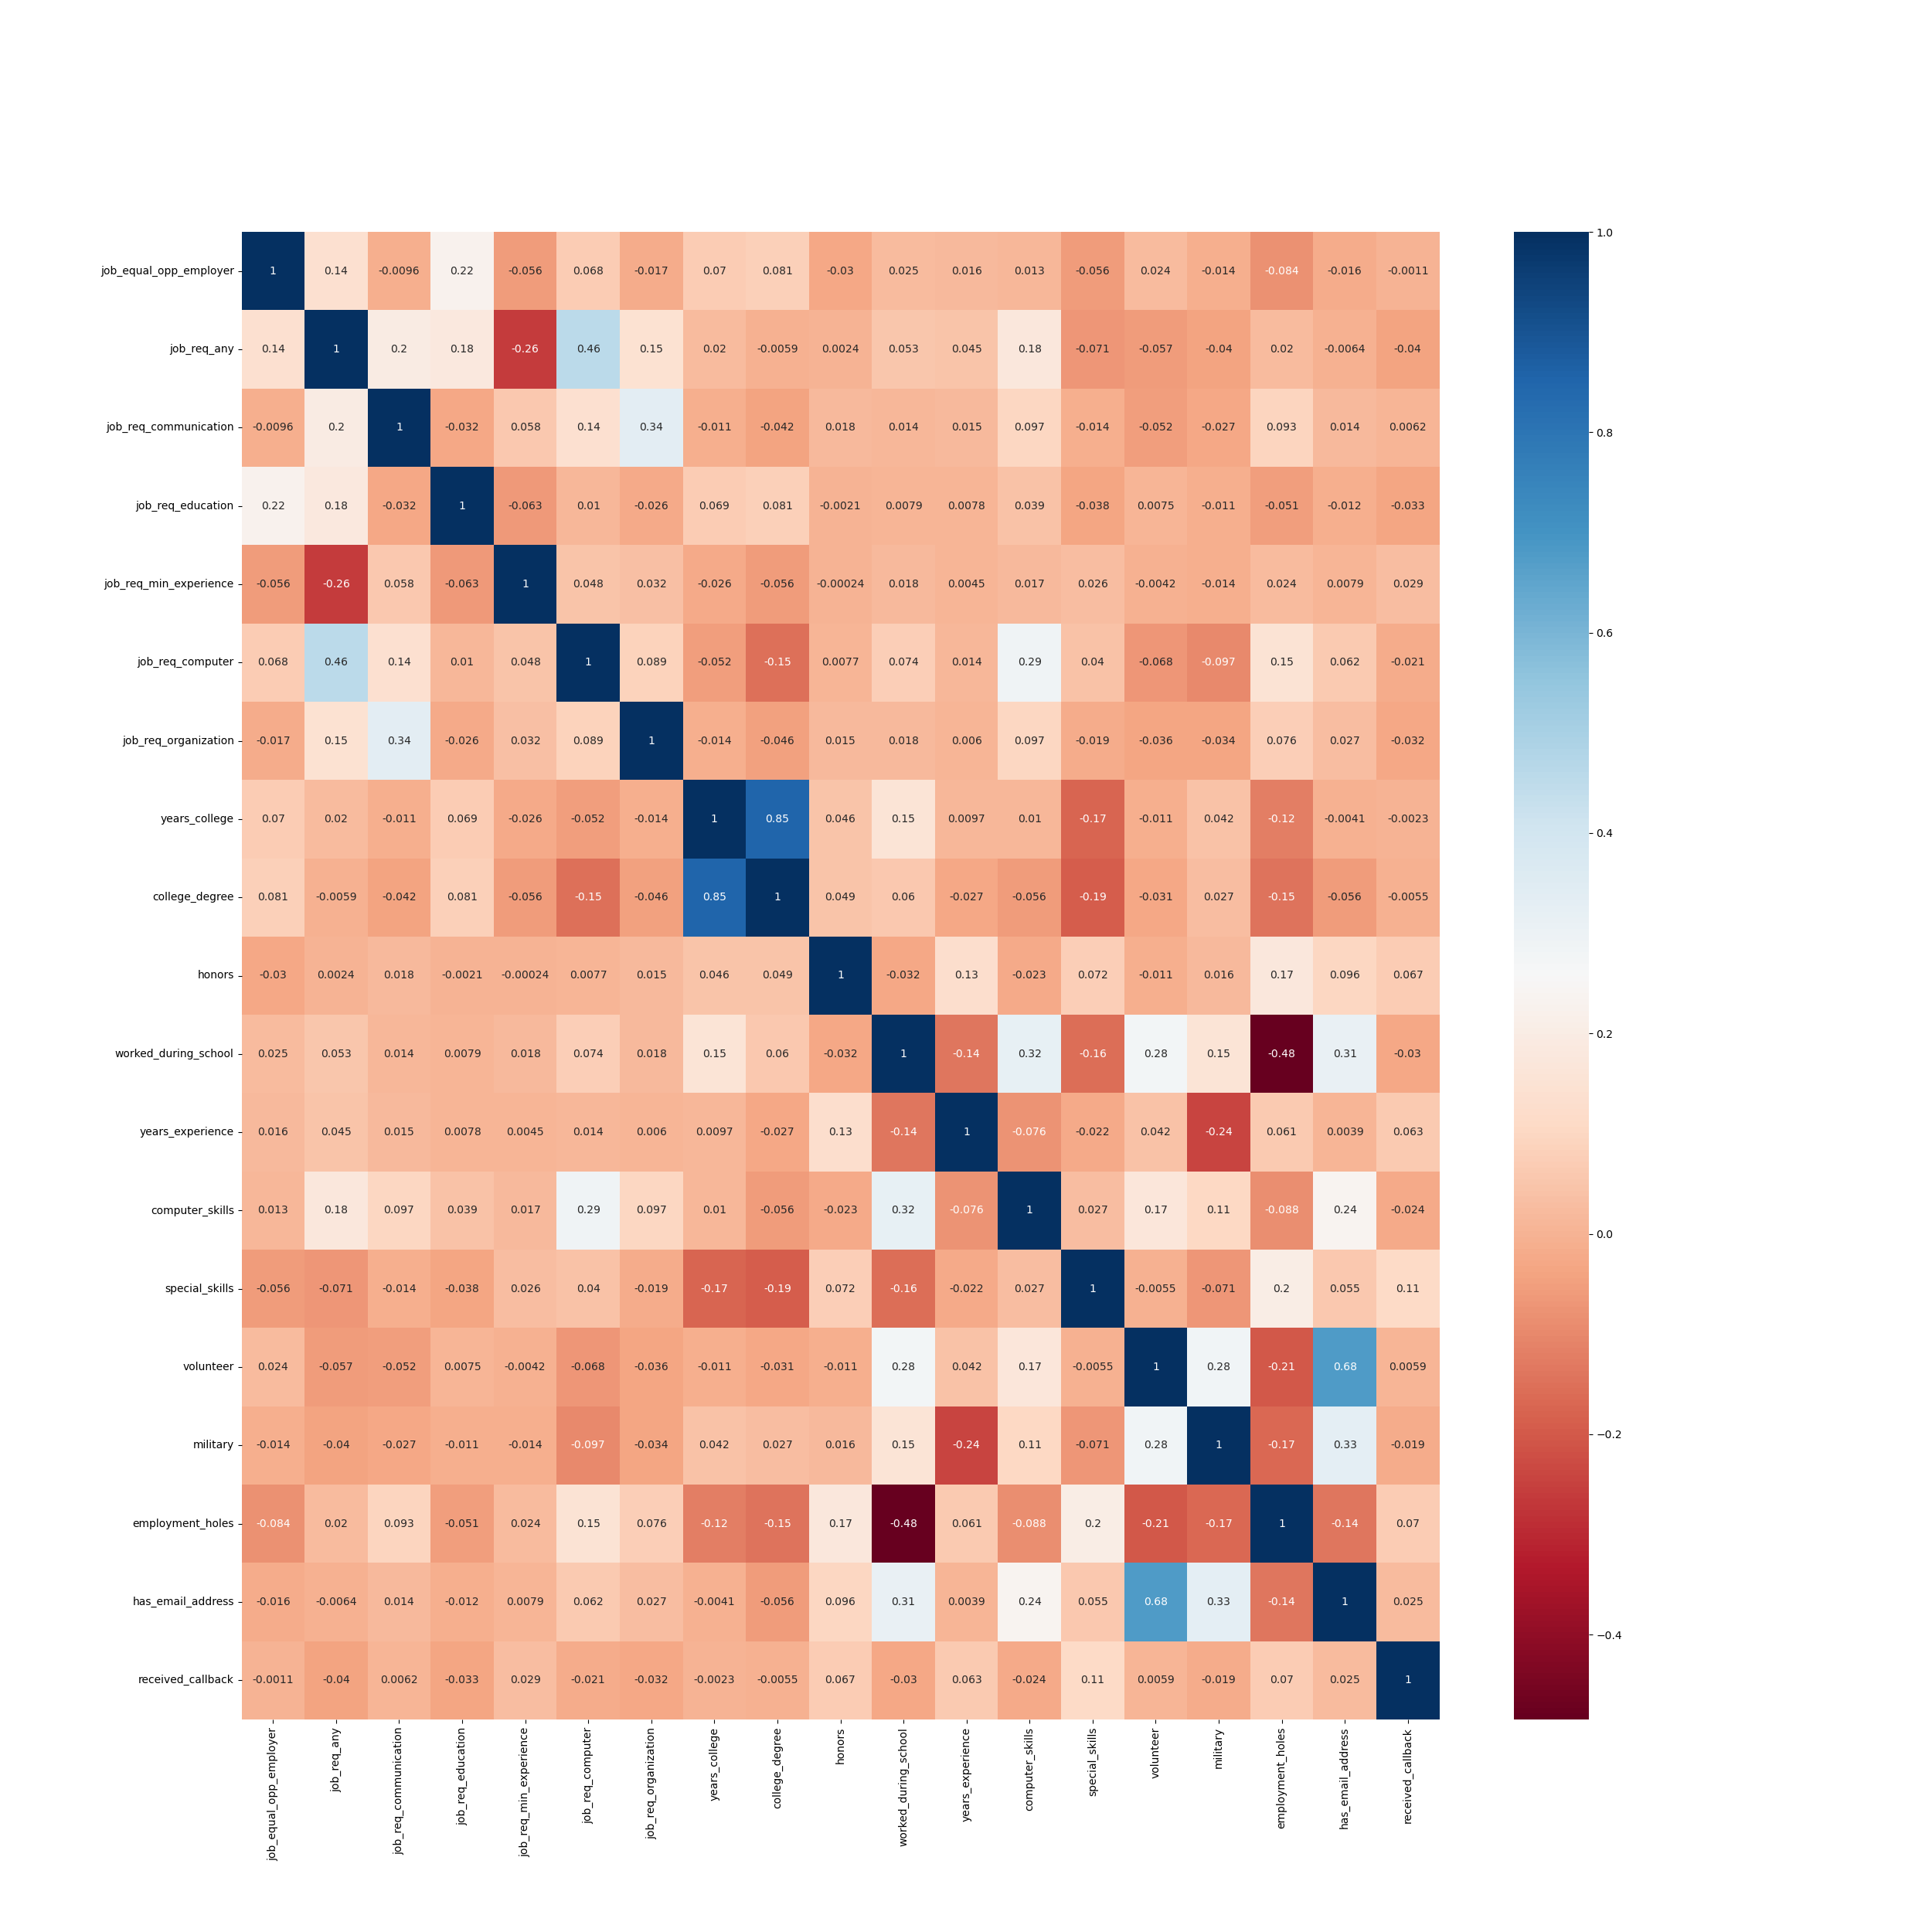
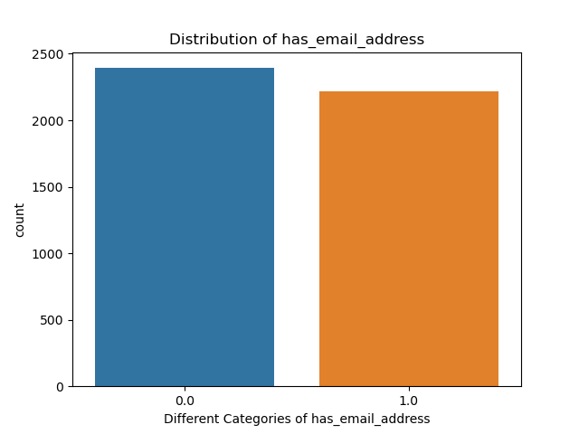

Slide 8
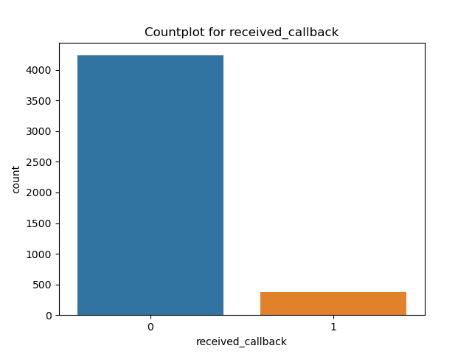
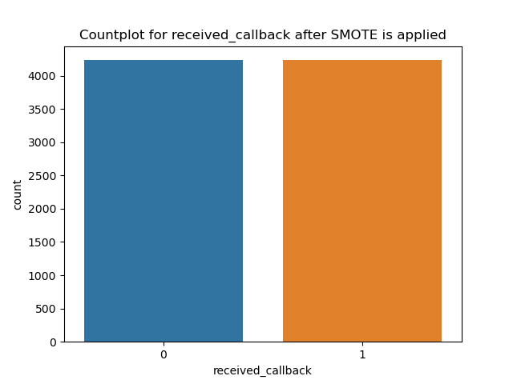
Model Preprocessing:
Applying one hot encoding to categorical columns.
Applying SMOTE as the dependent variable is imbalanced.
Creating Function to evalute the model performance
Creating Function to plot roc curve
Creating Function to compare performance of all algorithms
Selecting dependent and independent variable.
Splitting train test data
SMOTE

Slide 9
Applying multiple algorithms:
Logistic Regression
Logistic Regression (using SGD)
Decision Tree
Decision Tree with Pruning
Random Forest
Random Forest with Pruning
Bagging Ensemble
AdaBoost Ensemble
XGBoost Ensemble
Naive Bayes
K-Nearest Neighbors (KNN)
Support Vector Machines (SVM)
SVM with Hyperparametric tuning

Slide 10
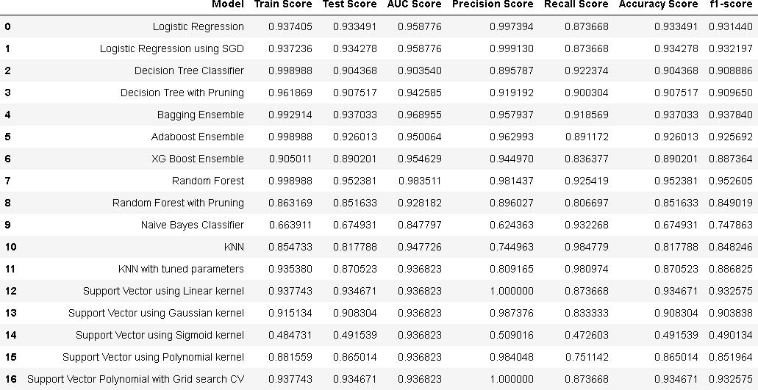
Model Comparison:

Slide 11
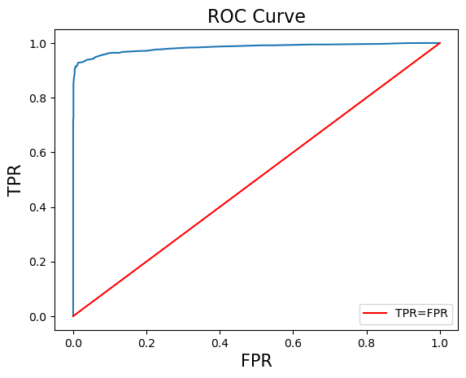
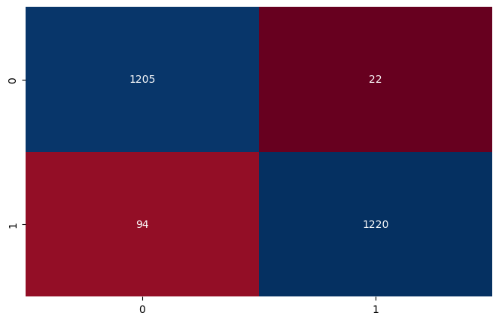
Results:
Random Forest Classifier is best performing model for this data.
Important evaluation parameters are:
Train Score: 0.998988
Test Score: 0.952381
AUC Score: 0.983511
Precision Score: 0.981437
Recall Score: 0.925419
Accuracy Score: 0.952381
f1-score: 0.952605

Slide 12
Scope of Improvement:
The dataset imbalanced and had 92% values in not receiving callbacks. We can ask client to provide better data so that we can improve the model performance.

Slide 13
Thank you for listening patiently and being attentive throughout the presentation.
Let’s answer your questions!

