Slide 1
DisruptionIQ
OVERCLOCK'26
24 HOURS HACKATHON | AN AI-ASSISTED HACKATHON
From delivery delays to recovery plans
PS [No.] · Logistics and Supply Chain
Team [TEAM NAME]
[NAMES]
Notes:
Hi, we are Team [TEAM NAME]. DisruptionIQ turns a delivery delay into a recovery plan that a person approves. In five minutes: the problem, how it works, and why you can trust it.

Slide 2
Spotting a late shipment is easy. Knowing what to do about it is not.
Problem Statement
Order
?
Which orders are affected?
Order
?
Delayed shipment
How serious is it?
Order
?
Order
?
What should we do?
Order
?
Notes:
Every logistics team can see a late shipment on a tracking screen. The hard part comes next: which customer orders it hits, how serious that is, and what to do. Today that is often worked out by hand.

Slide 3
One alert in, one approved recovery plan out.
Solution Overview
DisruptionIQ finds the damage, ranks the orders and proposes safe fixes for a human to approve.
Rules
decide
AI
advises
Humans
approve
Stock, deadlines, permissions
Summaries, explanations
Final say
Notes:
DisruptionIQ takes one alert and returns one recovery plan for a person to approve. The key idea is the split: rules decide what is possible, AI explains it in plain language, and a human has the final say.

Slide 4
Eight steps from delay to audit trail.
Technical Approach
1
2
3
4
5
6
7
8
Event arrives
Detect
Assess impact
Rank risk
Offer options
Approve
Simulate execution
Record
Rules decide
AI advises
Human approves
Notes:
An event arrives and rules detect the disruption, assess the impact and rank the risk. Rules build the recovery options and AI explains them; a human approves, we simulate execution, and every step is recorded.

Slide 5
Two disruptions, two different recoveries.
Technical Approach · Live demo
Disruption | Impact | Recovery | Approver
Sea freight delay (Chennai Port) | Shipment 5 days late; 3 orders (₹8.9 L) short, one Critical | Move stock from Hyderabad, or expedite the shipment | Supply Chain Manager
Supplier shortfall (Mumbai) | Mumbai stock short; 3 orders (₹12.0 L), one Critical | Move stock from Hyderabad; free split options flagged ⚠ | Supply Chain Manager
Notes:
These are the two disruptions in the live demo. A sea-freight delay at Chennai Port puts three orders worth ₹8.9 lakh at risk; a supplier shortfall in Mumbai hits three more worth ₹12 lakh. Watch the do-no-harm check: for Chennai it skips a stock source that would starve another order, and in Mumbai the free split options are flagged because each would starve the other.

Slide 6
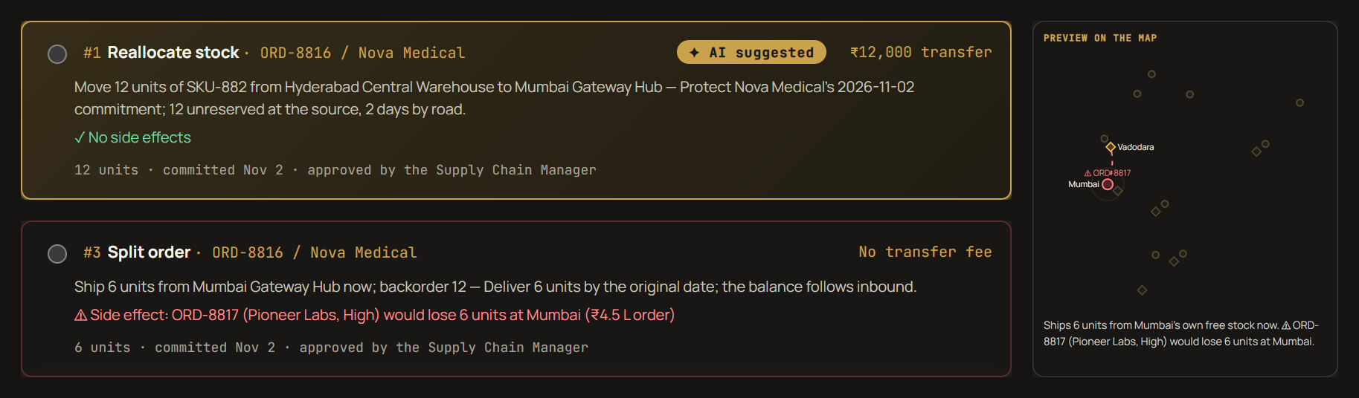
Do-no-harm recovery: no fix starts the next disruption.
Technical Approach · Our novelty
Before anyone approves
Side effects checked
Risky sources skipped
Harmful fixes go last
Fix previewed on a map
Re-checked at approval
Notes:
This is our novelty. Other tools judge a fix only by whether it saves the order in front of them. DisruptionIQ checks what every fix would take from other orders before anyone sees it. Here, the free option of splitting Nova Medical's order would leave Pioneer Labs six units short, so it is flagged in red and ranked last, and the map shows the harm. For the Chennai delay, Chennai was skipped as a stock source for the same reason. The approver sees the check again with today's stock.

Slide 7
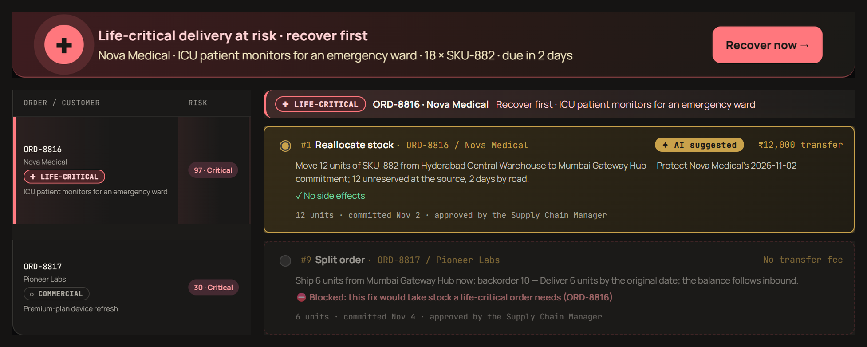
Necessity first: a hospital outranks a premium subscription.
Technical Approach · Risk priority
Need before value
Life-critical first
Then essential needs
Then urgency, contract
Its stock is protected
Alert: Recover now
Notes:
Who should be helped first: a hospital's ICU monitors or a premium subscription? DisruptionIQ ranks recovery by necessity: life-critical healthcare deliveries first, then essential services like food and energy, then operational and commercial orders, and only then urgency, contract priority and value. Here Pioneer Labs has a Critical premium contract, yet scores 30 while Nova Medical's ICU monitors score 97. A red header pops up on every page with Recover now, and any fix that would take stock the hospital needs is blocked outright.

Slide 8
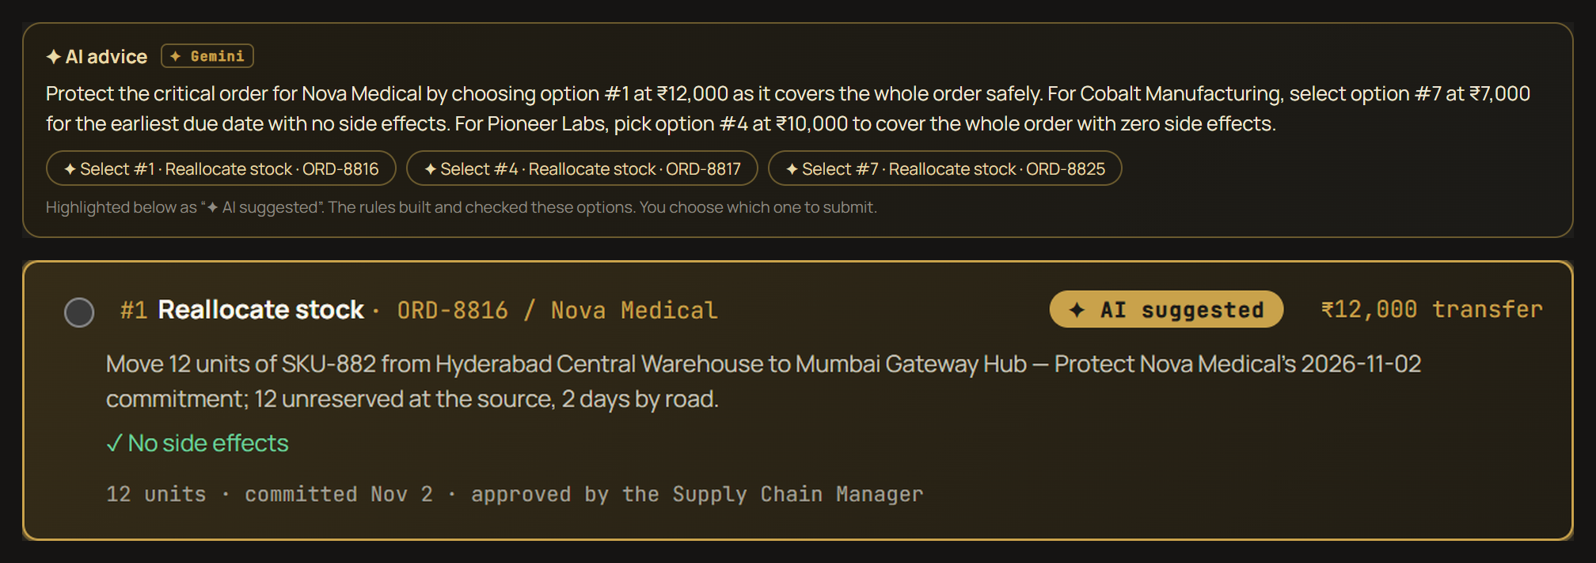
AI picks from options the rules built and checked.
Technical Approach · AI suggestion
Guardrail
Gemini can only recommend option numbers the rules built and checked. Its picks are highlighted as “AI suggested”; a person still chooses.
Notes:
The rules built nine options for the Mumbai disruption and checked each one for side effects. Gemini reads them and recommends one per order; the page highlights its picks as AI suggested, with one-click select buttons. Gemini can only pick option numbers that exist, and if the AI is unavailable the rules' own pick is shown instead. A person still submits, and another person approves.

Slide 9
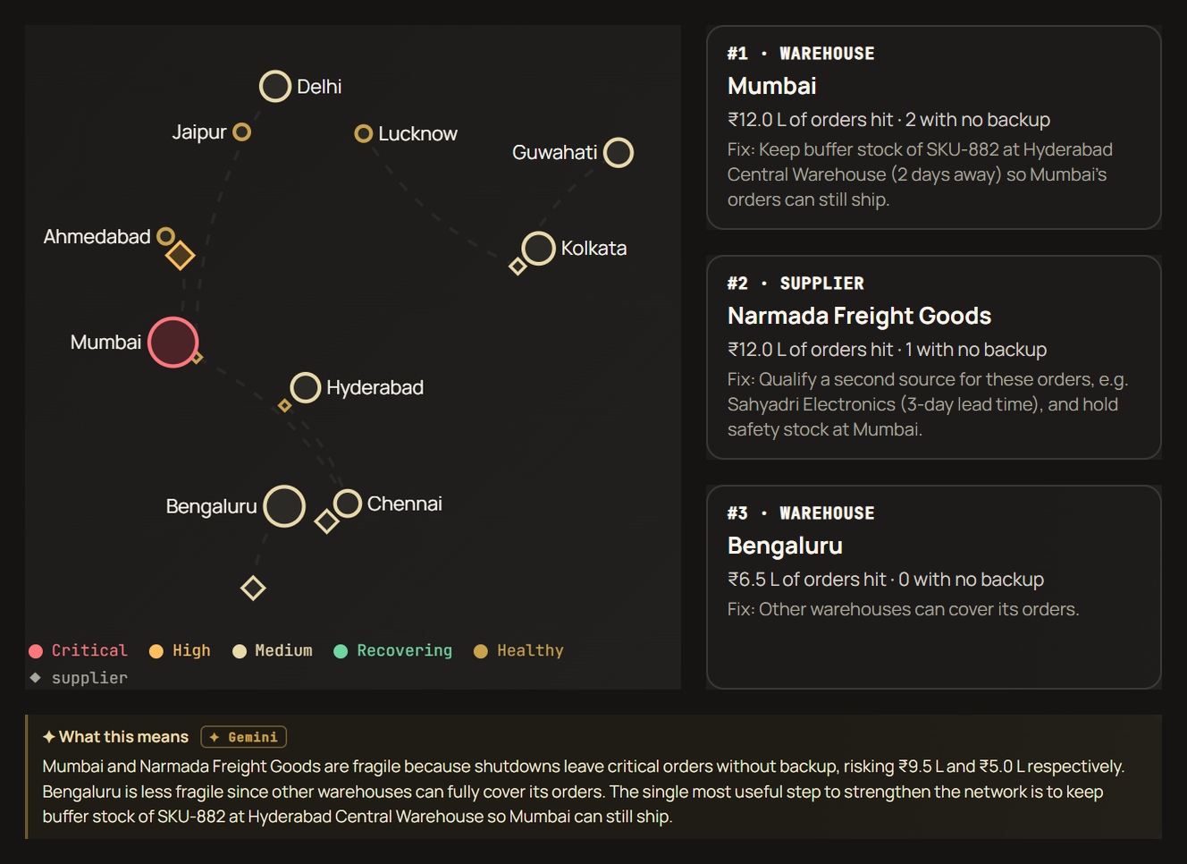
Break the network on purpose, before it breaks for real.
Technical Approach · Stress test
Fail each site for 7 days
₹ and orders hit
Orders with no backup
Top 3 weak spots
A fix for each one
Gemini explains it
Notes:
Most tools tell you what broke. The stress test breaks the network on purpose, in simulation: every warehouse and supplier fails for a week, one at a time, and the rules measure the damage. Mumbai is the weakest point, with ₹12 lakh of orders and two with no backup; the suggested fix is buffer stock of the control unit in Hyderabad. It is chaos engineering applied to a supply chain.

Slide 10
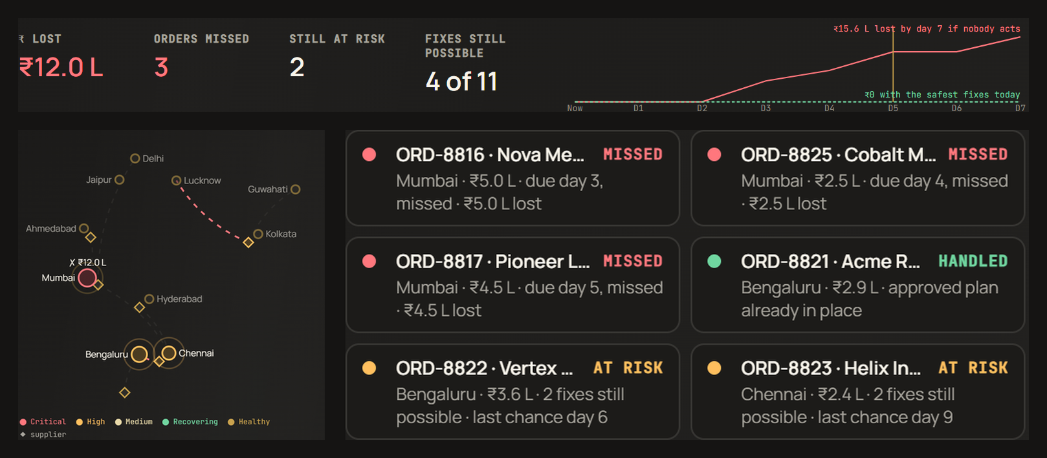
Every day of waiting has a price.
Technical Approach · Ripple replay
Next 7 days, two futures
Wait: ₹15.6 L lost
Fix today: ₹0 lost
Missed orders turn red
Fixes expire over time
Press play in the demo
Notes:
Ripple replay shows the cost of waiting. Drag through the next seven days: if nobody acts, Nova Medical's order is missed on day three, fixes expire as transit time runs out, and ₹15.6 lakh is lost by day seven. Switch to 'with suggested fixes' and the loss stays at zero.

Slide 11
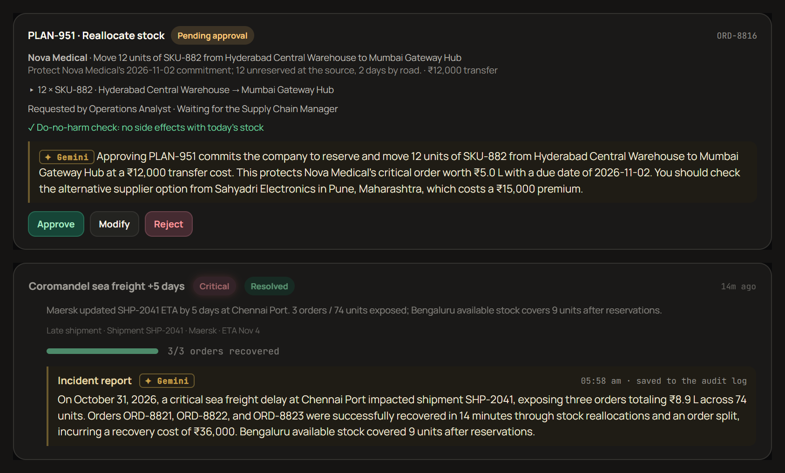
Gemini briefs, advises, summarises and reports.
Technical Approach · AI at every step
Rules do the maths
Every number comes from the rules engine. Gemini only writes the words, and rule-based text takes over if the AI is unavailable.
Notes:
Gemini 3.5 Flash-Lite works at every step: a morning briefing written for each role, a plain-English summary for the approver of what a plan commits to and what to check, and an incident report written automatically when a disruption is resolved and saved to the audit log. The rules work out every number; the AI only writes the words.

Slide 12
Safe by design.
Technical Approach · Rules and Safety
Handled safely
Enforced by the rules
Duplicate events
Five roles
Invalid data
No self-approval
Stale updates
Stock rechecked before execution
Full audit trail for every step.
Notes:
Real data is messy, so duplicate events, invalid data and stale updates are handled safely. The server enforces five roles, blocks self-approval and rechecks stock right before execution, and every step lands in an audit trail.

Slide 13
A control tower you can trust, and prove live.
Market Potential and Business Model · Competitors and edge
Guardrailed AI
Do-no-harm recovery
Chaos button that proves safety live
Visible separation of duties
Recheck before execution
✓ Live in demo
✓ Live in demo
✓ Live in demo
✓ Live in demo
✓ Live in demo
Also live in the demo
Stress test
Ripple replay
Fix preview on the map
Notes:
What sets us apart: AI with guardrails, a do-no-harm check on every fix, a chaos button that proves the safety rules live, visible separation of duties and a stock recheck before execution. Also live in the demo: the stress test, the ripple replay and a map preview of every fix.

Slide 14
From hours of spreadsheets to one decision.
Future Scope
Demo result
Next
< 5 s
1
Live carrier and ERP data
Alert → checked, ranked options
2
Delay-prediction model
₹15.6 L → ₹0
3
Spending limits, WhatsApp approvals
7-day loss: wait vs fix today
Thank you. Questions?
Notes:
In the demo, an alert becomes checked, ranked recovery options in under five seconds, and the ripple replay shows ₹15.6 lakh lost in a week if nobody acts, against zero with the fixes. Next: live carrier and ERP data, a delay-prediction model trained on our risk dataset, and spending limits with WhatsApp approvals. Thank you.

Slide 15
One app, one database, one rules engine.
Technical Approach · Backup
Carrier webhook
API
role checks
Rules engine
detect · impact
risk · options
Postgres
CSV / JSON import
Dashboard
AI layer (server only)
Output checked against rule-built options
Live demo: JavaScript page + Vercel serverless function + Google Gemini 3.5 Flash-Lite. Full app: Next.js 15, React 19, TypeScript, Prisma, PostgreSQL.
disruptioniq.vercel.app · github.com/RakeshKumar-18/disruptionIQ
Notes:
Backup for architecture questions. The full app is one Next.js app, one PostgreSQL database and one rules engine; the live demo runs the same rules in the browser. Gemini is called only from a Vercel server function that keeps the key secret, and its picks are checked against the options the rules built.

