Slide 1
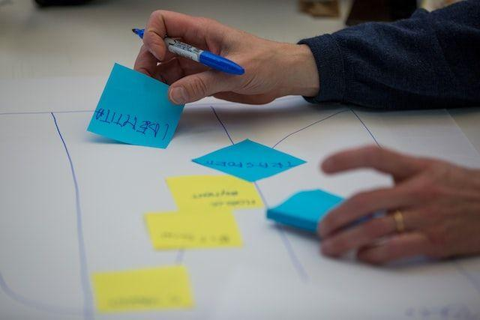
Introduction
Problem Statement: Addressing the client's need for a demand forecasting framework to handle changing demand trends and varying macroeconomic factors.
Challenges: Highlight the challenges faced due to the pandemic, high-stock inventory, and shifting historical demand patterns.
Impact on Business: Emphasize how an effective demand forecasting framework can significantly impact the client's bottom line by reducing excess inventory costs and improving customer satisfaction.
Market Dynamics: Discuss the dynamic nature of the sanitary ware industry, where customer preferences, construction trends, and regulatory changes can lead to unpredictable demand fluctuations.
Strategic Advantage: Stress that a well-designed forecasting framework not only helps manage supply chain operations but also positions the client as an industry leader, responsive to market changes.
Objectives: Define the key objectives, such as accurate demand forecasting for all SKUs in 5 regions, optimizing inventory, and adapting to changing market dynamics.

Slide 2
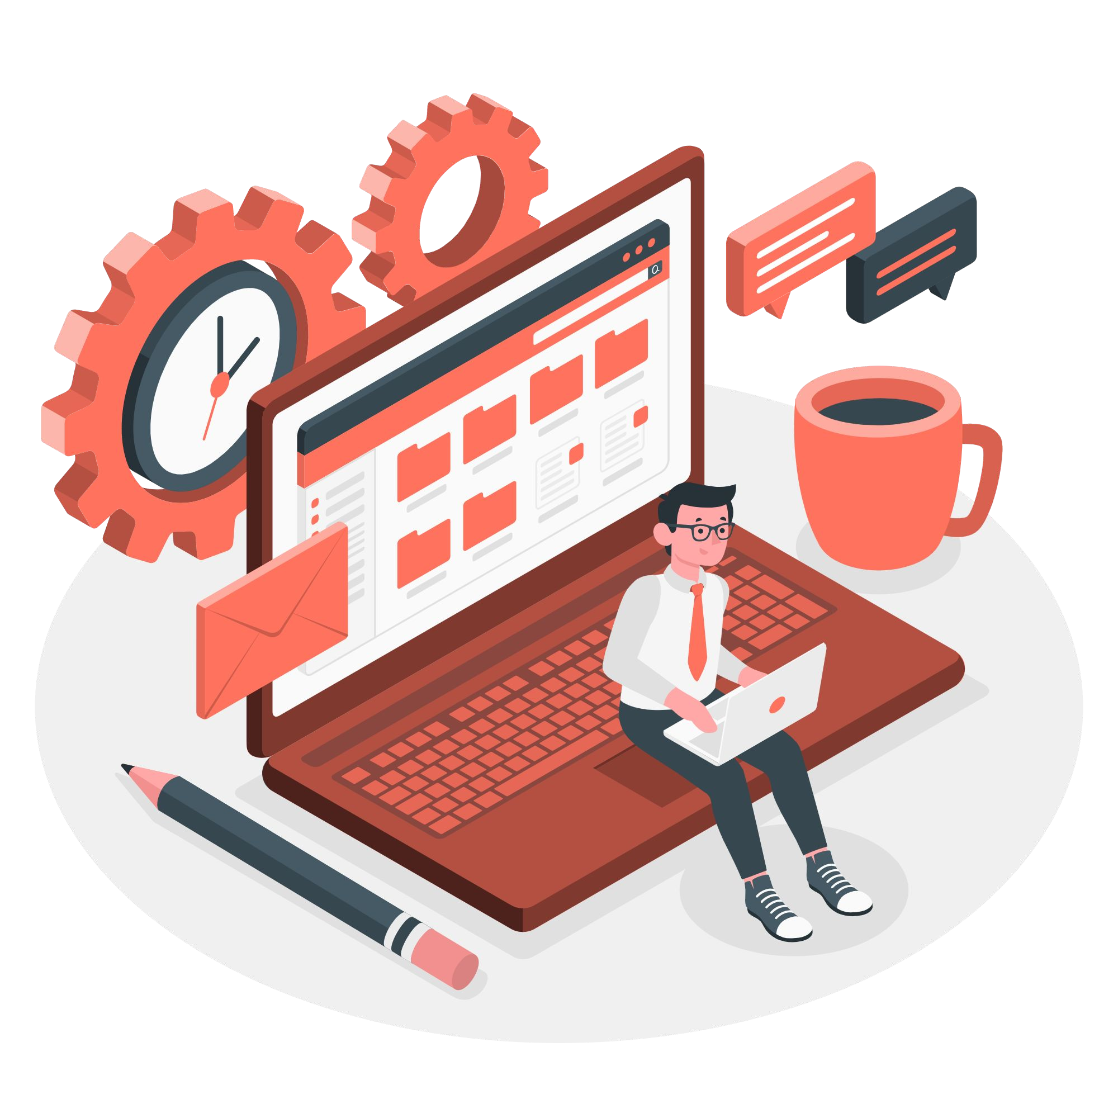
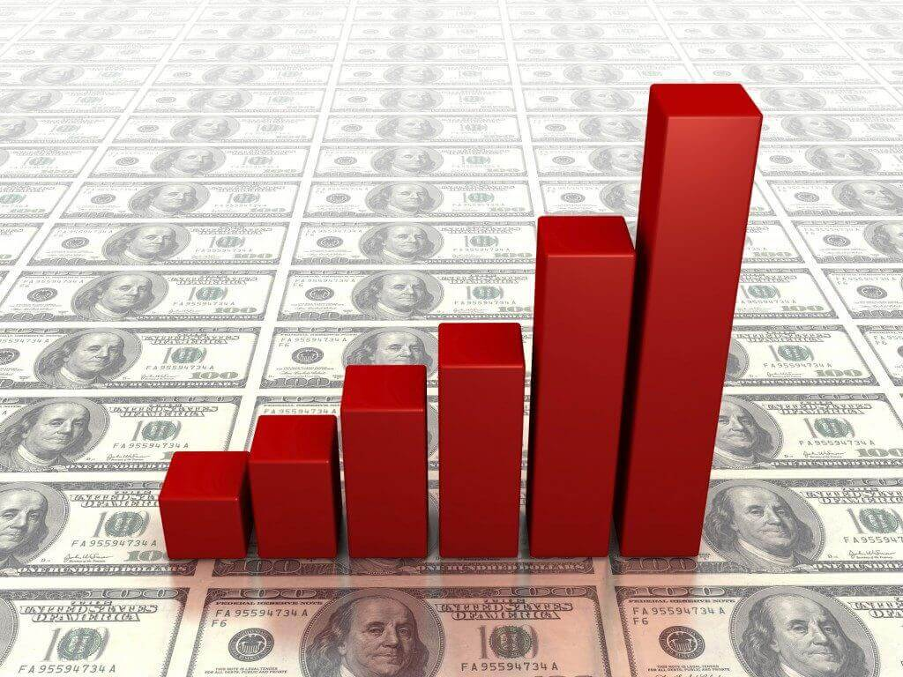
Solution Approach
Data Collection: Gather historical sales data, market trends, economic indicators, and any external factors.
Feature Engineering: Identify relevant features affecting demand, such as seasonality, product launches, promotions, economic indicators.
Model Selection: Choose suitable forecasting models (Example: Arima, Prophet, Neural Prophet) based on data characteristics. Consider an ensemble approach for robustness.
Model Training: Train models on historical data, considering regional variations and SKU-specific patterns.
Cross-validation: Implement cross-validation techniques to assess model accuracy and generalization.

Slide 3
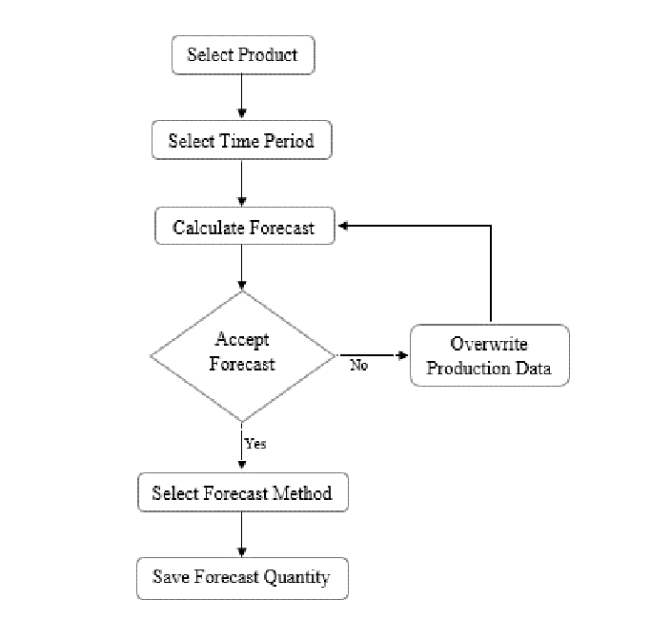
Implementation and Monitoring
Implementation: Deploy the forecasting framework integrated with the client's IT infrastructure to provide real-time forecasts.
Monitoring and Feedback Loop: Continuously monitor the forecasting accuracy and adapt models to changing conditions.
Collaboration: Collaborate with the client's teams to integrate the framework into their decision-making processes.
Reporting: Generate regular reports and dashboards to provide insights into demand patterns and forecasting accuracy.
Scalability: Ensure the framework can scale as the client's business grows or as new regions are added.
Benefit of Proposed Solution: The proposed demand forecasting framework is a robust and forward-looking approach that takes into account both historical and macroeconomic factors.

