Slide 1
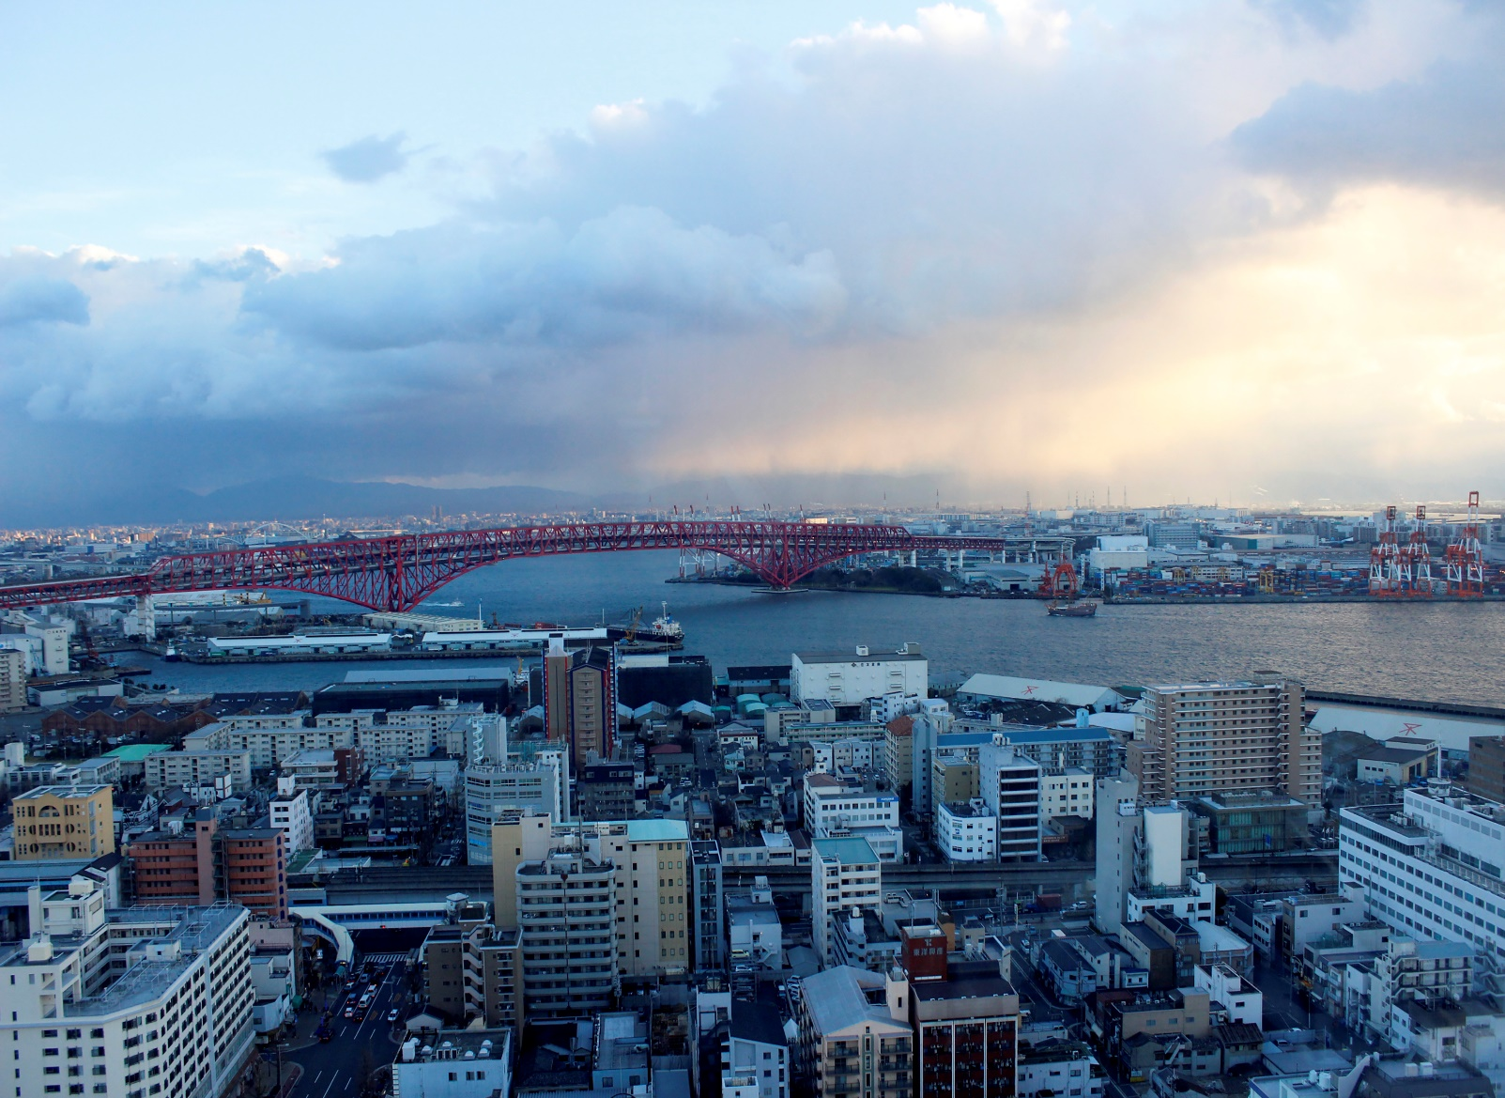

Jan-2024
Hotel Booking Demand Analysis &
Cancelation Prediction
Demo

Slide 2


Project Detail
Hotel Booking Demand Analysis & Cancelation Prediction are divided into 2 Machine Learning problems.
Hotel Booking Cancelation Prediction:
Hotel Booking Cancellation Prediction is a machine learning classiﬁcation problem statement that will try to predict whether a booking will be canceled or a booking will not be cancelled using machine learning based on historical data.
Hotel Booking Demand Analysis Forecast:
Hotel Booking Demand Analysis Forecast is a machine learning regression problem statement that will try to forecast hotel more demand to generate revenue based on historical pattern based on historical data.

Slide 3


Problem Statement
Hotel the growing trend of Hotel industry is beneﬁcial for hotels however it comes with it’s problem too.
One of the problem is the rising rate of cancellation in the hotel industry.
Cancellation rate increased 30-40% from 2015-2017.
Hotel owner wants to improve operational efficiency and enhance the guest experience by optimizing room allocation.
The goal is to assign rooms to guests in a way that maximizes guest satisfaction, minimizes wait times, and optimizes room occupancy rates.

Slide 4
Background Information Problem
Hotel the growing trend of Hotel industry is beneﬁcial for hotels however it comes with it’s problem too.
One of the problem is the rising rate of cancellation in the hotel industry.
Cancellation rate increased 30-40% from 2015-2017.
The hotel business is currently facing a severe and sustained revenue loss, which poses a substantial threat to its financial health.

Slide 5


Background Information
The hotel industry is a dynamic and highly competitive business. Hotels constantly face the challenge of optimizing their room occupancy rates while ensuring efficient resource allocation.
Understanding booking patterns, analyzing factors influencing cancellations, and making accurate predictions is critical for hotel management to enhance operational efficiency and revenue.
Data Description:
This data set contains booking information for a city hotel and a resort hotel and includes information such as when the booking was made, length of stay, the number of adults, children, and/or babies, and the number of available parking spaces, among other things.

Slide 6
Points to Discuss
Agenda
Data Summary
Univariate analysis
Hotel wise analysis
Distribution Channel wise analysis
Booking cancellation analysis
Timewise analysis
Some important questions
Correlation heatmap
Conclusion

Slide 7
Agenda
To discuss the analysis of given hotel bookings data set from 2015-2017.
We’ll be doing analysis of given data set in following ways :
Univariate analysis
Hotel wise analysis
Distribution Channel wise analysis
Booking cancellation analysis
Timewise analysis
By doing this we’ll try to find out key factors driving the hotel bookings trends.

Slide 8
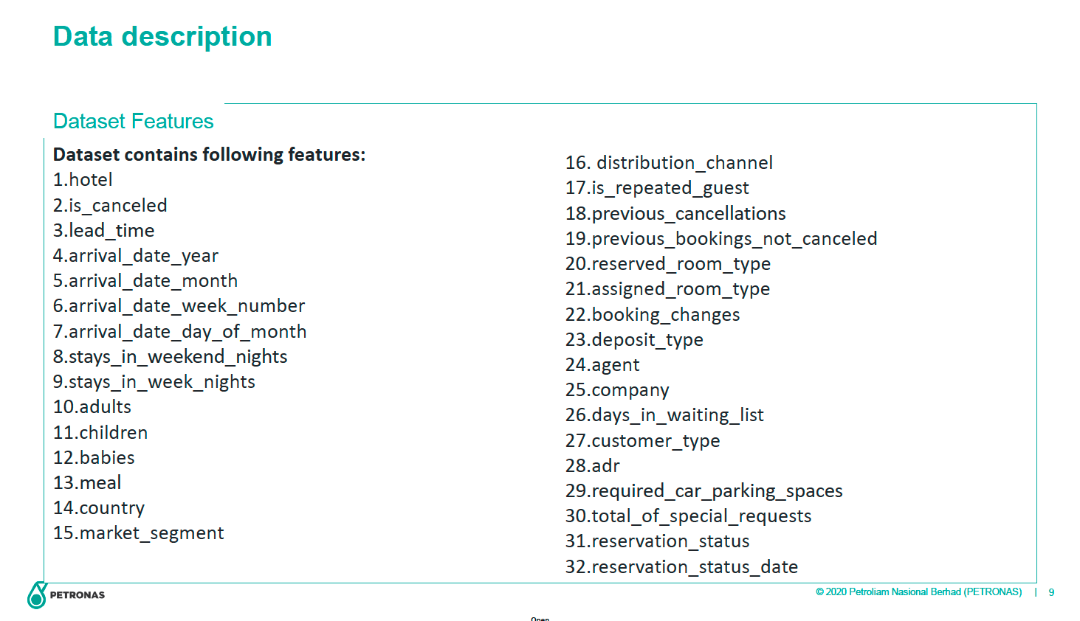

Slide 9
Data Summary
Given data set has different columns of variables crucial for hotel bookings. Some of them are:
hotel: The category of hotels, which are two resort hotel and city hotel.
is_cancelled : The value of column show the cancellation type. If the booking was cancelled or not.
Values[0,1], where 0 indicates not cancelled.
lead_time : The time between reservation and actual arrival.
stayed_in_weekend_nights: The number of weekend nights stay per reservation
stayed_in_weekday_nights: The number of weekday nights stay per reservation. meal: Meal preferences per reservation.[BB,FB,HB,SC,Undefined]
Country: The origin country of guest.

Slide 10
Data Summary(Contd..)
market_segment: This column show how reservation was made and what is the purpose
of reservation. Eg, corporate means corporate trip, TA for travel agency.
distribution_channel: The medium through booking was made.[Direct,Corporate,TA/TO,undefined,GDS.]
Is_repeated_guest: Shows if the guest is who has arrived earlier or not.Values[0,1]-->0
indicates no and 1 indicated yes person is repeated guest.
days_in_waiting_list: Number of days between actual booking and transact.
customer_type: Type of customers( Transient, group, etc.)

Slide 11
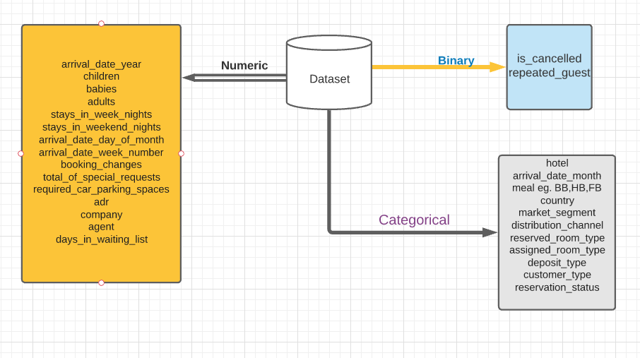
Data Summary FlowChart

Slide 12
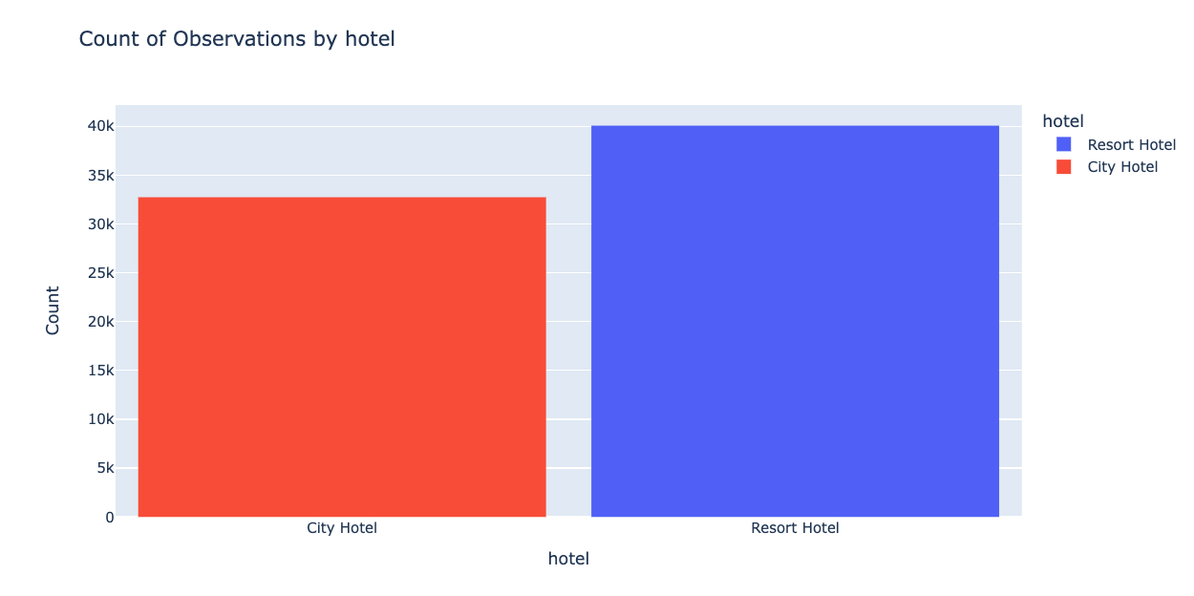
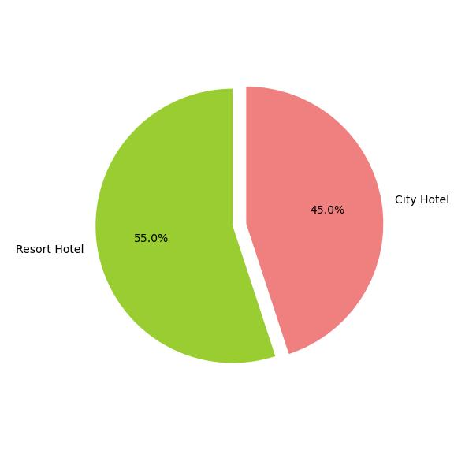
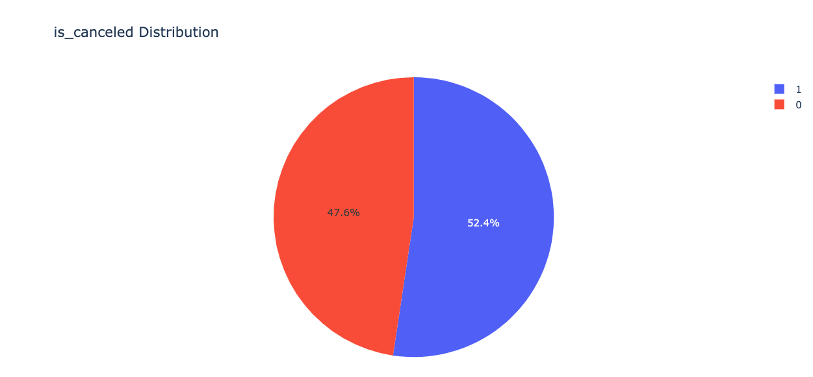
55 % of Resort hotel is more in demand as compared to City hotel.
City Hotel tend to be on the expensive side and most people will just stick with Resort hotel.
38038 bookings were canceled which is around 52%

Slide 13
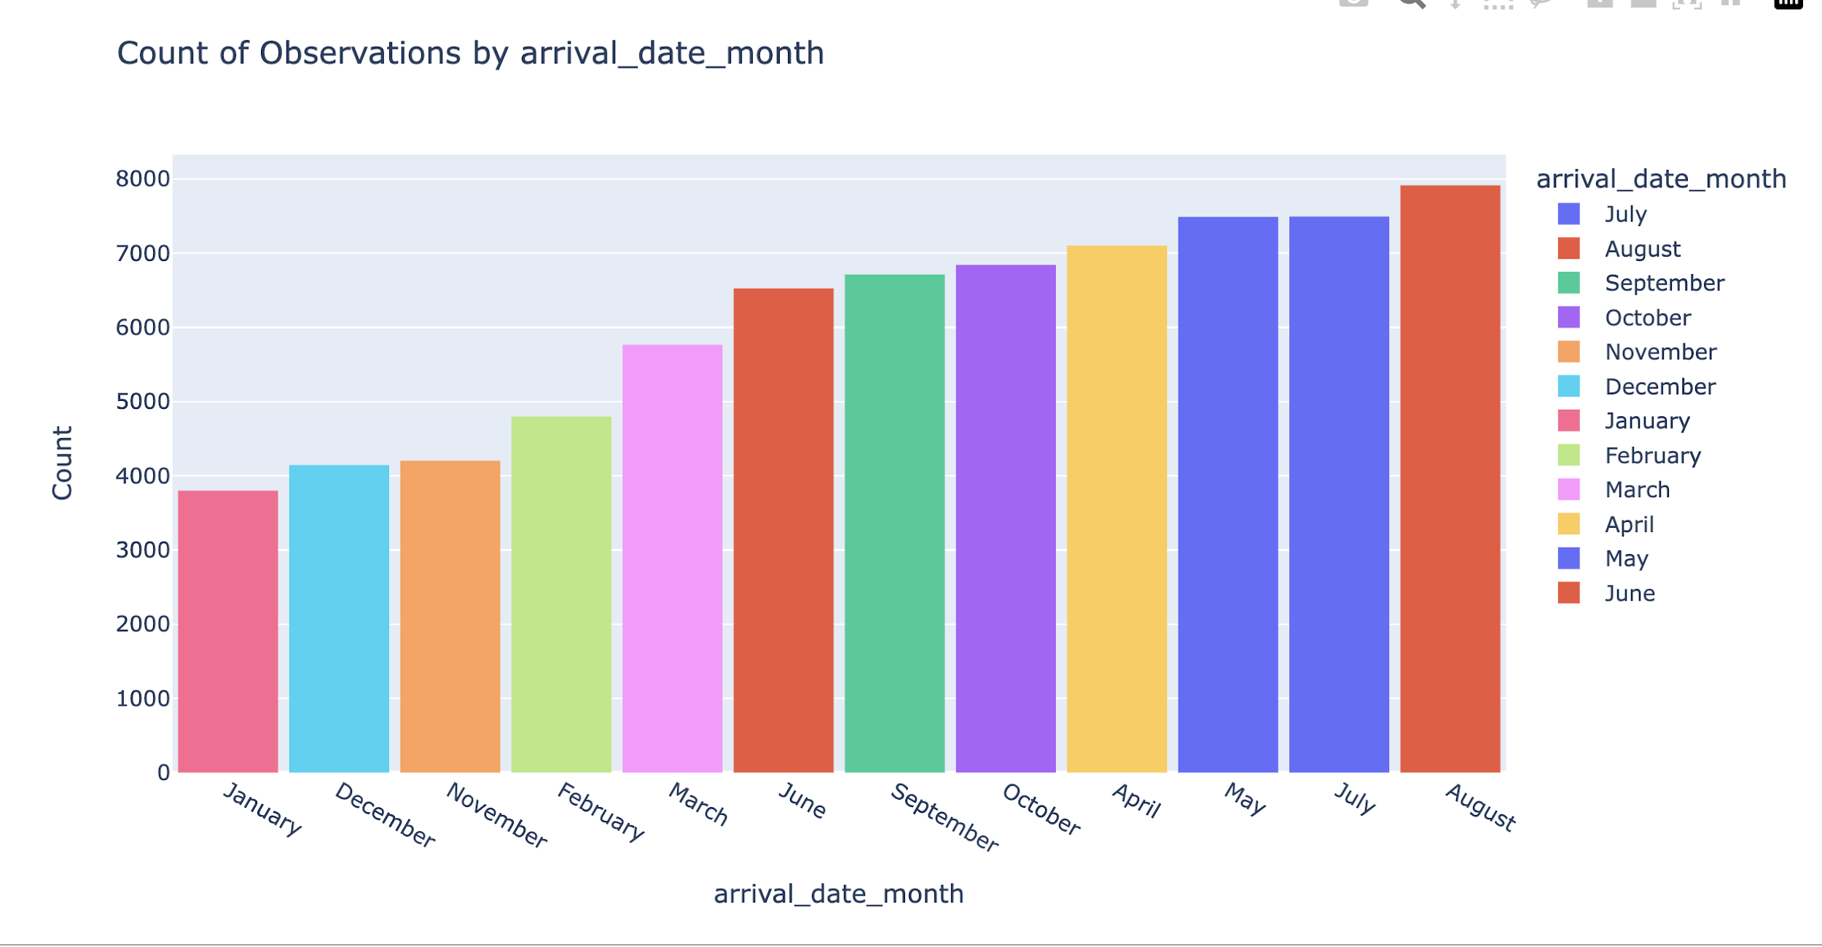
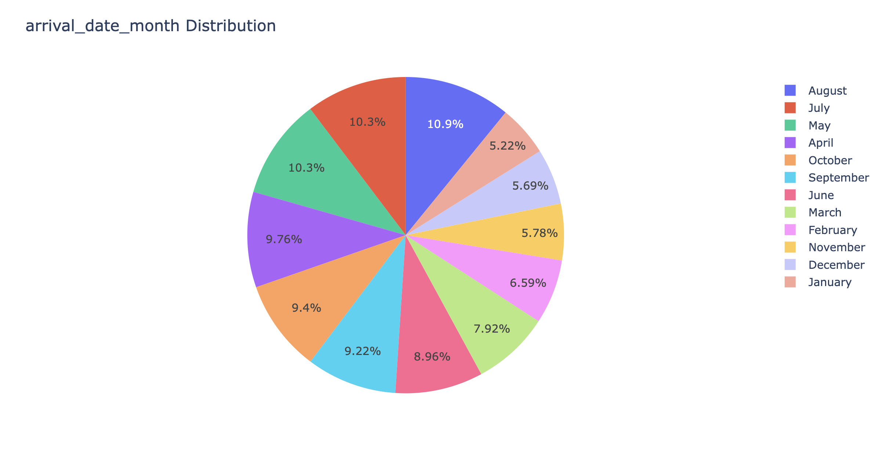
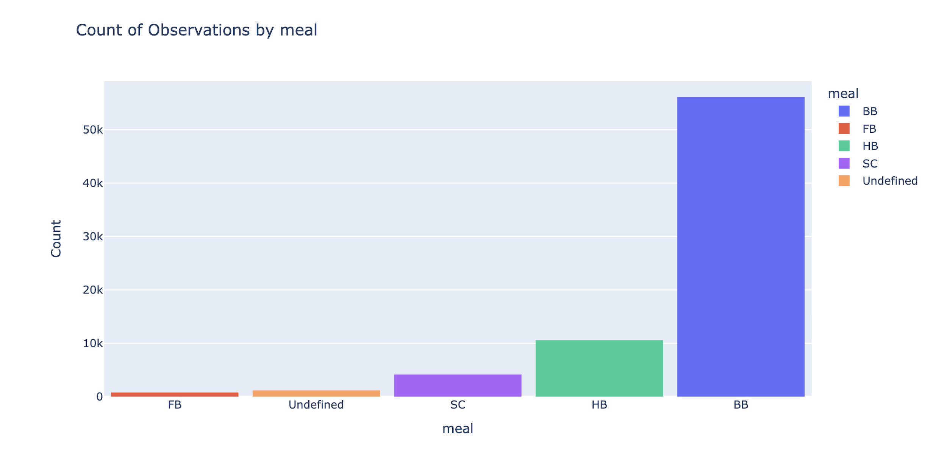
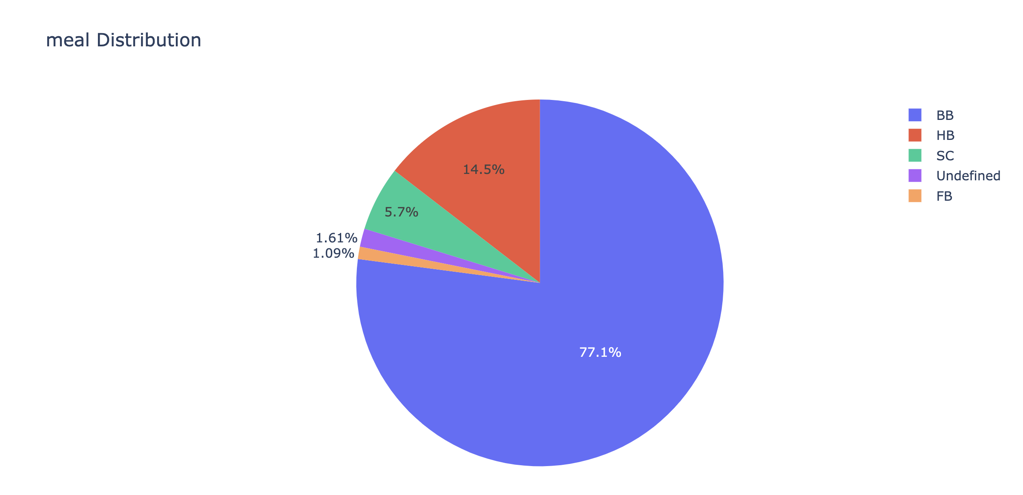
August is the most occupied (busiest) month with 10.90%.
January is the most unoccupied month with 5.17% bookings.
BB (Bed & Breakfast) is the most ordered meal which is around 76.9%

Slide 14
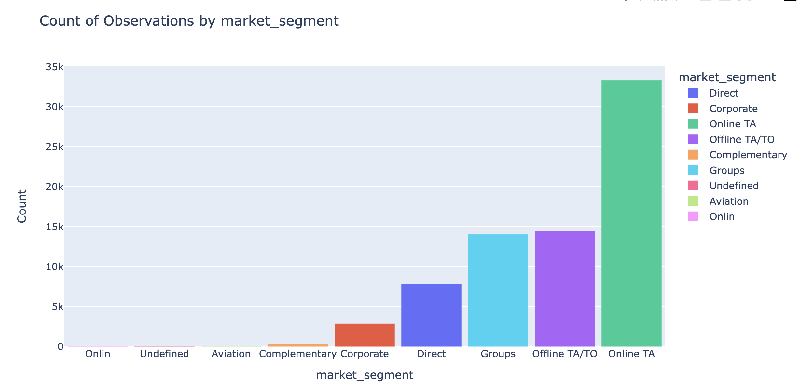
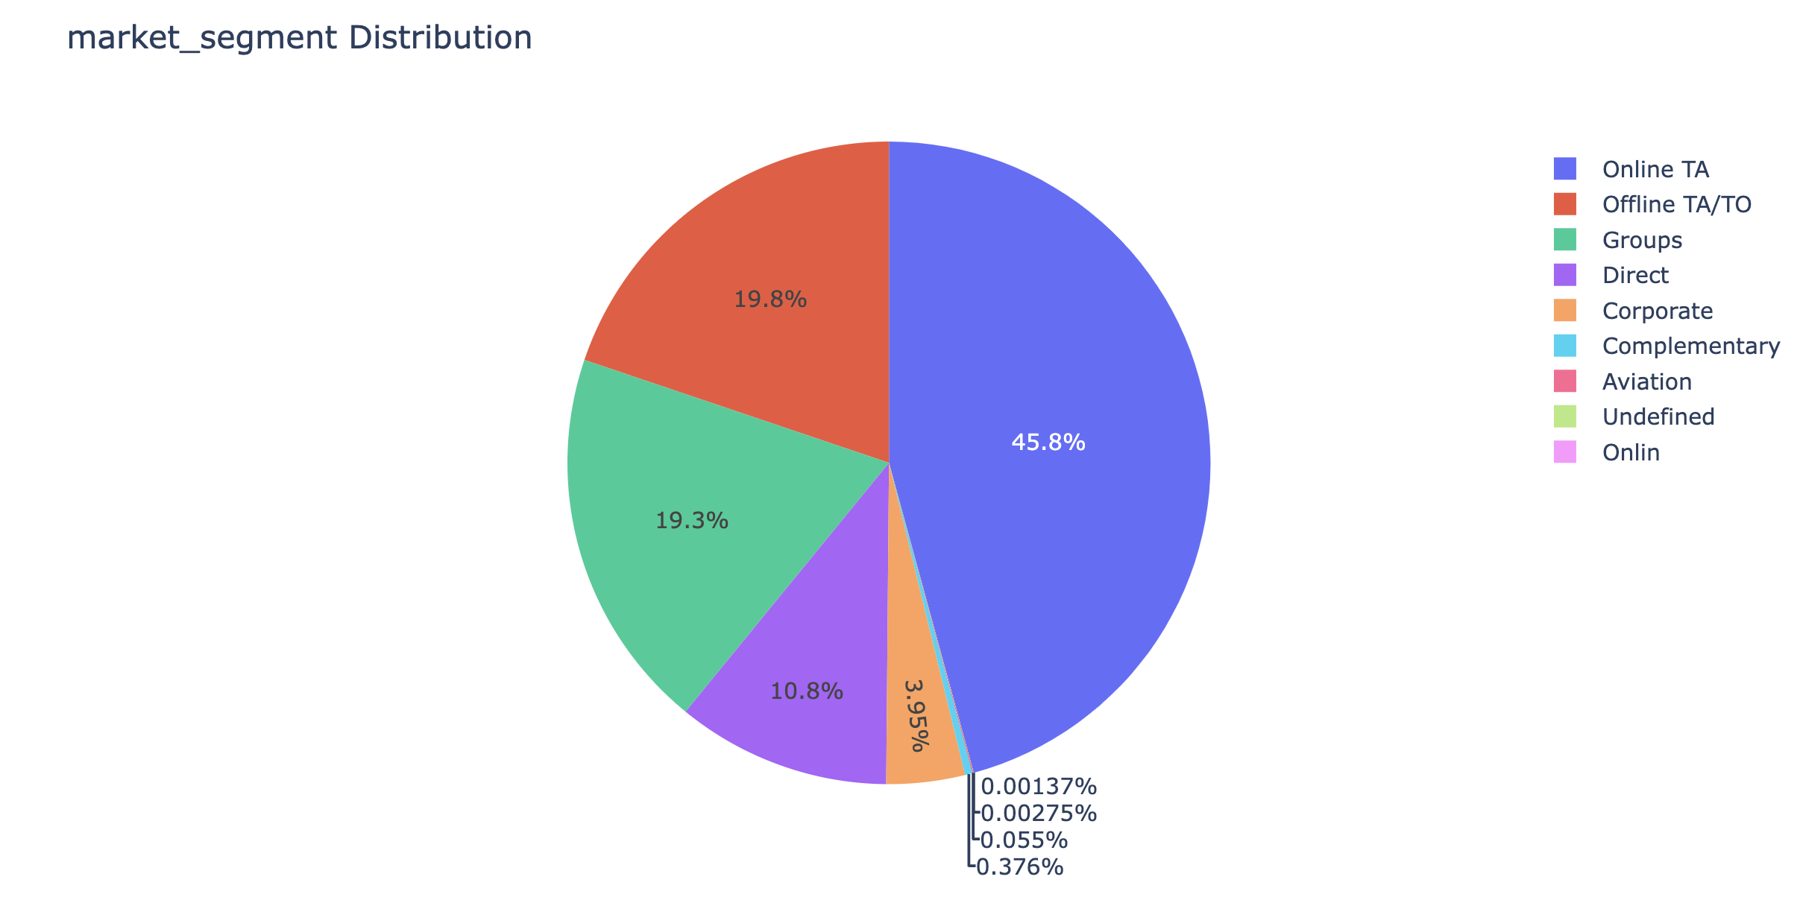
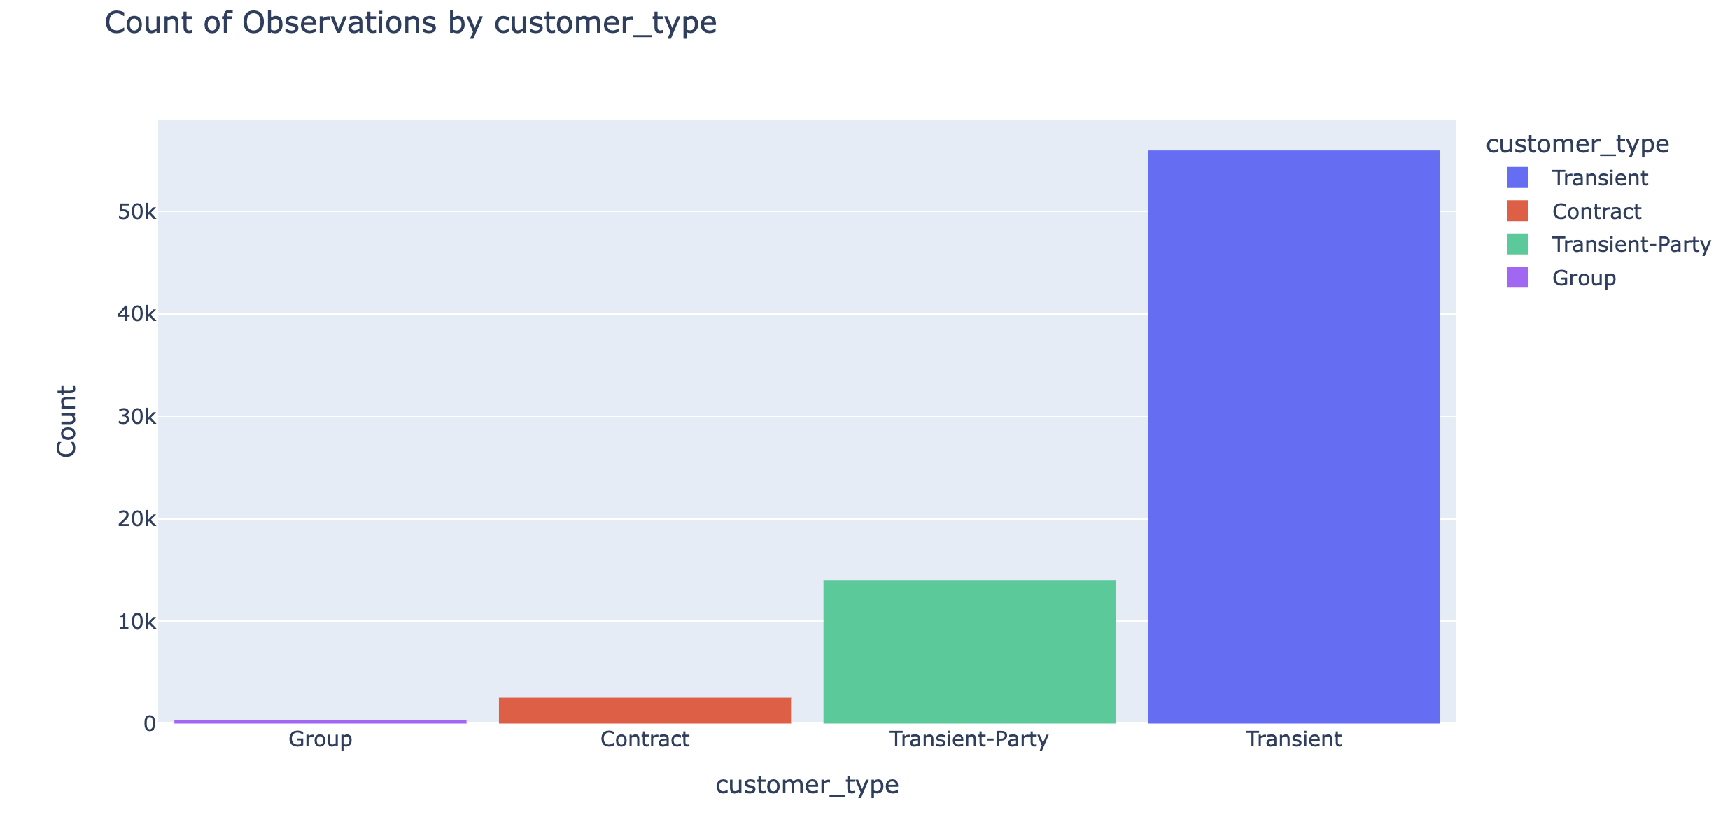
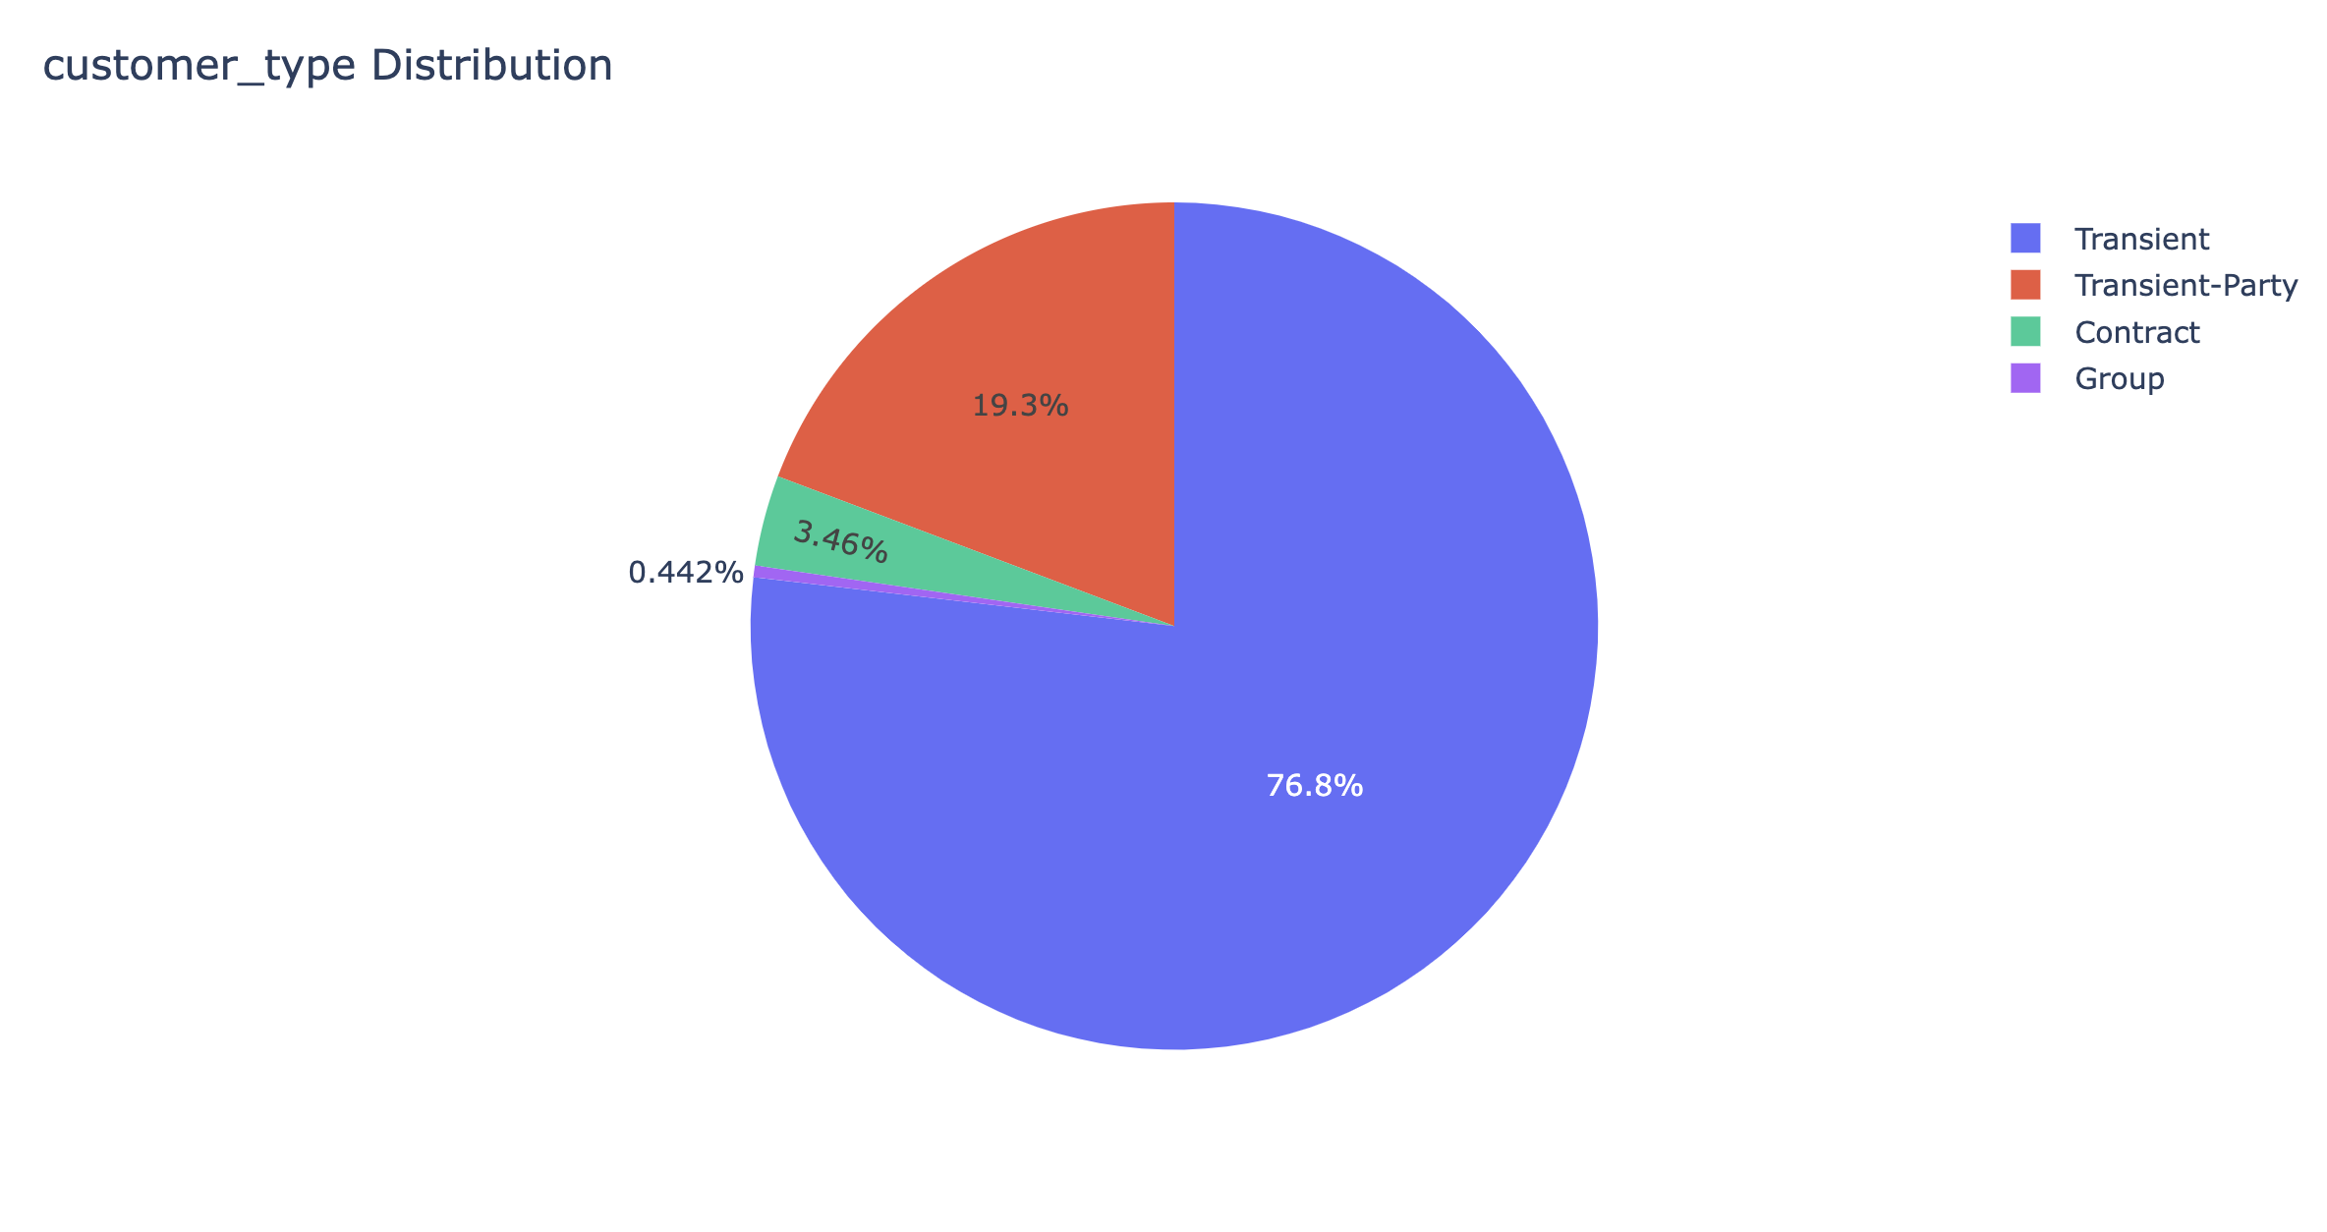
Around 45% of bookings are made via Online Travel Agents.
19% of bookings are made via Offline Travel Agents.
Transient type of customers are the more around 76%.

Slide 15
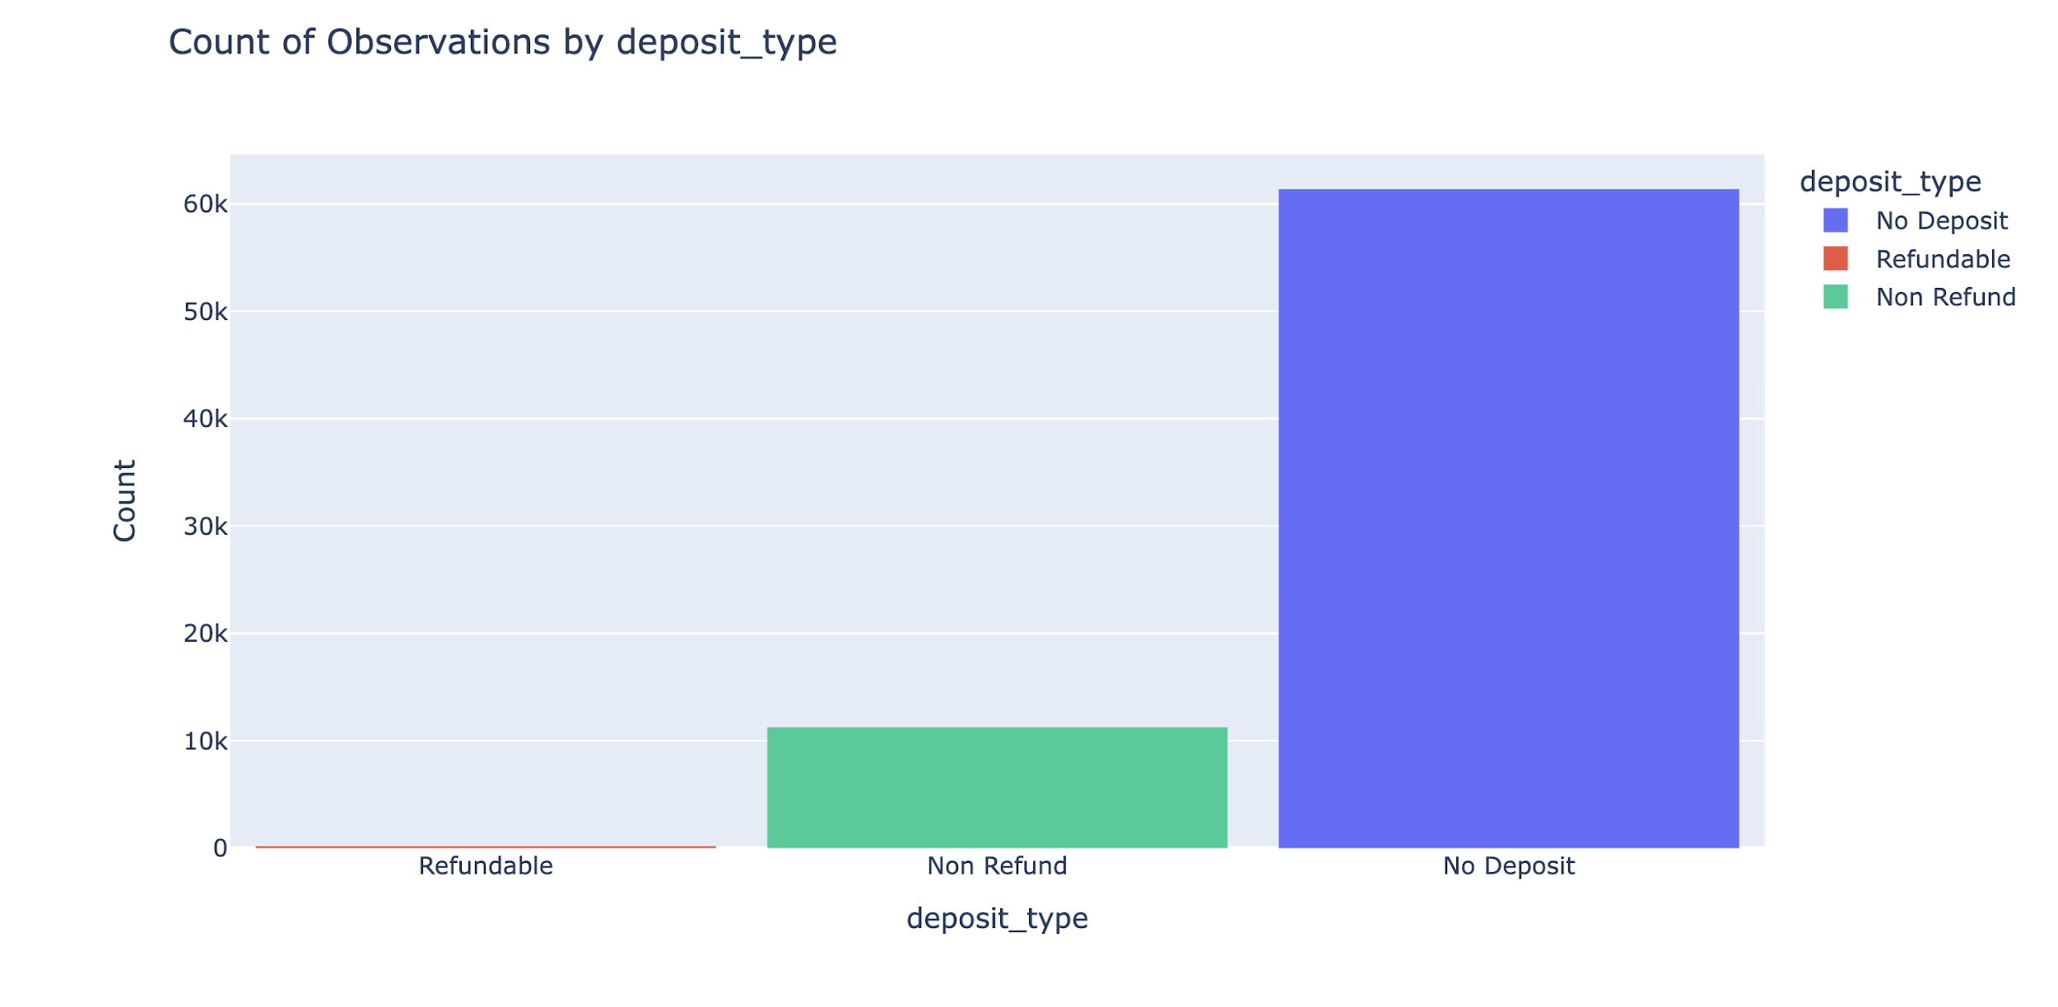
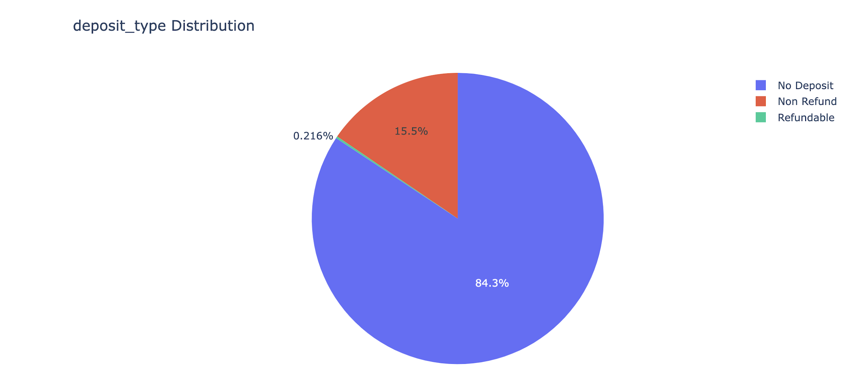
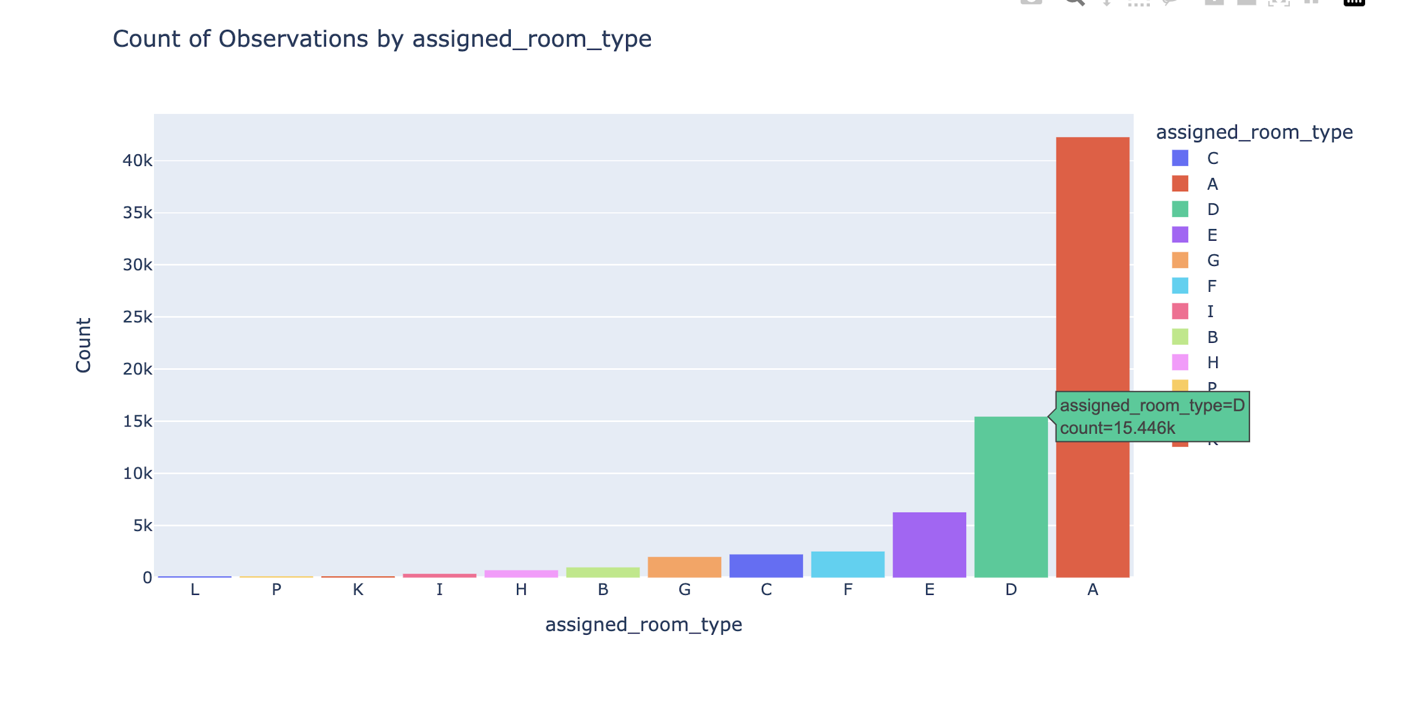
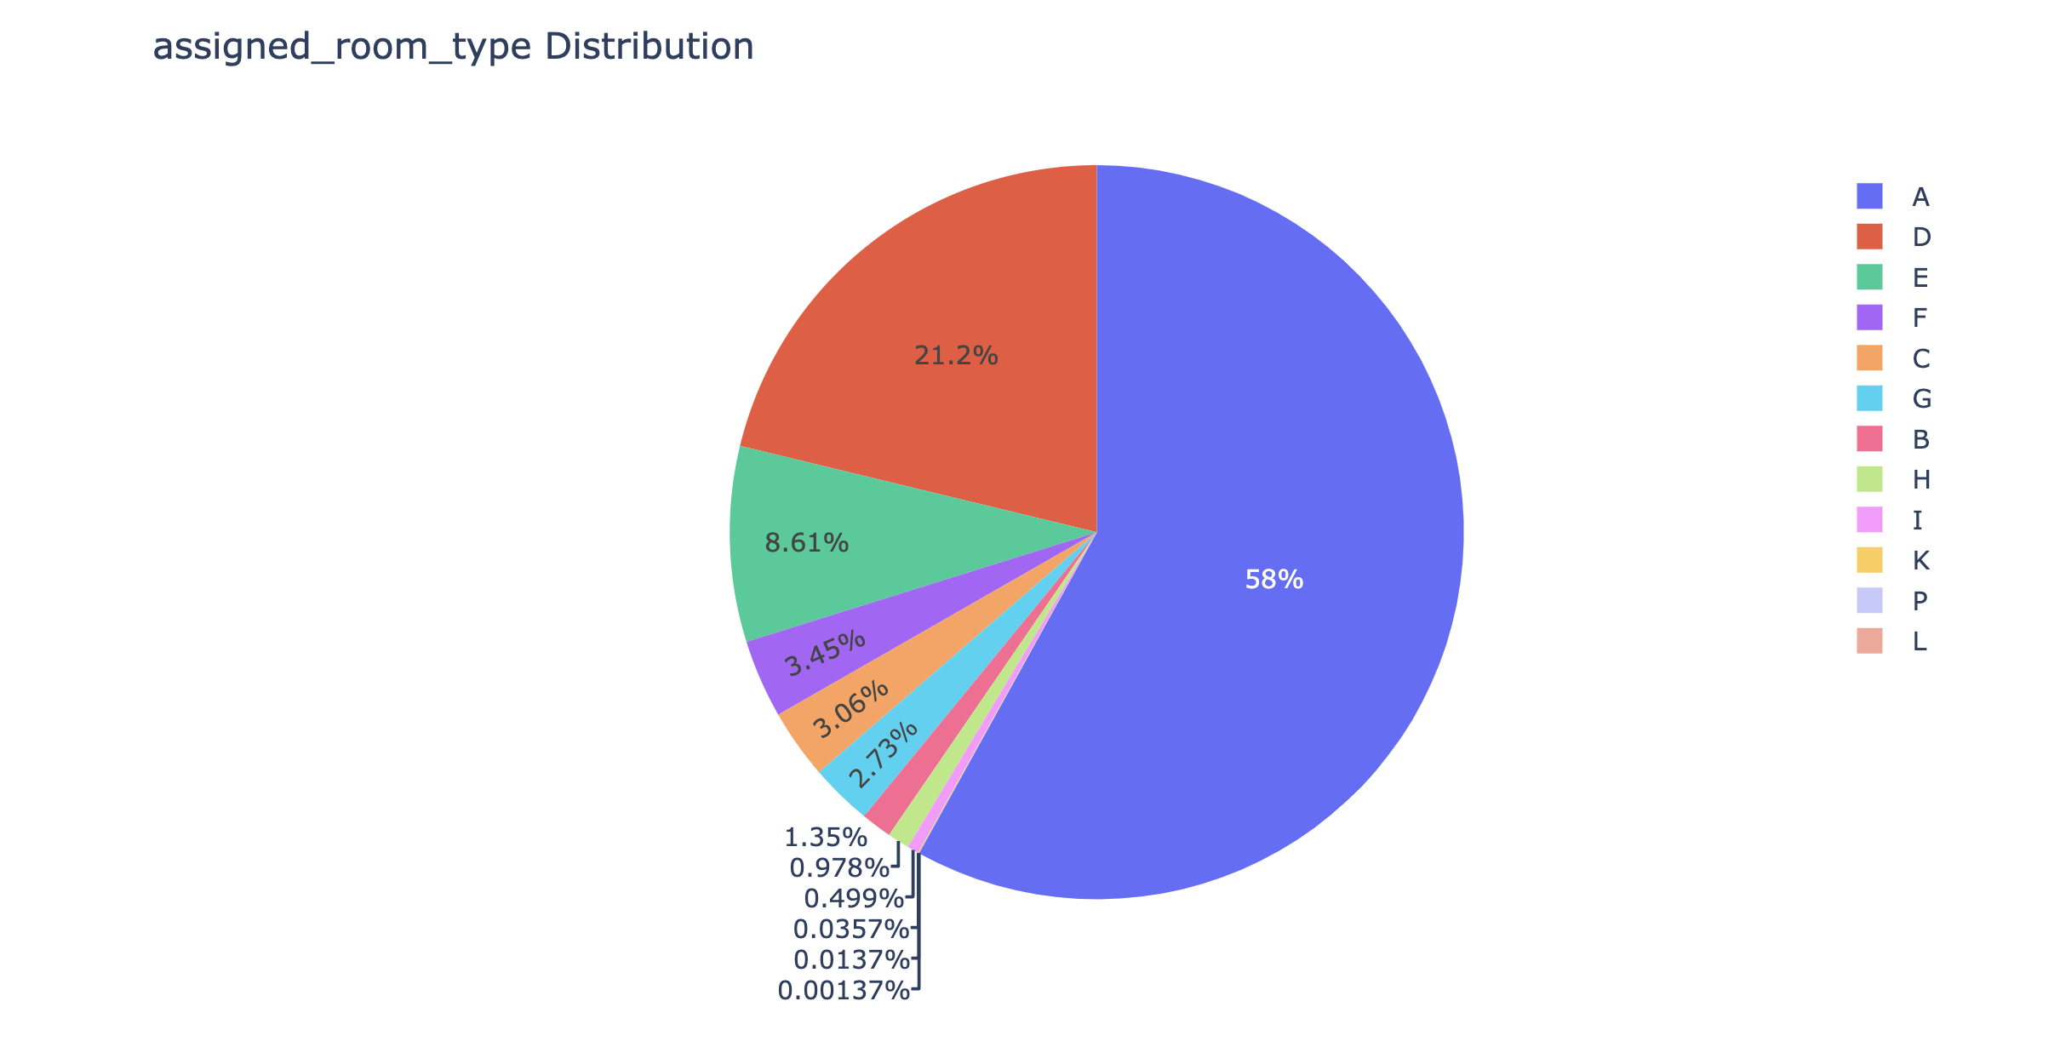
Around 84% of bookings are Non-Deposit.
58% of bookings are more demand for A room type

Slide 16
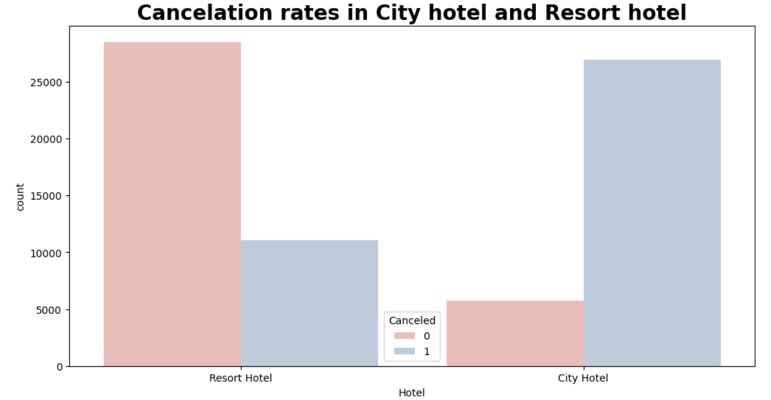
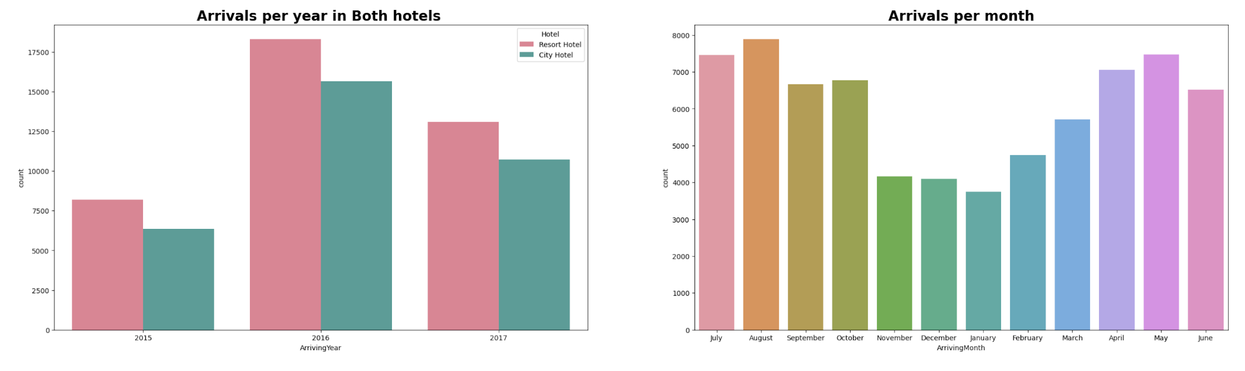
Most bookings were in Resort Hotel.
Cancelations in Resort hotel is less compared to city hotel
Most of the bookings were in the year 2016 and bookings were done in Resort.
Most bookings were done in the month of May, July, August.

Slide 17
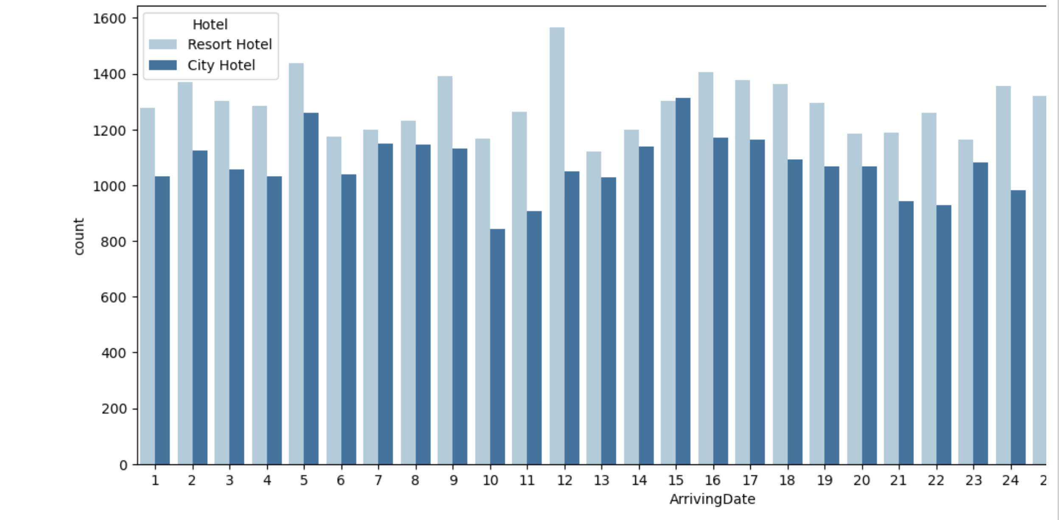
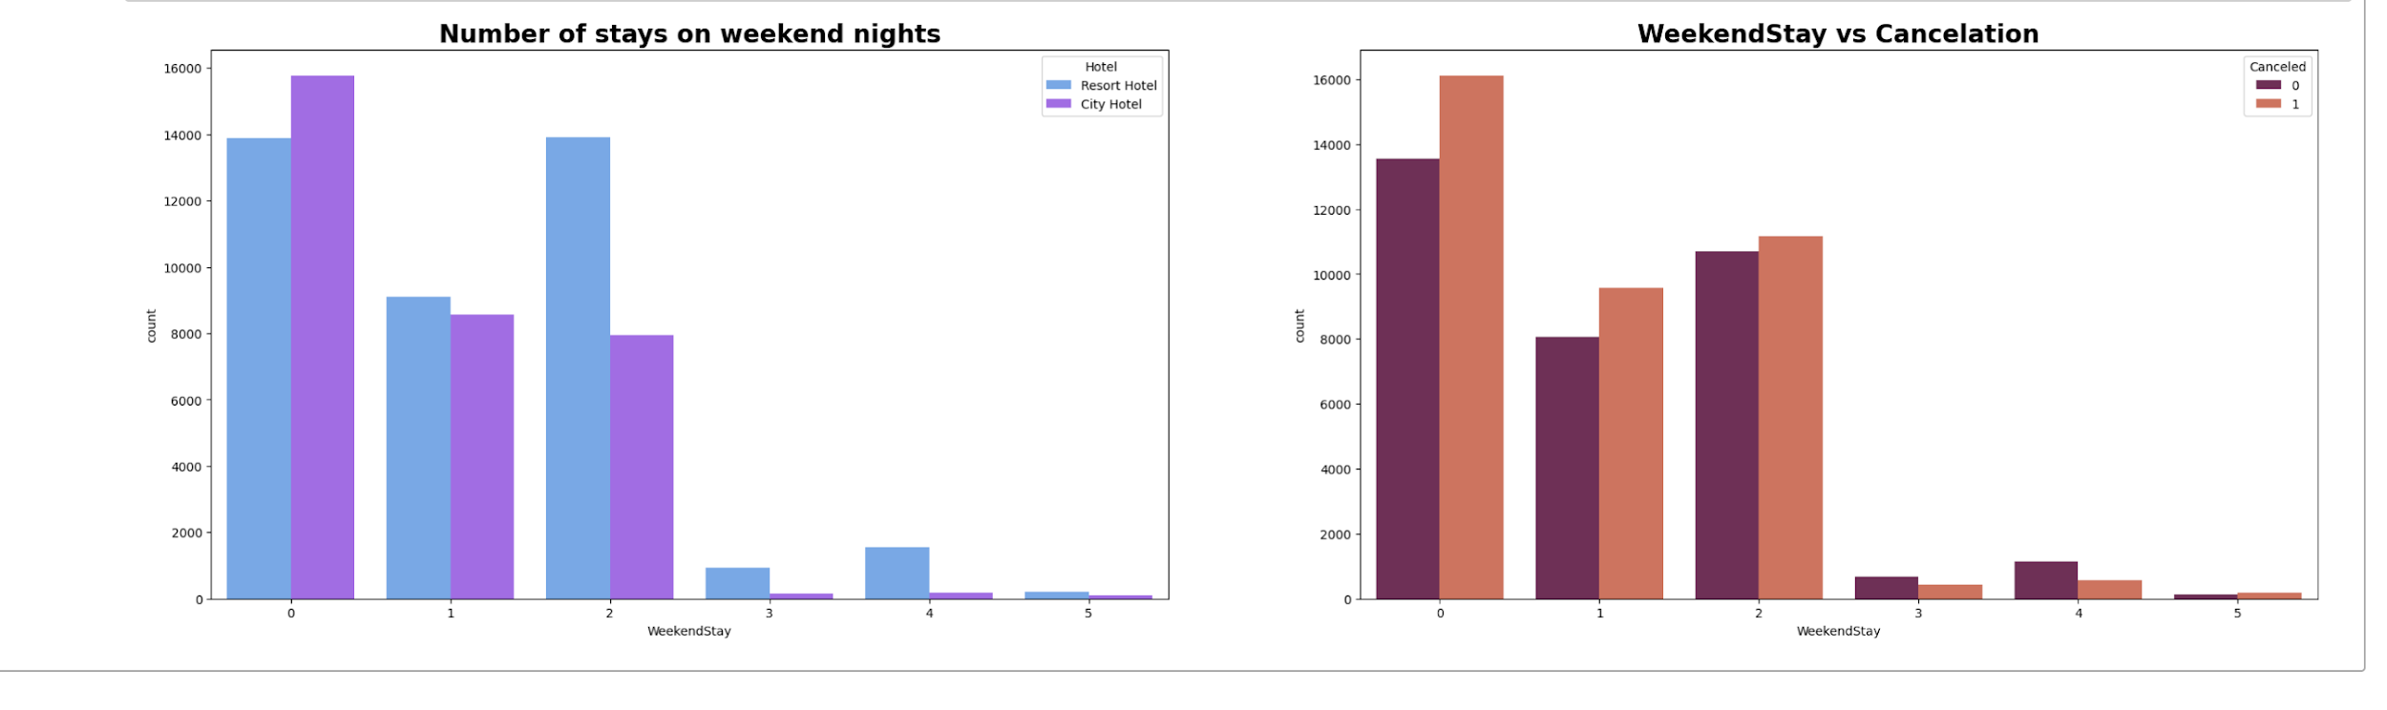
Month end day has very less arrivals.
Bookings are more in Resort hotel.
Most of the weekend nights were booked in City Hotel.
Most of weekend nights which were booked were canceled.

Slide 18
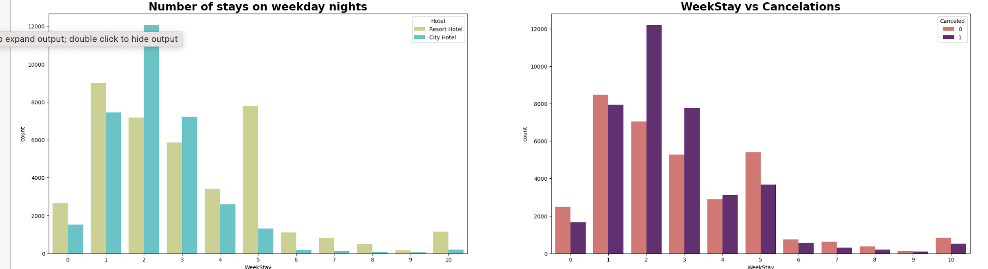
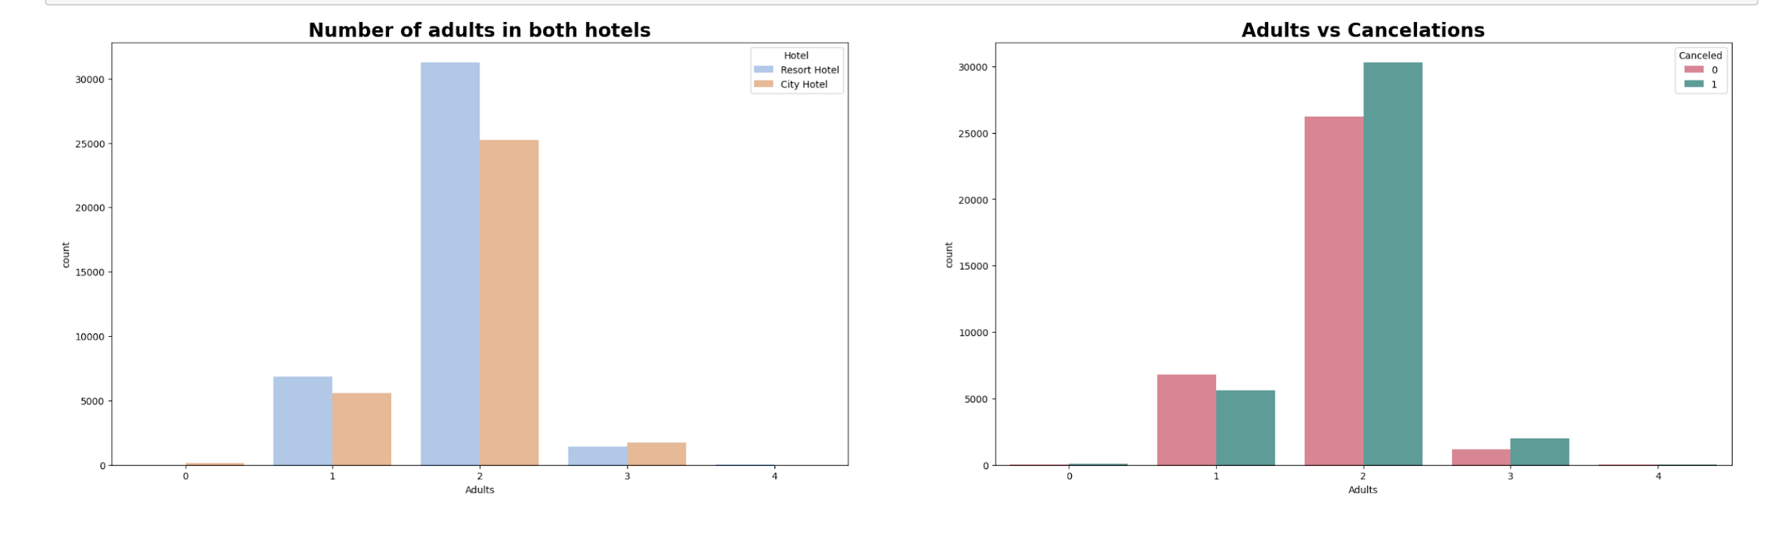
Weekday night stays were more in City Hotel.
Less cancelations were observed.
Adults who were 2 in number are more and preferred resort hotel rather than city hotel, infact more than half the visitors even canceled the bookings

Slide 19
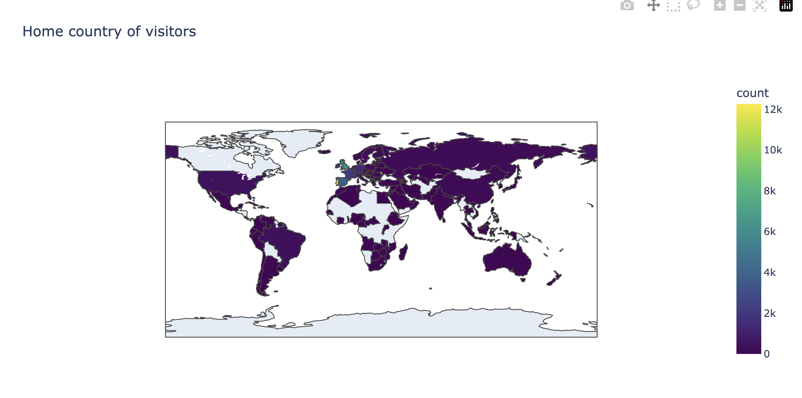
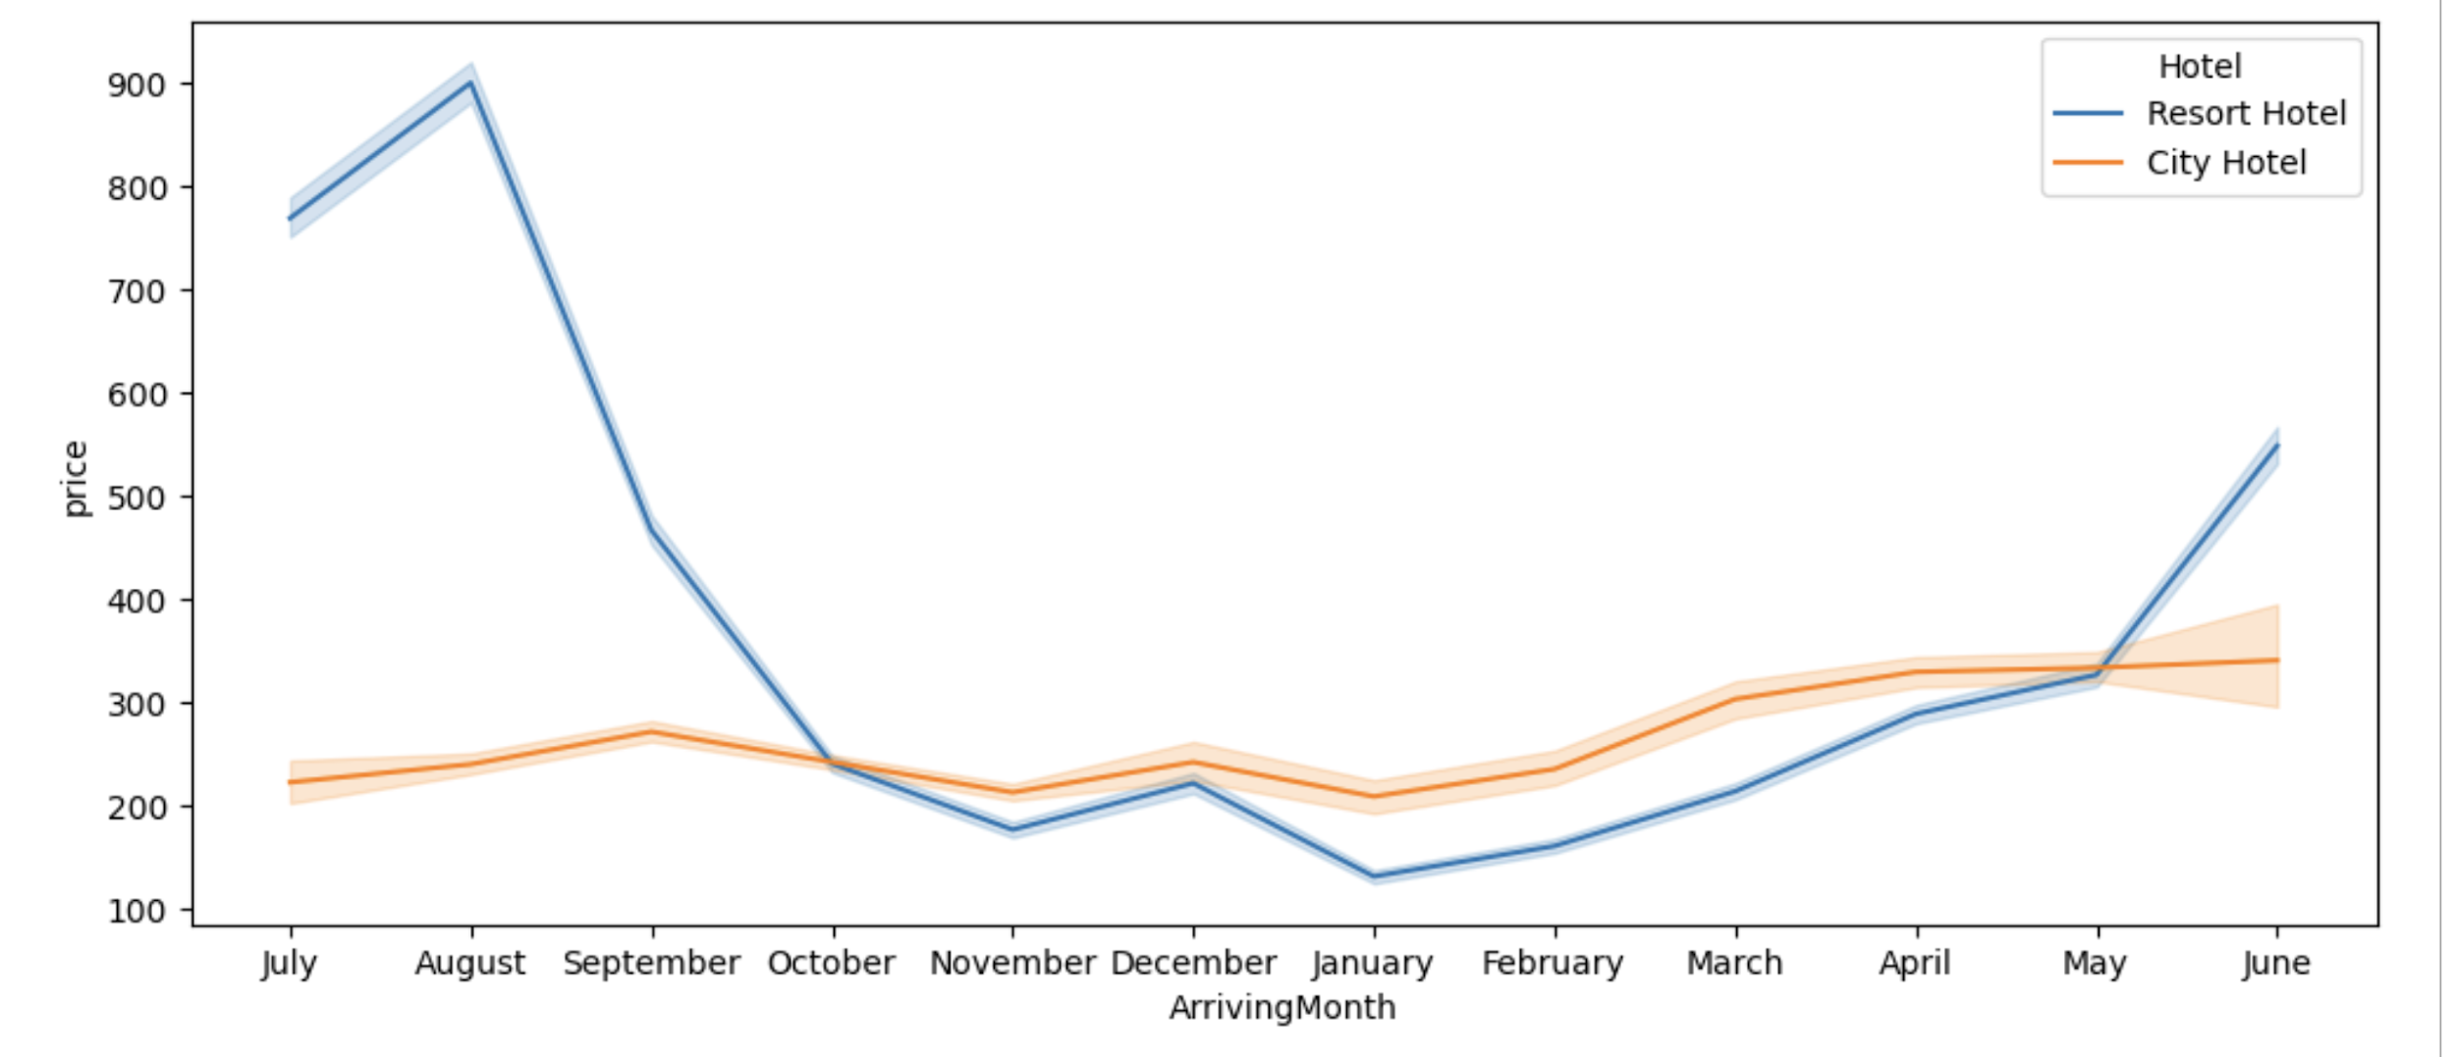
More visitors are from western europe, namely France,UK and Portugal being the highest.
Prices of resort hotel are much higher.
Prices of city hotel do not fluctuate that much.

Slide 20
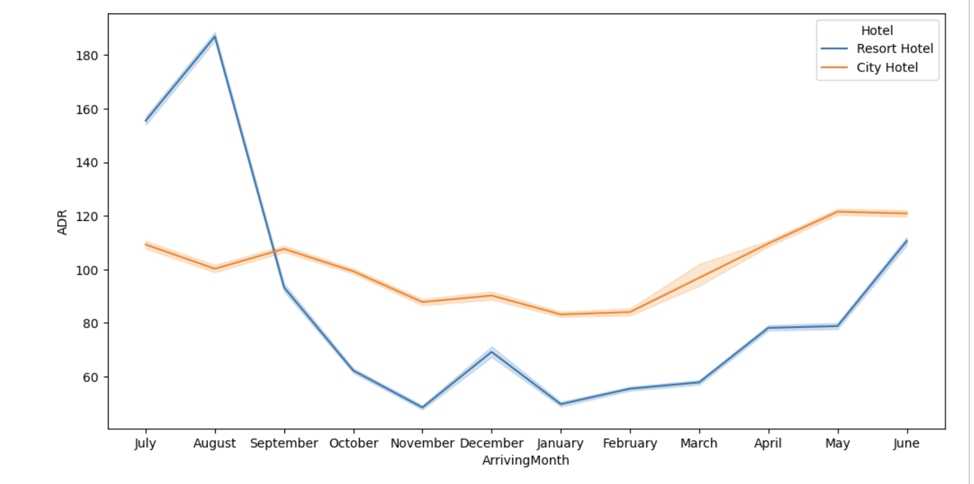
For Resort Hotel, ADR is more expensive August and for City Hotel, ADR is slightly more during November, Decemeber, January, February, March, April, May & June.

Slide 21
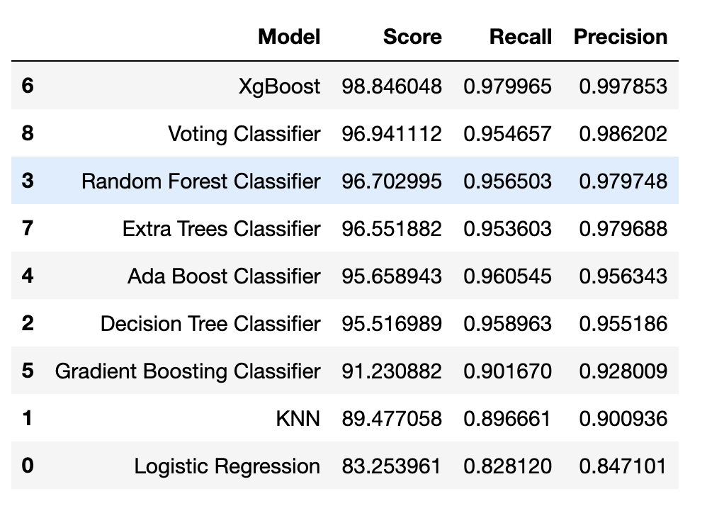
Model Building

Slide 22
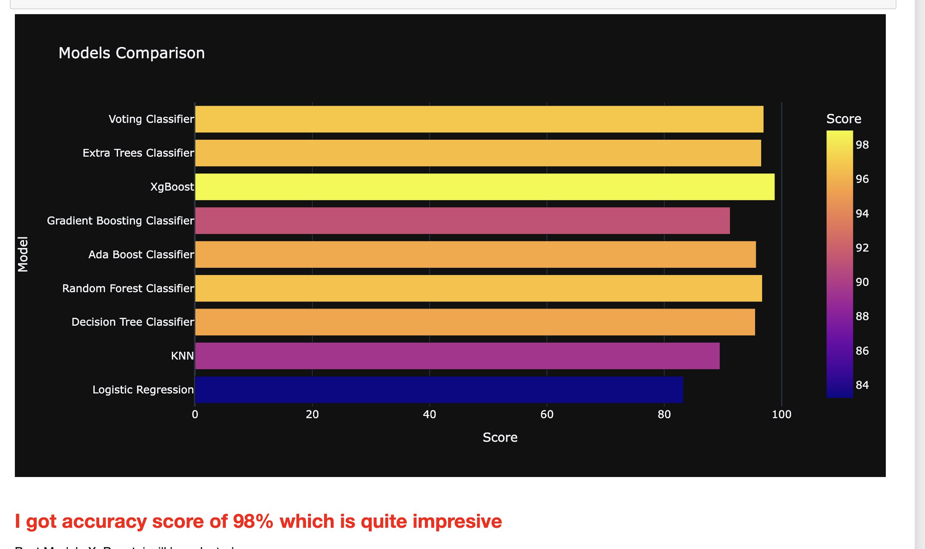
Model Building
Best model is XGboost

Slide 23

Q & A

Slide 24
LOGO
Thank You All
Business Plan PowerPoint Template
Presented by: XX
Directed by: XX

