Slide 1
Named Entity Recognition
LSTM + Word2Vec/BERT Implementation with Flask Deployment
Rakesh Kumar
Date : 20th May 2025

Slide 2
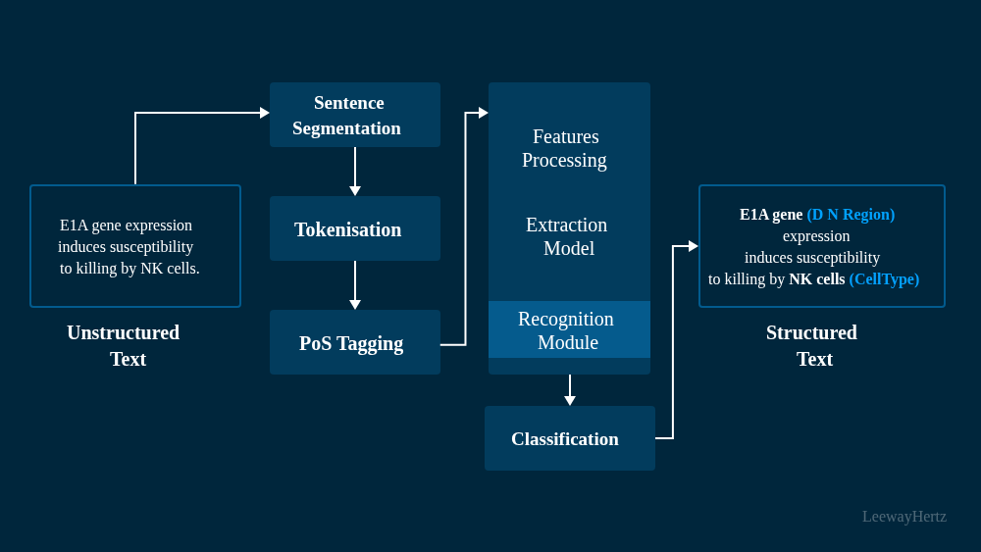
Problem Statement
Predict NER tags (IOB2 format) for each word in a sentence.
Dataset includes words, POS (ignored), and NER tags.
Goal: Build and deploy a robust NER system.

Slide 3
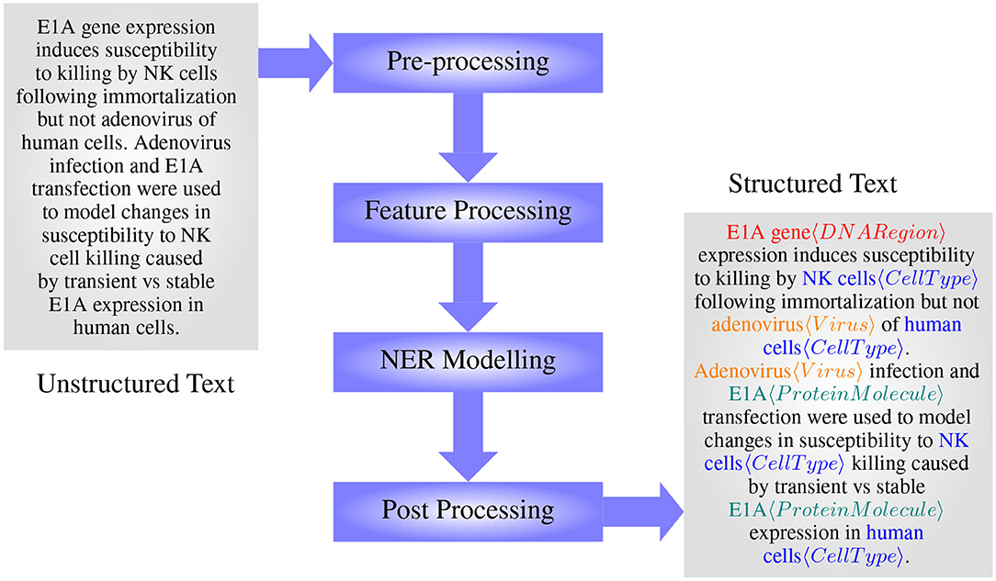
Data Overview
Format: Sentence #, Word, POS (ignored), NER Tag
IOB2 Scheme: B = Beginning, I = Inside, O = Outside
Preprocessing: Sentence to list of (word, tag) pairs

Slide 4
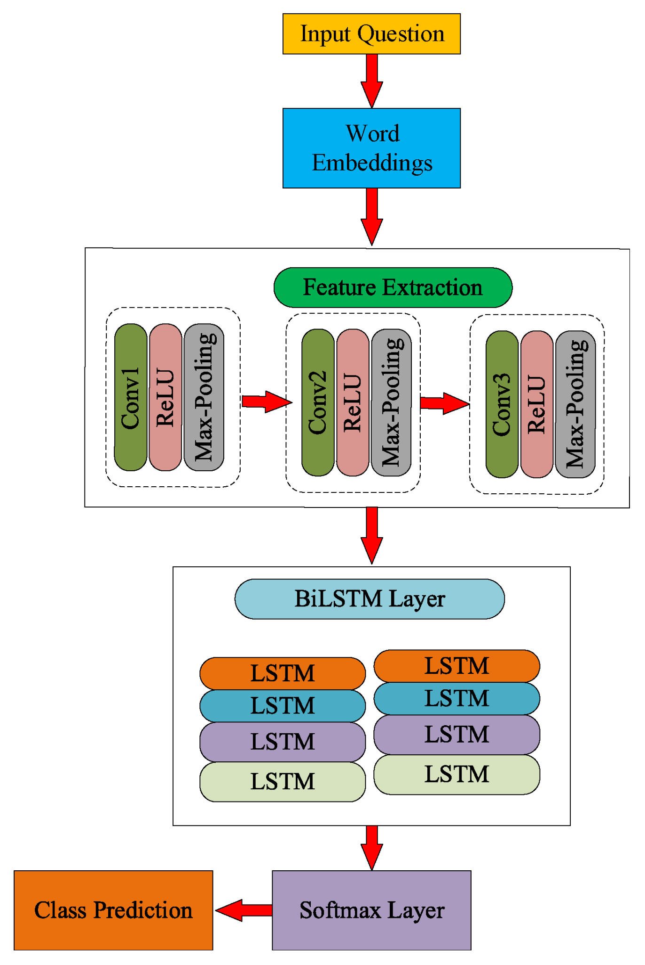
Baseline Model
Architecture: Embedding → BiLSTM → Dense → Softmax
Loss: Categorical Crossentropy
Metrics: Accuracy, Precision, Recall, F1-score
Limitations: Context ignorance, poor on rare entities

Slide 5
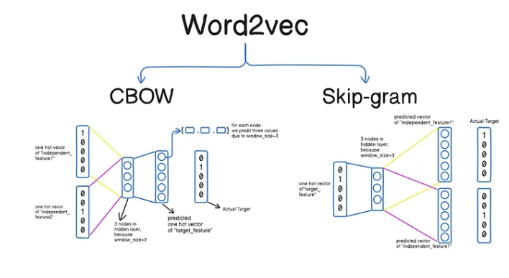
Enhanced Model With Word2Vec
Word2Vec: Pre-trained Word Embeddings Model
Word2Vec Embeddings capture semantic relationships between words, such that semantically similar words have similar vectors.
Results: Better Precision, Recall, Accuracy

Slide 6
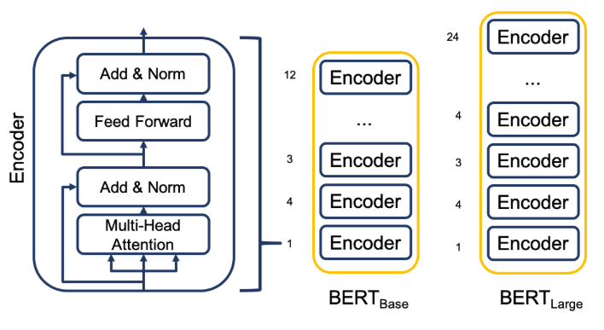
Enhanced Model With BERT
BERT Model: Pre-trained Contextual Embeddings Model
Powerful language model and bidirectional transformers to understand the context of text, achieving state-of-the-art results in many natural language processing tasks
Results: Better Precision, Recall, Accuracy

Slide 7
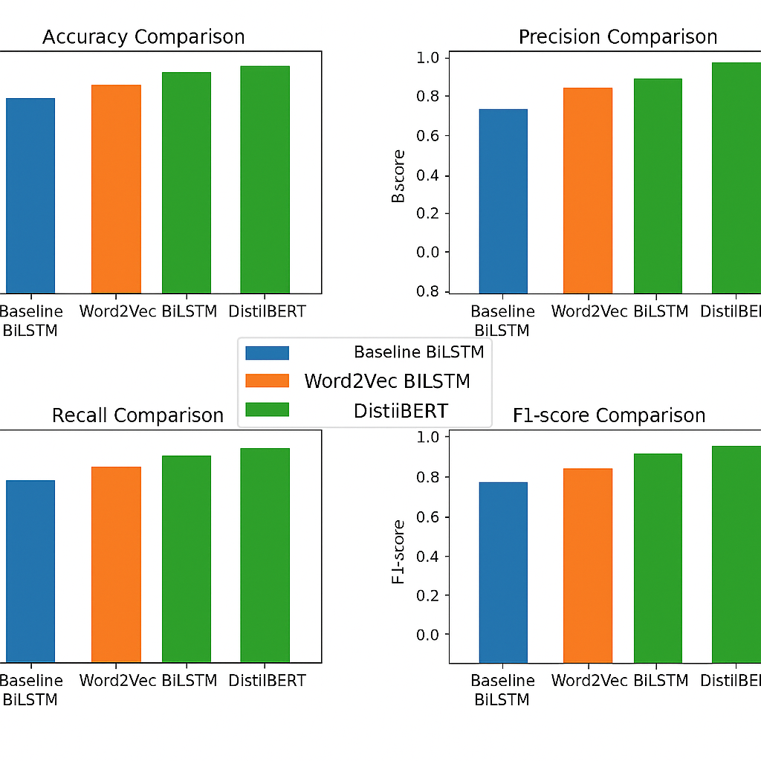
Model Evaluation
Metrics: Accuracy, Precision, Recall, F1 Score
Confusion matrix analysis
Baseline vs Enhanced: Comparison table

Slide 8
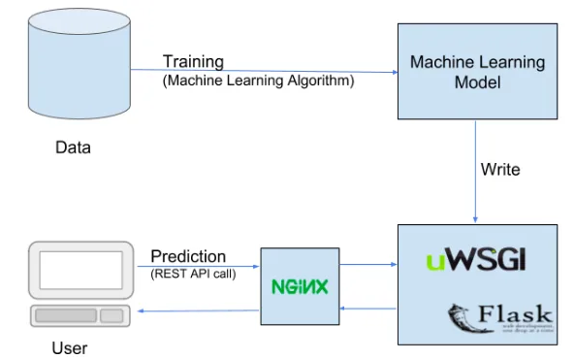
Deployment Architecture
Model: Saved as .h5
Flask API with tokenizer
Endpoints: '/', '/predict_api'
Output: Word-tag pairs

Slide 9
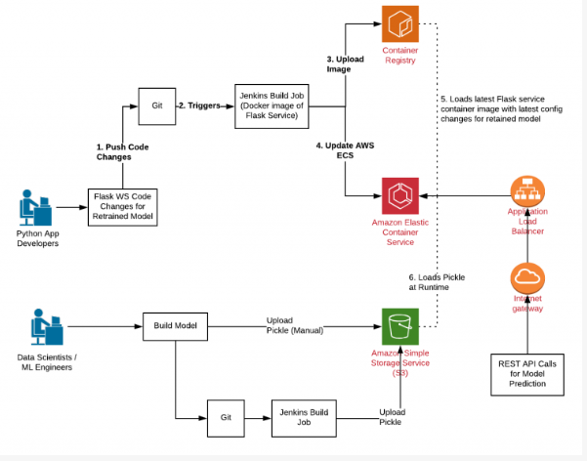
System Design
Canary Deployment: Gradual exposure
Monitoring: Latency, tag drift
Load Testing: Locust/JMeter
Training Audit: MLflow, version tracking

Slide 10
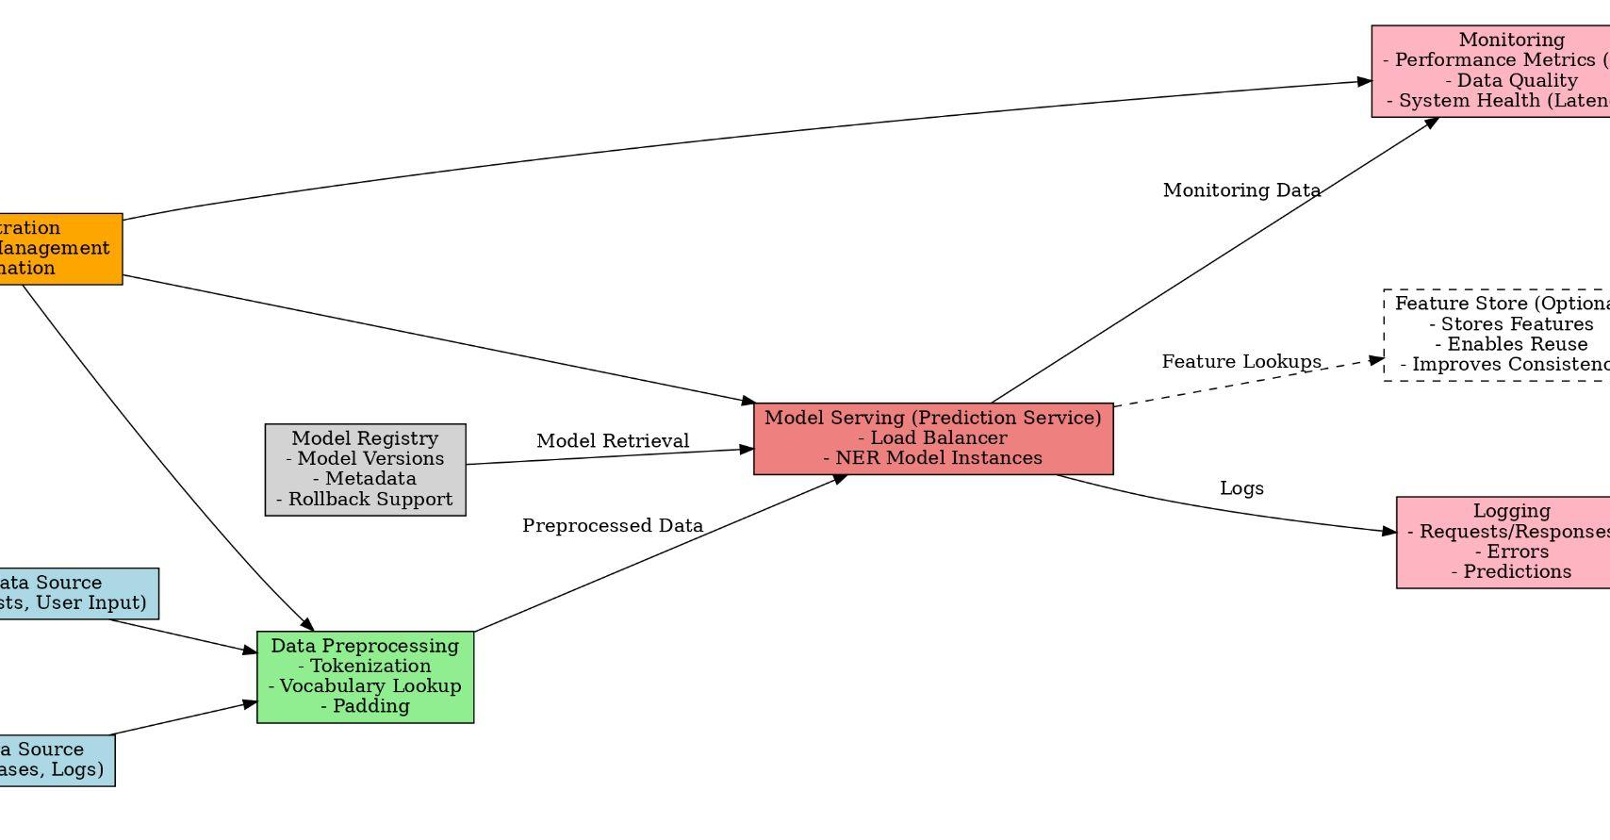
System Design Flowchart

Slide 11
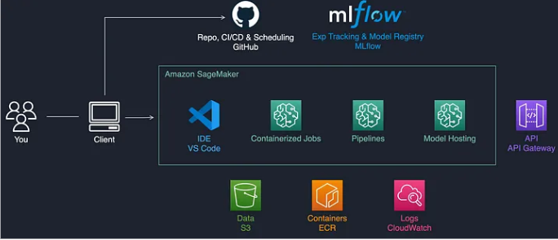
MLOps Strategy
CI/CD: Testing, training, deployment
Dockerized app, Jenkins/GitHub Actions
Continuous Monitoring & Retraining

Slide 12
Future Scope
Add CRF layer
Use advanced transformers (RoBERTa, T5, BERT-Base)
Multilingual NER
Real-time streaming with FastAPI

Slide 13
Deliverables Summary
✅ Data Understanding
✅ Data Pre-processing
✅ EDA Perform
✅ Feature Engineering
✅ Model Building : LSTM, Word2Vec, BERT
✅ Model Evaluation
✅ Model Save
✅ Installing All Required Library using Requirements file
✅ Flask App (app.py)
✅ Fronted : UI(Model Prediction on Unseen Data)

Slide 14
Thank You

