Slide 1

#LifeKoKaroLift
Post-Graduate Diploma in ML/AI

Slide 2



Course : Machine Learning
Lecture On : Chatbot
Instructor : Manish Kumar

Slide 3
Today’s Agenda
What are chatbots?
Subparts of Chatbot
RASA Installation
RASA Architecture
Natural Language Understanding
Dialogue Management system

Slide 4




Chatbots: Introduction
“ Chatbots are computer programs that maintain a conversation with a user in natural language, understand the user’s intent and send responses based on the organization’s business rules and data “
Building blocks of chatbots
Natural language Understanding, responsible for recognizing the user’s intent. This element uses natural language processing and machine learning to parse user messages, collect relevant parameters from words and sentences, and map those to actions to take
A front-end interface, which connects to a messaging applications such as Facebook Messenger or Slack, through which users interact with the chatbot.
Dialogue Management, manages the dialogue by maintaining a representation of the conversational logic and keeping track of context.

Slide 5
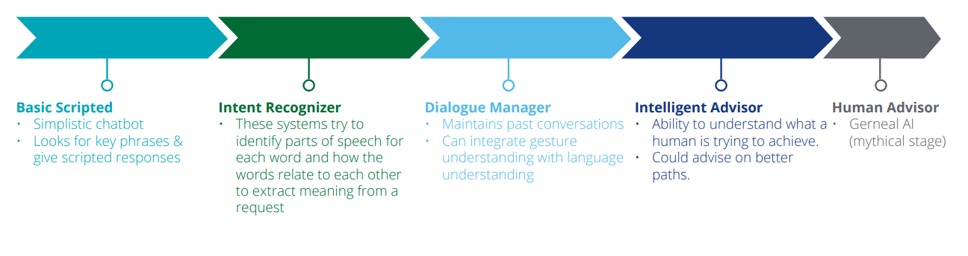
Evolution of a chatbot

Slide 6
Problem Statement
The main purpose of the bot is to help users discover restaurants quickly and efficiently and to provide a good restaurant discovery experience.
Foodie works only in Tier-1 and Tier-2 cities. You can use the current HRA classification of the cities from here. Under the section 'current classification' on this page, the table categorizes cities as X, Y and Z. Consider 'X ' cities as tier-1 and 'Y' as tier-2.
The bot should be able to identify common synonyms of city names, such as Bangalore/Bengaluru, Mumbai/Bombay etc.
Your chatbot should provide results for tier-1 and tier-2 cities only, while for tier-3 cities, it should reply back with something like "We do not operate in that area yet".

Slide 7
Problem Statement
NLU training: You can use rasa-nlu-trainer to create more training examples for entities and intents. Try using regex features and synonyms for extracting entities.
Build actions for the bot. Read through the Zomato API documentation to extract the features such as the average price for two people and restaurant’s user rating. You also need to build an ‘action’ for sending emails from Python.
Creating more stories: Use train_online.py file to create more stories. Refer to the sample conversational stories provided above. Your bot will be evaluated on something similar to the test stories shared.
Deployment (Optional): Deploy the model on Slack. You can create a new workspace or deploy it on an existing workspace (if you already use Slack).

Slide 8

Getting Started with Rasa
Rasa NLU and Rasa Core are two open source libraries for building conversational agents. Rasa NLU is the tool used for intent classification and entity extraction.
https://rasa.com/docs/getting-started/

Slide 9
Rasa – Installation (Requirements)
Python 3.7.0
Rasa NLU
Rasa Core
Spacy – en models

Slide 10


Python 3.6.5
Creating an environment
conda create --name rasa
https://docs.conda.io/projects/conda/en/latest/user-guide/tasks/manage-environments.html
DEMO !

Slide 11
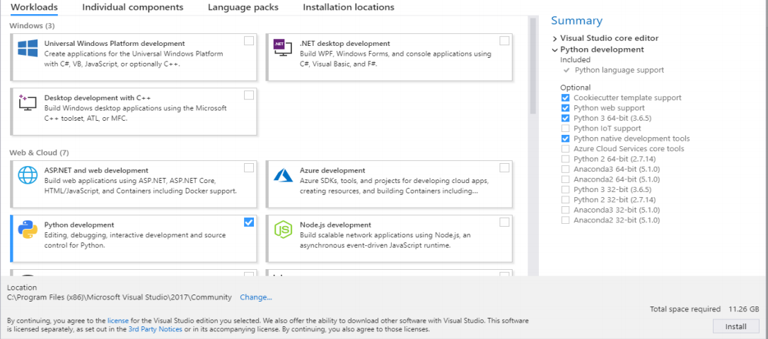
Visual Studio (Python Development tools)
Go the Microsoft Visual Studio link: https://visualstudio.microsoft.com/
Select the ‘Visual Studio IDE’ and from the dropdown, select the ‘Community version 2019’:
Install the downloaded file.
Once the Visual Studio is installed, select the Python Development under ‘Web & Cloud’ Environment. Also, on right side (Summary), in optional menu select the ‘Python native development tools’. Click on install

Slide 12
Rasa & Rasa X
Step 1 : Open anaconda prompt with administrator rights
Step 2 : Activate Virtual environment
>> activate rasa
Step 3 :
>> pip install rasa-x --extra-index-url https://pypi.rasa.com/simple
>> pip install rasa
Step 4 : Install rasa-nlu with spacy using
>> pip install rasa[spacy]
Step 5 : Download spacy model and link it
>> python -m spacy download en_core_web_md
>> python -m spacy link en_core_web_md en

Slide 13
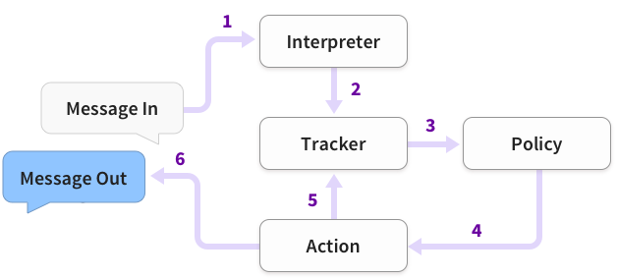
RASA - Architecture
The message is received and passed to an Interpreter, which converts it into a dictionary including the original text, the intent, and any entities that were found. This part is handled by NLU.
The Tracker is the object which keeps track of conversation state. It receives the info that a new message has come in.
The policy receives the current state of the tracker.
The policy chooses which action to take next.
The chosen action is logged by the tracker.
A response is sent to the user.

Slide 14

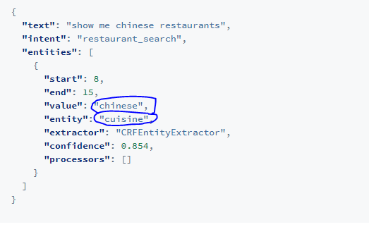
Natural Language Understanding (NLU)
The first layer of the conversational system, NLU, interprets the free text provided by the user. It basically takes an unstructured text phrase or sentence, understands what the user probably intends to say, extracts entities from it and converts it into structured data.
Unstructured user query: ‘show me Chinese restaurants’
Intent: restaurant_search; Entities: [cuisine=chiniese]

Slide 15

NLU – Training Data Format
The training data for Rasa NLU is structured into different parts:
common examples
synonyms
regex features
lookup tables
Data Formats
Markdown Format
JSON Format
https://rasa.com/docs/rasa/nlu/training-data-format/

Slide 16
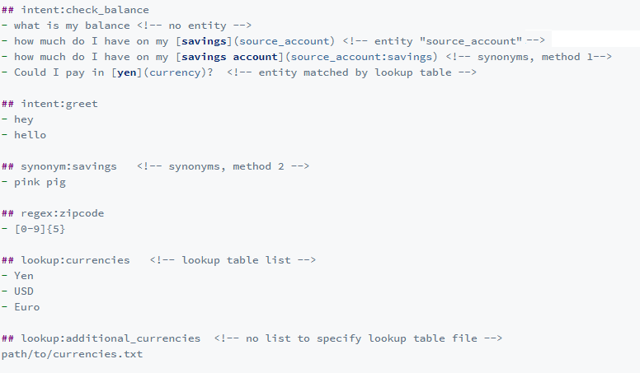
Markdown Data Format

Slide 17
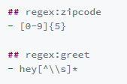


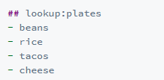
Training Data Format
We can create regular expression features for both intent and entity extraction. For e.g.the following piece of code specifies regexes for extracting zip code and the entity “greet”. Which are used as feature functions of the CRF
Rasa provides support to map synonyms or misspellings to an entity. For example:
Chinese <-> Chines.
Lookup tables in the form of external files or lists of elements may also be specified in the training data. The externally supplied lookup tables must be in a newline-separated format.

Slide 18
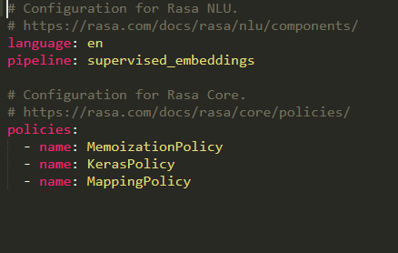

Training the NLU Model
Rasa NLU Training Pipelines
Rasa NLU comes with builtin pipelines for intent classification and entity extraction. The two most popular ones are:
pretrained_embeddings_convert
supervised_embeddings
./config.yml
https://rasa.com/docs/rasa/nlu/choosing-a-pipeline/
Notes:
If your training data is in english, a good starting point is using pretrained_embeddings_convert pipeline.
In case your training data is multi-lingual and is rich with domain specific vocabulary, use the supervised_embeddings pipeline:

Slide 19
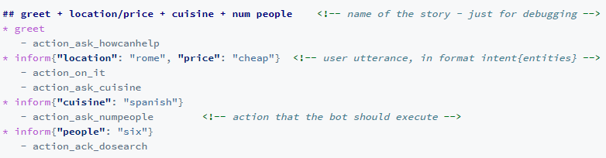
Dialogue-Flow Management
RASA Core
A dialogue management model will predict what response or action the chatbot should take based on the stage of the conversation. These actions/responses could be printing results on the screen, fetching data from a database, sending mail to the user, or simply saying "thank you!".
./stories.md

Slide 20
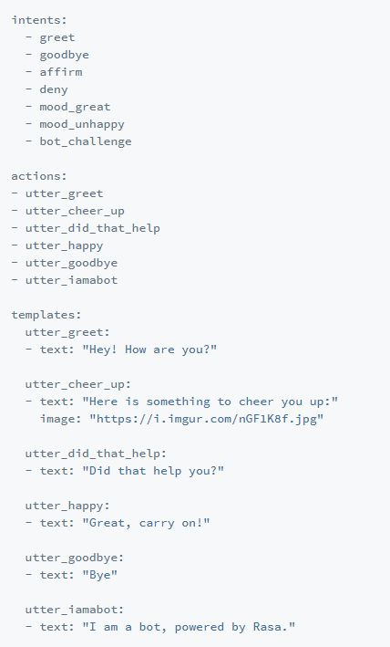
Dialogue-Flow Management
RASA Core
./domain.yml
The Domain defines the universe in which your assistant operates. It specifies the intents, entities, slots, and actions your bot should know about. Optionally, it can also include templates for the things your bot can say.

Slide 21
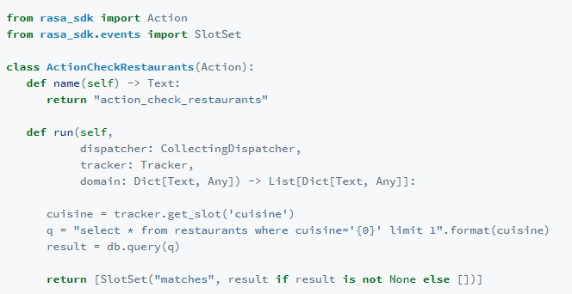
Dialogue-Flow Management
RASA Core
Actions are the things your bot runs in response to user input. There are four kinds of actions in Rasa:
Utterance actions: start with utter_ and send a specific message to the user
Retrieval actions: start with respond_ and send a message selected by a retrieval model
Custom actions: run arbitrary code and send any number of messages (or none).
Default actions: e.g. action_listen, action_restart, action_default_fallback
./actions.py

Slide 22
Problem Statement
The main purpose of the bot is to help users discover restaurants quickly and efficiently and to provide a good restaurant discovery experience.
Foodie works only in Tier-1 and Tier-2 cities. You can use the current HRA classification of the cities from here. Under the section 'current classification' on this page, the table categorizes cities as X, Y and Z. Consider 'X ' cities as tier-1 and 'Y' as tier-2.
The bot should be able to identify common synonyms of city names, such as Bangalore/Bengaluru, Mumbai/Bombay etc.
Your chatbot should provide results for tier-1 and tier-2 cities only, while for tier-3 cities, it should reply back with something like "We do not operate in that area yet".

Slide 23
Problem Statement
NLU training: You can use rasa-nlu-trainer to create more training examples for entities and intents. Try using regex features and synonyms for extracting entities.
Build actions for the bot. Read through the Zomato API documentation to extract the features such as the average price for two people and restaurant’s user rating. You also need to build an ‘action’ for sending emails from Python.
Creating more stories: Use train_online.py file to create more stories. Refer to the sample conversational stories provided above. Your bot will be evaluated on something similar to the test stories shared.
Deployment (Optional): Deploy the model on Slack. You can create a new workspace or deploy it on an existing workspace (if you already use Slack).

Slide 24
Dialogue-Flow Management
RASA Core
Domain file: It defines "the universe of your bot" by specifying the following:
Intents
Slots
Entities
Templates
Actions
Stories: Every training example for the dialogue system is a story. This file contains multiple stories your bot is likely to experience with users. Based on these stories, Rasa’s dialogue management model is trained using a sequence model such as RNN.
Actions: There are mainly two types of actions we will be using in this projects:
Utterance action: The bot just sends a text message to the user. For example: replying with a greet message, asking the location, etc
Custom actions: Actions such as querying the database, sending emails to the user, etc. If you want the bot to perform a custom action, you need to add that action in your domain file as well.

Slide 25
Dialogue-Flow Management
RASA Core
Slots: These are 'objects' you want to 'keep track of' during a conversation. For example, if a user says: ‘I want to book movie tickets for Raazi’, and the bots asks ‘For how many people?’, and the user responds 'Two'. Throughout this conversation, the bot needs to remember that ‘Raazi’ is the value of the entity movie_name and '2' is the value of the entity number_of_tickets, so it can be used to, for e.g., query a database. In other words, slots are the ‘memory’ of the bot. You can read more about slots here.
Intents (NLU layer): These are strings (such as 'greet', 'weather_search'), which describe what the user (probably) intends to say. Intents are extracted using typical machine learning classifiers.
Entities (NLU Layer): As you have already seen, entities are extracted using models such as (sklearn) CRF, spaCy etc. In most cases, entities are stored in slots; in cases when the entity is irrelevant for the dialogue flow, you don't need to assign it a slot (e.g. the name of the user).
Templates: Templates define how the bot will utter a statement. For example, if the bot wants to ask for cuisine preference, the template can define how the bot can ask it: ‘What kind of cuisine would you like’, ‘Specify your cuisine preference’, etc. All these can be specified in the template section of the domain file. A random response from the template is picked so that your bot doesn’t sound robotic or bland.
Actions: The 'actions' component enlists all the actions the bot can do - uttering a text message such as "Hi", looking up a database, making an API call, asking a question to the user etc. For example, an action named as 'actions.ActionSearchRestaurants' could look up a restaurant database to search for the restaurants given entities such as location and cuisine preferences. In this case, it looks up the 'ActionSearchRestaurants' class in the "actions.py" module.

Slide 26
Thank You !

