Slide 1
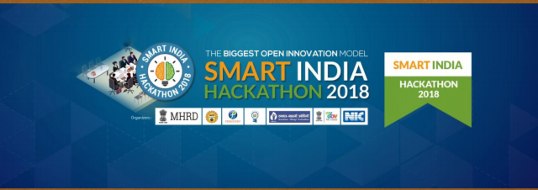
Smart India Hackathon 2018

Slide 2
Problem Statement
Real time monitoring of
mid-day meal Scheme
Ministry :
Government of Assam
Problem code:
#MWC6
College code :
4736
Team leader :
G . Sangeetha

Slide 3
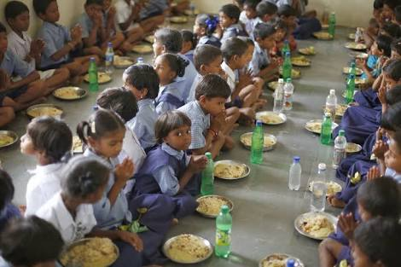
Distribution of mid day meals

Slide 4
Mid day meal scheme:
1. Midday Meal Scheme is a school meal programme of the Government of India designed to improve the nutritionalstatus of school-age children nationwide.
2. The programme supplies free lunches on working days for children in lower primary and upper primary classes in government, government aided, local body, Education Guarantee Scheme, and alternate innovative education centres.
3.Tracking of mid day meal will decipher the loop holes of the scheme and solve this monitoring issue. This program would help in central monitoring of the scheme thus increasing the transparency in scheme.

Slide 5
Solution :
1. We have developed an optimised and efficient Solution for monitoring of mid day meal scheme. It includes SMS based monitoring of the scheme. 2.Solution includes development of an application and a web portal for monitoring state's mid day meal activities. 3. Solution is done by automated monitoring system and by setting a gateway protocol for the conversion and it is obtained based on the development without internet that is also useful for rural areas people too.

Slide 6
BASIC PROTOTYPE :
APPLICATION
SMS is sent from a basic mobile to our application
Application receives SMS and checks whether it is registered number or not
Raw materials or cooked food is delivered accordingly to the schools
SMS is forwarded to The contractor and the information is updated in the website

Slide 7
Web portal
The portal will capture the information regarding the parameters of messages whether it is sent or not and it will manage the data between the in-charge and contractor.
The website will handle information by collecting data entry forms and enter the data into the online portal according to district level or school level.
Automated monitoring system, it will done the work by capturing the data from the schools by setting up the different systems like SMS and the reports will be made available for real time monitoring of the scheme at district level or school level.

Slide 8
Highlights :
Since our application has been built by an SMS gateway which acts as a simulator it receives message request from most basic mobile from most remote rural areas, no internet is needed to send request.
Web portal has been built for automatic monitoring and up dation of school information on daily basis.
Since it is an automatic monitoring and reporting system corruption could be controlled and transparency is ensured.

Slide 9
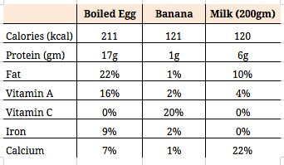
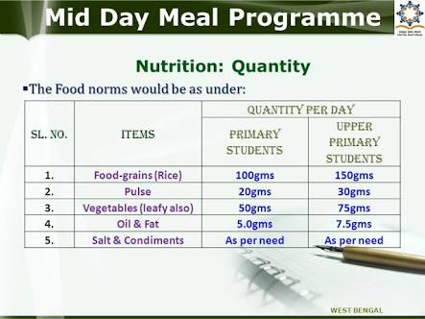
Nutritional Stack:
Notes:
This images indicates food norms of the food to be supplied to schools and nutritional table.

Slide 10
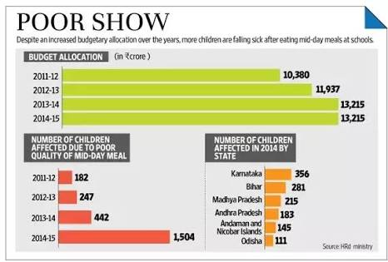
Malnutrition Eradication :

Slide 11
Additional features :
The main problem in mid day meal food supplement is some schools may corrupt the money by buying low quality ingredients and feeding adulterated food to children.
SOLUTION :
Our solution to the problem is by uploading photograph of the food prepared in the school to the server on daily basis. The date and time of the photo upload could be monitored efficiently so that hygiene and supplement of proper food according to mid day meal menu could be ensured.

