Slide 1
Realsense/camera based system for tracking Hand Pose
Implemented for ASL alphabet detection
Presented By:
J.V.S Kalyan Aashish(M22AI561)
Krishna Kumari Ravuri(M22AI567)
Rakesh Reddy Kadapala(M22AI608)

Slide 2
Introduction:
The project is motivated by the challenges faced by differently-abled children in acquiring sign language skills, a critical means of communication, due to limitations in traditional learning methods.
The primary goal is to develop a robust sign language recognition system within the MediaPipe framework and create an interactive learning companion application. This application aims to guide differently-abled children step-by-step in learning sign language independently.
The project is designed with a user-centric approach, specifically targeting differently-abled children. The intention is to provide an engaging tool that enhances their communication abilities, boosts confidence, and fosters inclusivity in education.
The project leverages the MediaPipe framework for sign language recognition, showcasing a commitment to using advanced technology, such as webcams on laptops, to address the learning needs of the target audience.
Beyond technical development, the project aspires to contribute to the broader goal of making education more accessible and inclusive for differently-abled individuals, ultimately impacting the lives of young learners by equipping them with vital communication skills.

Slide 3
Our Approach:
Dataset Creation
Dataset Preprocessing
Model Selection
Training the Model
Testing and Evaluation
Results

Slide 4
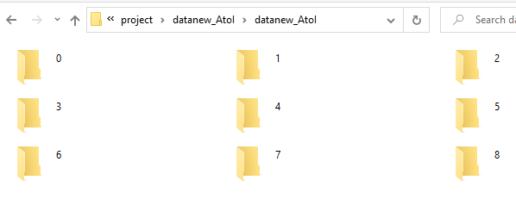
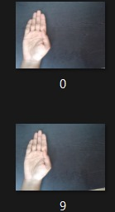
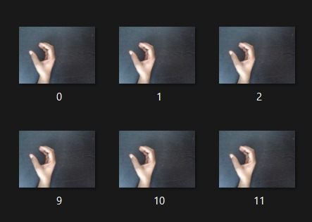
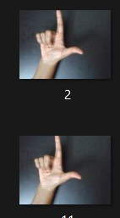
Dataset Creation and Preprocessing:
Used OpenCV to capture images in real-time
Organized the dataset with labeled images for each gesture class
Extracted features from hand landmarks with the help of Media pipe
Normalized the data to ensure consistency.
The processed data and labels are saved into pickle files .These pickle files store a dictionary containing the processed data and corresponding labels.

Slide 5
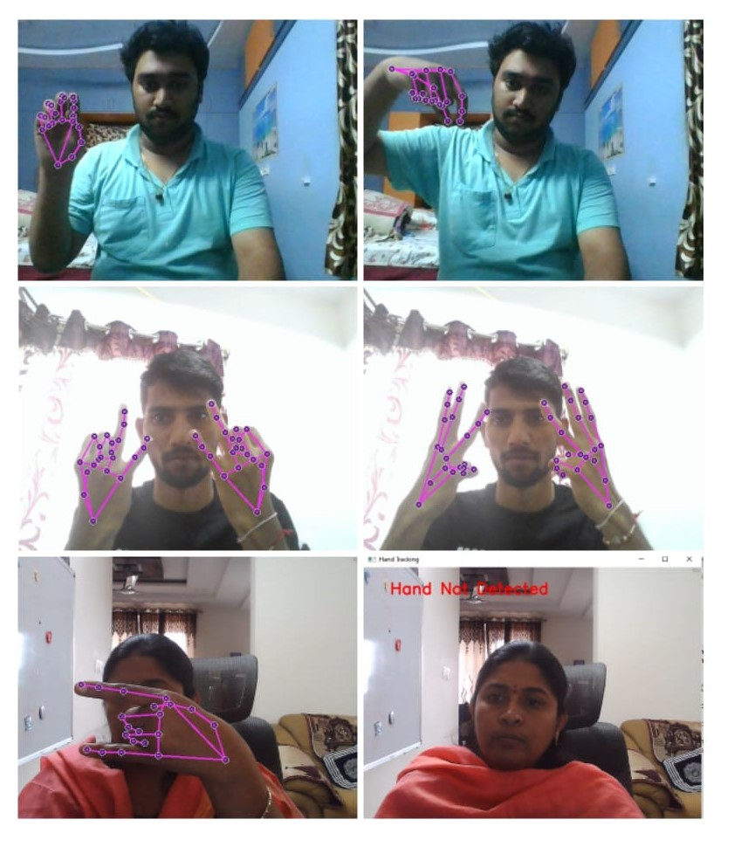
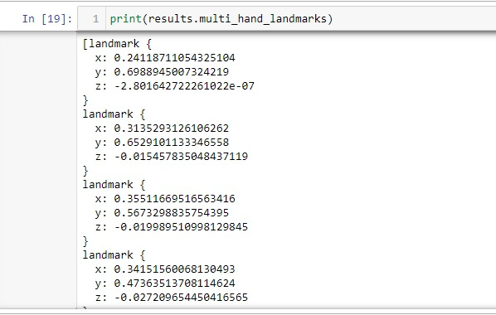
Media Pipe:
MediaPipe is an open-source framework developed by Google that provides a comprehensive and flexible set of tools for building perception pipelines. It is designed to simplify the development of applications related to computer vision, machine learning, and augmented reality. MediaPipe offers pre-trained models and building blocks for tasks such as hand tracking, face detection, pose estimation, and more.
the `MediaPipe` library is specifically used for hand tracking and landmark extraction

Slide 6
Model Selection and Training the Model:
Splitting dataset into training and validation sets
Training the model on prepared dataset using Random Forest classifier
Cross-validation for model evaluation
Trained model and the label encoder are saved into pickle. These pickle files store a dictionary containing the trained model and the label encoder, Which allow us to reuse them later without retraining.
Random Forest Classifier:
The Random Forest classifier is a popular machine learning algorithm
It is implemented in the scikit-learn library in python
Random Forest is robust to noise and outliers, making it suitable for real-world scenarios where hand positions may vary

Slide 7
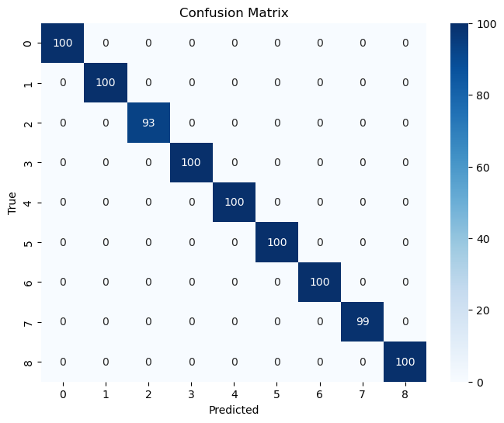
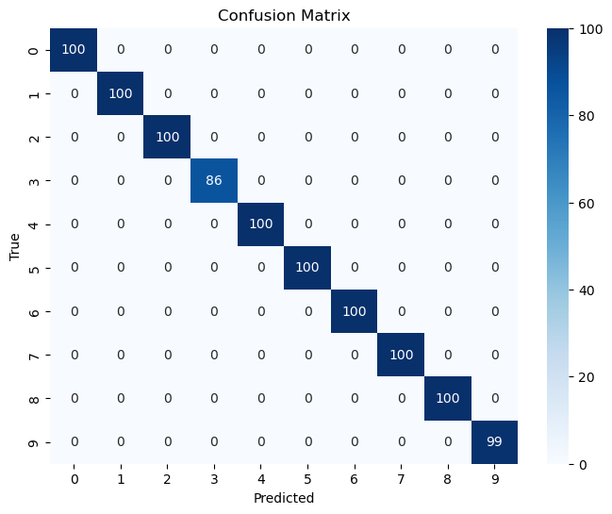
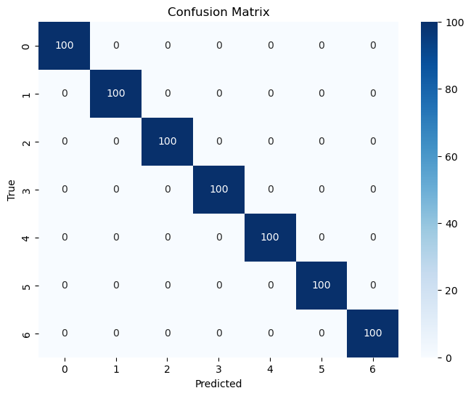
Confusion Matrix:
A to I Model
I to S Model
T to Z Model

Slide 8
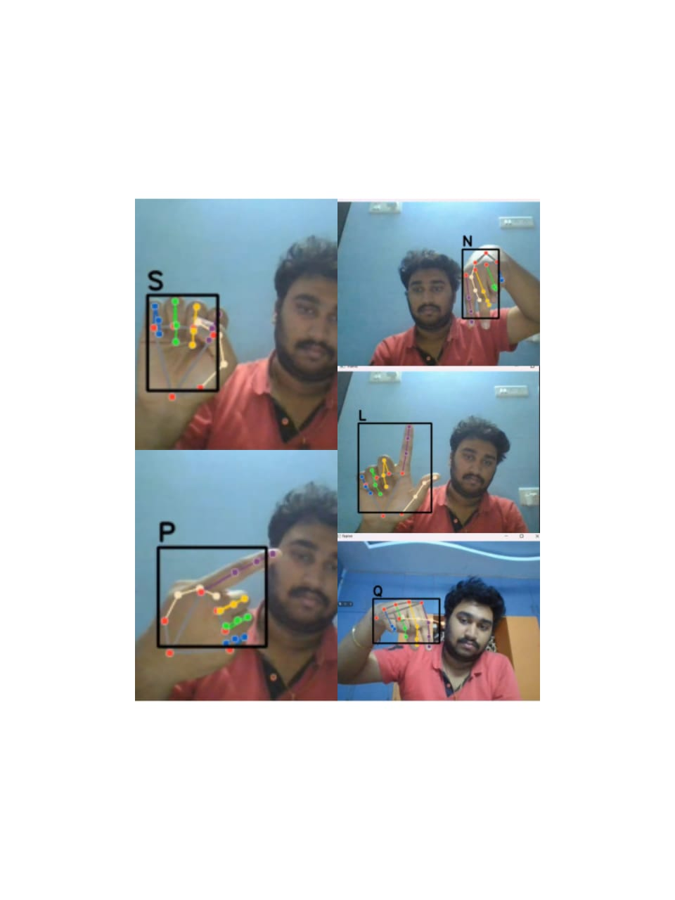
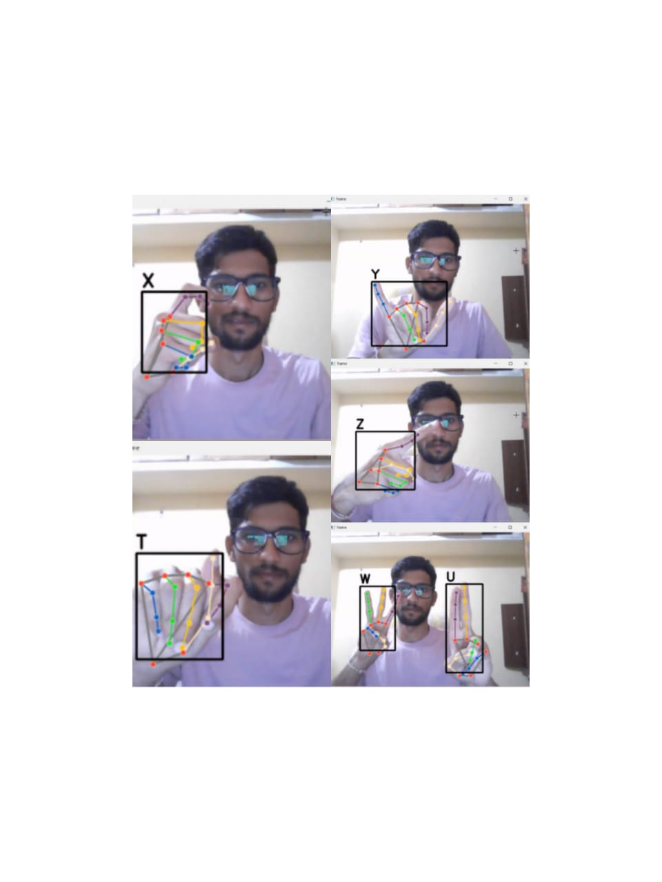
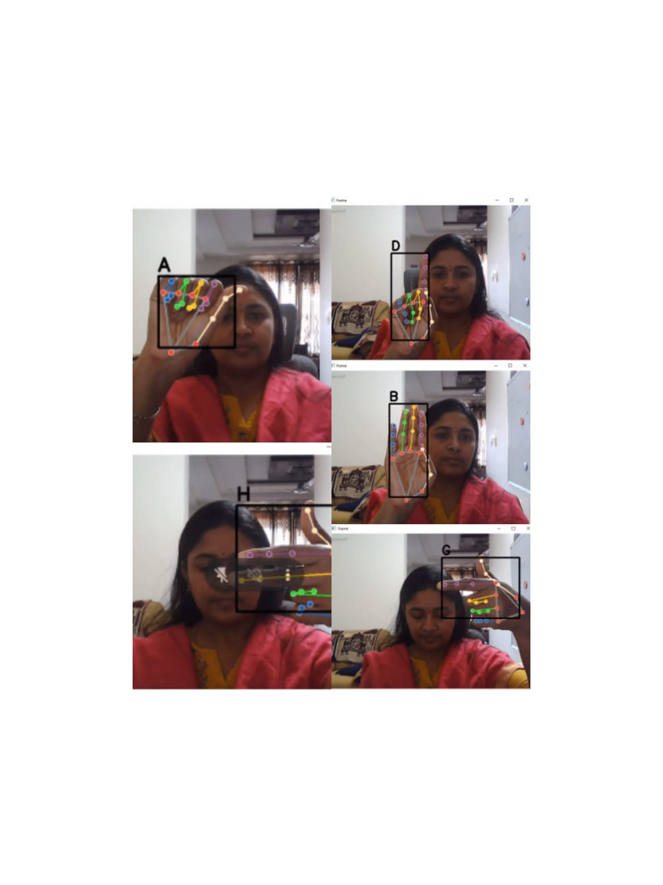
Results:

Slide 9
DEMO

Slide 10
THANK YOU

