Slide 1


Start-Up Acceleration
INSPIRING EXCELLENCE Copyright 2020 SkillAssure

Slide 2

AGENDA
Project Introduction
Problem Statement
Code Walkthrough
Key Concepts - Why we are doing it ? & Benefits?
Threads & Files Explanation - Why implementing Threads? How? & Benefits?
Output Explanation

Slide 3

PROJECT INTRODUCTION
Search Engine Case Study
This case study was carried out to implement search operations on files present in the system. It consists of 5 levels.
This algorithm displays all Active and Inactive drives prsesnt in the system.
It can search the file in each directory and displays the location of the file on the console.
For improving the efficiency of our algorithm, the multithreading algorithm has been used for searching file.
Caching concept is implemented to search for a file if it is already searched earlier.
At last, Unit testing is done for all the level works perfectly.

Slide 4
1.0 USE CASES 1. Search for a file in the system 2. View File Locations Searched
2.0 LEVELS TO CRACK
Level 1
· Identify the Drives Active and Inactive
· Display the Drives found
· Display a message asking for file name to search
PROBLEM STATEMENT

Slide 5
Level 2
Search for File Name in each drive Display the path if file name is found in console
Linear Search – Sequential in one drive after another
Level 3
Refine your search to enable parallel processing
Each drive to be searched multi-threaded.
Implement Exceptions - Generic and Custom
Display the path if file name is found in console
PROBLEM STATEMENT

Slide 6
Level 4
Store the Search Results in a file : Search History
Every Search initiated would now first check in history
If found, user is presented the file locations from the history
A new search is initiated if user is not satisfied with results from history
Level 5
Write Unit Tests to ensure code quality
Break down into Unit Testable methods
PROBLEM STATEMENT

Slide 7
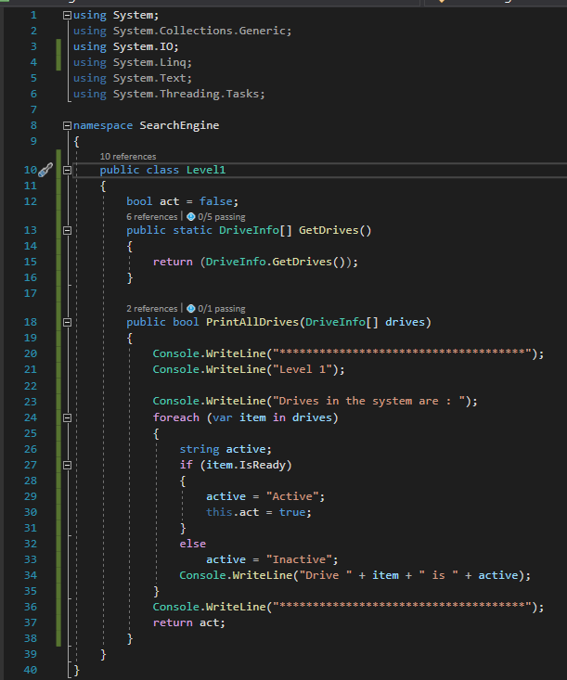
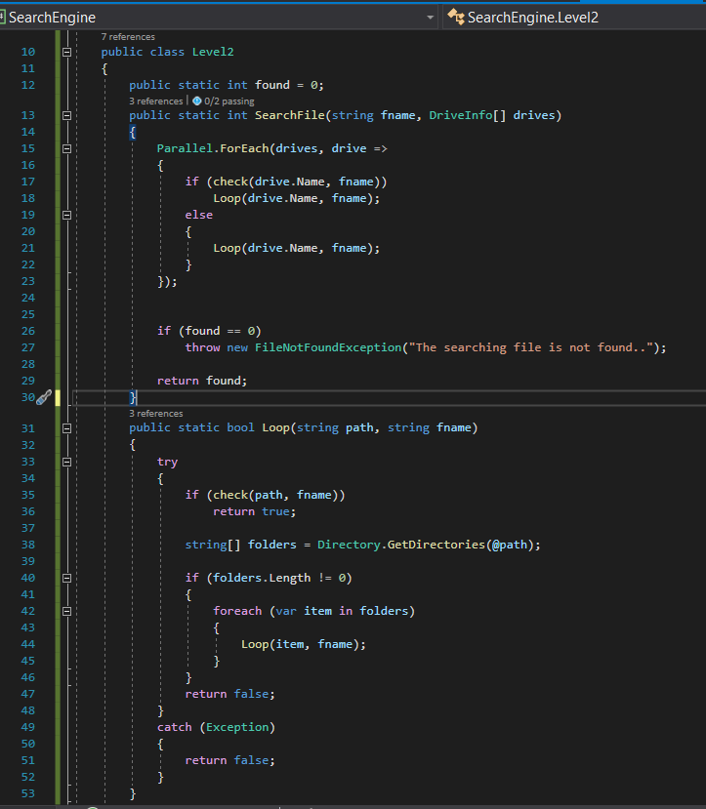
PROJECT SOLUTIONS

Slide 8
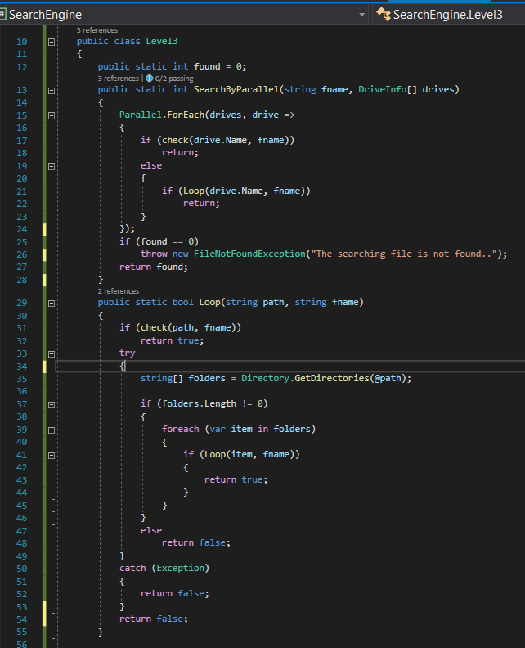
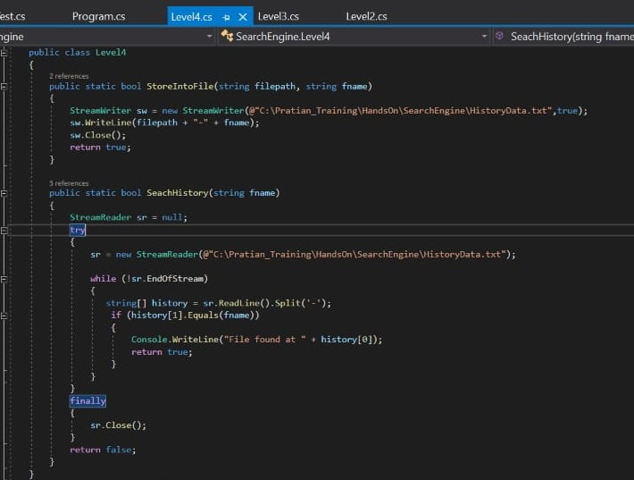
PROJECT SOLUTIONS

Slide 9
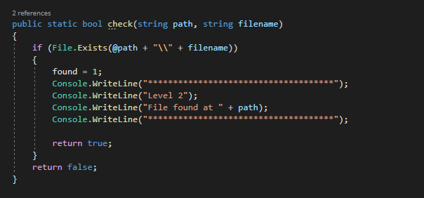
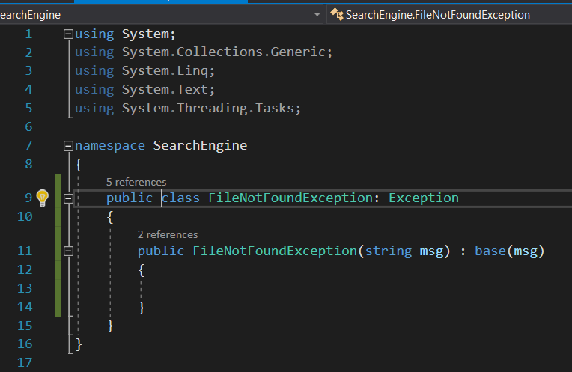
PROJECT SOLUTIONS

Slide 10
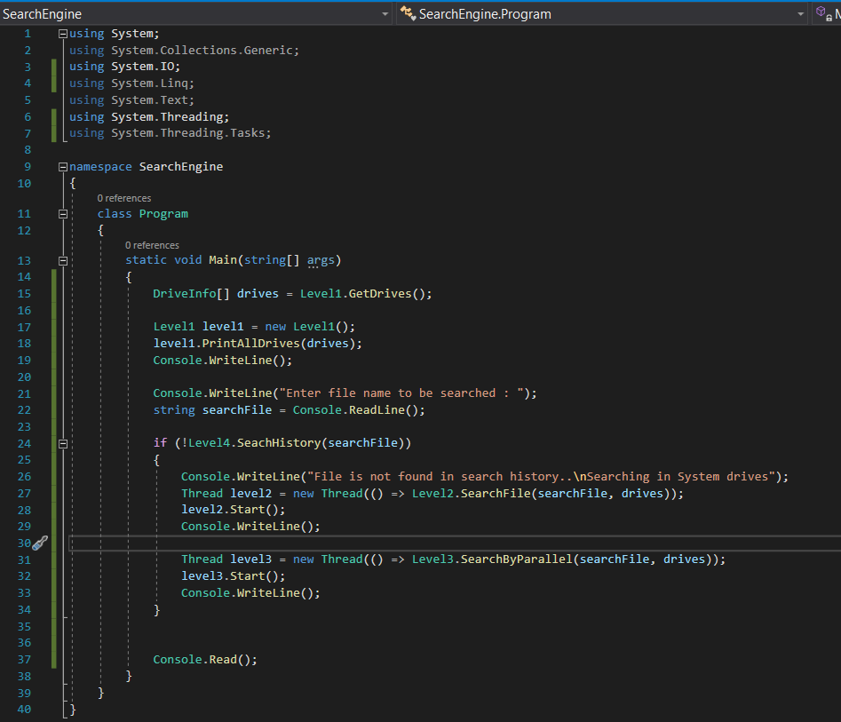
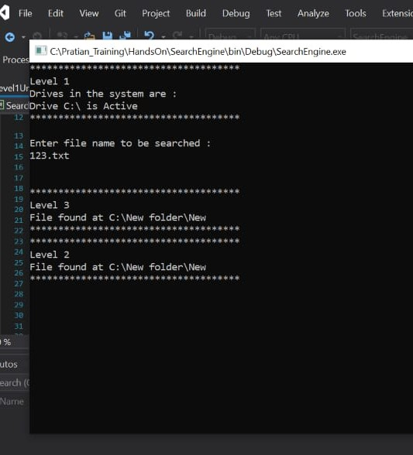
PROJECT SOLUTIONS

Slide 11
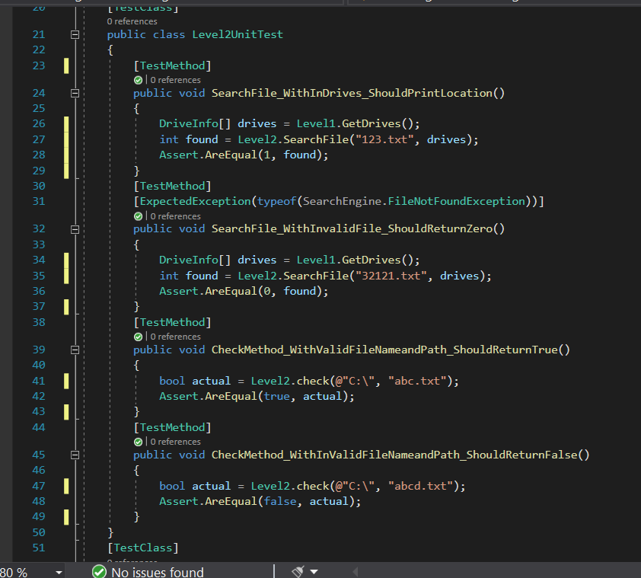
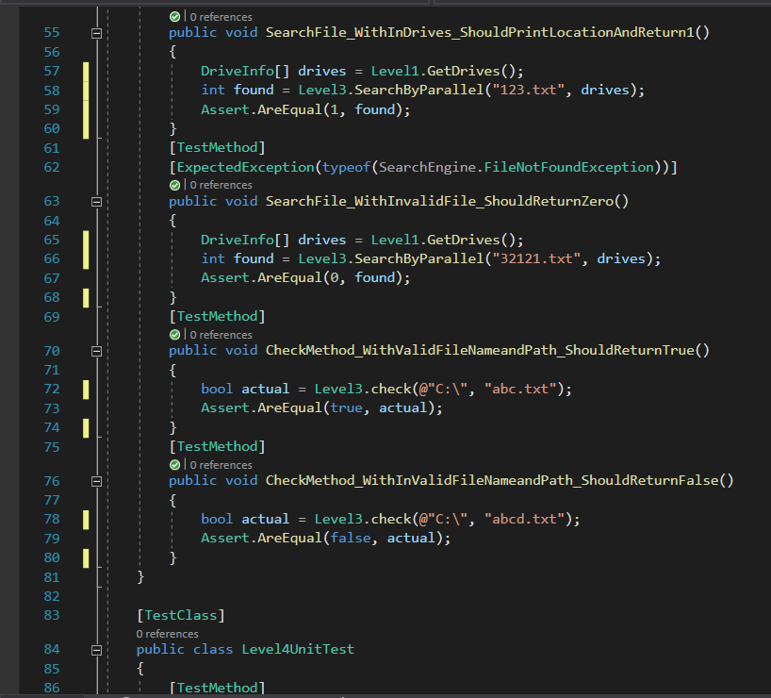
PROJECT SOLUTIONS

Slide 12
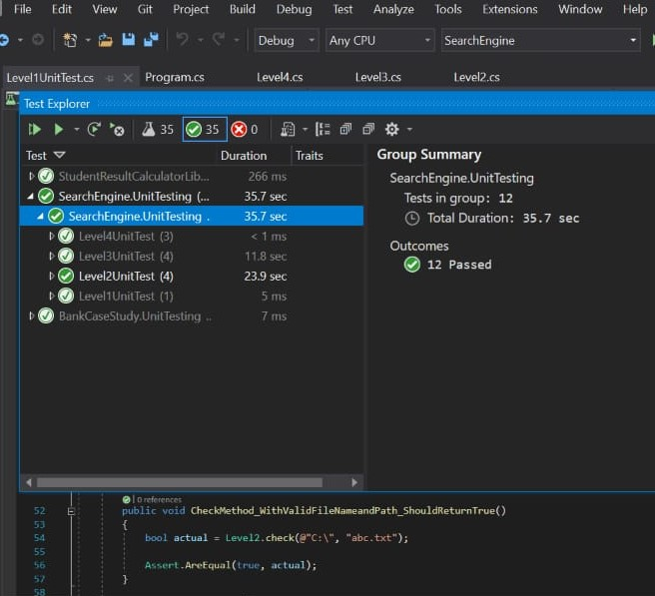
PROJECT OUTPUT

Slide 13
CODE WALKTHROUGH ...

Slide 14
RECORDING LINK

Slide 15

Thank You
© Pratian Technologies (India) Pvt. Ltd, 2020

