Slide 1

FPGA is all you need!
Akula Nitish
Rakesh Gourani

Slide 2
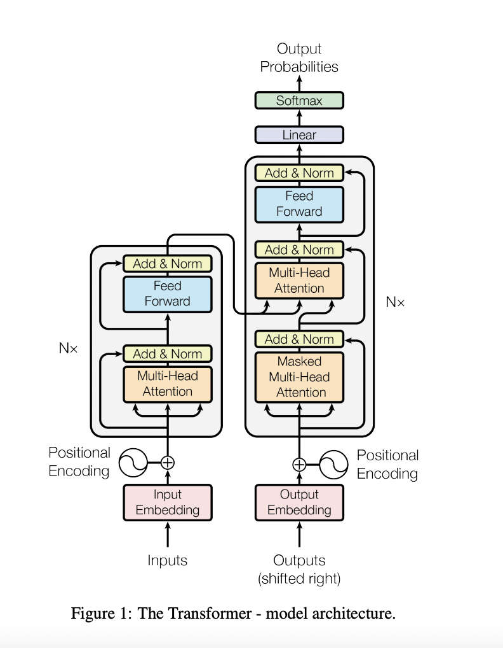
Problem Statement
Transformer's impact spans NLP, Computer Vision, and beyond[1].
There are Energy and Power efficient FPGA Implementations of the Transformer and similar Architectures[2][3].
Current gap: absence of open-source RTL code for FPGA-based Transformer implementation
Open-Source HLS Code Solution:
Developing open-source HLS code.
Prioritizing ease of use and flexibility.
Enabling seamless integration as an IP for diverse learning models.

Slide 3
Key Challenges
Absence of Existing C/C++ Codebase:
No available C/C++ codebase for Transformer analysis and acceleration.
Python Library Dependency:
Necessity to delve into Python libraries, such as PyTorch, and convert implementations to C/C++.
Scaling for FPGA Constraints:
Primitive Transformer model's size exceeds FPGA capacity.
Challenge in accommodating numerous layers within FPGA limitations.

Slide 4
Solutions & Novelty
Open-Source HLS Implementation:
Deliver an open-source HLS-based Transformer implementation tailored for vision applications.
Tunability and Flexibility:
Offer an easily tunable and flexible Transformer implementation, enhancing adaptability to diverse requirements.
Optimization for PYNQ Board:
Specialized optimization of Transformer HLS for superior performance, power efficiency, and space utilization on the PYNQ board.
Distinctive Approach: Unveiling a customizable, open-source HLS solution optimized for vision tasks and fine-tuned for PYNQ board specifications.

Slide 5
Initial Results
Started on converting the pytorch code to C/C++ for the required layers.

Slide 6
References
[1] K. Han et al., "A Survey on Vision Transformer," in IEEE Transactions on Pattern Analysis and Machine Intelligence, vol. 45, no. 1, pp. 87-110, 1 Jan. 2023, doi: 10.1109/TPAMI.2022.3152247.
[2] T. Wang et al., "ViA: A Novel Vision-Transformer Accelerator Based on FPGA," in IEEE Transactions on Computer-Aided Design of Integrated Circuits and Systems, vol. 41, no. 11, pp. 4088-4099, Nov. 2022, doi: 10.1109/TCAD.2022.3197489.
[3] Li Bingbing, Pandey Santosh, Fang Haowen, Lyv Yanjun, Li Ji, Chen Jieyang, Xie Mimi, Wan Lipeng, Liu Hang, and Ding Caiwen. 2020. FTRANS: Energy-efficient acceleration of transformers using FPGA. InInternational Symposium on Low Power Electronics and Design (ISLPED’20). Association for Computing Machinery, New York, NY, 175–180.

Slide 7
Thank you!
Q&A

