Slide 1
Detailed Project Report
THYROID DISEASE DETECTION……

Slide 2
INTRODUCTION
The thyroid gland is one of the endocrine glands that produce thyroid hormone to regulate the body’s metabolism. The Levothyroxine (T4) and Triiodothyronine (T3) hormones are produced by thyroid gland. These hormones play a major role in converting nutrients into energy and thereby helps in regulating body temperature, heart rate, and even brain function. Hyperthyroidism occurs when the hormones produced by the gland is more than the requirement of the body. However, hypothyroidism occurs when the hormones produced by the gland is less than the requirement of the body . Severe hyperthyroidism and end-stage hypothyroidism may cause deaths. During pregnancy, it can lead to health problems for the mother and baby.
About 70% risk of developing the thyroid disease is found to be associated with genetic background. Also, the contribution of environmental exposures such as perchlorate in rocket fuel, polychlorinated bi-phenols, and radiations (from nuclear fallout and medical radiation) in the disease risk is significant. Most of the environmental exposures reduce thyroid hormone levels. Recently, the thyroid disease risk is found to be linked with systemic lupus erythematosus, an autoimmune disease. There is some evidence of the correlation between thyroid disease and the low level of vitamin D.
The amount of T3 and T4 hormone in the blood is controlled by another hormone known as Thyroid Stimulating Hormone (TSH). Low T4 results in more production of TSH that initiates thyroid gland to produce more T4 & vice versa.
The different thyroid function tests such as TSH, T3, T4U, Total T4, and Free T4 Index (FTI) are done to assess the various functions related to the thyroid gland. A normal TSH and normal T4 is indicative of normal functioning of the thyroid gland, a low TSH and elevated T4 indicates hyperthyroidism, a low TSH and low T4 indicates secondary hypothyroidism, and a high TSH and low T4 indicates primary hypothyroidism. T3 tests are used for determining the severity of the hyperthyroidism or to diagnose the hyperthyroidism. The classification algorithm is based on supervised learning methodology where the labeled data is used for learning. These algorithms require very large labeled training sets which consist of many features or attributes. Finding meaningful information from the thyroid datasets of the patients with regard to the thyroid disease diagnosis is important. This paper compares the performance of three classification algorithms, namely, RF, SVM, and K-NN for the diagnosis of thyroid disease by analyzing labels (TSH, TT4, T3, FT4, and T4U) in hyperthyroid, hypothyroid, and normal subjects.

Slide 3
OBJECTIVE
The goal is to build a model which identify the type of thyroid, So a person can be either suffering from thyroid or can not be suffering from thyroid. In this project is to predict the risk of hyperthyroid and hypothyroid based on various factors of individuals. Thyroid disease is a common cause of medical diagnosis and prediction, with an on set that is difficult to fore cast in medical research. It will play a decisive role in order to early detection, accurate identification of the disease and helps the doctors to make proper decisions and better treatment.

Slide 4
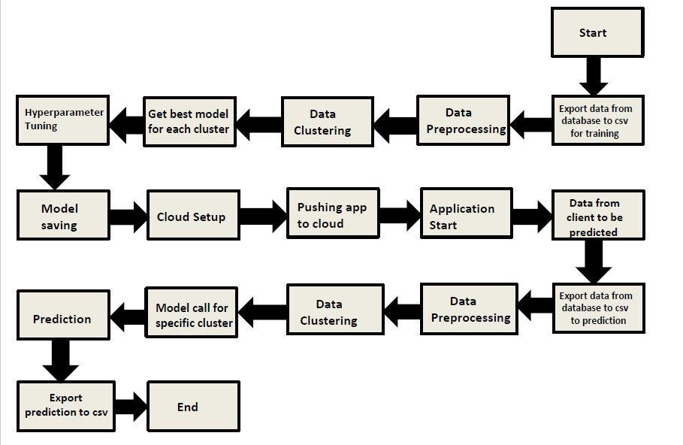
ARCHITECTURE

Slide 5
DATASET
Age
Sex
TSH Level
Total Thyroxine(TT4)
Free Thyroxine Index
Thyroxine Medication
Thyroid Disease Detection
AntiThyroid Medication
Goitre Test
Hypopituitary
Iodine Test
T3 Level Measure
Lithium Test
T4 Level Measure
Tumour Test
Psychological Symptoms
TBG Blood Test

Slide 6
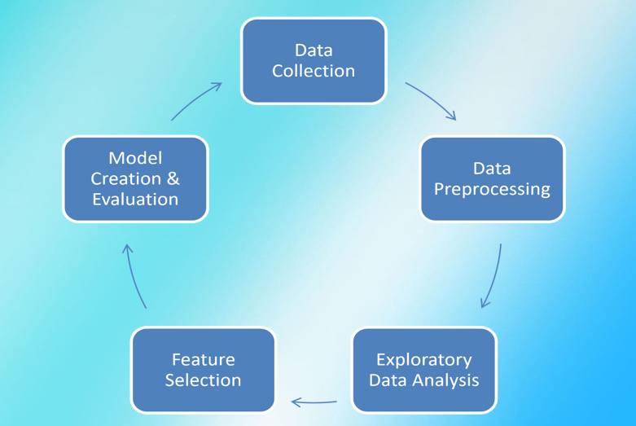
DATA ANALYSIS STEPS

Slide 7
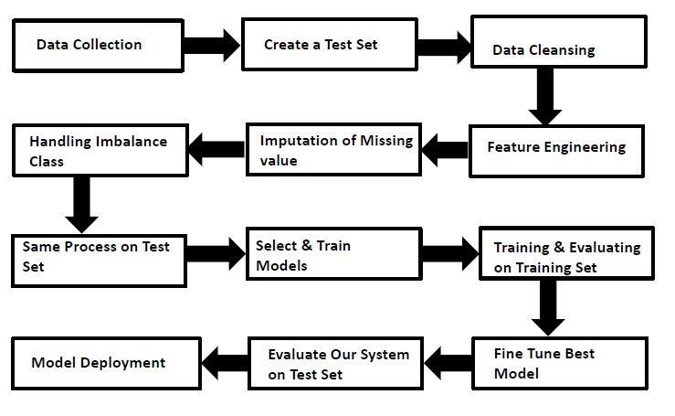
MODEL TRAINING AND VALIDATION WORKFLOW

Slide 8
Home Page:
This page will ask the user to insert the value
Result Page:
This page show the predicted value or result

Slide 9
Exploratory Data Analysis is a process of examining or understanding the data and extracting insights or main characteristics of the data. EDA is generally classified into two methods, i.e. graphical analysis and non-graphical analysis. EDA is very essential because it is a good practice to first understand the problem statement and the various relationships between the data features before getting your hands dirty.
EDA will be having the followings sections:
Data Summary
Show Dataset
Missing Values Report
Correlation Report
Outlier Report
Plots
Profiler Report
EDA

Slide 10
DATA PREPROCESSING
Data preprocessing is the process of transforming raw data into an understandable format. It is also an important step in data mining as we cannot work with raw data. The quality of the data should be checked before applying machine learning or data mining algorithms.
Data Preprocessing will be having the following sections:
Delete Columns
Handle Duplicate Data
Handle Missing Data
Missing values handling by Simple imputation (Used KNN Imputer)
Categorical features handling by ordinal encoding and label encoding
Imbalanced dataset handled by SMOTE -Over sampling
Drop unnecessary columns

Slide 11
Feature Engineering
Data Science is not a field where theoretical understanding helps you to start a career. It totally depends on the projects you do and the practice you have done that determines your probability of success. Feature engineering is a very important aspect of machine learning and data science and should never be ignored. The main goal of Feature engineering is to get the best results from the algorithms.
Feature Engineering will be having the following sections:
Scaling
Train Test Split
Feature Selection

Slide 12
Model Creation and Evaluation
Various classification algorithms like Random Forest and KNN (K-nearest neighbors) etc. tested.
Random Forest and KNN all were given better results.
Hyper parameter tuning was performed.
Model performance evaluated based on accuracy, confusion matrix, classification report.

Slide 13
Model Training
Machine Learning is all about developing computer programs that can receive various types of data as input (images, text, signals, numeric tables, etc), and then recognize patterns in the data and make insights and predictions based on those patterns. One of the most important features of ML is “self learning”. That said, it is important to note that while the computers can do a lot independently, there’s still a long way to go before they can take over the world.
Algorithm Used for Training:
K-nearest neighbors
Random Forest

Slide 14
Prediction
In this section of the web app, after inserting the value user gets its output

Slide 15
MODEL DEPLOYMENT
The final model is deployed on AWS using GitHub

Slide 16
QUESTIONS
Q1) What’s the source of data?
Ans: The data is available at uci site or Kaggle.
Q 2) What was the type of data?
  Ans: The data was the combination of numerical and Categorical values.
  Q 3) What’s the complete flow you followed in this Project?
  Ans: Please refer slide 7th to 15th for better understanding.

Slide 17
Q 4) How logs are managed?
Ans: Loggers are implemented in each and every module and function. All logs are being captured and recorded in a separate log file.
Q 5) What techniques were you using for data pre-processing?
Ans: Following techniques are used :
  Removing unwanted attributes
  Visualizing relation of independent variables with each other and output variables
  Checking and changing Distribution of continuous values
  Cleaning data and imputing if null values are present.
  Scaling the data

Slide 18
Q 6) How training was done or what models were used?
Ans:
Before diving the data in training and validation set we performed clustering over fit to divide the data into clusters.
As per cluster the training and validation data were divided.
The scaling was performed over training and validation data
Algorithms like Random Forest were used based on the recall final model was used for each cluster and we saved that model .
Q 7) How Prediction was done?
Ans: After performing the training and selecting the best model, when user gives input, we perform necessary step to make data clean and then predict the output.

Slide 19
Q 8) What are the different stages of deployment?
Ans: The web app will get deployed in:
AWS through GitHub
Q 9) How is the User Interface present for this project?
Ans: • For this project I have made UI.
• It is for one user input prediction also one can use bulk csv file upload using custom file upload or default file upload option.
• UI is very user friendly and easy to use.

Slide 20
Q 10) After the File validation what you do with incompatible file or files which didn’t pass the validation?
Ans: Files like these are moved to the Achieve Folder and a list of these files has been shared with the client and we removed the bad data folder.

Slide 21
Thank you……..

