Slide 1
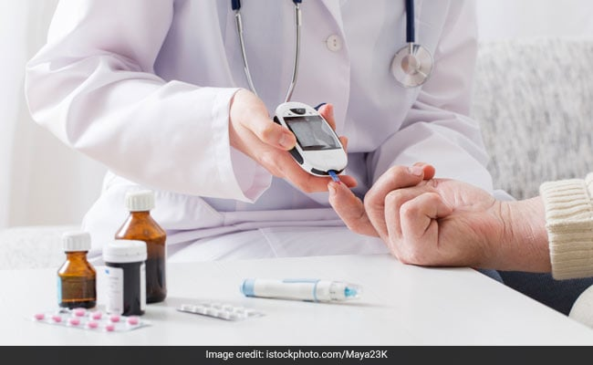
Final Project Healthcare

Slide 2
Results
As per the project requirement, ML model, Tableau worksheets and dashboard is created to give clear visibility to the Business for taking major decisions on company's next steps.
Through, Logistic Regression and RF model an accuracy of above 75% is attained.

Slide 3
Source Code
ML Code Link:
https://github.com/RakeshYads/Projects_2022/blob/main/Poject_Final/Final_Project_Diabetes.ipynb
Tableau Public Link:
https://public.tableau.com/app/profile/rakesh.yadav4533/viz/Final_Project_Healthcare/Dashboard1?publish=yes

Slide 4
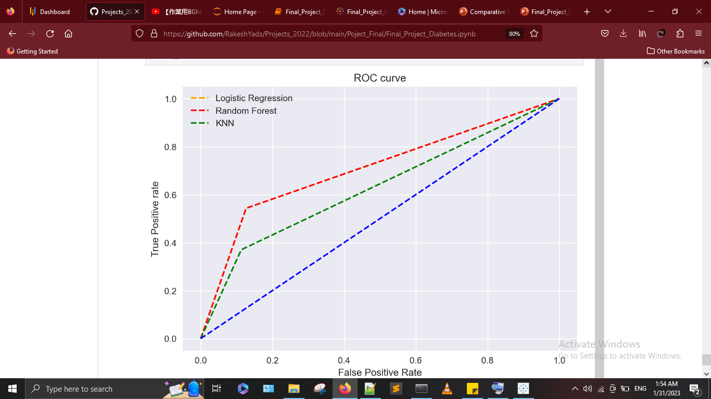
ML Model Results

Slide 5
Tableau Results

Slide 6
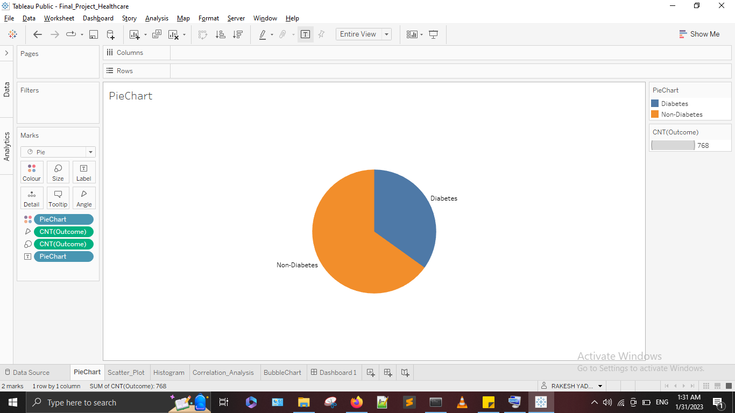

Slide 7
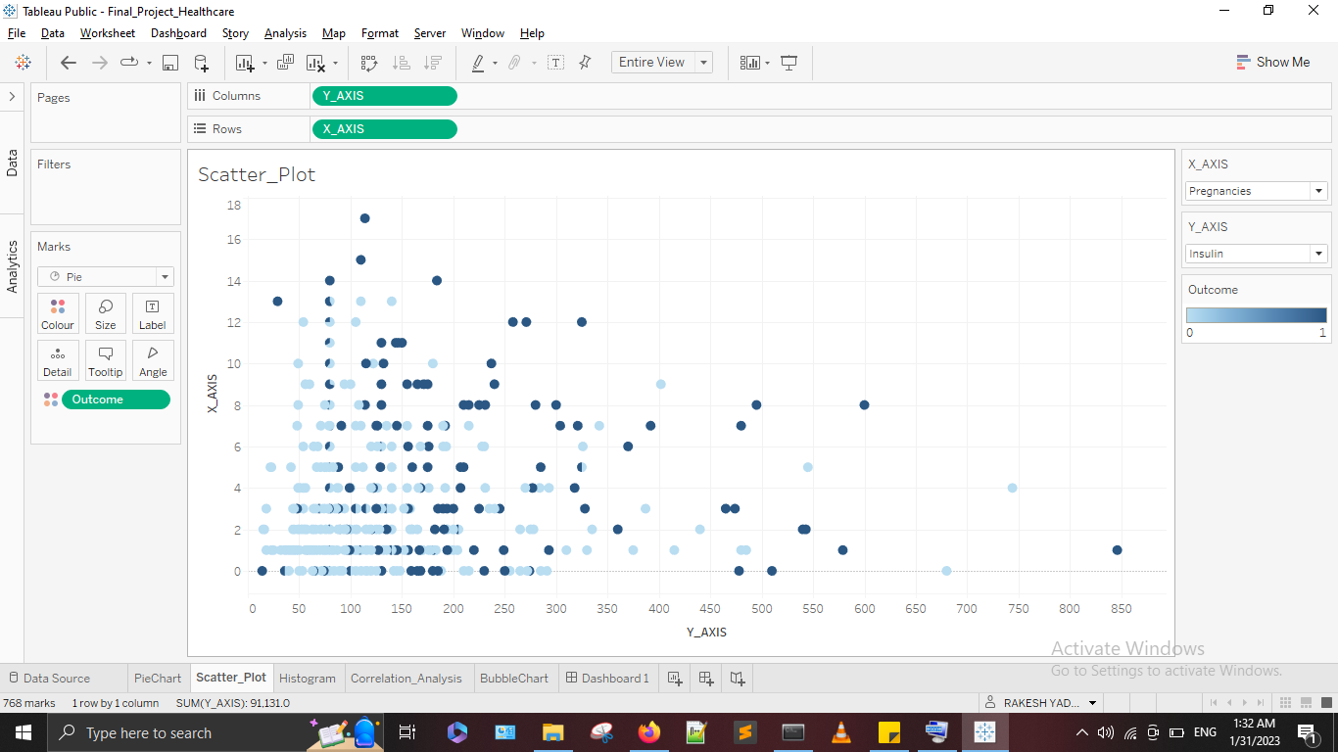

Slide 8
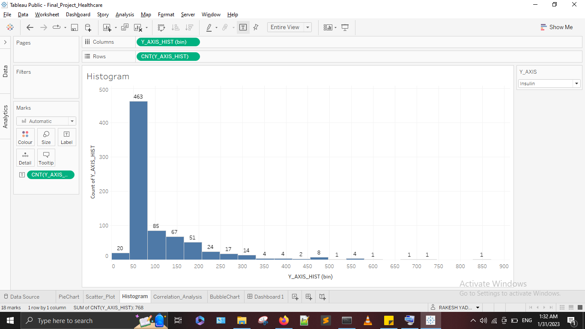

Slide 10
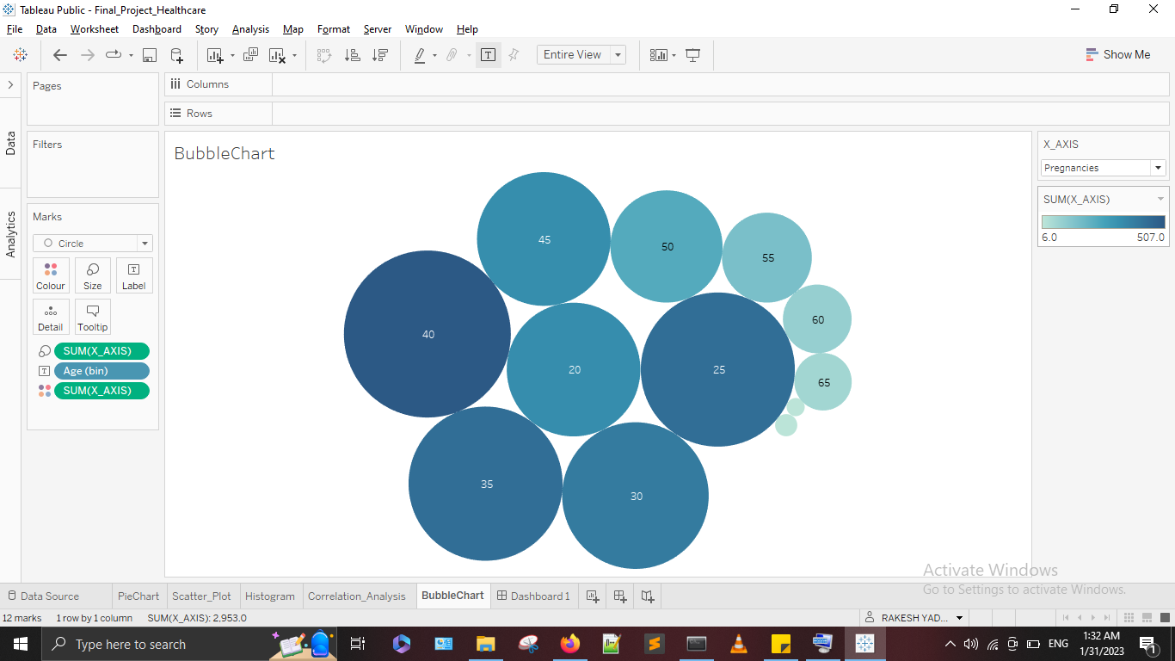

Slide 11
