Slide 1

ML- HEALTH CARE

Slide 2

Results
As per the project requirement, ML model, Tableau worksheets and dashboard is created to give clear visibility to the Business for taking major decisions on company's next steps.
Logistic Regression and Random Forest gives almost the same accuracy. We got an accuracy of above 80%. It's good enough to predict heart diseases in effective manner.

Slide 3
Source Code
ML Code Link:
https://github.com/RakeshYads/Projects_2022/blob/main/Project_2_Health_Care/Health_Care.ipynb

Slide 4
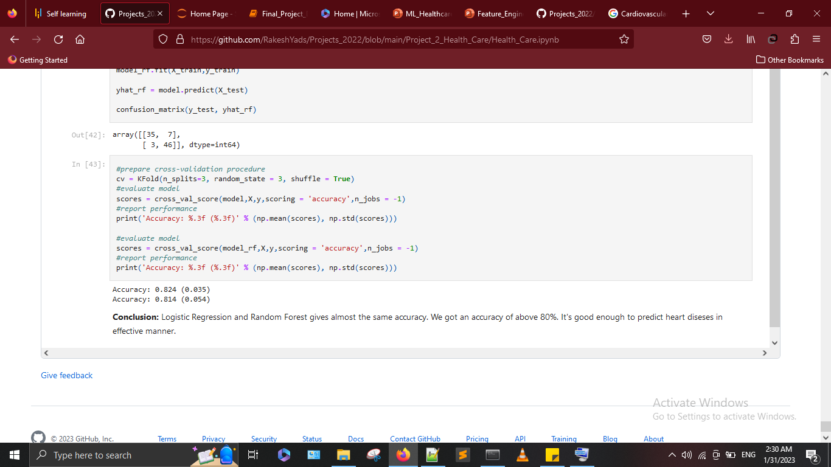
ML Model Results

