Slide 1

Feature Engineering – Real Estate

Slide 2
Results
As per the project requirement, the factors has been identified that influence price negotiations while buying a house. This will give a general idea to Real Estate on the factors that the buyers are looking for.
An accuracy of above 85% has been attained from ML model with the identified factors.

Slide 3

Source Code
ML Code Link:
https://github.com/RakeshYads/Projects_2022/blob/main/Project_1_Real_Estate/Feature_Engineering_Project_1.ipynb

Slide 4
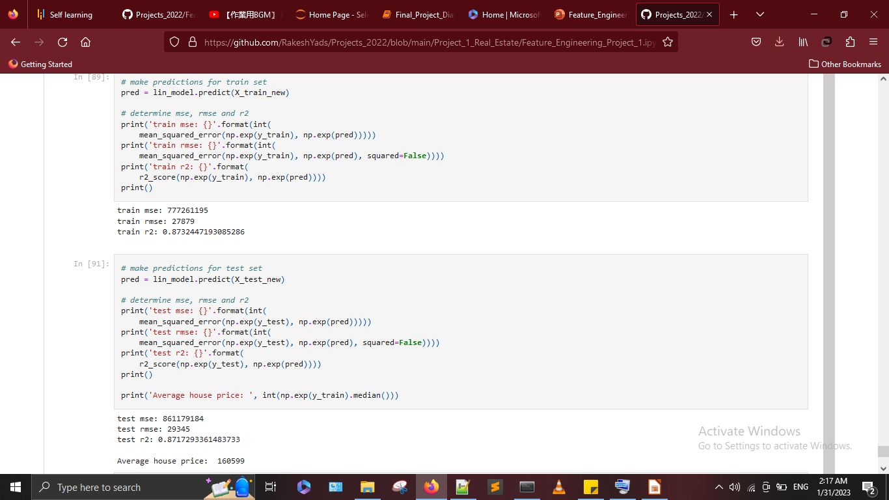
ML Model Results

