Slide 1
Idea Proposal – Smart Virtual Hackathon 2020
Problem Statement
Attendance using Face Recognition in a classroom with a single click
Team Name
Originators
Team Lead Name
Rakesh D
College Name
Kumaraguru College of Technology, Coimbatore.
Team Members
Rakesh D
Samvasan P
Mohan A
Sridhar A
Keerthivaasan K V R
Mentor
Raffik R, Assistant Professor

Slide 2
INTRODUCTION
There are many scientific advancements and inventions have taken place to save labor, increase the accuracy and to make life even more easier everyday.
Automatic Attendance System is one of the advancement in the field of automation replacing traditional attendance marking activity.
Automatic Attendance Systems are generally,
bio-metric based(fingerprint),
smart-card based(RFID), etc.
These systems are widely used in different organizations.
Traditional method of attendance marking is very time consuming and becomes complicated when the strength is more.
Automation of Attendance System has edge over traditional method as it saves time. This also helps to prevent fake attendance.
The subsequent sections in this presentation are objectives, assumptions, constraints, methodology and conclusion will be discussed in detailed in the following slides.

Slide 3
OBJECTIVES
To develop AI(Artificial Intelligence) model using machine learning process to mark attendance for students.
To reduce time and mistakes while marking attendance manually.
To make attendance marking system user friendly and efficient than conventional methods.
To establish sustainable method for facial detection and recognition for marking attendance.
ASSUMPTIONS
Good lighting condition and images.
Less processing time.
User-friendly(Simple interface).
Completes marking attendance in a single click.
CONSTRAINTS
Suitable only for classroom environment.
Attention from students is required to get better results.

Slide 4
Technology used
Computer vision – openCV
Dependencies openpyxl - excel sheet management
Tkinter - GUI Development
Matplotlib – Plotting data
Numpy – image pixels handled as array
tqdm – progress bar in iterations
Facial detection - haars cascade classifier
Face Recognition – createLBPHFaceRecognizer() algorithms
Machine learning(Artificial Intelligence)
Camera sensor
Computing device (4 GB RAM, Any OS)

Slide 5
METHODOLOGY
Creation of Dataset and face detection
For creating the dataset, we have used openCV and haars cascade classifier.
By using this classifier faces are detected and the cropped images of the face with their roll number are saved as folder.
While creating dataset, the name and roll number is updated in a spreadsheet.
Facial recognition and training
After creating dataset, the model for recognizing faces is build using open cv's model createLBPHFaceRecognizer() or any other equivalent model.
And the model is trained and saved and so, every time the dataset is updated.
Prediction (or) Testing
For attendance the camera is set on and all the faces are obtained from the haars cascade face classifier is looped to predict by the model.
Thus the roll number of the predicted faces is updated in a list and later updated in the spreadsheet created earlier using openpyxl module.
* haars cascade classifier to detect face in the image using openCV

Slide 6


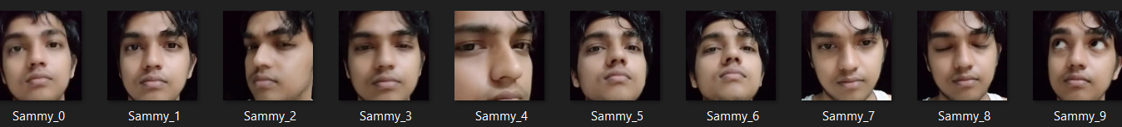

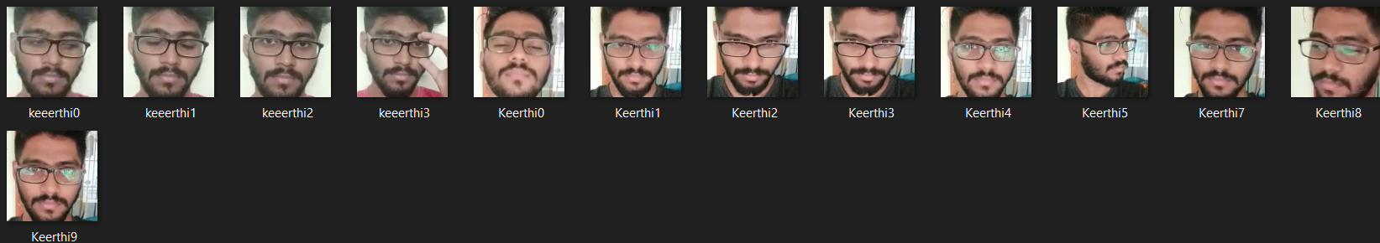
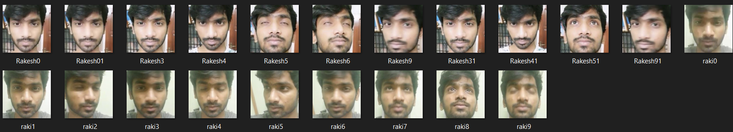
create_datasets.py
Created Datasets
Creation of Datasets
Collection of face data in different lighting conditions.
Data collected in form of video.
Image datasets acquired from collected video
Datasets collected from different students.
Saved separately

Slide 7
Created Datasets
training.py
Training Process
trainingData.yml

Slide 8
update_attendance.py
attendance.xlsx
trainingData.yml
Updating Attendance
attendance.xlsx
with a single click in GUI
Using:
1. Live stream(say 10 seconds)
2. With a single image

Slide 9
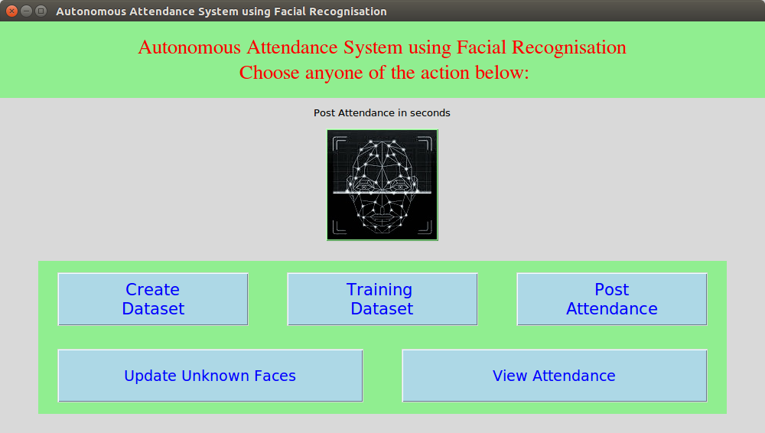

Slide 10
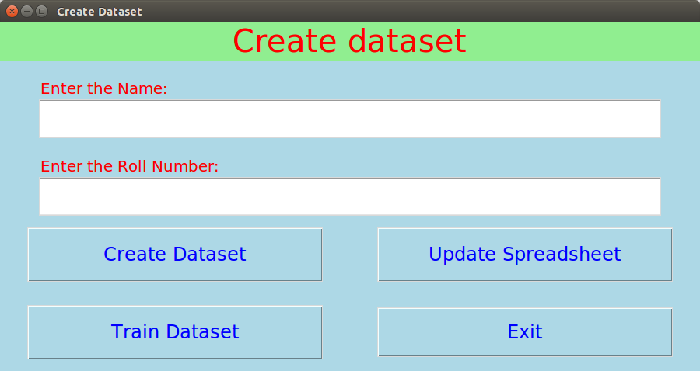

Slide 11
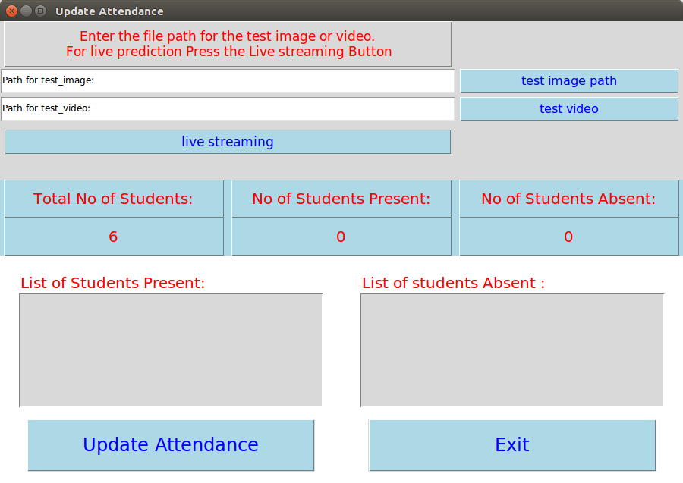

Slide 12
Conclusion
The above methodology can be used for the autonomous attendance system in educational institutions, offices, industries, companies, etc. depends upon environmental constraints.
This reduces the time and the model can be further improved for the precision and accuracy of the prediction.

