Slide 1
DOM Manipulation

Slide 2
JavaScript DOM Manipulation Basics
The DOM (Document Object Model) is a programming interface that represents your HTML page as a tree of objects.
JavaScript can use this tree to select, change, create, and remove elements, making web pages dynamic and interactive.

Slide 3
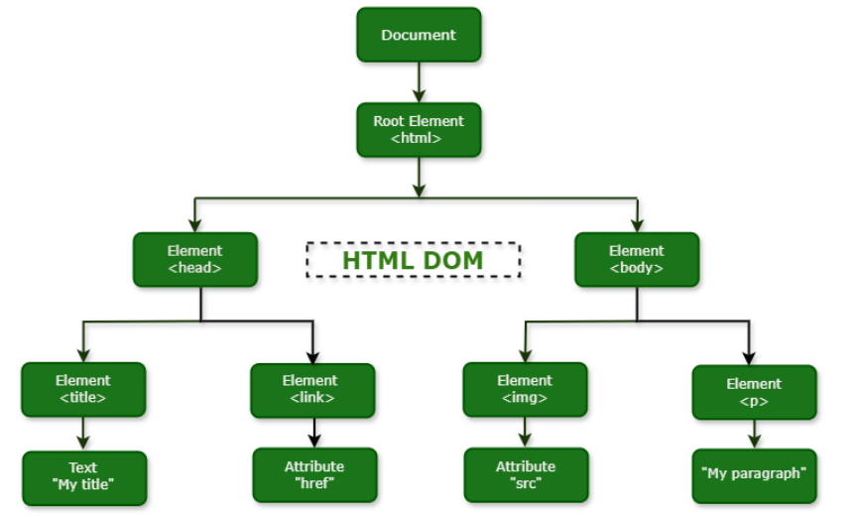
DOM Tree

Slide 4
1. What is the DOM?
The browser parses your HTML and creates a DOM tree.
Each HTML element becomes a node in this tree.
JavaScript can access and modify these nodes through the document object.
Think of the DOM as a live, in-memory representation of your page that you can manipulate with code.

Slide 5
2. The document object
The global document object is your entry point to the DOM.
console.log(document); // the entire document
console.log(document.body); // the <body> element
console.log(document.head); // the <head> element
console.log(document.title); // page title

Slide 6
3. Selecting elements
Before manipulating elements, you must select them.

Slide 7
3.1 getElementById
Selects a single element by its id.
const heading = document.getElementById("mainHeading");

Slide 8
3.2 getElementsByClassName
Returns a live collection of elements with a given class.
const items = document.getElementsByClassName("item");
console.log(items[0]); // first element with class "item"

Slide 9
3.3 getElementsByTagName
Returns a live collection of elements with a given tag.
const paragraphs = document.getElementsByTagName("p");

Slide 10
3.4 querySelector
Selects the first element that matches a CSS selector.
const firstItem = document.querySelector(".item");
const heading = document.querySelector("#mainHeading");
const firstLi = document.querySelector("li");

Slide 11
3.5 querySelectorAll
Selects all elements that match a CSS selector (returns a static NodeList).
const allItems = document.querySelectorAll(".item");
const allLis = document.querySelectorAll("ul li");
Modern code mostly uses querySelector and querySelectorAll because they support full CSS selector syntax.

Slide 12
4. Reading and changing content
textContent
innerHTML
innerText

Slide 13
4.1 textContent
Gets or sets the text content of an element (safe for plain text).
const p = document.querySelector("p");
// Read text
console.log(p.textContent);
// Change text
p.textContent = "New text content";

Slide 14
4.2 innerHTML
Gets or sets the HTML content inside an element.
const div = document.querySelector("#content");
// Read HTML
console.log(div.innerHTML);
// Change HTML
div.innerHTML = "<strong>Bold text</strong> and more";
Use innerHTML carefully; inserting untrusted HTML can cause security issues.

Slide 15
4.3 innerText
Similar to textContent but reflects rendered text and is affected by CSS. Prefer textContent for most cases.

Slide 16
5. Working with attributes
getAttribute & setAttribute
Direct Property Access
removeAttribute and hasAttribute

Slide 17
5.1 getAttribute and setAttribute
const img = document.querySelector("img");
// Read attribute
const src = img.getAttribute("src");
// Set attribute
img.setAttribute("alt", "Sample image");
img.setAttribute("src", "new-image.jpg");

Slide 18
5.2 Direct property access
Many attributes map directly to properties.
const link = document.querySelector("a");
console.log(link.href);
link.href = "https://example.com";
link.target = "_blank";

Slide 19
5.3 removeAttribute and hasAttribute
const input = document.querySelector("input");
console.log(input.hasAttribute("disabled"));
input.removeAttribute("disabled");

Slide 20
6. Working with classes
className
classList

Slide 21
6.1 className
Gets or sets the entire class string.
const box = document.querySelector(".box");
console.log(box.className); // "box active"
box.className = "box new-class";

Slide 22
6.2 classList (preferred)
Provides methods to manipulate classes cleanly.
const box = document.querySelector(".box");
box.classList.add("highlight");
box.classList.remove("old");
box.classList.toggle("dark"); // add if missing, remove if present
console.log(box.classList.contains("highlight")); // true

Slide 23
7. Changing styles
Inline Style
Computed Style

Slide 24
7.1 Inline styles via style
const box = document.querySelector(".box");
box.style.backgroundColor = "lightblue";
box.style.fontSize = "18px";
box.style.padding = "10px";
Note: CSS property names use camelCase in JavaScript (background-color → backgroundColor).

Slide 25
7.2 Computed styles
To read the final computed style (including CSS files):
const box = document.querySelector(".box");
const computed = window.getComputedStyle(box);
console.log(computed.backgroundColor);
console.log(computed.width);

Slide 26
8. Creating and adding elements
createElement
Adding Element
Inserting Adjacent Element

Slide 27
8.1 createElement
Creates a new element node.
const newDiv = document.createElement("div");
newDiv.textContent = "I am a new div";

Slide 28
8.2 Adding elements to the page
Common methods:
appendChild – add as the last child.
prepend – add as the first child.
append – add one or more nodes/strings at the end.
insertBefore – insert before a specific child.
const container = document.querySelector("#container");
// Append as last child
container.appendChild(newDiv);
// Prepend as first child
container.prepend(newDiv);
// Append multiple nodes or text
container.append(newDiv, " some text");

Slide 29
8.3 Inserting adjacent elements
const ref = document.querySelector("#ref");
// Insert as sibling
ref.insertAdjacentElement("beforebegin", newDiv); // before ref
ref.insertAdjacentElement("afterend", newDiv); // after ref
// Insert HTML string
ref.insertAdjacentHTML("beforeend", "<span>New span</span>");

Slide 30
9. Removing and replacing elements
Remove
removeChild
replaceChild

Slide 31
9.1 remove
Removes an element from the DOM.
const item = document.querySelector(".item");
item.remove();

Slide 32
9.2 removeChild
Older pattern, still common.
const parent = document.querySelector("#list");
const child = document.querySelector("#itemToDelete");
parent.removeChild(child);

Slide 33
9.3 replaceChild
Replaces one child with another.
const parent = document.querySelector("#list");
const oldItem = document.querySelector("#old");
const newItem = document.createElement("li");
newItem.textContent = "New item";
parent.replaceChild(newItem, oldItem);

Slide 34
10. Traversing the DOM
You can move around the DOM tree.

Slide 35
10.1 Parent
const child = document.querySelector(".child");
const parent = child.parentElement; // or child.parentNode

Slide 36
10.2 Children
const parent = document.querySelector("#list");
const children = parent.children; // HTMLCollection
const firstChild = parent.firstElementChild;
const lastChild = parent.lastElementChild;

Slide 37
10.3 Siblings
const elem = document.querySelector("#item");
const next = elem.nextElementSibling;
const prev = elem.previousElementSibling;

Slide 38
10.4 General nodes
childNodes – includes text nodes, comment nodes, etc.
firstChild, lastChild, nextSibling, previousSibling – work on all node types.
For most cases, use the *Element* versions to ignore text/comment nodes.

Slide 39
11. Event listeners and interaction
DOM manipulation is often combined with events to make pages interactive.

Slide 40
11.1 addEventListener
Attaches an event handler to an element.
const button = document.querySelector("#myButton");
button.addEventListener("click", function() {
console.log("Button clicked");
});
With arrow functions:
button.addEventListener("click", () => {
console.log("Button clicked");
});

Slide 41
11.2 Common events
click
mouseover, mouseout
keydown, keyup
submit (on forms)
input, change (on inputs)
const input = document.querySelector("#nameInput");
input.addEventListener("input", () => {
console.log("Input value:", input.value);
});

Slide 42
11.3 Event object
The handler receives an event object with details.
button.addEventListener("click", (event) => {
console.log("Event type:", event.type);
console.log("Target:", event.target);
});

Slide 43
11.4 Prevent default and stop propagation
const form = document.querySelector("#myForm");
form.addEventListener("submit", (event) => {
event.preventDefault(); // stop form from submitting normally
console.log("Form submitted (handled by JS)");
});
To stop an event from bubbling up:
element.addEventListener("click", (event) => {
event.stopPropagation();
});

Slide 44
12. Common DOM manipulation patterns
Toggle visibility
Update text based on input

Slide 45
12.1 Toggle visibility
const box = document.querySelector(".box");
const toggleBtn = document.querySelector("#toggleBtn");
toggleBtn.addEventListener("click", () => {
box.classList.toggle("hidden");
});

Slide 46
12.2 Update text based on input
const input = document.querySelector("#nameInput");
const greeting = document.querySelector("#greeting");
input.addEventListener("input", () => {
greeting.textContent = "Hello, " + (input.value || "Guest"); });

Slide 47
12.3 Create and add list items
const list = document.querySelector("#todoList");
const input = document.querySelector("#todoInput");
const addBtn = document.querySelector("#addBtn");
addBtn.addEventListener("click", () => {
const text = input.value.trim();
if (!text) return;
const li = document.createElement("li");
li.textContent = text;
list.appendChild(li);
input.value = "";
});

Slide 48
13. Performance and best practices
Prefer querySelector / querySelectorAll for selection.
Use classList instead of manually editing className.
Use textContent for plain text; avoid unnecessary innerHTML.
Batch DOM changes when possible (e.g., build a fragment, then append once).
Cache selected elements in variables instead of querying repeatedly in loops.
Example with DocumentFragment for many items:
const list = document.querySelector("#list");
const fragment = document.createDocumentFragment();
for (let i = 1; i <= 1000; i++) {
const li = document.createElement("li");
li.textContent = "Item " + i;
fragment.appendChild(li);
}
list.appendChild(fragment); // one DOM update

Slide 49
14. DOM vs BOM
DOM: Document Object Model – represents and manipulates the HTML document.
BOM: Browser Object Model – represents browser features (window, location, navigator, etc.).
Most UI work is DOM manipulation; browser-level features use BOM.
DOM manipulation is the foundation of interactive web pages and a key skill before moving to libraries like React. Mastering selection, content changes, attributes, classes, styles, creating/removing elements, and events gives you full control over the page using plain JavaScript.

