Slide 1
Gentrification explorer
Based Taxi-Dataset , Income & Rent

Slide 2
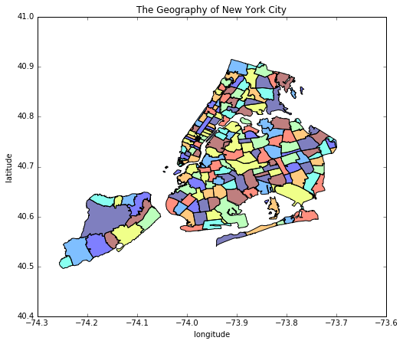
The point of this project is to investigate if a certain neighborhood in Brooklyn is gentrified

Slide 3
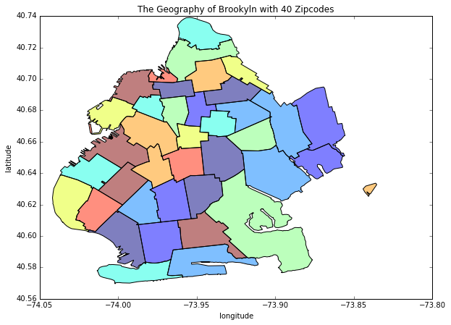
Extraction of Brooklyn data from nyc [zip, lons, lats]

Slide 4
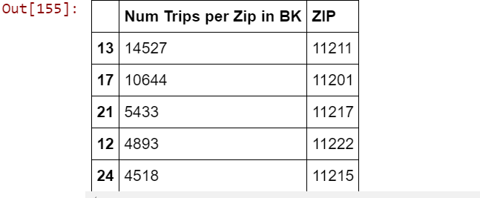

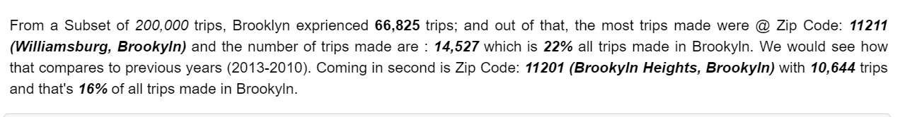
Trips per zicode in Brooklyn 2014

Slide 5
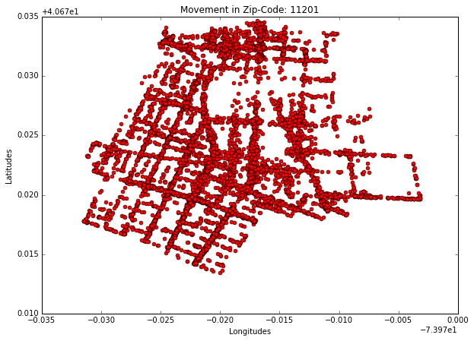
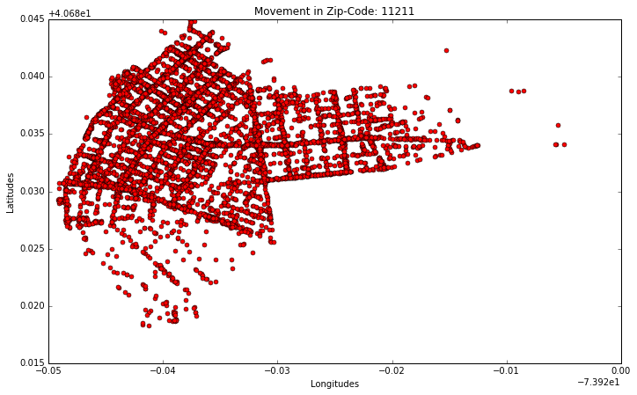
highest trips made in Brooklyn (test and control)
Zip Code 11211 (Williamsburg)
Zip Code 11201 (Brooklyn Heights)

Slide 6
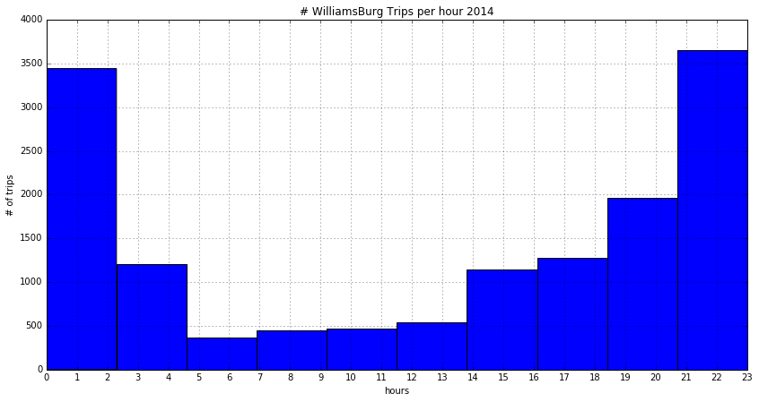
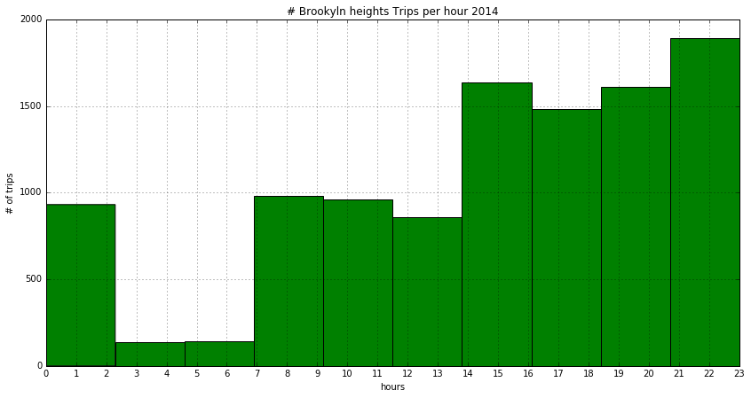
Number of trips per given hour
Williamsburg
Brooklyn-Heights

Slide 7
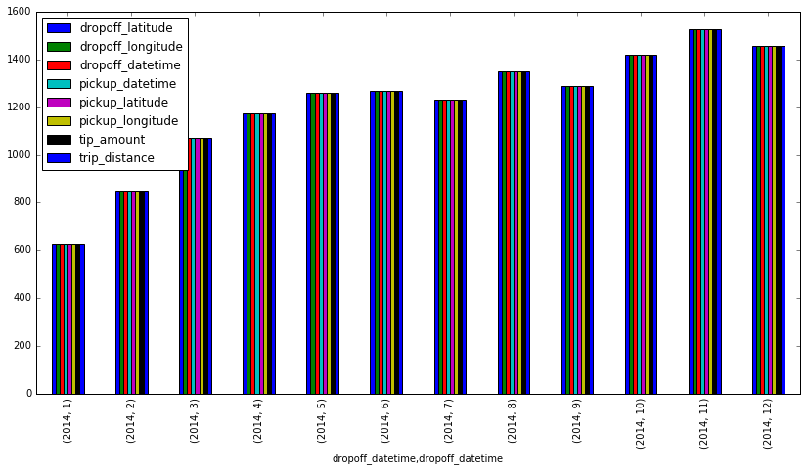
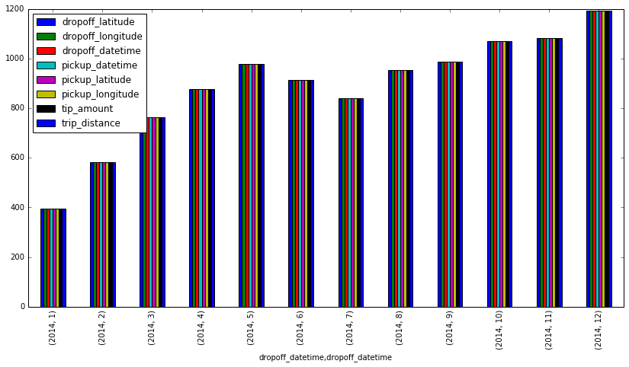
Trips numbers made in a given year
Williamsburg
Brooklyn-Heights

Slide 8
Summary of 2014
Voice-Summary

Slide 9
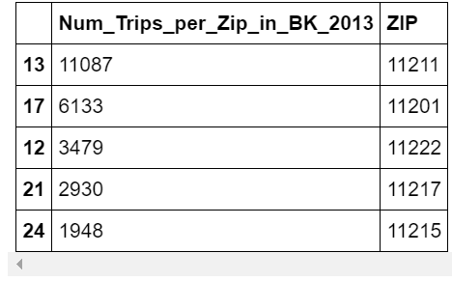
Trips per zicode in Brooklyn 2013

Slide 10
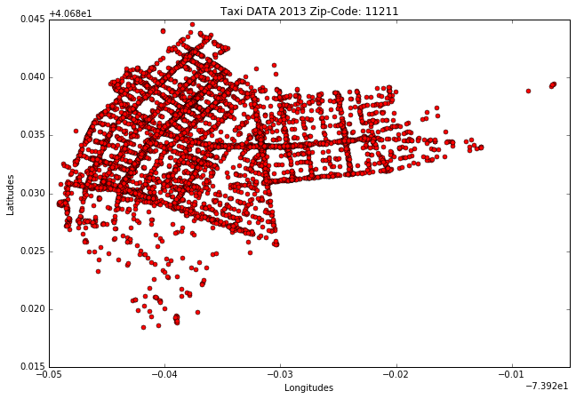
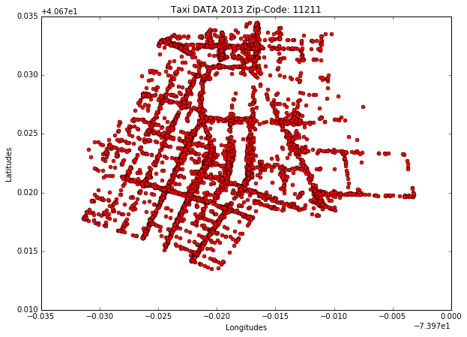
Trips made in highest trips made in Brooklyn (test and control)
Williamsburg
Brooklyn-Heights

Slide 11
Comparison 2014 vs 2013 as it relates to trips
2014 – Williamsburg & BK-Heights
2013 – WilliamsBurg & BK-Heights

Slide 12
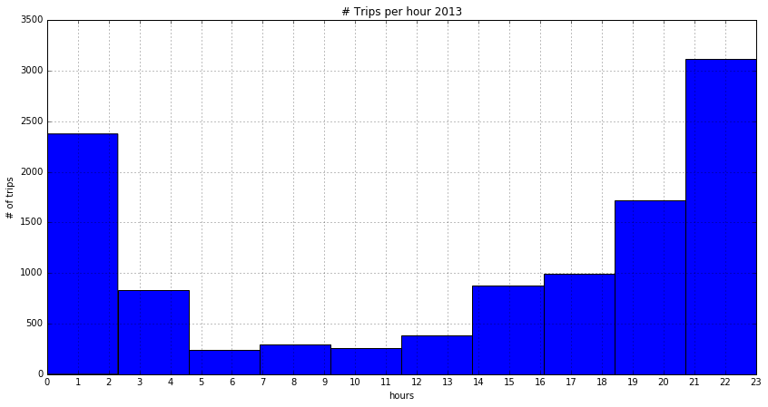
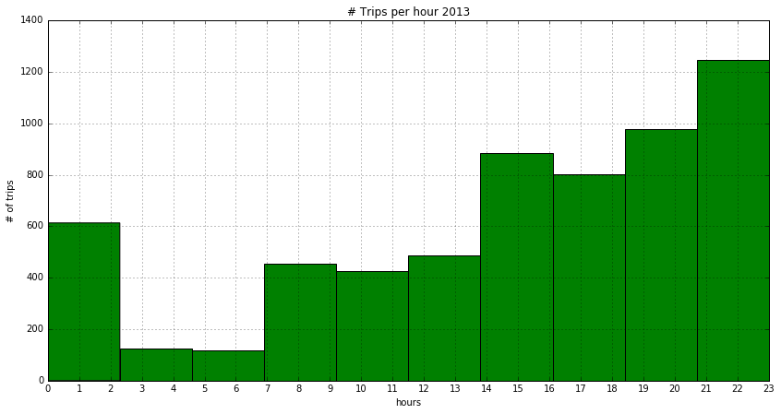
Number of trips per given hour
Williamsburg
Brooklyn-Heights

Slide 13
2014 VS 2013 INTERMS OF # TRIPS PER HOUR
2014
2013

Slide 14
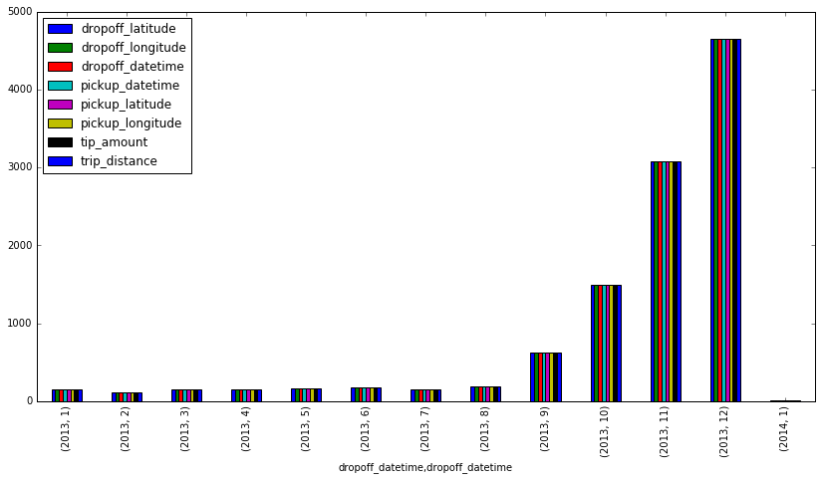
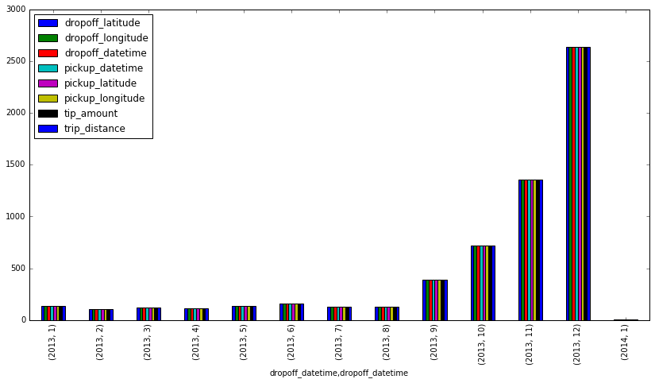
Trips numbers made in a given year
Williamsburg
Brooklyn-Heights

Slide 15
2014 vs 2013
2014
2013

Slide 16
Summary 2013
Voice-Summary

Slide 17
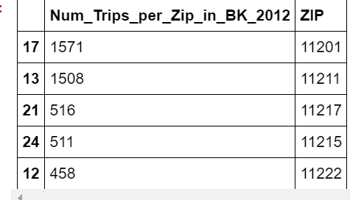

Trips per zicode in Brooklyn 2012

Slide 18
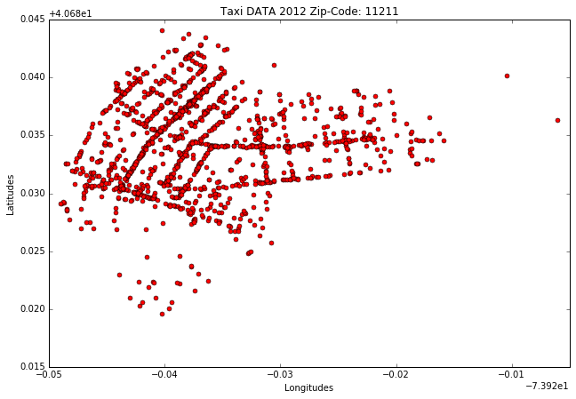
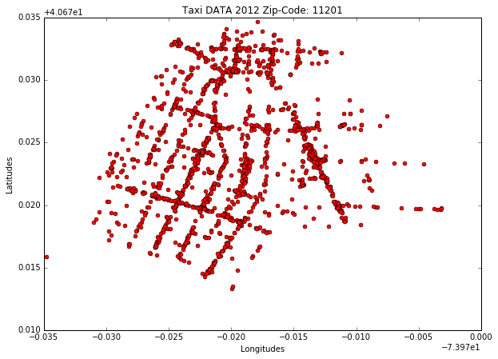
highest trips made in Brooklyn (test and control)
WilliamsBurg
Brooklyn-Heights

Slide 19
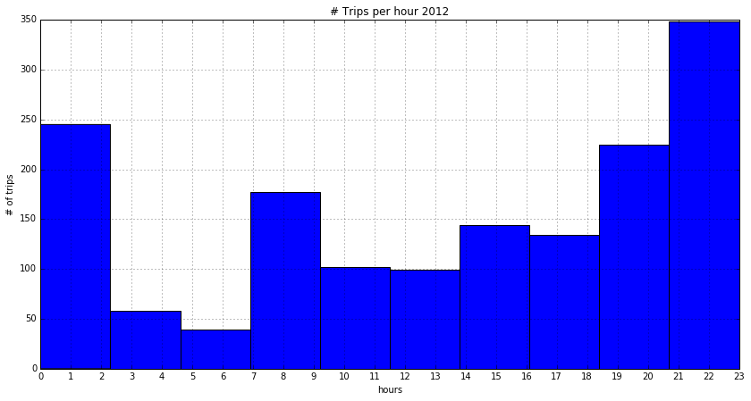
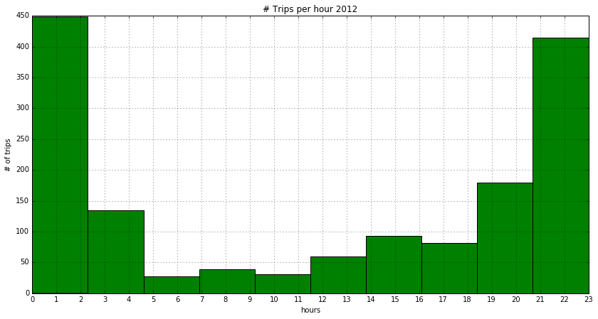
Number of trips per given hour
Williamsburg
Brooklyn-Heights

Slide 20
2014, 2013 vs 2012 most in descending order
WilliamsBurg
Brooklyn-Heights

Slide 21
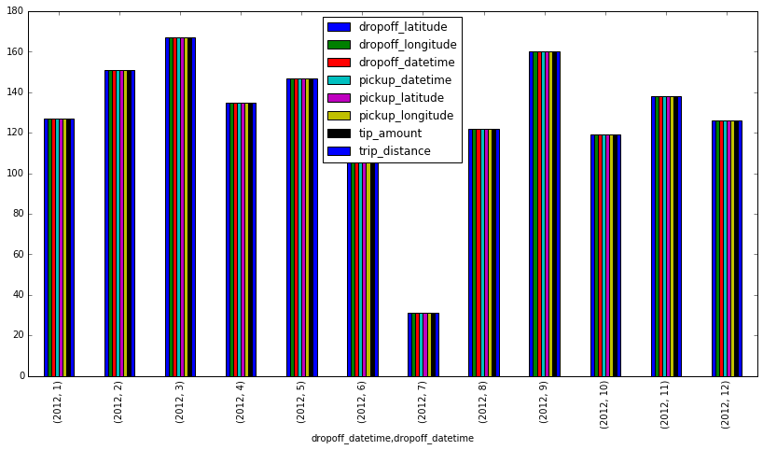
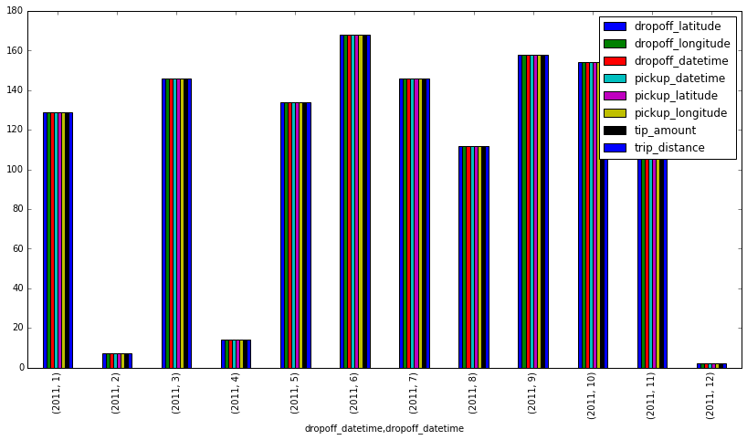
Trips numbers made in a given year

Slide 22
2014, 2013 vs 2012
WilliamsBurg
BrooklynHeights

Slide 23
Summary 2012
Voice

Slide 24
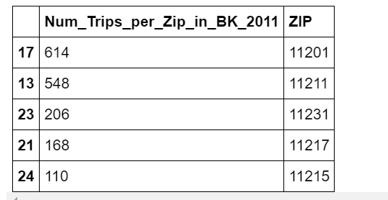

Trips per zicode in Brooklyn 2011

Slide 25
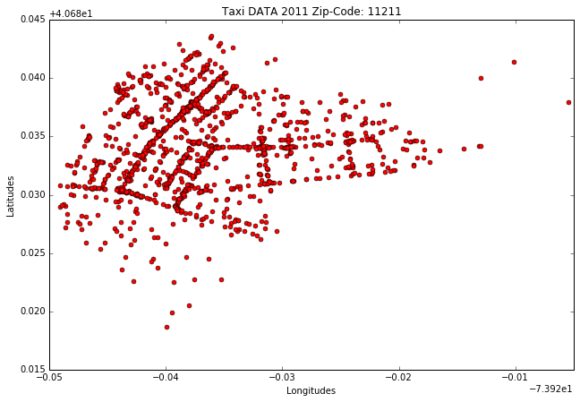
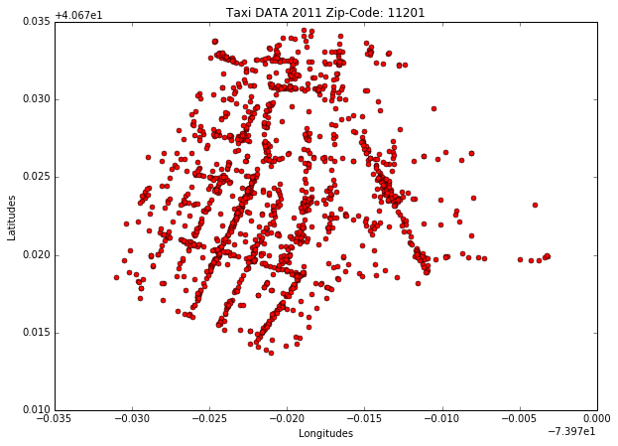
highest trips made in Brooklyn (test and control)
WilliamsBurg
Brooklyn-Heights

Slide 26
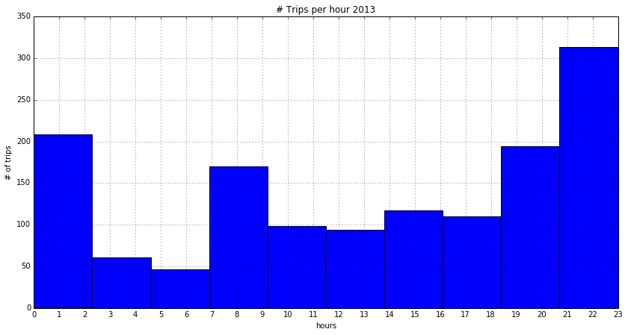
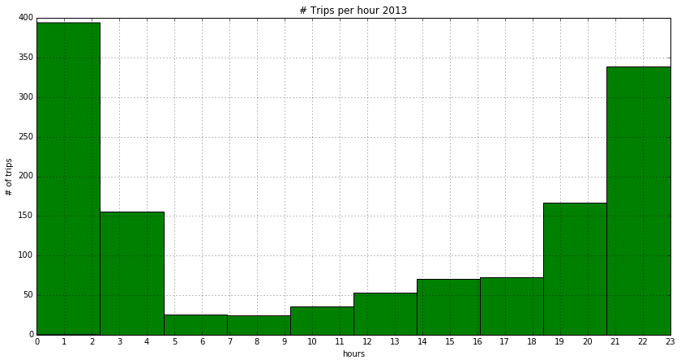
Trips numbers made in a given hour
WilliamsBurg
BrookylnHeights

Slide 27
2014, 2013, 2012 vs 2011
WilliamsBurg
Brooklyn-Heights

Slide 28
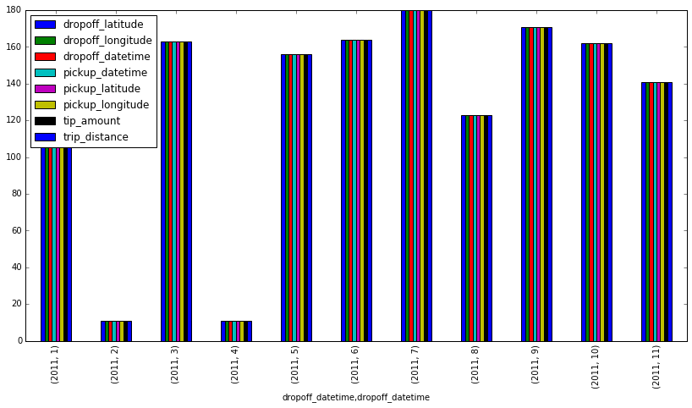
Trips numbers made in a given year
Williamsburg
BrookylnHeights

Slide 29
WilliamsBurg
Brooklyn-Heights

Slide 30
Summary 2011
Voice

Slide 31
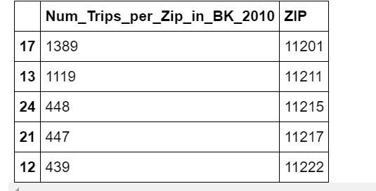

Trips per zicode in Brooklyn 2010

Slide 32
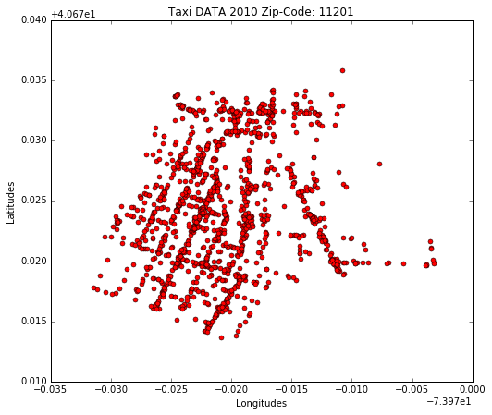
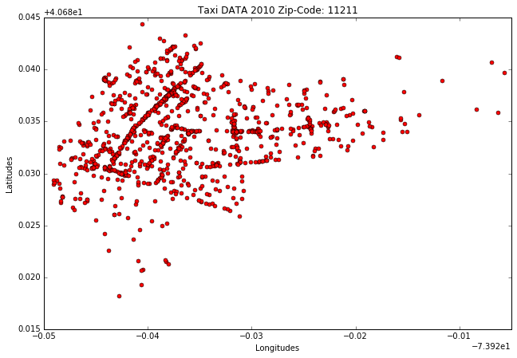
highest trips made in Brooklyn (test and control)

Slide 33
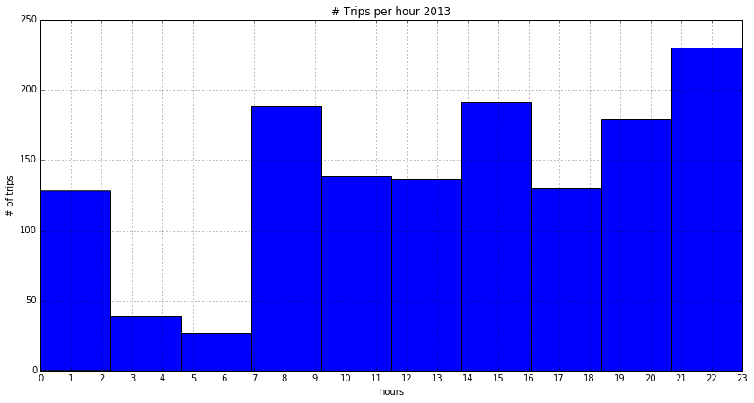
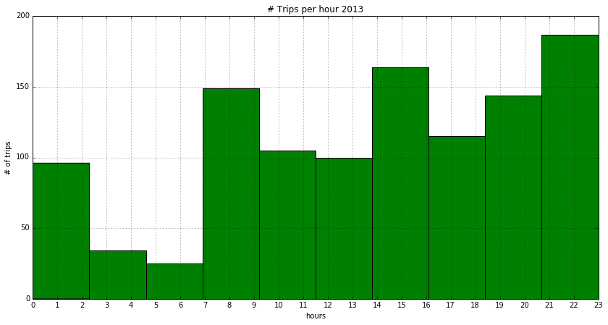
Trips numbers made in a given hour
WilliamsBurg
BrooklnHeights

Slide 34
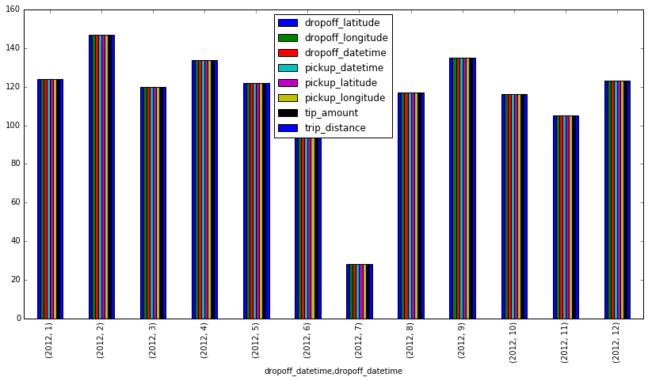
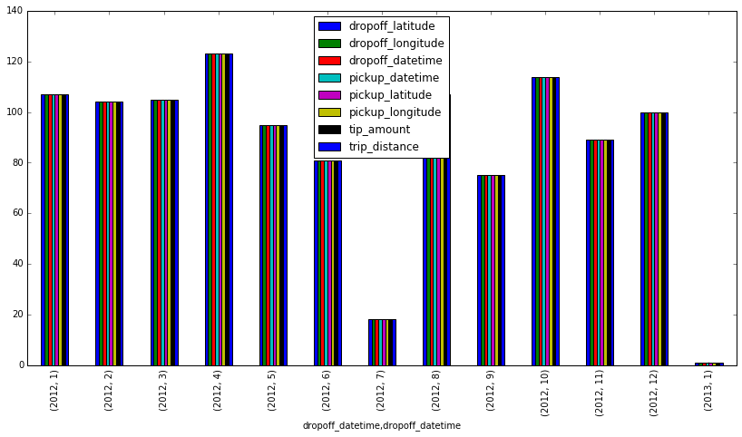
Trips numbers made in a given year
WilliamsBurg
BrooklyHeights

Slide 35
conclusion
Voice

Slide 37
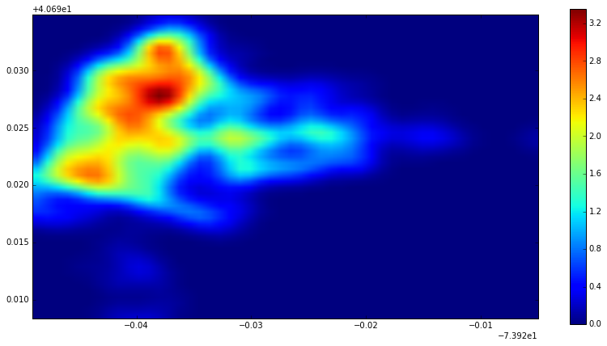
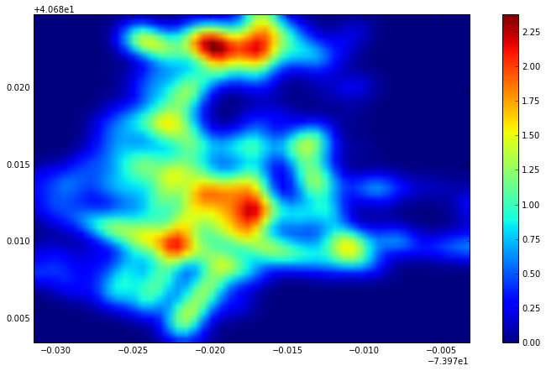
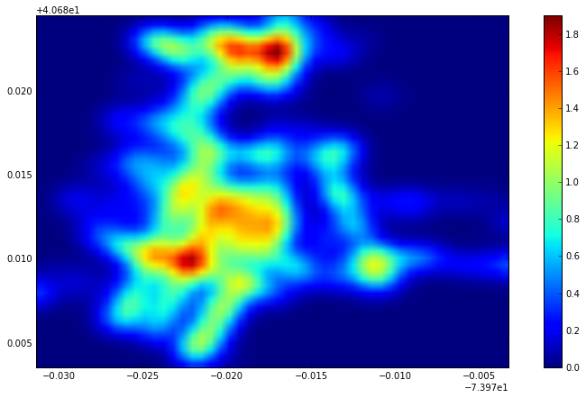
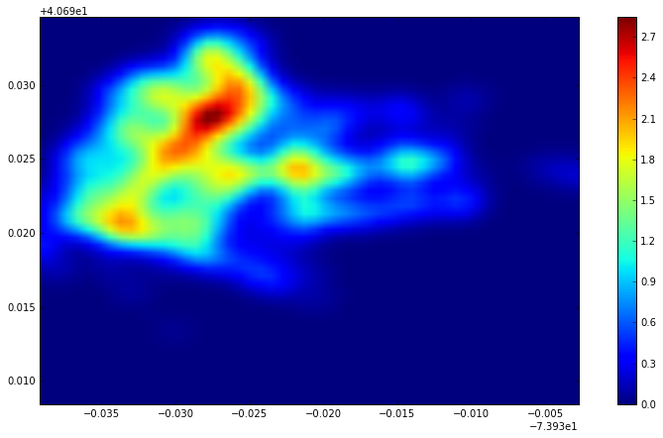
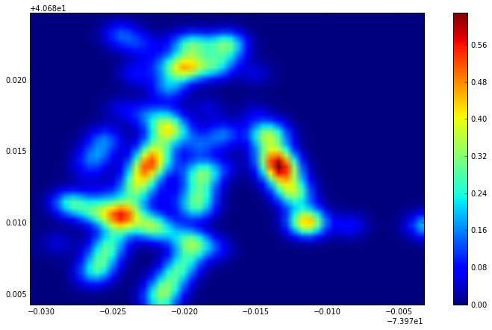
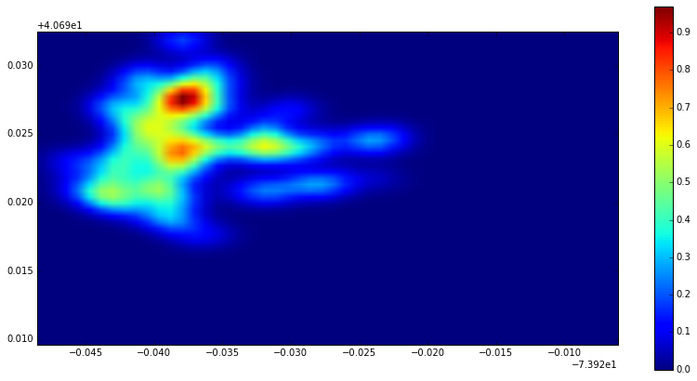
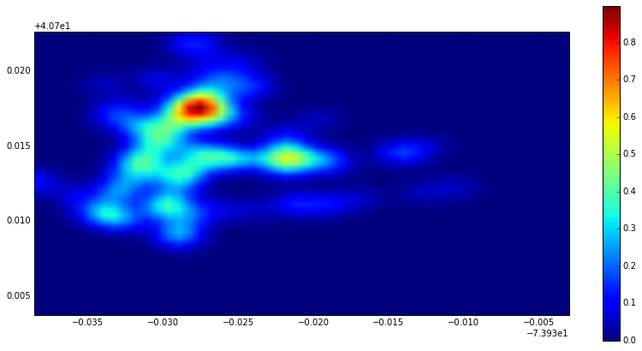
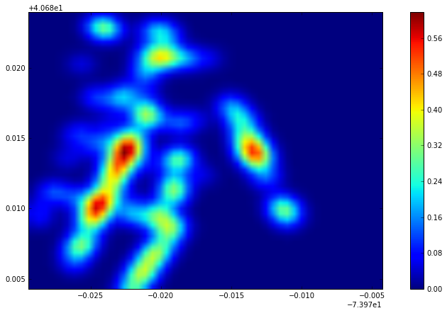
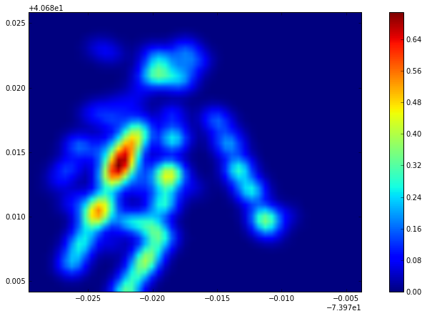
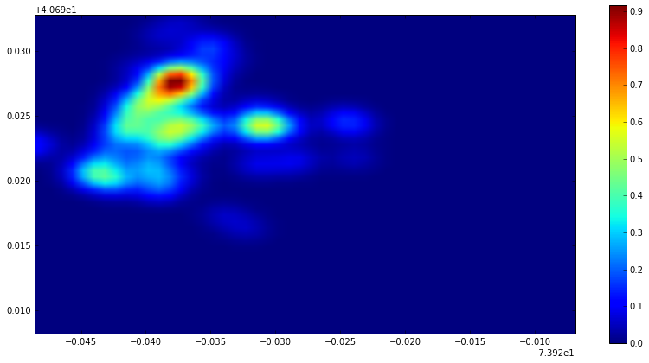

Slide 39
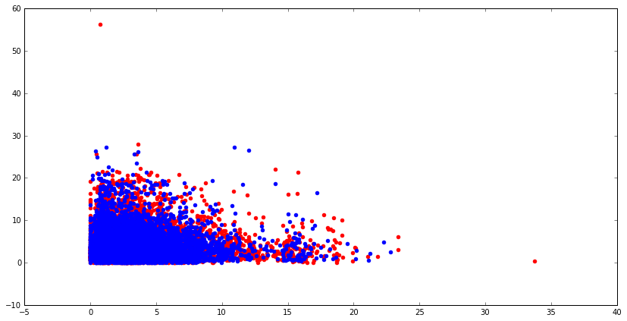
Cross validation based on distance travel using only points in two different neighborhood being observed

