Slide 1
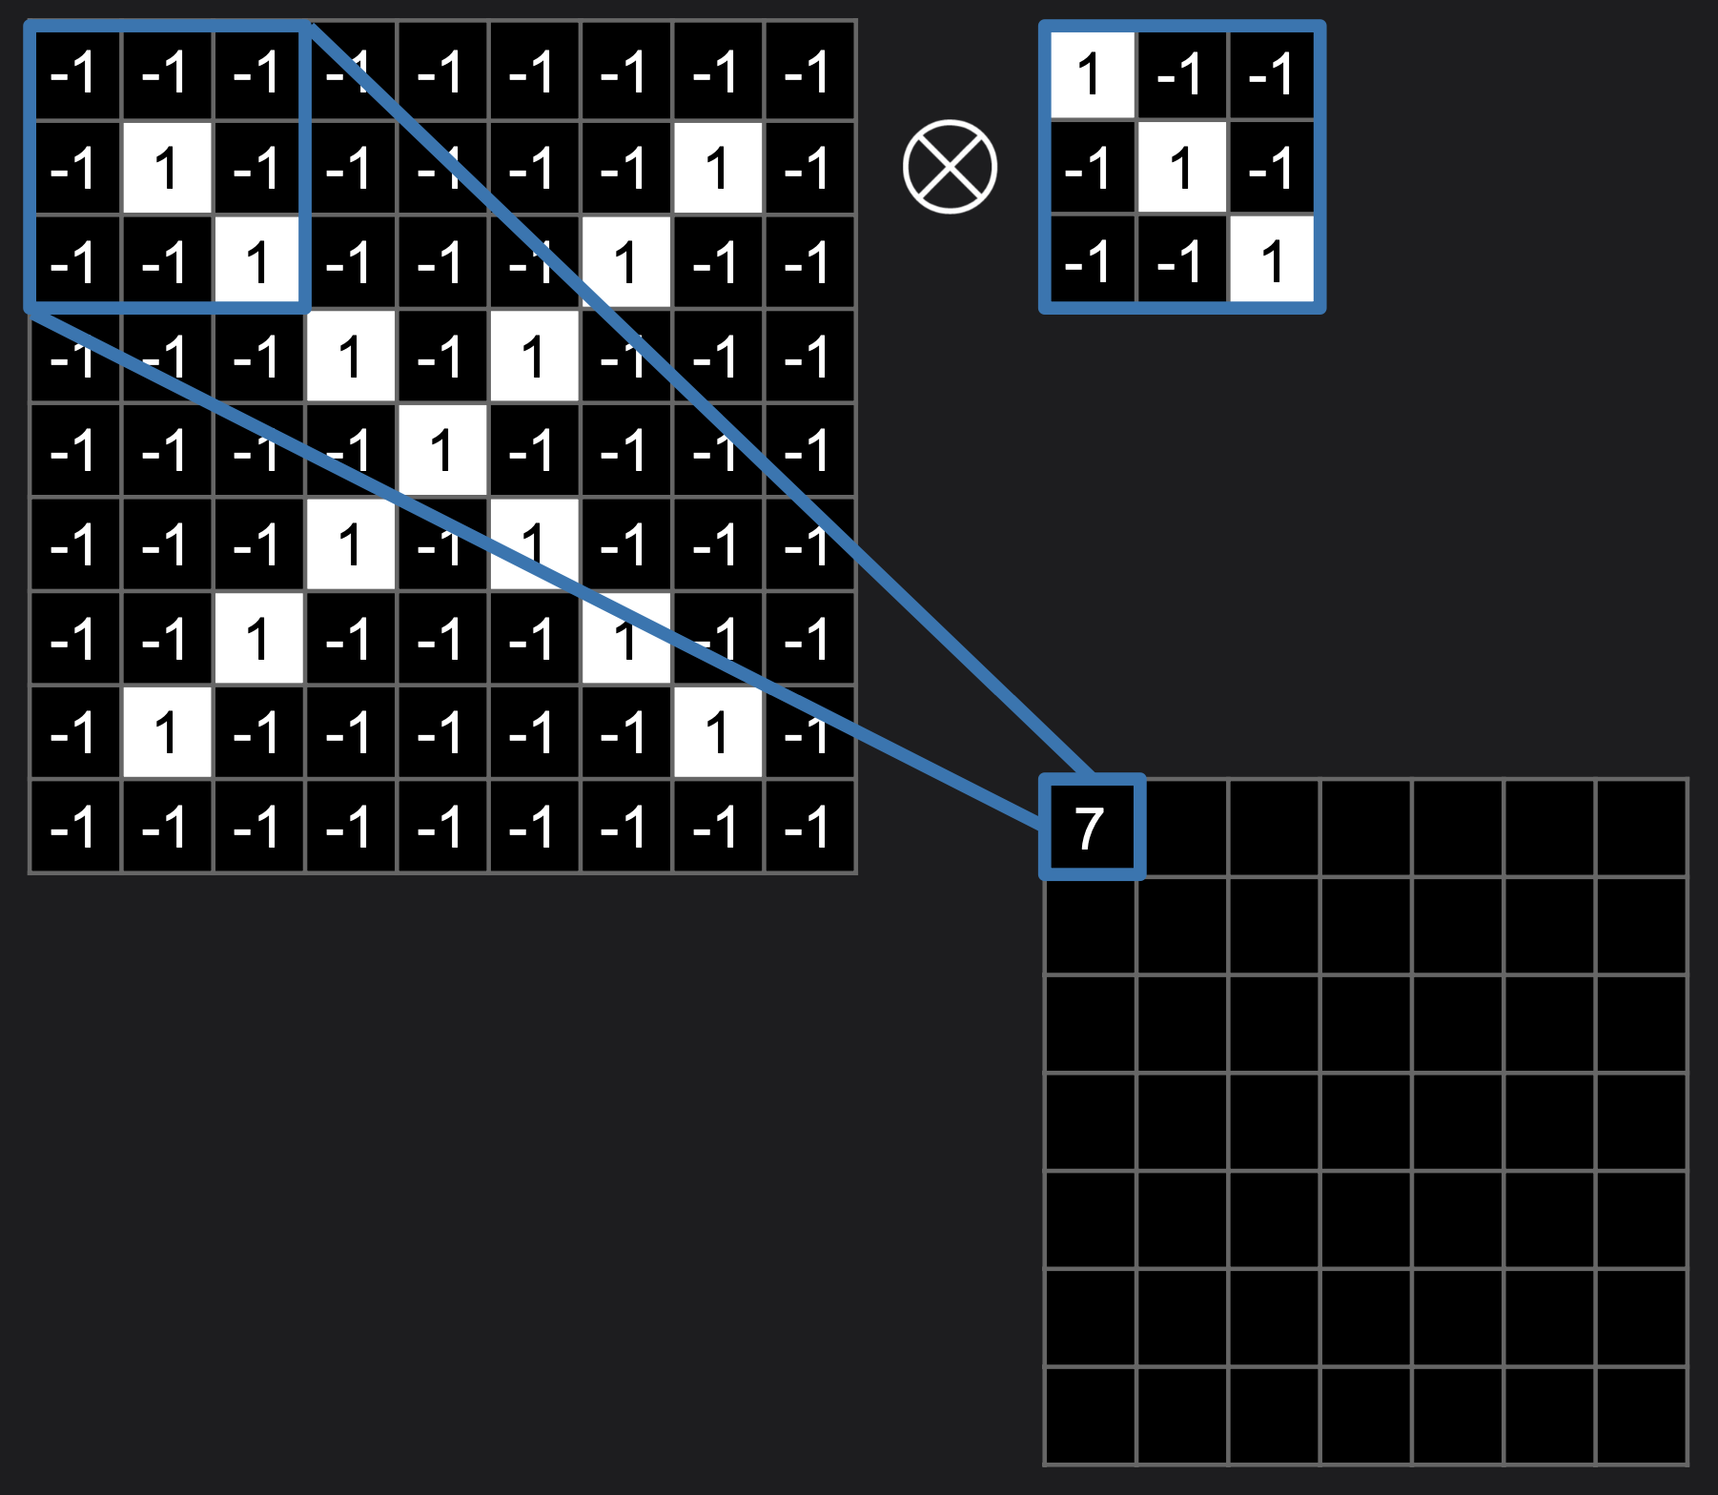
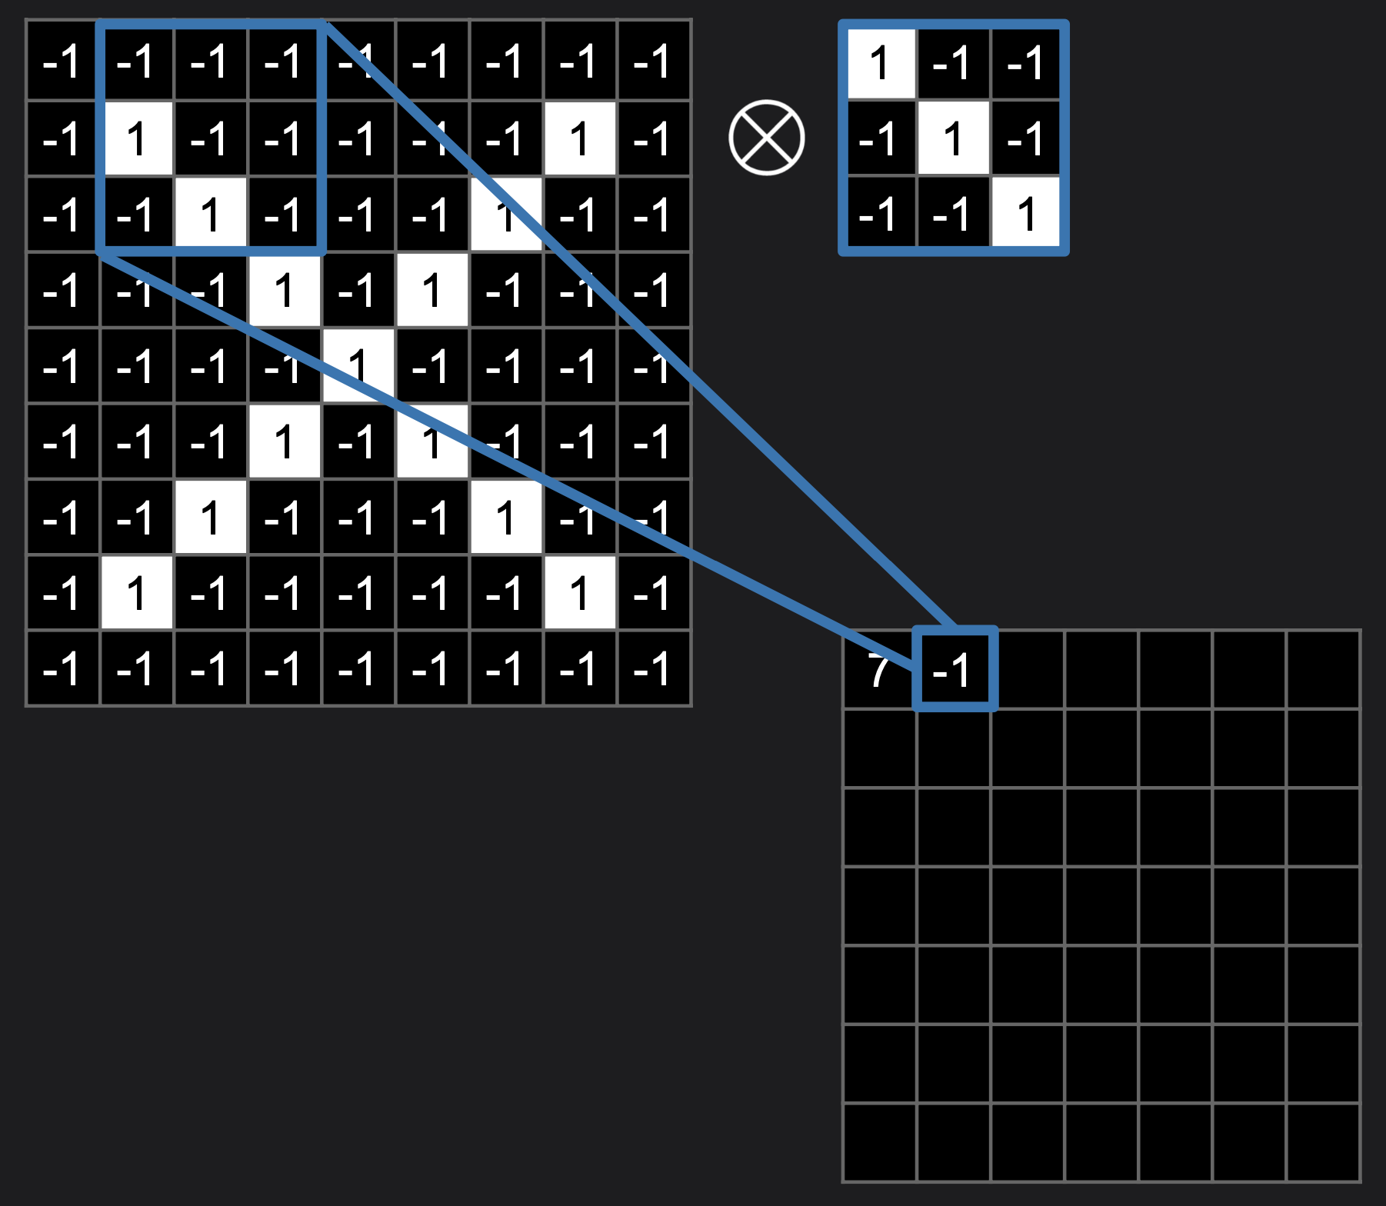
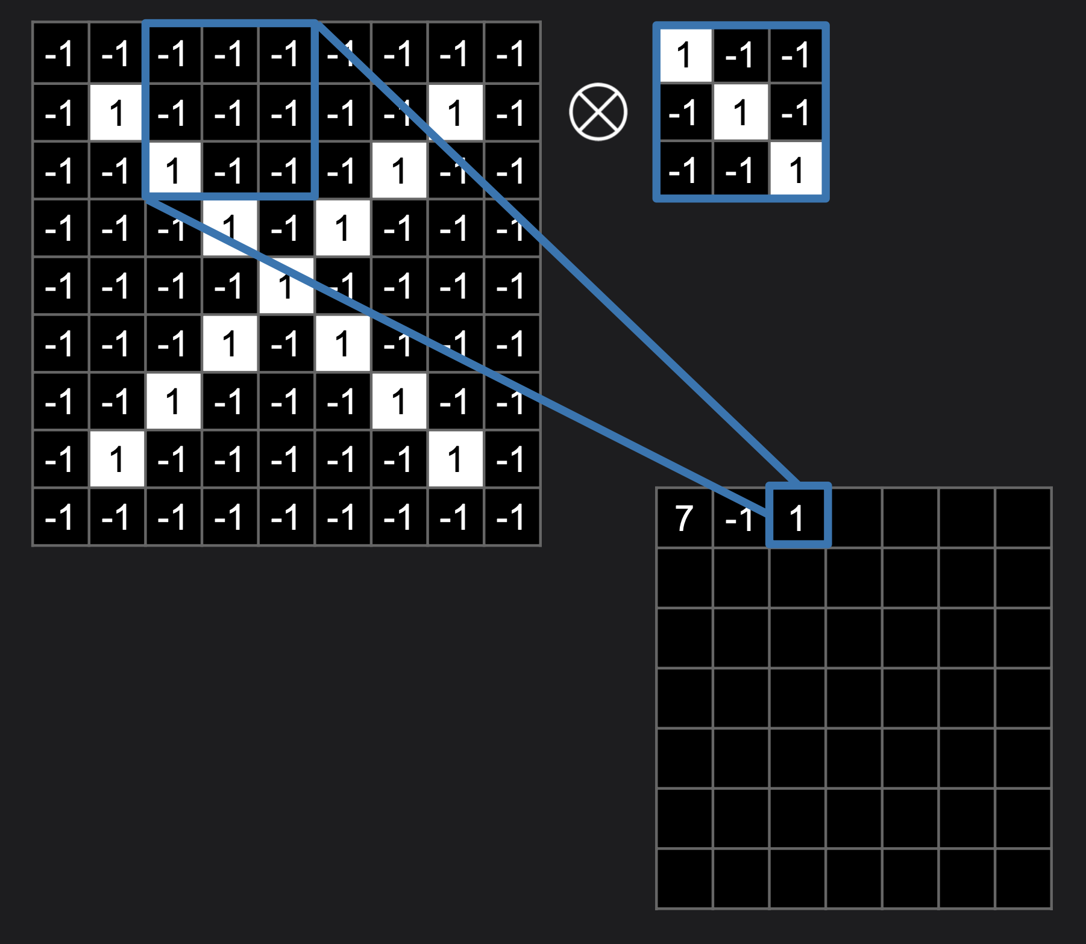
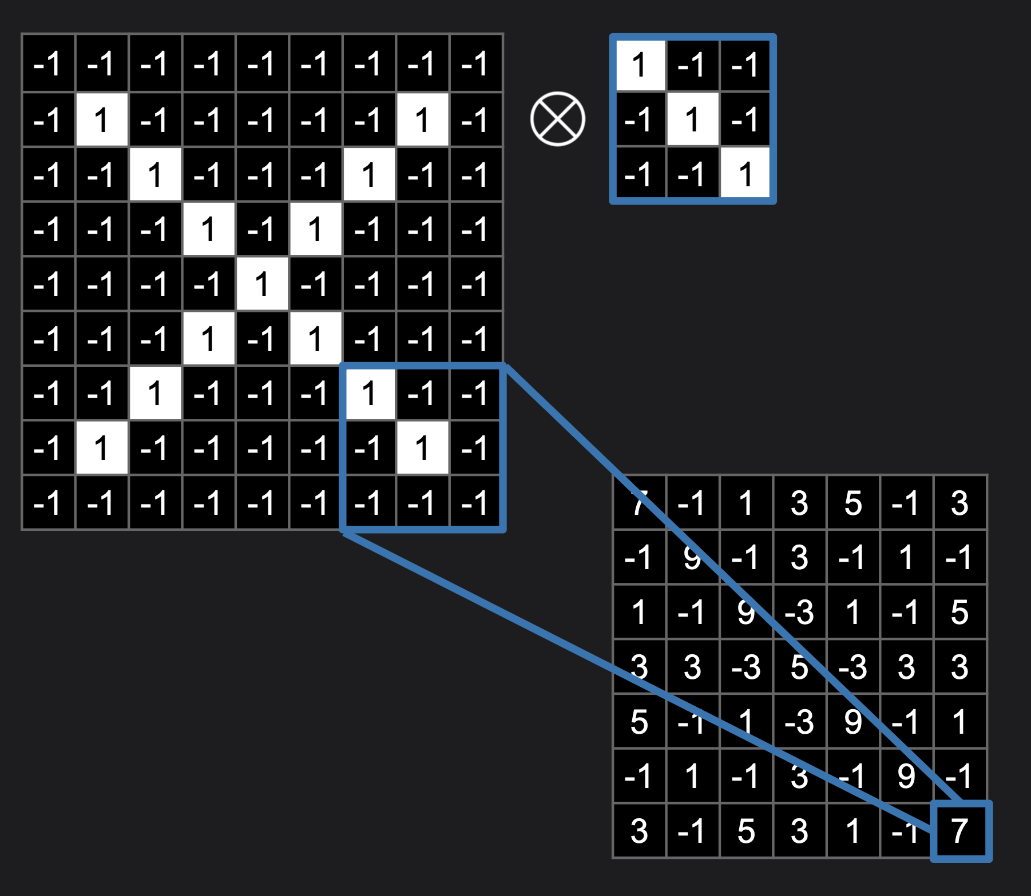
Each stride instance calculates the dot product to give an element of feature map matrix. For RGB data, each filter will comprise of 3 channels (for each color data). The dot product with filter weights results in three feature maps. These three maps added element wise to give single feature map for the filter.
Convolution Operation

Slide 2
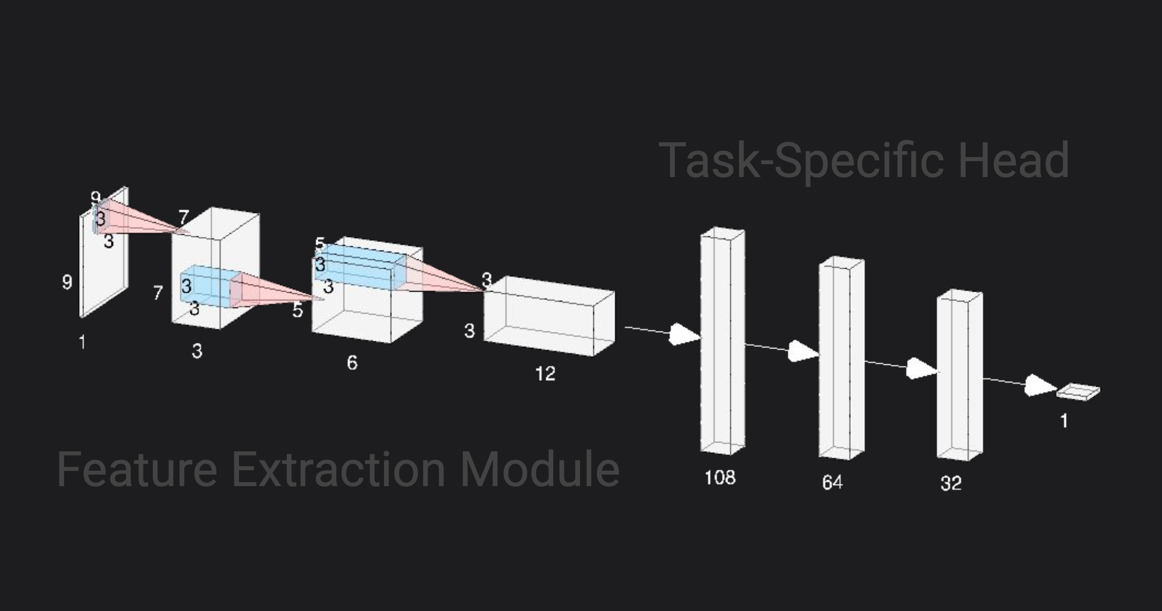
CNN Layers
Theory
Convolutional layers
Pooling layers
Fully connected/dense layers

