Slide 1

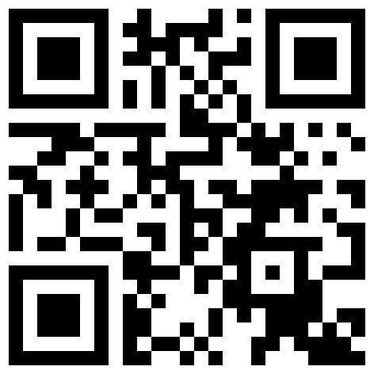
CHILDREN’S PROGRAM 8
We offer a class during the sermon for children aged 3 to 6 years-old. Please register your child before the service at the back of the sanctuary. The classroom is in the basement on the east side of the building.
We also have two unsupervised rooms in the basement for parents to use. One is a family play room and one is only for women (& babies) to accommodate nursing mothers.
FELLOWSHIP AFTER THE SERVICE
Join us for snacks and coffee at the back after the service!
GIVING
Cash or cheques can be left in the offering box at the back. E-transfer: mountpleasantgiving@gmail.com.
Other digital giving methods are also available.
Sign up using this QR code for
our weekly announcement email:
Corporate Worship Service: June 15, 2025
Questions about who we are or what we believe? Interested in membership?
Speak to Pastors John or Alex today!
LOOKING AHEAD…
Thu., June 26th | Corporate Prayer Meeting 7:30pm @MPBC.
Sun., Jun 22nd | Membership Class @9:30am Speak to Pastor Alex
July 3rd - 5th | Camping Trip @Muskoka Bible Centre Deadline to register: Today
Sun., July 20th | Members’ Meeting after the service

Slide 2
Order Of Service 2
________________________________________________________
Acapella Doxology WELCOME
SILENCE FOR PREPARATION
_________
CALL TO WORSHIP Psalm 112
HYMN “Be Thou my Vision”
HYMN “Complete In Thee”
OPPOSITE TESTAMENT READING 2 Kings 5
PRAYER OF CONFESSION
HYMN “Christ is Mine Forevermore”
HYMN “Take My Life And Let It Be”
PASTORAL PRAYER
SCRIPTURE READING 1 Timothy 6: 1-10
Before the reading, children ages 3-6 are dismissed to their program
SERMON
“Christian, The Lord Desires Your Heart, Not Your Money!”
1 Timothy 6:9-10;17-19
The latest sermon in a series on the Pastoral Epistles
HYMN “I’d Rather Have Jesus”
COMMISSION & BENEDICTION Ecclesiastes 5:15
Preacher: Pastor John Bell
Service Leader: Alex Bloomfield

Slide 3
Take My Life and Let it Be 6
Take my life and let it be consecrated Lord to Thee. Take my moments and my days;
Let them flow in ceaseless praise.
Let them flow in ceaseless praise.
Take my hands and let them move at the impulse of Thy love. Take my feet and let them be
Swift and beautiful for Thee.
Swift and beautiful for Thee.
Take my voice and let me sing always only for my King. Take my lips and let them be
Filled with messages from Thee.
Filled with messages from Thee.
Take my silver and my gold; not a mite would I withhold. Take my intellect and use
Every pow’r as Thou shalt choose.
Every pow’r as Thou shalt choose.
Take my will and make it Thine; it shall be no longer mine. Take my heart it is Thine own;
It shall be Thy royal throne.
It shall be Thy royal throne.
Take my love my Lord I pour, at Thy feet its treasure store. Take myself and I will be
Ever, only, all for Thee.
Ever, only, all for Thee.
Words: Frances Ridley Havergal / Music: Henri A. Cesar Malan, 1874.
Acapella Doxology 3
Praise God from Whom all blessings flow;
Praise Him all creatures here below;
Praise Him above ye heavenly host;
Praise Father, Son, and Holy Ghost.
A-men.
Be Thou my Vision
Be Thou my Vision, O Lord of my heart;
Naught be all else to me, save that Thou art
Thou my best tho-ught, by day or by night,
Waking or sleeping, Thy presence my light.
Be Thou my Wisdom, and Thou my true Word;
I ever with Thee and Thou with me, Lord;
Thou my great Fa-a-ther, and I Thy true son;
Thou in me dwelling, and I with Thee one.
Riches I heed not, nor man’s empty praise,
Thou mine Inheritance, now and always:
Thou and Thou o-o-nly, first in my heart,
High King of heaven, my Treasure Thou art.
High King of heaven, my victory won,
May I reach heaven’s joys, O bright heaven’s Sun!
Heart of my own heart, whatever befall,
Still be my Vision, O Ruler of all.
Words: Attributed to Dallan Forgaill, 6th Century .

Slide 4
Complete In Thee 4
Complete in Thee! no work of mine
May take, dear Lord, the place of Thine;
Thy blood hath pardon bought for me,
And I am now complete in Thee.
Yea, justified! O blessed thought!
And sanctified! Salvation wrought!
Thy blood hath pardon bought for me,
And glorified, I too, shall be!
Complete in Thee! no more shall sin,
Thy grace hath conquered, reign within;
Thy voice shall bid the tempter flee,
And I shall stand complete in Thee.
Dear Saviour! when before Thy bar
All tribes and tongues assembled are,
Among Thy chosen will I be,
At Thy right hand, complete in Thee.
Chris is Mine Forevermore 5
Mine are days that God has numbered,
I was made to walk with Him
Yet I look for worldly treasure,
and forsake the King of kings
But mine is hope in my Redeemer,
though I fall, His love is sure
For Christ has paid for every failing,
I am His forevermore!
Mine are tears in times of sorrow,
darkness not yet understood
Through the valley I must travel,
where I see no earthly good
But mine is peace that flows from Heaven,
and the strength in times of need
I know my pain will not be wasted,
Christ completes his work in me!
Mine are days here as a stranger,
pilgrim on a narrow way
One with Christ I will encounter,
harm and hatred for His name
But mine is armour for this battle,
strong enough to last the war
And He has said He will deliver,
safely to the golden shore!
And mine are keys to Zion city,
where beside the King I walk
For there my heart has found its treasure,
Christ is mine forevermore!
Come rejoice now, O my soul, For His love is my reward!
Fear is gone and hope is sure, Christ is mine forevermore! (repeat)
And mine are keys to Zion city
Where beside the King I walk
For there my heart has found its treasure
Christ is mine forevermore! (x3)
CityAlight. Johnny Robinson & Rich Thompson, 2016.

