Slide 1

SCHOOL OF ELECTRICAL AND ELECTRONICS ENGINEERING (SEEE)
CAPSTONE PROJECT
2021-2025 BATCH
Automatic speech recognition system of low resource Malvi language
GROUP MEMBERS :
Laxmi Parmar (21BAC10033)
Rakesh Lodhi(21BAC10034)
Manish Meena(21BAC10038)
SUPERVISOR NAME:
Dr. Anirbhan Bhowmick
Date : 18 August 2024

Slide 2
REVIEW 0

Slide 3
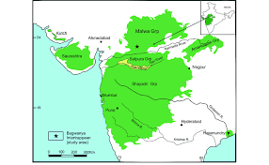

Problem Statement
There is a significant lack of resources, such as transcribed corpora and technological tools, supporting the Malvi language.
The preservation and promotion of the language.
Accessibility and use in modern communication and educational platforms.

Slide 4
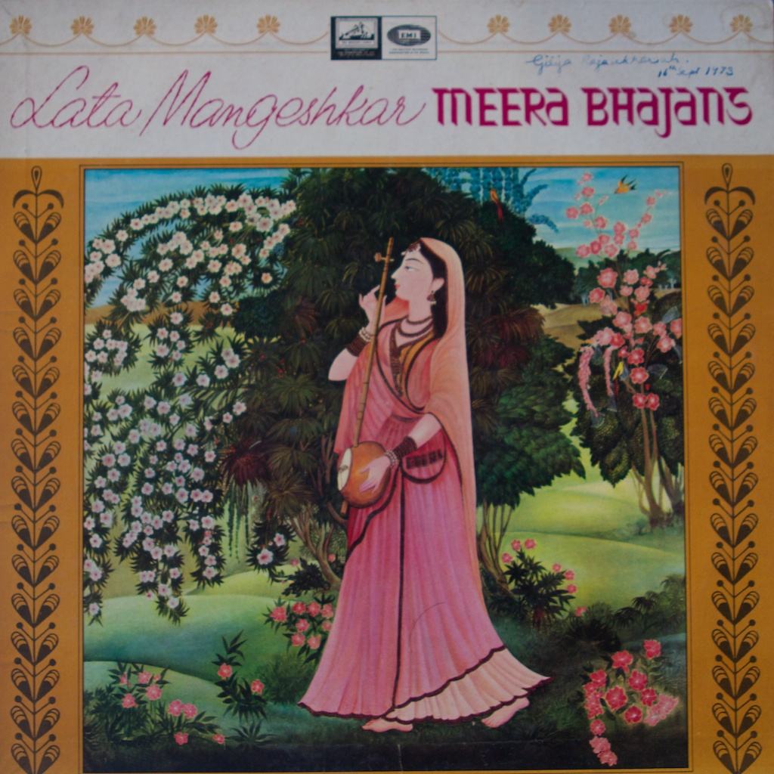
Objective
Develop an Automatic Speech Recognition (ASR) system for Malvi
Create an accurate transcription model by collecting a comprehensive corpus of Malvi audio and text data from native speakers.
Evaluate the ASR system's performance using Word Error Rate (WER) and Character Error Rate (CER) metrics..
.

Slide 5


Novelty
The development of the first comprehensive ASR system tailored specifically for Malvi, aiming to bridge the technological gap and ensure the language's digital presence.
Interfacing circuits

Slide 6
Literature Review

Slide 7
Literature Review
A. Sharma, R. Mehta, “Speech Recognition Systems: A Comparative Analysis,” Journal of Computer Science and Applications, 2015.
Findings:
Comprehensive evaluation of various speech recognition methodologies including neural networks, HMM, and template-based systems.
Highlighted the importance of feature extraction techniques like MFCC and Wavelet Transform.
Limitations:
High computational complexity and resource requirements.
Challenges with speaker variability and noise sensitivity.

Slide 8
Literature Review
L. Lamel, J.L. Gauvain, G. Adda, M. Adda-Decker, L. Canseco, L. Chen, O. Galibert, A. Messaoudi, H. Schwenk. “Speech Transcription in Multiple Languages,” LIMSI-CNRS, [2021].
Findings:
Development of speech-to-text transcription systems for multiple languages, focusing on broadcast audio and conversational speech.
Systems have been implemented for languages including English, French, German, Mandarin, Portuguese, Spanish, and Arabic.
Techniques used include robust signal processing, improved training methods, and large vocabulary continuous speech recognition.
Successful porting of techniques across languages, with language-specific modeling primarily concerning lexical and pronunciation aspects.
Limitations:
High word error rates in some languages due to varying linguistic and acoustic challenges.
Variability in language resources, such as the availability of transcribed data and pronunciation lexicons, affects system performance.
Specific issues in handling languages with significant dialectal variation or lack of standard written forms.

Slide 9
References
[1] A. Sharma, R. Mehta, “Speech Recognition Systems: A Comparative Analysis,” Journal of Computer Science and Applications, 2015.
[2] L. Lamel, J.L. Gauvain, G. Adda, M. Adda-Decker, L. Canseco, L. Chen, O. Galibert, A. Messaoudi, H. Schwenk. “Speech Transcription in Multiple Languages,” LIMSI-CNRS, [2021].

Slide 10

ThankYou

