Slide 1


Key Java Concepts for MapReduce
When implementing MapReduce in Java for big data computing, understanding and effectively utilizing key Java concepts is crucial for developers and engineers. This knowledge forms the foundation for building efficient and scalable MapReduce applications to process large datasets in big data environments.
by Rakesh Naik

Slide 2
Concurrency in Java
Benefits of Concurrency
Challenges of Concurrency
Java's java.util.concurrent package and java.util.concurrent.Executor framework are instrumental in managing parallelism in MapReduce tasks.
Understanding concurrent programming challenges is essential to effectively utilize Java's concurrency utilities in MapReduce applications.

Slide 3
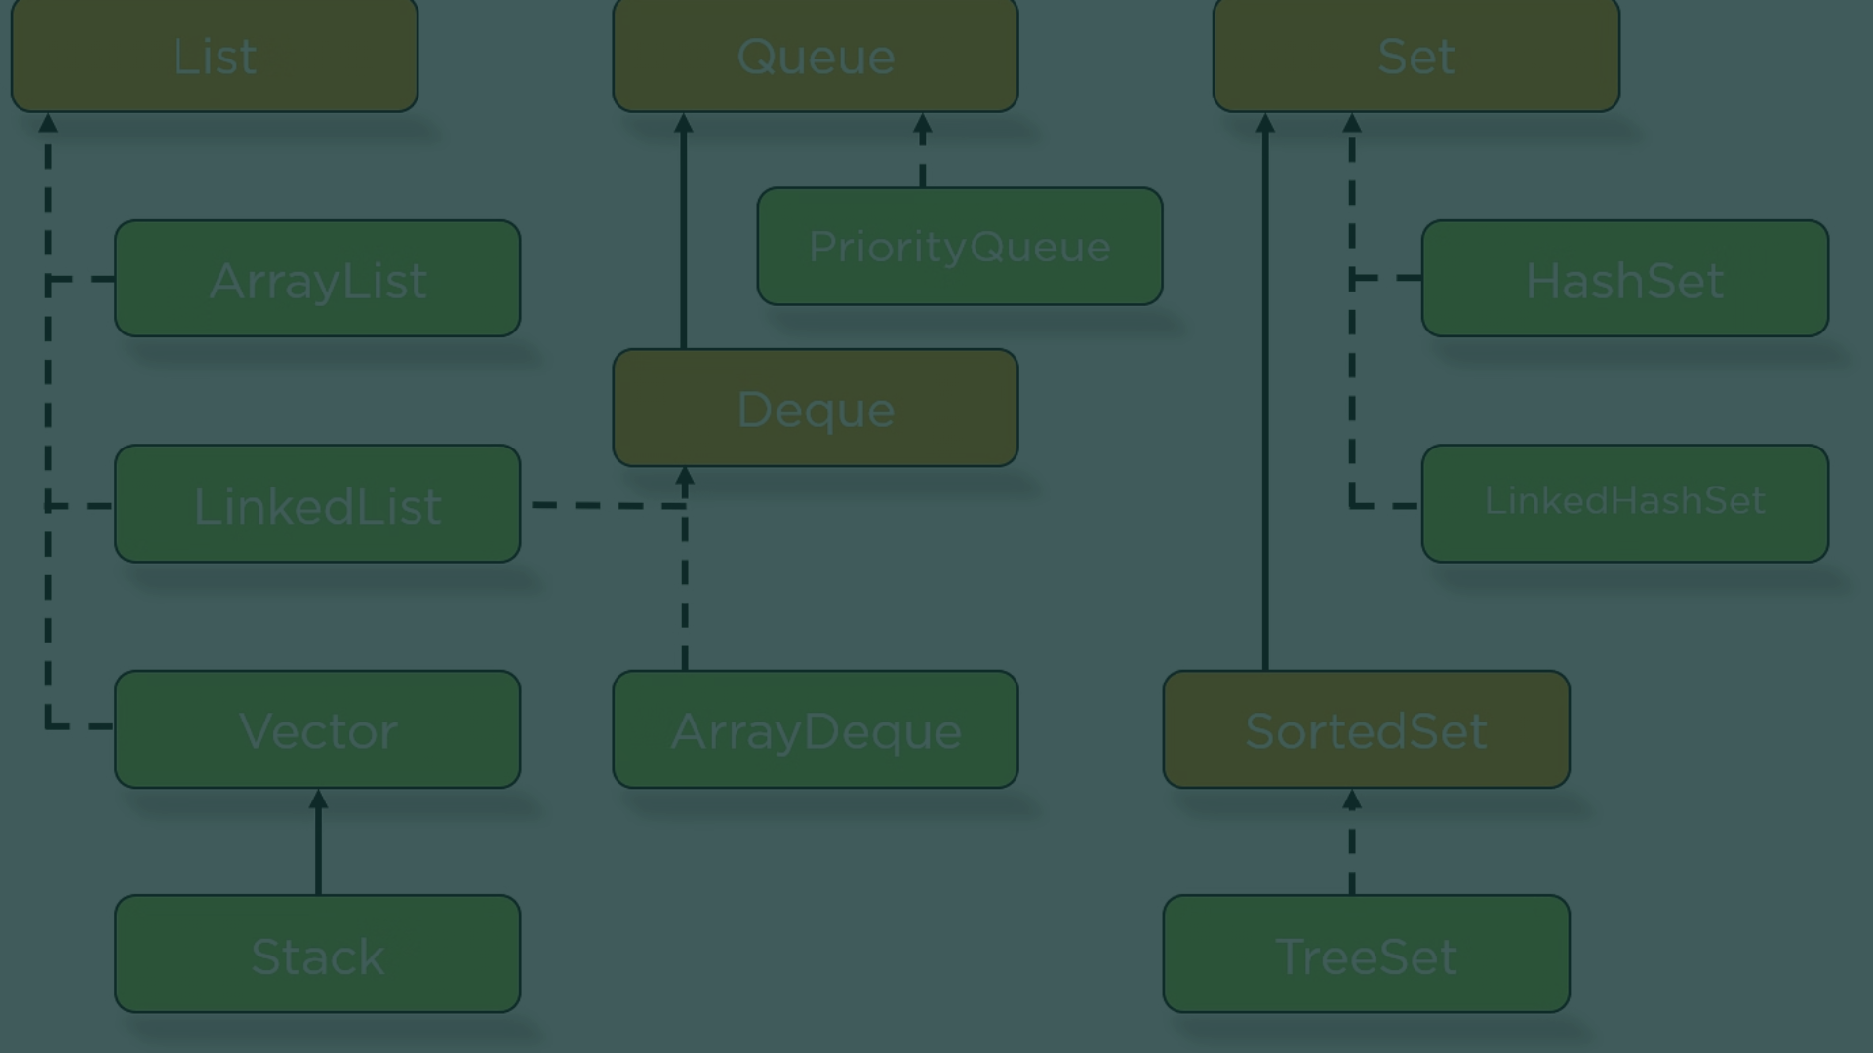
Collections Framework
1
HashMap
2
Data Structures
HashMap and ArrayList are frequently used in MapReduce programs to aggregate and manipulate intermediate data.
Understanding the different data structures offered by Java's Collections Framework is crucial for effective data processing in MapReduce tasks.

Slide 4


Generics in Java
Flexibility
Generics enable type-safe collections and methods in Java, supporting the processing of heterogeneous data in MapReduce tasks.
Code Reusability
Utilizing generics enhances code reusability and maintains type safety in Java MapReduce implementations.

Slide 5
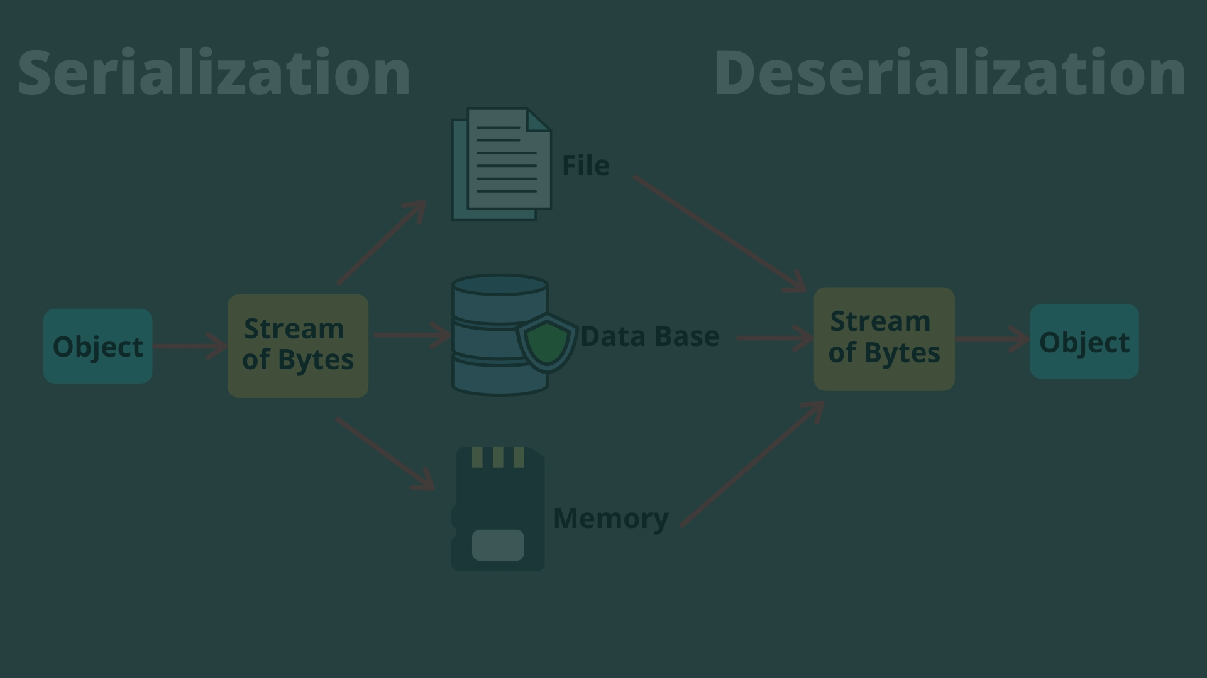
Serialization Mechanism
Importance of Serialization
Error Prevention
Exploring the crucial role of Java's serialization mechanism in sending data between mappers and reducers, and storing intermediate results in MapReduce.
Addressing the significance of serialization in error prevention and data consistency in distributed MapReduce environments.

Slide 6
File Handling in Java
Input Data
1
Understanding the essential role of java.io.File and java.nio.file.Path classes for reading input data in Java MapReduce tasks.
2
Output Data
Efficiently leveraging Java's file handling utilities for writing output data from MapReduce programs.

Slide 7
Lambda Expressions & Stream API
1
2
3
Conciseness
Expressive Code
Functional Style
Exploring the benefits of Java lambda expressions and the Stream API for defining functions and facilitating functional-style operations on data in MapReduce tasks.

Slide 8
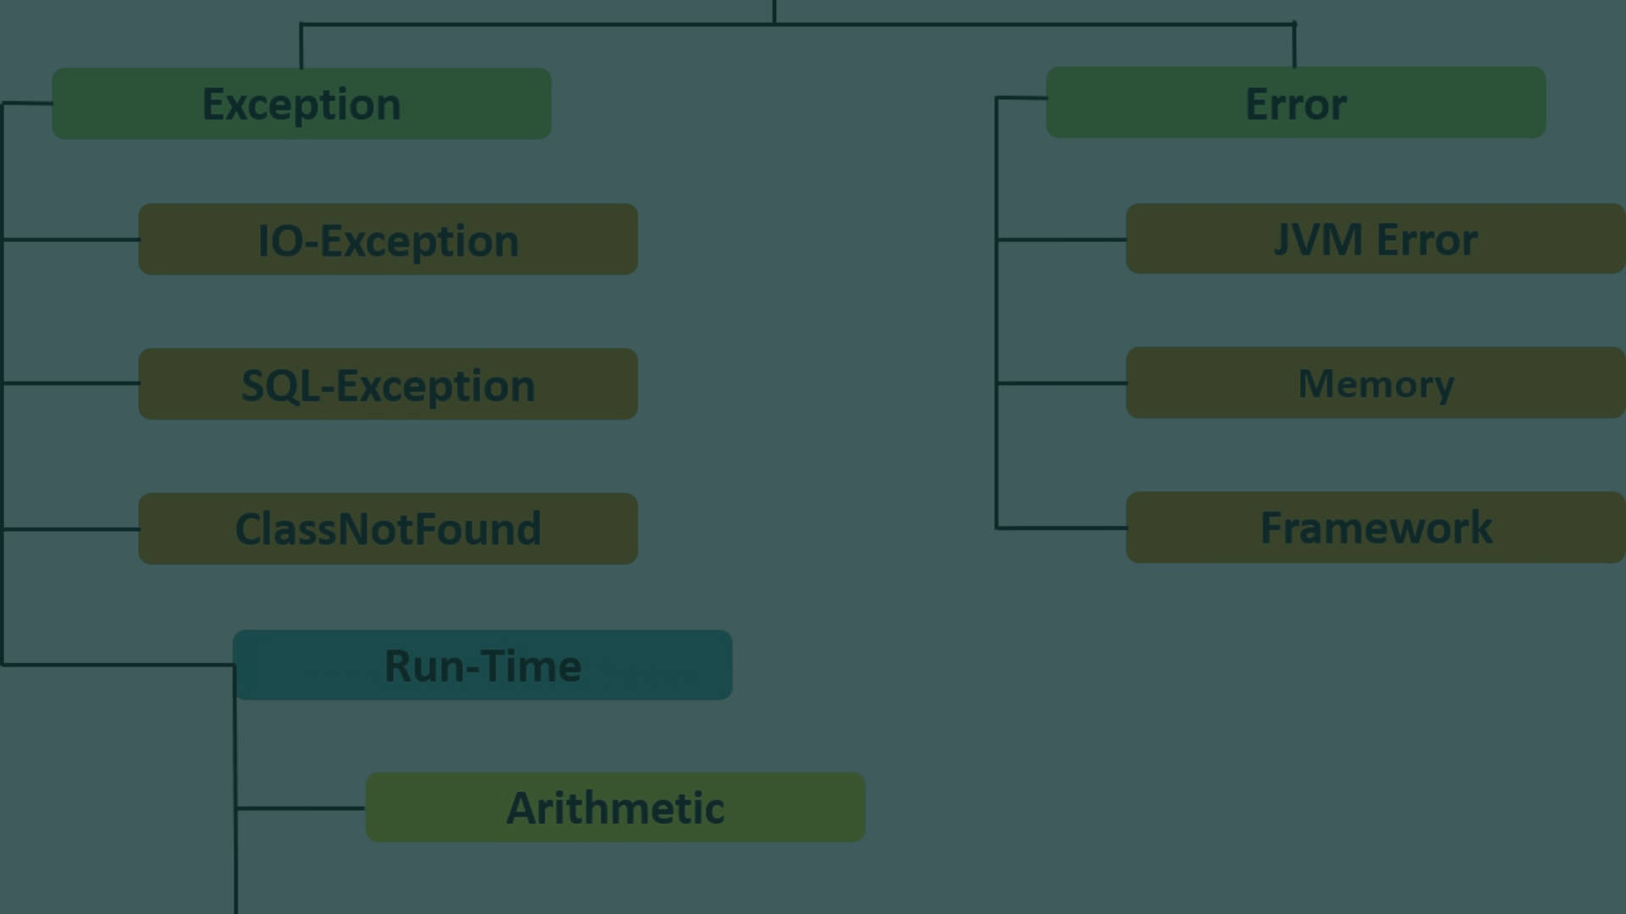
Exception Handling and JVM Tuning
1
Exception Handling Best Practices
2
Optimizing JVM Parameters
Understanding the impact of tuning JVM parameters on the performance of Java MapReduce programs in big data computing.
Discussing the importance of proper exception handling to ensure fault tolerance and error management in Java MapReduce programs.

