Slide 1
Dashboard Overview
This is the main landing page of the dashboard with high-level KPIs:
Total Sales
Total Profit
Total Orders
Filters like Region, Category, and Order Date allow for interactive analysis.
KPI Cards give a quick snapshot of D-Mart’s performance.

Slide 2
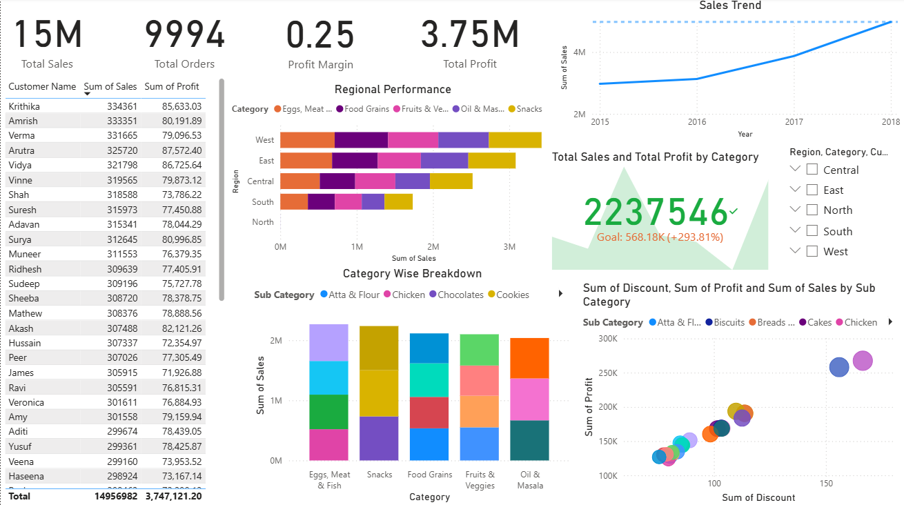
Dashboard

Slide 3
Monthly Sales Trends
This visual shows sales and profit over time (month-wise):
Noticeable spike in sales during October–December (festive season).
MoM growth is calculated using DAX measures for business monitoring.

Slide 4
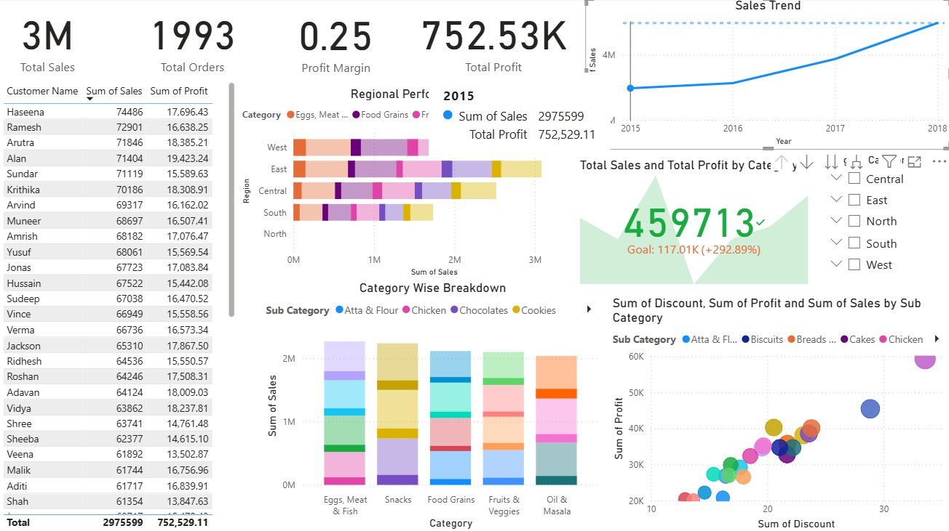
Visualization of 2015

Slide 5
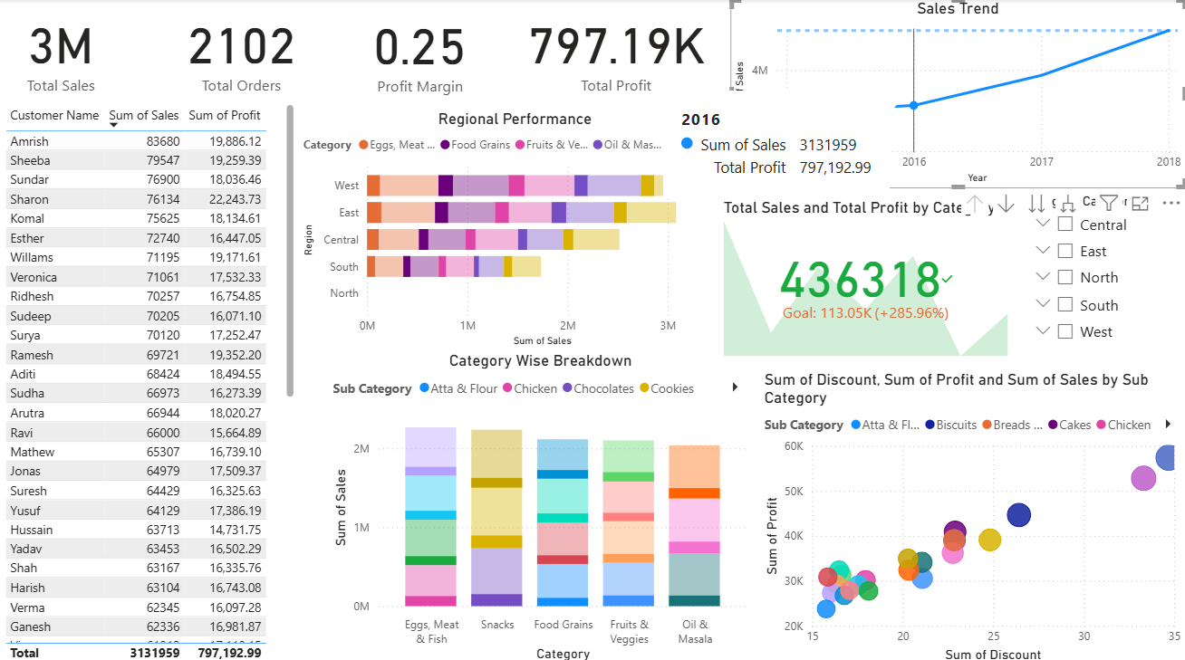
Visualization of 2016

Slide 6
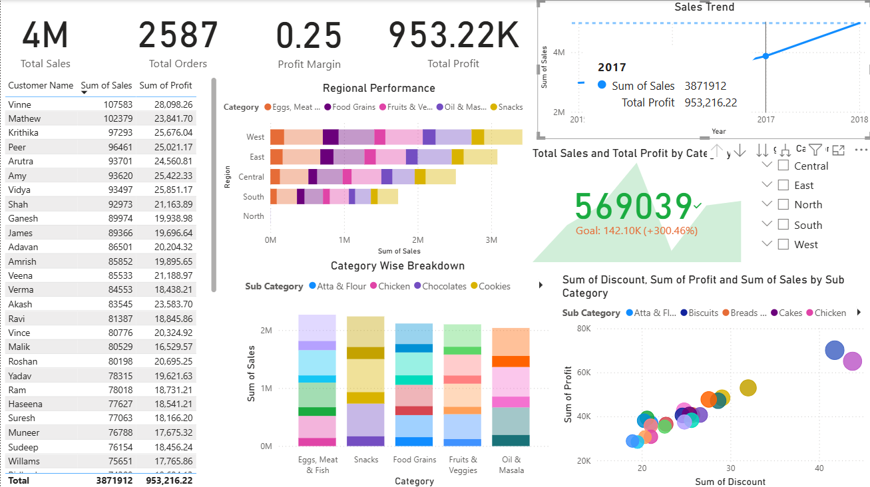
Visualization of 2017

Slide 7
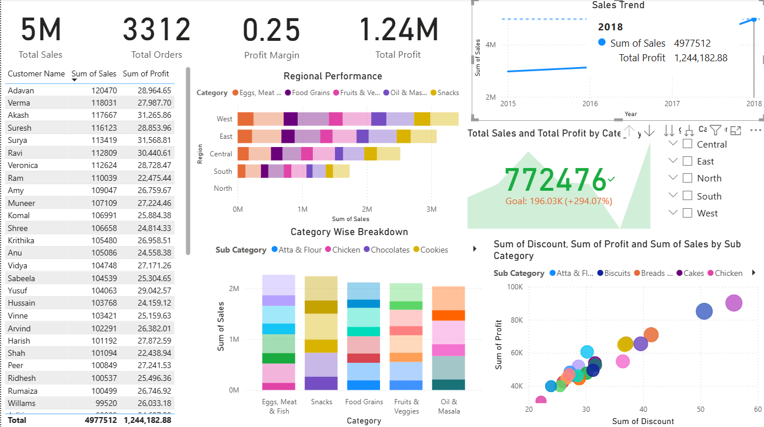
Visualization of 2018

Slide 8
Regional Sales & Profit
A bar chart comparing sales and profit across different regions
South region performs the best.
Central region is underperforming.
Helps understand geographic strengths and areas needing attention.

Slide 9
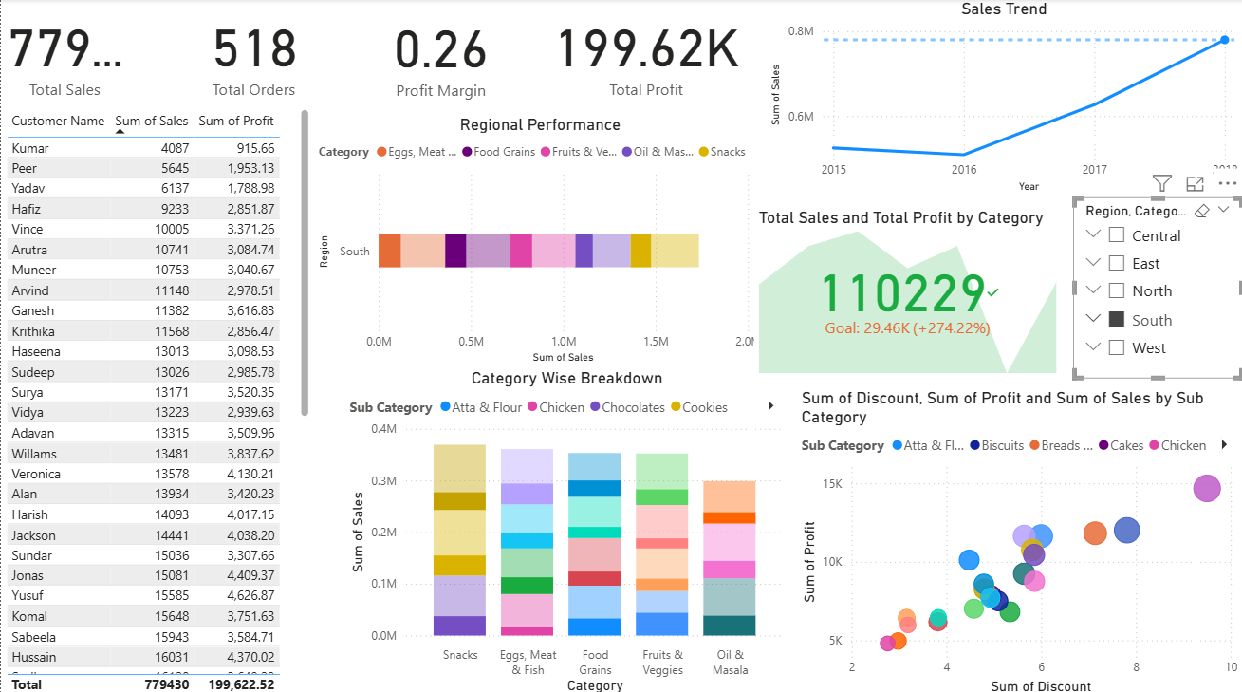
Regional Sales of South

Slide 10
High-Value Customer Analysis
Shows customers who contribute the most to sales
These customers can be targeted for loyalty campaigns.
Cross-selling and upselling opportunities can be explored.

Slide 11
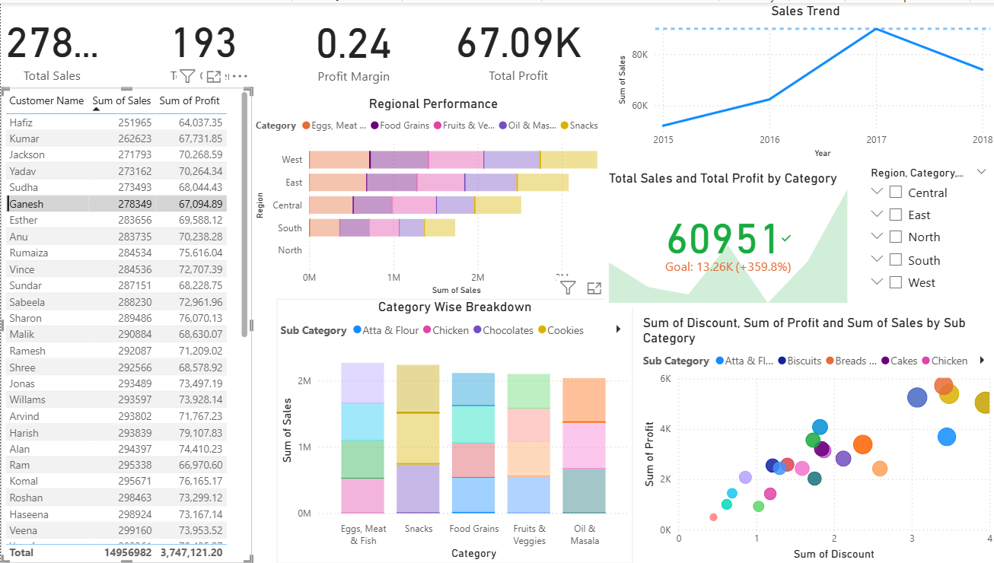
Shows Ganesh’s Sales

Slide 12
State-Level Sales Distribution
Geographic map of India showing sales by state
Maharashtra and Tamil Nadu are top contributors.
Weak regions can be targeted for marketing or expansion.

Slide 13
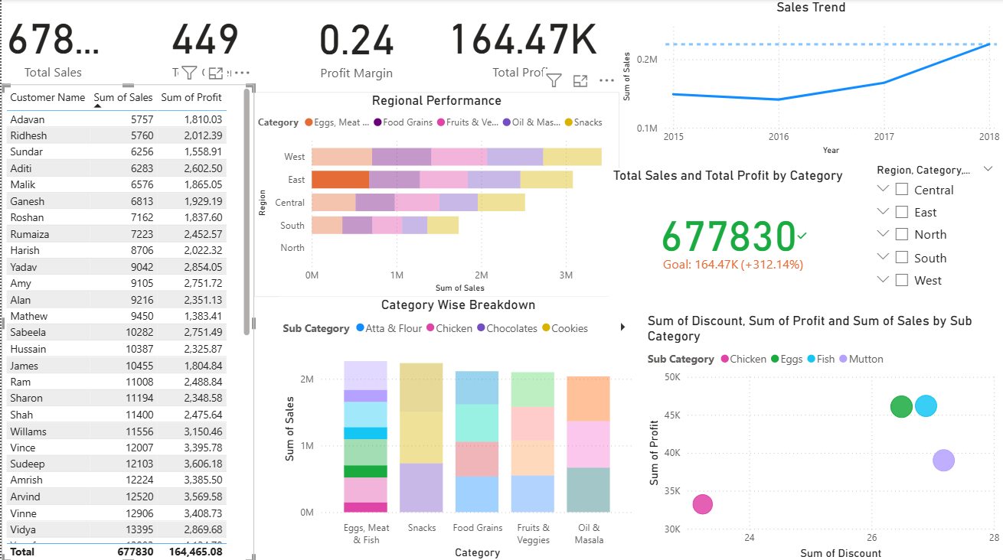
Sales Based On Region

Slide 14
Segment-wise Profit Contribution
Visual comparing profit by customer segments
Consumer and Corporate are leading segments.
Business segment has room for growth.

Slide 15
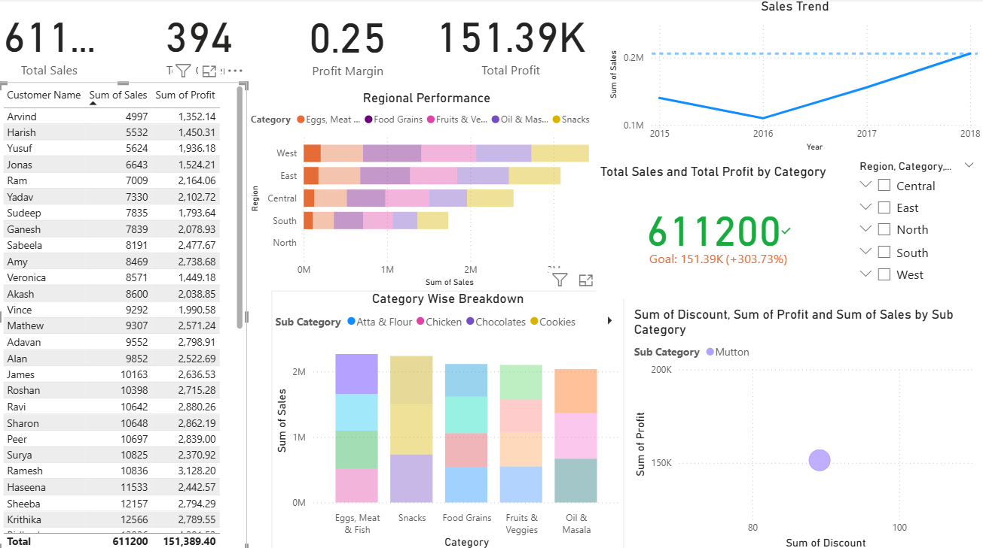
Profit Contribution

Slide 16
Product Category Insights
Compares sales and profit across product categories:
- Beverages, Snacks, and Personal Care are top performers.
- Home Office and Envelopes are low performers.
Useful for inventory and promotional decisions.

Slide 17
Sub-Category Breakdown
Deep-dive into individual product sub-categories:
- High performers: Soft Drinks, Biscuits, Soaps
- Low performers: Envelopes, Scissors
Helps refine product offerings and marketing.

Slide 18
Sales Forecast
Uses Power BI forecasting to predict future sales trends:
- Helps plan stock and financial projections.
- Can guide monthly targets and budget planning.

