Slide 1

Bio-Medical Application on Predicting Blood Donors Using Machine Learning Techniques
INTRODUCTION
The requirements for blood is steadily increasing as a result of increasing population and also advancement in clinical medicine.
On the contrary, the number of voluntary donors is decreasing over the last few years.
Recent findings bring to light the fact that a majority of the new donors fail to donate a second time.
It is not economically viable to continuously check for donors who fail to return for a subsequent donation.
An analysis conducted shows that the factors influencing the decision to donate blood are complex.

Slide 2

This creates an impending need for an intelligent automation mechanism that can with minimalistic human intervention, select potential blood donors and gather them based on blood requirement.
The incorporation of information and computer technology can help in decreasing the workload of blood centres and in the analysis of the contributing factors.
In this project, we review and contrast different implementation techniques to solve the above mentioned problem.
The donation of blood is important because most often people requiring blood do not receive it on time causing loss of life.

Slide 3

PROBLEM STATEMENT
To predict the blood donors who are willing to donate blood, by studying their knowledge, intention and attitude towards blood donation using machine learning techniques.

Slide 4

OBJECTIVES
To measure the level of knowledge regarding blood donation and its importance.
To find out positive and negative attitudes towards blood donation
Provide guidance on the measures needed to develop and implement effective systems for assessing the suitability of individuals to donate blood.
Review the available evidence base and provide recommendations on criteria for blood donor selection.

Slide 5

APPLICATIONS
It can be used by the hospitals and blood bank in emergency, who require blood and want to contact a person who is ready to donate blood.
In a short span of time, the person who is willing to donate blood is identified and can be contacted.
In case of emergency, where every second is valuable, one cannot contact all the people who are eligible to donate blood, so we help them by predicting the donors who are willing to donate blood and thus saving life of person in danger.

Slide 6
EXISTING SOLUTION METHODS
AUTHORS | METHODS | DATA | RESULTS
(Mostafa 2009) | ANN (MLP), ANN (PNN), LDA | Survey (430 records, 8 features) | ANN (MLP): Test accuracy (98%) ANN (PNN): Test accuracy (100%) LDA: Test accuracy (83.3%)
(Santhanam and Sundaram 2010) (Sundaram 2011) | CART CART vs. DB2K7 | UCI ML blood transfusion data (748 donors, 5 features) | Precision/ PPV (99%), Recall/ Sensitivity (94%)
(Darwiche, Feuilloy et al 2010) | PCA for feature reduction ANN (MLP) vs SVM (RBF) | UCI ML blood transfusion data (748 donors, 5 features) | SVM (RBF) using PCA: Test sensitivity (65.8%): Test Specificity (78.2%): AUC (77.5 %).
Table 1: Predicting blood donation with a focus on machine learning techniques

Slide 7

PROPOSED SOLUTION METHOD
Online Questionnaire:
At the first step of this work, questionnaire is used to collect data about feelings or opinions of individuals who become blood donors.
Online questionnaire is used to conduct data survey from different people.
The questionnaire consists of two parts: the first part is about personal information including sex, age, level of education, weight and height, contact address, phone numbers, and the other part consists of 15 questions about their feelings or opinions why they decide to become blood donors.

Slide 8
The questionnaire format is the opinion of respondents with 1 to 5 (strongly disagree, disagree, not sure, agree, and strongly agree).
The factors to be used in this study aiming to analyse the intensity of the feelings or opinions of the individuals will comprise of the following five factors:
Altruistic values (ALT): These are the questions asking for attitudes about reduction in blood donation, benefit to the society, social ethics and social belief.
Knowledge in blood donation (KNL): These questions are related to the knowledge asking for individual’s age and body mass index (BMI) in blood donation along with the understanding screening and recruiting first-time blood donors.

Slide 9

3. Perceived risks (RSK): These are related to an individual’s perception of standard procedure and safety control in blood donation along with the risk issues in donating blood.
4. Attitudes in blood donation (ATT): In this category, questions relating to attitude in the satisfaction and the aspect of blood donation.
5. Intention to donate blood (INT): The questions about blood donation in future will be asked.

Slide 10
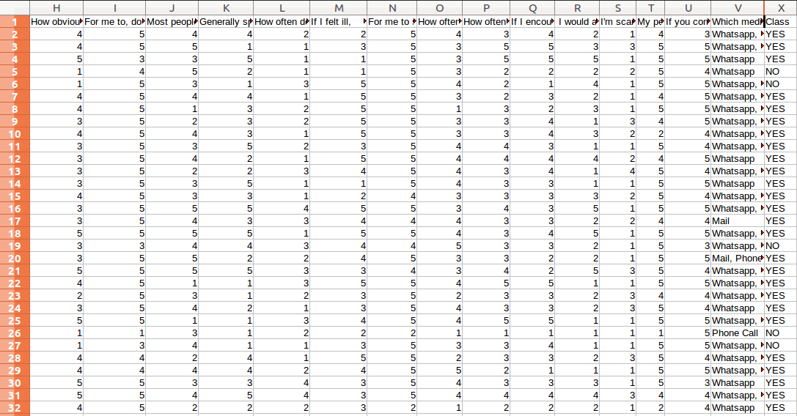
ii. Classification using Naïve Bayes:
To classify blood groups, it needs to prepare input data to the learning process by adjusted data obtained from questionnaires and made them as input attributes, according to the technique of Naïve bayes, in order to classify output as blood donor groups. A sample of input is shown in the following image.
Table 2: Classification using Naïve Bayes

Slide 11
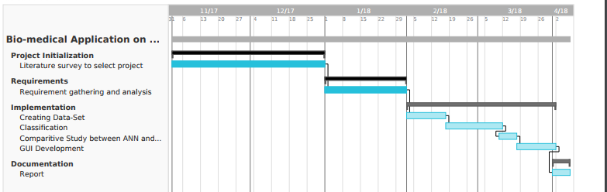
PROJECT SCHEDULE
Table 3: Schedule of the project

Slide 12

LITERATURE SURVEY
Significant research and work has been previously done to address the enhancement of the efficiency of blood donation process.
The notification systems involving various communication technologies have been studied, research heavily supports mobile communication as the most viable method.
Further, messaging services (SMS) and smartphone applications are the most popular[1].
Studies have been conducted on various implementation techniques like Decision trees, Random forests, Bayesian Networks, Neural Networks, Extreme Learning Machines, clustering techniques and their accuracies.

Slide 13
The intention to donate blood is one of the most important factors that can be used to predict behaviours in donating blood[7].
Imran Ahmed Khan wrote a thesis on how to extract knowledge from survey data using neural networks[5].
M.M Mustafa conducted a research analysis and tried to profile donors for optimized recruitment[6].
Research conducted attempts to identify factors that discriminate donors from non-donors.

Slide 14

SYSTEM REQUIREMENTS AND ANALYSIS
The system requirements have been divided into modules like :
Input Requirements
Output Requirements
Specific Requirements
Functional Requirements
Non-Functional Requirements
Hardware Specifications
Software Requirements

Slide 15
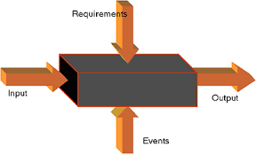
INPUT REQUIREMENTS
Dataset: Set of donor data i.e. around 250 samples consisting of personal information about the donor and his opinion to the questions are collected using Google forms.
Input: The user has to give city and blood group as the input, where he wants to find the donor.
OUTPUT REQUIREMENTS
Once the input is given, the donors matching the city and blood group are listed along with personal details.

Slide 16
SPECIFIC REQUIREMENTS
Google form : It is a free service for data collection provided by Google. Users with a google account can create forms through an interface that can be shared via email, social media, or filled out in person.
csv : The so called CSV (Comma Separated Values) format is the most common import and export format for spreadsheets and databases.
MySQLdb : MySQLdb is an interface for connecting to a MySQL database server from Python.
random : This module implements pseudo-random number generators for various distributions.
math : It provides access to the mathematical functions defined by the C standard.
phpMyAdmin : It is a free and open source administration tool for MySQL and MariaDB.

Slide 17
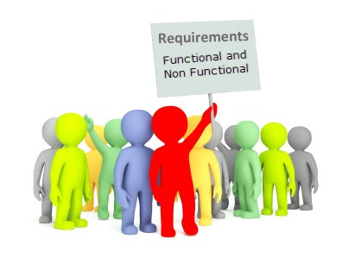
FUNCTIONAL REQUIREMENTS
Collection of data : The data collected from Google form are stored in file in .csv format.
Split data-set : The data-set is divided into training and testing set using split ratio of 0.67.
Separate By Class : The records are separated according to class i.e Donors and Non-Donors.
Classification : Naive Bayes algorithm is used for this purpose.
User input : It is necessary to know city where, and type of blood group required.
List the donors : Based on the inputs given by the user, the donors who are willing to donate blood are listed.

Slide 18
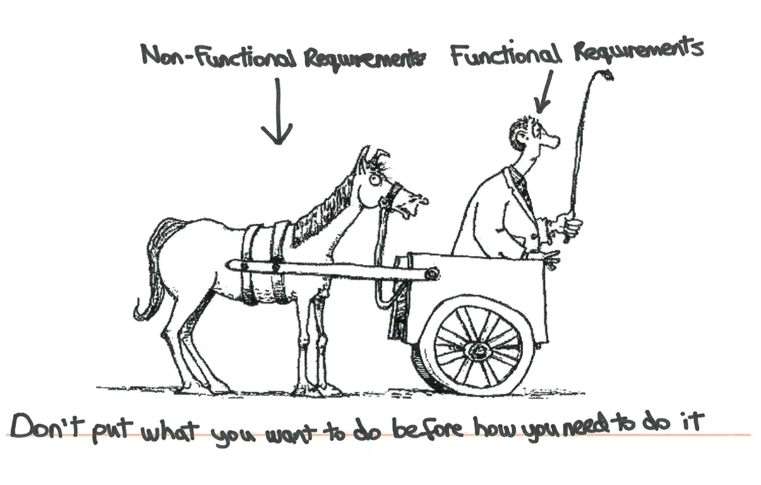
NON FUNCTIONAL REQUIREMENTS
Portability : The application should be portable to different computer systems running Linux.
Accuracy: Since we will give the priority to the accuracy of the system, the performance will be based on the accuracy on classification.
Openness : The system should be extensible to guarantee that it is useful for a reasonable period of time

Slide 19

HARDWARE SPECIFICATIONS
Processor : Intel i3
Speed : 2.2 GHz
RAM : 4 GB
Hard Disk : 1 TB
SOFTWARE SPECIFICATIONS
Operating System : Linux
Programming Language : Python 2.7.12 ( Classification ), MySQL ( Data-base ), HTML, CSS, PHP, JavaScript ( Front-End ).

Slide 20
TOOLS AND TECHNOLOGY USED
LINUX: It is one of popular version of UNIX operating System. It is open source as its source code is freely available. It is free to use. Linux was designed considering UNIX compatibility. Its functionality list is quite similar to that of UNIX.
PYTHON: It is a widely used high-level programming language for general-purpose programming. Python features a dynamic type system and automatic memory management and supports multiple programming paradigms, including object-oriented, imperative, functional programming, and procedural styles.
GOOGLE FORMS: Google Forms is a tool that allows collecting information from users via a personalized survey or quiz. The information is then collected and automatically connected to a spreadsheet. The spreadsheet is populated with the survey and quiz responses.

Slide 21
CSV: In computing, a comma-separated values(CSV) files stores tabular data (numbers and text) in plain text. Each line of the file is a data record. Each record consists of one or more fields, separated by commas. The use of the comma as a field separator is the source of the name for this file format.
MySQLdb: MySQL is an open-source relational database management system( RDBMS ). The MySQL development project has made its source code available under the terms of the GNU General Public License.
phpMyAdmin: phpMyAdmin is a free and open-source administration tool for MySQL and MariaDB. As a portable web-application written primarily in PHP, it has become one of the most popular MySQL administration tools, especially for web hosting services.

Slide 22
SYSTEM DESIGN
Collection of data : For our project we used Google form to create data-set. The form consisted of two parts, first part was used to collect personal information of the donor and in the latter part, questionnaire consisting of 15 questions were present. In total we had created data-set of 246 records, which were stored in a file with .csv extension.
Split data-set : The data-set is divided into training and testing set using split ratio of 0.67.
Separate By Class : The records are separated according to class i.e. Donors and Non-Donors.
Classification : Naive Bayes algorithm is used for this purpose.
User input : It is necessary to know city where, and type of blood group required.
List the donors : Based on the inputs given by the user, the donors who are willing to donate blood are listed.

Slide 23
IMPLEMENTATION
Creating Dataset: The data-set is created using Google Forms. It comprises of two parts, the first part is used to collect personal details of the donors and the latter part consists of questionnaire. The questionnaire consists of 15 questions, 14 of which are likert-type scale based having inputs from 1 to 5, and one question asks opinion of the person on how he should be contacted.
Classification: For Classification we have used Naive Bayes classification algorithm. The Naive Bayes algorithm is an intuitive method that uses the probabilities of each attribute belonging to each class to make a prediction. It is the supervised learning approach you would come up with if you wanted to model a predictive modelling problem probabilistically. The classification problem is divided into the following steps:
Handle Data : Load data from CSV file and split it into training and test datasets.
Summarize Data : Summarize the properties in the training dataset so that we can calculate probabilities and make predictions.
Make Predictions : Generate predictions given a test dataset and a summarized training dataset.
Evaluate Accuracy : Evaluate the accuracy of predictions made for a test dataset as the percentage correct out of all predictions made.

Slide 24
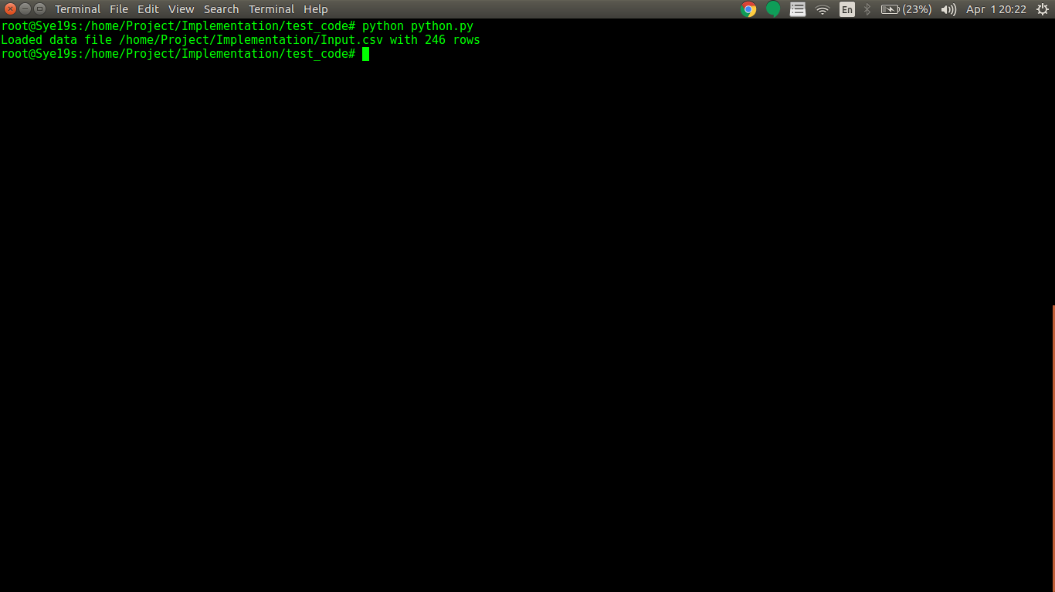
SYSTEM TESTING AND RESULT ANALYSIS
We imported csv module, to load data-set using loadCsv() method.

Slide 25
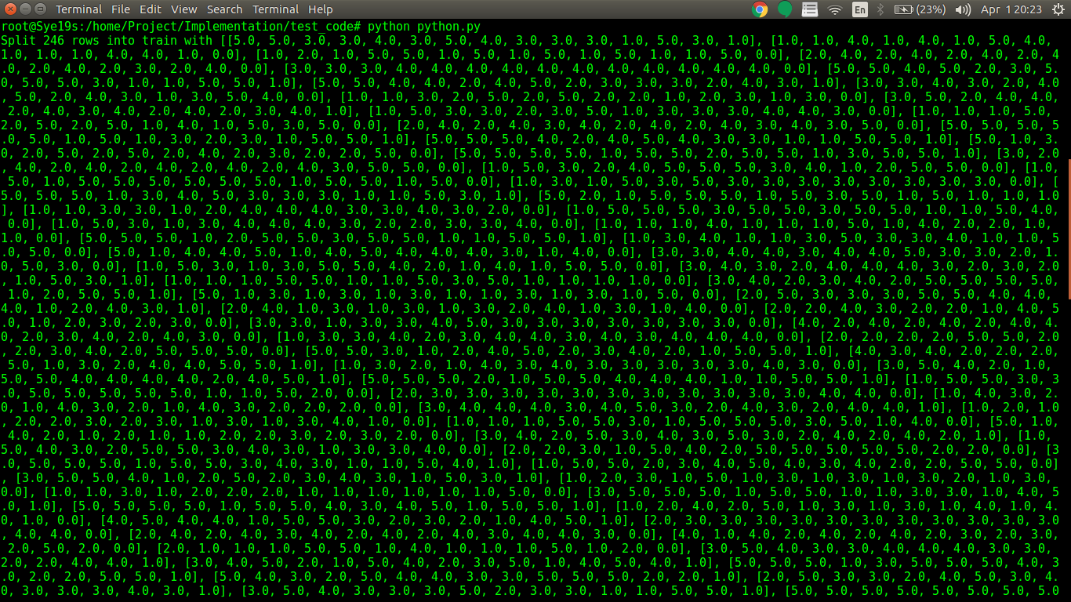
Splitting the dataset

Slide 26
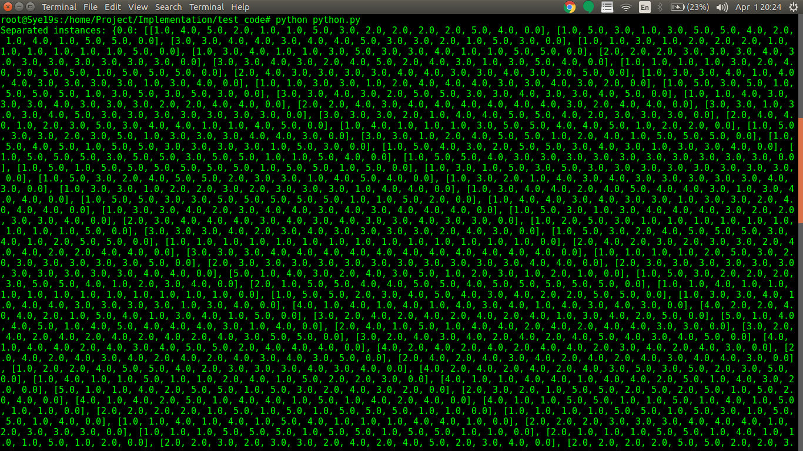
Separating the instances

Slide 27
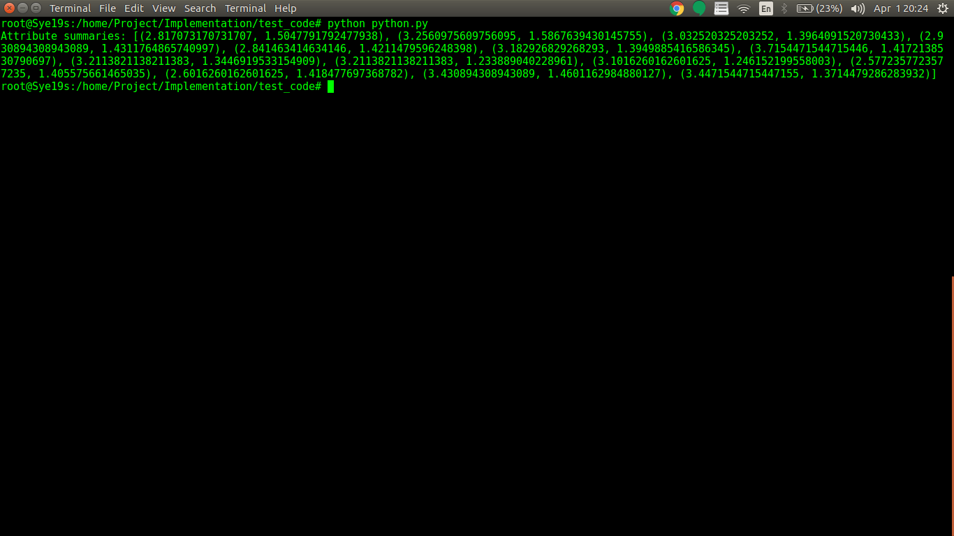
Summarizing the attributes

Slide 28
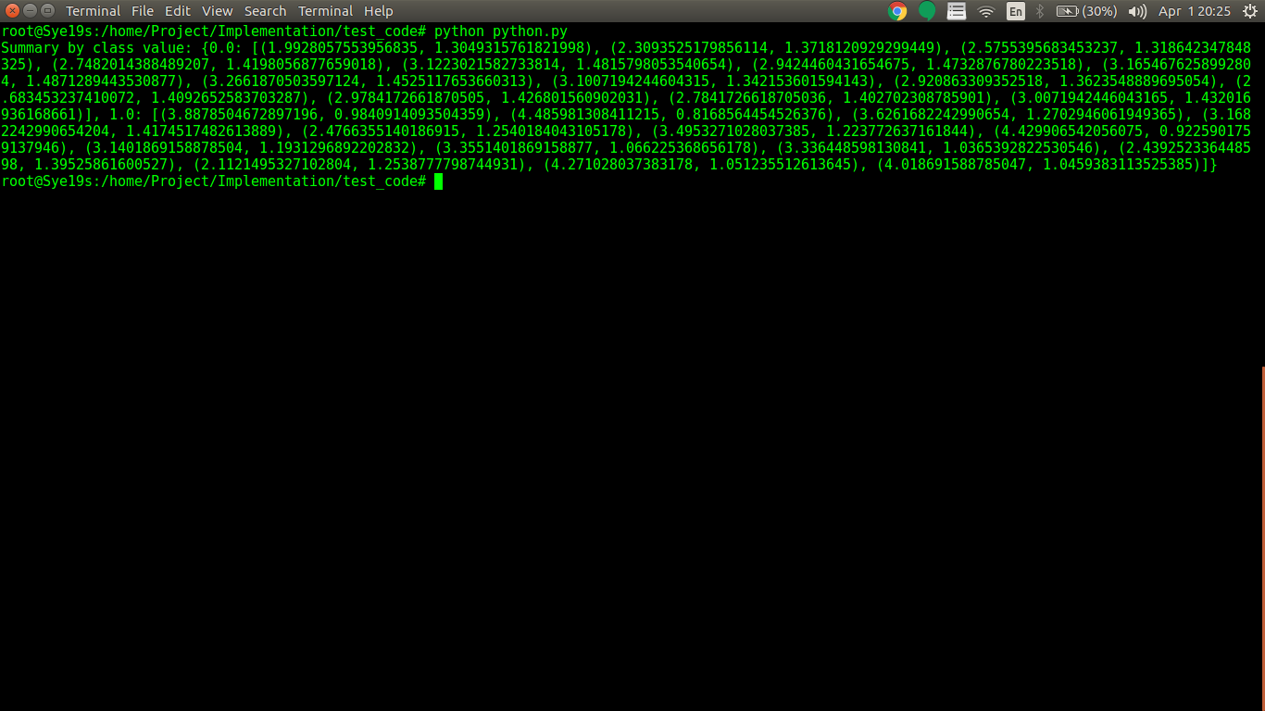
Summarizing by class values

Slide 29
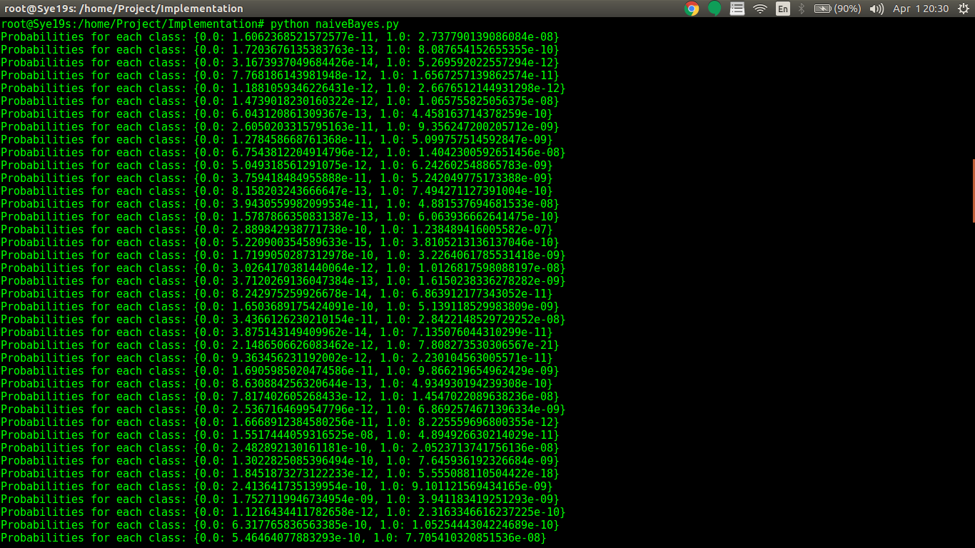
Calculating probabilities for each class

Slide 30
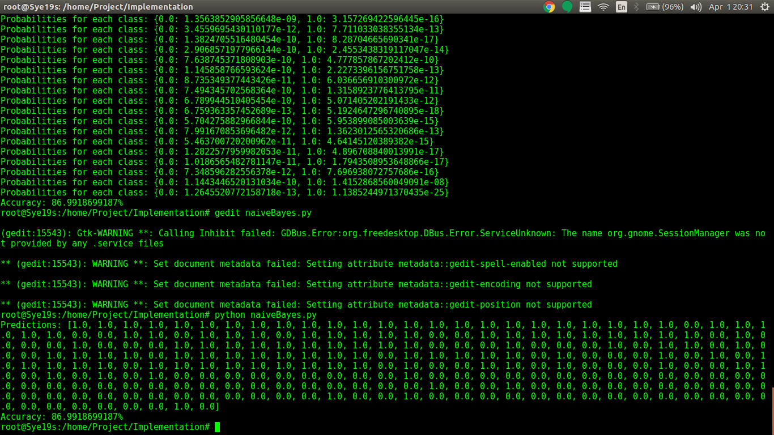
Predictions

Slide 31
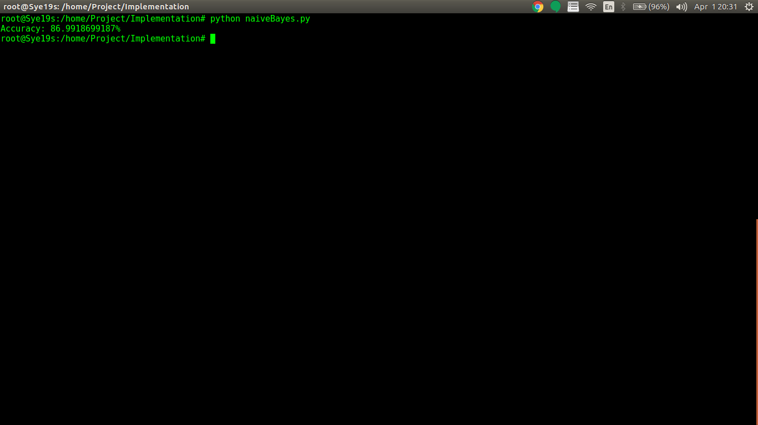
Calculating accuracy

Slide 32

Applying information of consumer survey such as behaviors, feelings and opinions of the donors in blood donation can enhance the analysis of the feasibility of blood donation of each individual.
This study can be used as a prototype and expand the sample group in order to develop blood donor classification model in both the regional and the national levels, which will be beneficial for developing blood donor database system in different levels.
This database system is advantageous for classifying potential blood donors and tracking them to donate blood again in the future.
The obtained information can be used to determine potential blood donors and manage blood on the supply chain more effectively.
Furthermore, this classification model and donor database system will contribute greatly for blood acquisition especially when there are emergency needs for blood for uses in the life saving treatments.

Slide 33

FUTURE WORK
Other factors affecting blood donation should be explored in order to better manage blood donors’ behaviors.
The work can be extended by enlarging the sample size of the study.
Moreover, other machine learning techniques can be used comprehensively in analyzing the model and comparing the results.

Slide 34
Suggestions and actions taken
Suggestion: To use efficient machine learning algorithm to predict the donor.
Action taken: We have used Naïve Bayes algorithm which gives 87% accuracy

Slide 35
REFERENCES
Arunkumar Chinnaswamy, 2015 “A study on automation of blood donor classification and notification techniques”, 2015 in International Journal Of Applied Engineering Research.
Deepti Bahel, Prerna Ghosh, Arundhyoti Sarkar, Matthew A. Lanham, “ Predicting blood donations using machine learning techniques ”
https://medlineplus.gov/bloodtransfusionanddonation.html
https://www.ncbi.nlm.nih.gov/pubmed/19040598
http://people.umass.edu/aizen/tpb.html
https://www.czp.cuni.cz/czp/images/stories/Vystupy/Seminare/2010%20Theory%20of%20Planned%20Behavior/Prezentace/Lukacovska_Motivation%20towards%20blood%20donation.pdf
Icek Ajzen, “ Behavioral Intentions Based on the Theory of Planned Behavior ”
Icek Ajzen, “ Sample Theory of Planned Behavior Questionnaire ”

Slide 36
Imran Ahmed Khan, 2013 “Knowledge extraction from Survey data using Neural Networks”, 2013, Scholar works at UT Tyler.
Judith Holdershaw, Philip Gendall and Malcolm Wright, “ Predicting Willingness to Donate Blood ”
Kathi L. Rose, “ The Blood Donor of the Future : Demographic Predictions ”
Mehrdad Jalalian, Latiffah Latiff, Syed Tajuddin Syed Hassan, Parichehr Hanachi and Mohamed Othman, May 2010 “ Development of a Questionnaire for assessing factors predicting Blood Donation among University Students : A pilot study ”
Mustafa .M, 2009 “Profiling blood donors in Egypt: a neural network analysis”, Expert systems with applications.
Nur Zainie Abd Hamid, Rohaida Basiruddin and Narehan Hassan, July 2013 “ Factors influencing the Intention to Donate Blood : The Application of the Theory of Planned Behavior ” , July 2013, International Journal of Social Science and Humanity.
W. A. Flegel, W. Besenfelder and F.F. Wagner, “ Predicting a donor’s likelihood of donating blood ”
Wijai Boonyanusith and Phongchai Jittamai, 2012 “Blood donor classification using neural networks and decision tree techniques”, 2012, IAENG.

