Slide 1
Marketing and Retail Analytics – Capstone Project
By: Rakhee Kumari

Slide 2
Problem Statement
OList is an e-commerce company that is facing some losses recently and they want to manage their inventory very well so as to reduce any unnecessary costs that they might be bearing.
I will be managing the inventory cost of this e-commerce company called OList.
For this purpose I will identify top products that contribute to the revenue and also use market basket analysis to analyse the purchase behavior of individual customers to estimate with relative certainty, what items are more likely to be purchased individually or in combination with some other products.

Slide 3
Olist Dataset- Retail Dataset
The dataset available to us is called “Retail_dataset”. It is a xlsx file or simply a
spreadsheet.
There are five worksheets in the excel file. They are namely:
Orders
Order_Items
Products
Payments
3. Customers
The total number of Products available at Olist Warehouse is 32950. There are total 99440 Orders ordered. Unique customers total at 96096. There were 3345 repeat customers.
The dataset contains transactions from September 2016 to September 2018.

Slide 4
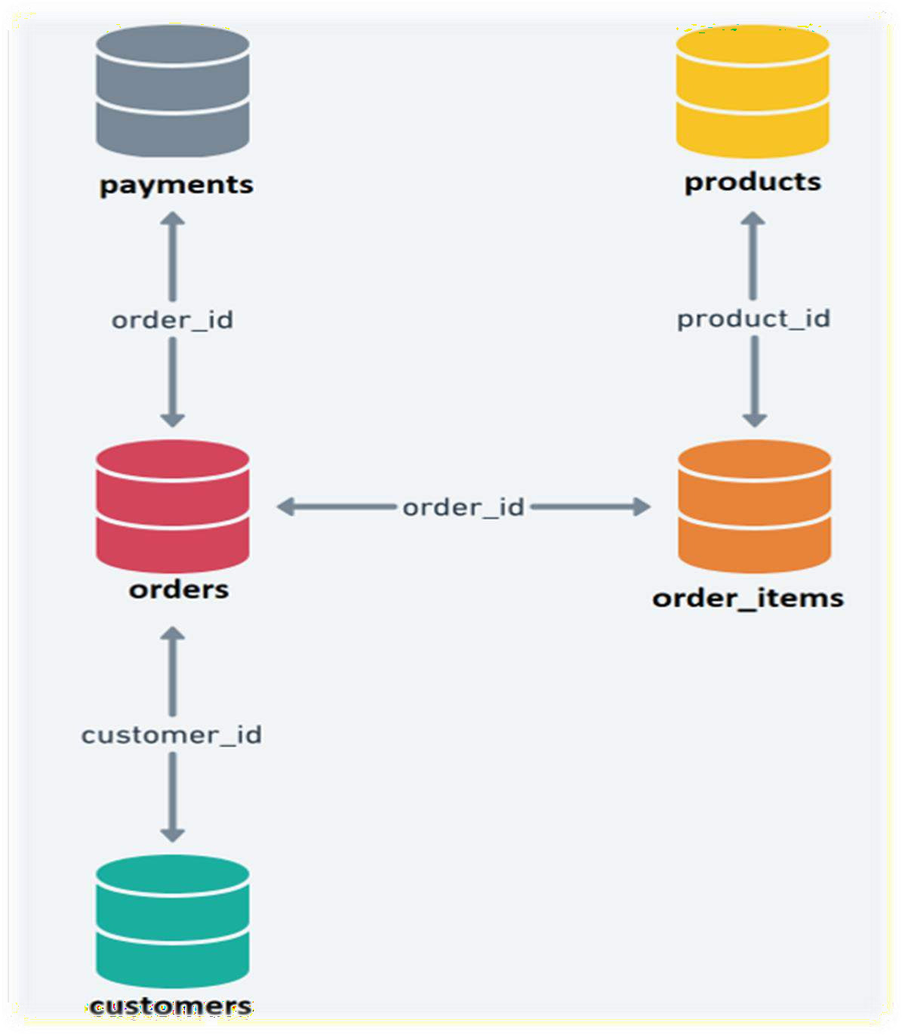
Entity Relationship Diagram

Slide 5
Step 1: Importing Libraries and Reading Data
Used many python libraries throughout the project. Some of the most important of them are as follows: pandas, numpy, seaborn, Sklearn, matplotlib.pyplot, squarify etc.

Slide 6
Step 2: Data Cleaning and EDA
Since the data available to us contains many duplicates and Null values. We will first make the data suitable for evaluation by performing Exploratory Data Analysis.
As per requirement, we are interested in only orders having statuses as ‘delivered’. We will filter down the values in the jupyter notebook and create a separate cleaned file which we can use to create visualizations in Tableau.
If necessary we may create new derived fields which may enhance our understanding of the dataset.

Slide 7
EDA Analysis Observations
We find that 97 % or orders were of ‘delivered’ status. Dropped all the others orders for the purpose of this project.
There were 160 ‘order_approved_at’ null values and 2965 ‘order_delivered_timestamp’ null values in the order’s sheet.
I filled the Nan values of ‘order_approved_at’ and ‘order_delivered_timestamp’ with the appropriate values derived from the same dataframe.

Slide 8
Step 3: Creating a Cleaned Excel File
After having gone through the whole dataset and performing necessary cleanup and EDA. I converted the dataframes into a new excel file using the ‘ExcelWriter’ function of pandas.
I combined all the dataframe into a single sheet to be used further in the Tableau environment.

Slide 9
Step 4: Merging Dataframes
Using pandas merge function to join all the sheets using the common fields as depicted in the Entity Relationship Diagram.

Slide 10
Step 5: Data Visualisation in Python
Using bar plot and pandas value_counts functions, I figured out the: Top 20 most ordered product categories
I saw that the most frequent purchases from a product category are in the following order:
Toys, Health and Beauty, Bed Bath Table, Sports and Leisure, Computer Accessories
I observed that Toys health and beauty and watches and gifts make up more than 80% of all revenue.

Slide 11
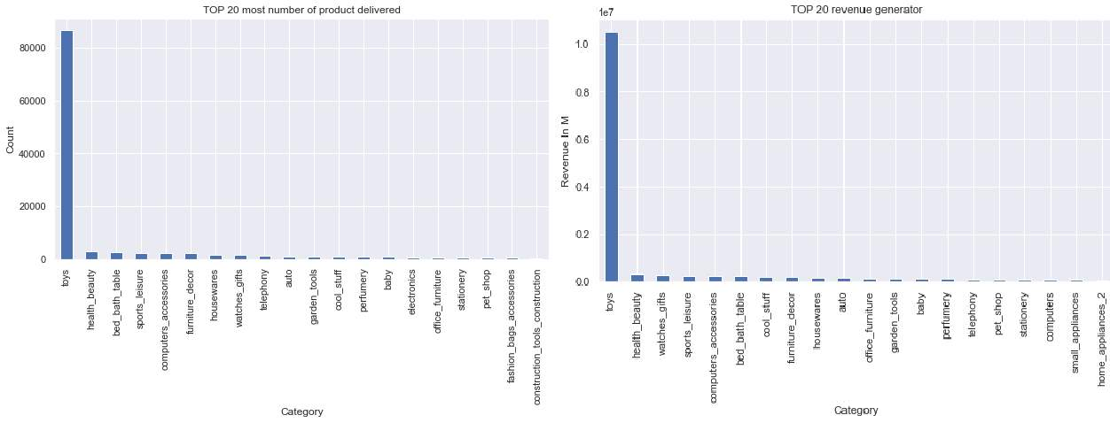

Slide 12
Tableau Visualizations

Slide 13
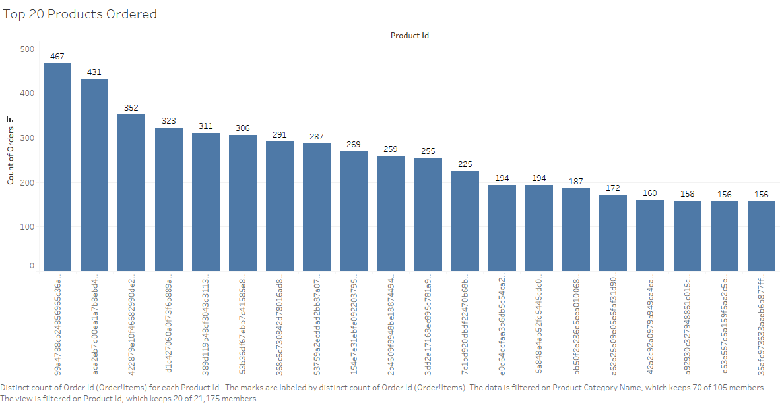
Top 20 Most Ordered Products by Product Id

Slide 14
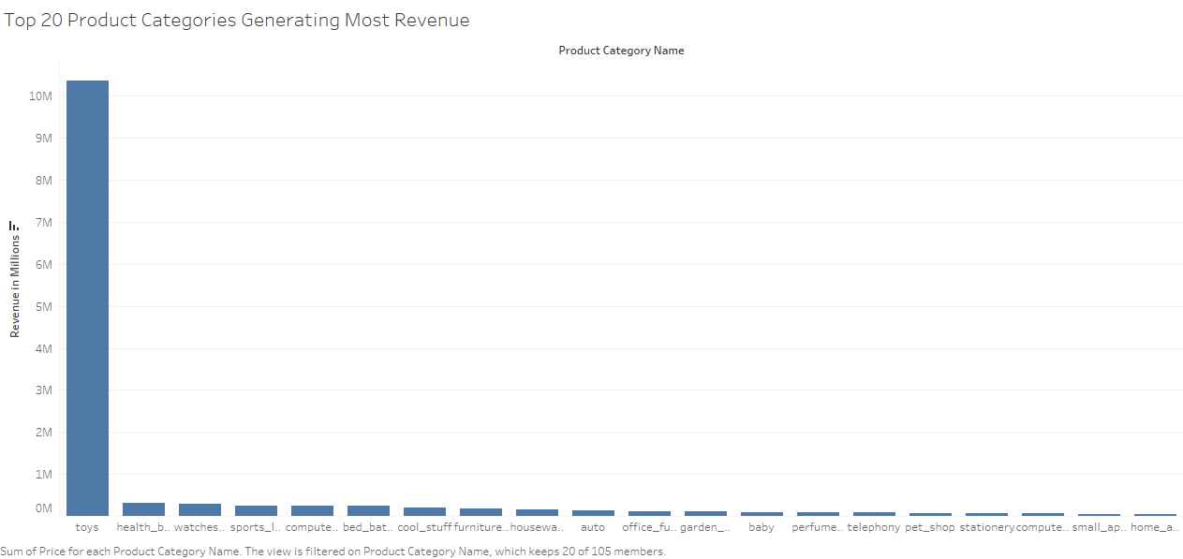
Top 20 Most Revenue Generating Product Categories

Slide 15
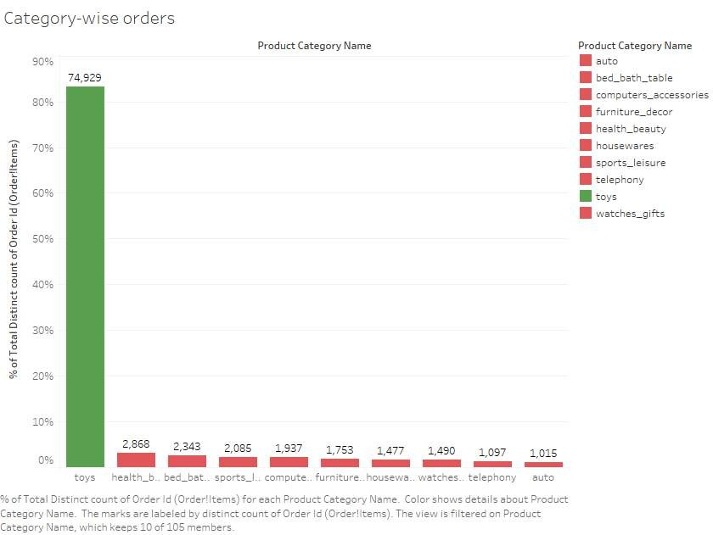
Top 10 Most Ordered Product Category

Slide 16
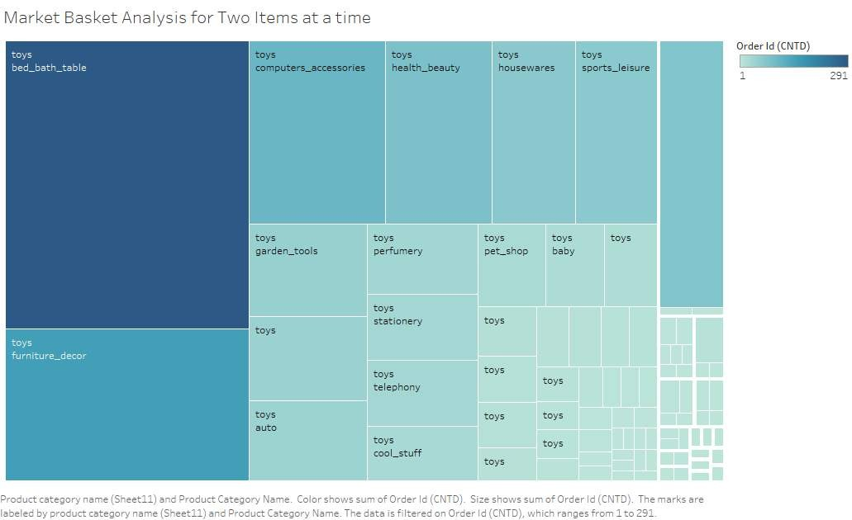
Most Ordered Product Category in Combination of Twos

Slide 17
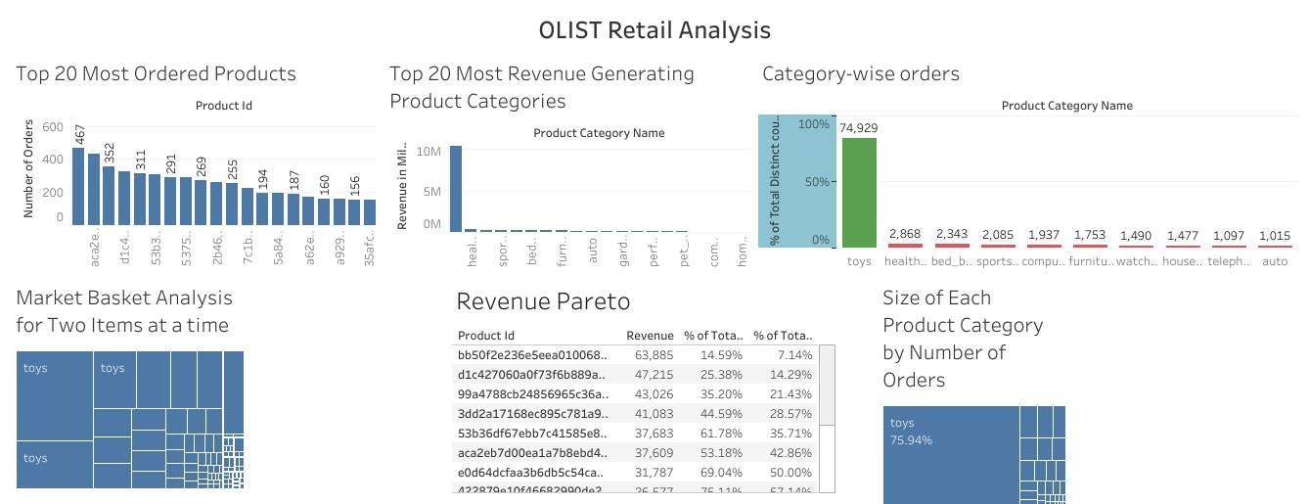
Olist Retail Analytics Dashboard

Slide 18
Step 6: RFM Modelling
Using Recency, Frequency and Monetary modelling I divided the products at Olist
warehouse into five different categories using a RFM score assignment method. Ranging from 1-4 with the highest number corresponding with the best score on the RFM scale
I got the following product categories:
1. Superhit Products
2 .Average Sale Products
3. Costly Products
4 .Fast Moving Average Price Products
Hardly Any Sale Products
Infrequent Products

Slide 19
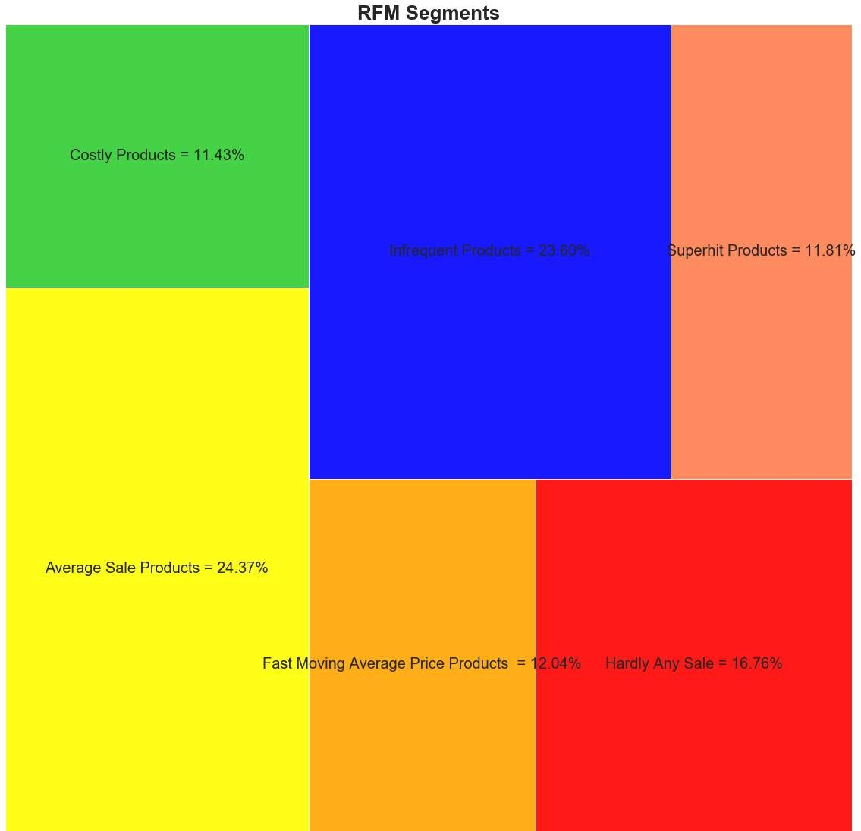
Observation
There is almost equal proportions of average sale and infrequent cheap products. They make up approx. 50% of inventory
Superhit Products and Fast- moving average price products account for 25% of inventory
Hardly any Sale products account for 1 out of every 6 products in the inventory

Slide 20
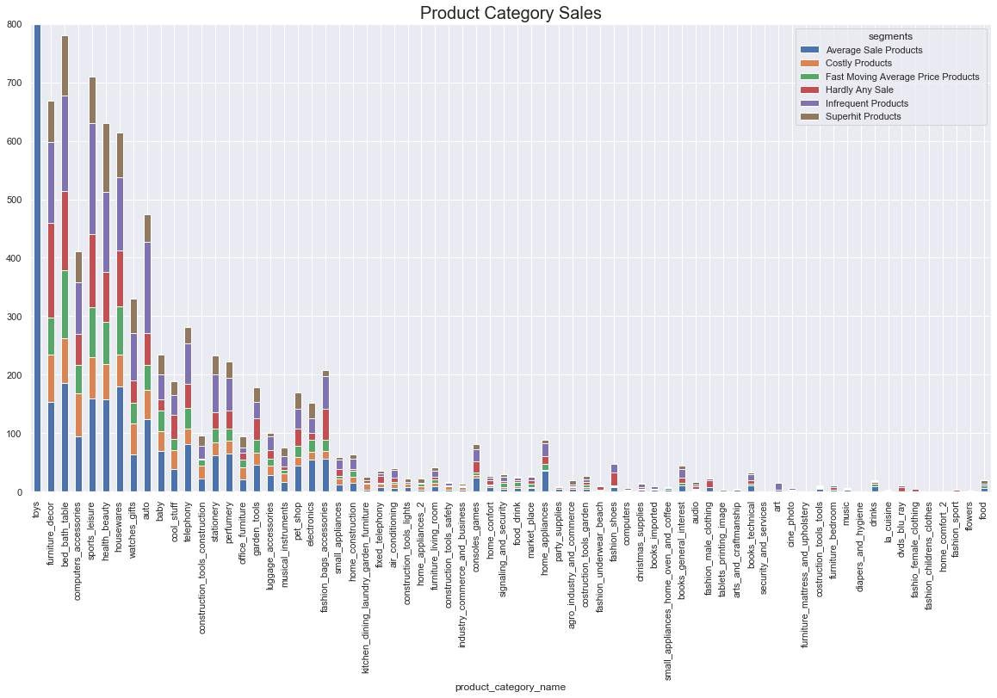
Stacked Bar Chart of the Product Category Depicting their Product Type

Slide 21
Observation
It is observed that around 20 product categories account for 80% of Overall Sale count.
Close to 40-50 % of the sales of furniture decor, bed bath table, sports_leisure, fashion bags and accessories and auto have low frequency or hardly any sale products
Flowers, home comfort, fashion childrens clothing , furniture mattress and upholstery , security and services and many more have hardly any sale

Slide 22
Market Basket Analysis
Top five products categories in groups of threes are:
1.Toys, Cine photos and Telephony 2.Toys, Home Construction and Computer Accessories
Toys, Garden Tools and Computer Accessories
Toys Furniture Decor and Electronics 5.Toys, Furniture Decor and Health and Beauty
Top five products categories in groups of twos are:
Toys and Bed Bath Table
Toys and Fashion Bags Accessories
Toys and Auto
Toys and Watches Gift
Toys and Health & Beauty

