Slide 1
HR Workforce Analytics
This project gives an overview of the workforce, including employee numbers, work location, age, hiring trends, gender, state, department and race.
The dashboard currently shows 1,000 employees.
The presentation summarizes the findings from the Power BI dashboard and the PRDA–03 brief.
1

Slide 2
KPI SUMMARY
A quick look at the main figures in the dashboard
Total Employees
1,000
Remote Workforce
25%
HQ Workforce
75%
Average Age
39 years
2

Slide 3
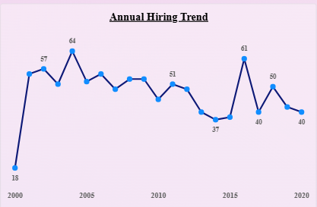
ANNUAL HIRING TREND
What the yearly hiring figures show
The chart shows the number of employees hired each year from 2000 to 2020.
Hiring was highest at 64 around 2004, with another high point of 61 around 2017.
The lowest figure shown is 18 in 2000.
Overall, hiring changed from year to year rather than following a steady pattern.
3

Slide 4
GENDER DISTRIBUTION
Breakdown of employees by gender
Male
531 employees
53.1%
Female
440 employees
44.0%
Non-Conforming
29 employees
2.9%
The three categories add up to 1,000 employees, which matches the total shown in the dashboard.
4

Slide 5
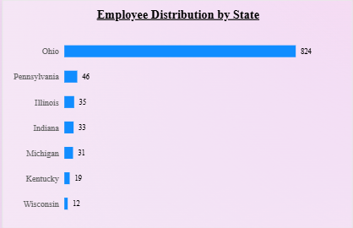
EMPLOYEE DISTRIBUTION BY STATE
Employee numbers across the states
Ohio has the largest workforce, with 824 employees (82.4%).
Pennsylvania: 46 | Illinois: 35 | Indiana: 33.
Michigan: 31 | Kentucky: 19 | Wisconsin: 12.
Most employees shown are based in Ohio. It is worth checking whether the chart includes every state.
5

Slide 6
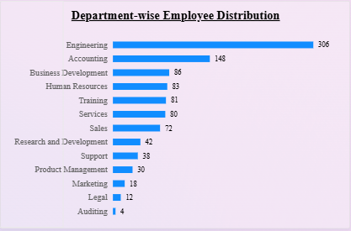
DEPARTMENT-WISE EMPLOYEE DISTRIBUTION
Employee numbers across departments
Engineering has the highest employee count, with 306 people (30.6%).
Accounting: 148; Business Development: 86; Human Resources: 83.
Training: 81; Services: 80; Sales: 72; Research and Development: 42.
Support: 38; Product Management: 30; Marketing: 18; Legal: 12; Auditing: 4.
6

Slide 7
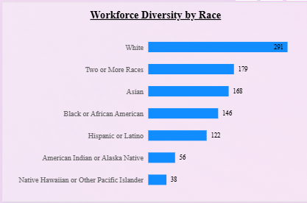
WORKFORCE DIVERSITY BY RACE
Employee numbers across departments
White: 291
Two or More Races: 179
Asian: 168.
Black or African American: 146
Hispanic or Latino: 122.
American Indian or Alaska Native: 56
Native Hawaiian or Other Pacific Islander: 38
These figures show the current mix of employees. Tracking them over time can help the company understand how representation changes.
7

Slide 8
KEY ANALYTICAL INSIGHTS
Main points from the dashboard
Most employees work at the head office (75%), while 25% work remotely.
Ohio accounts for 82.4% of the employees shown in the dashboard.
Engineering is the largest department, representing 30.6% of the workforce shown.
The gender split is 53.1% male, 44.0% female and 2.9% non-conforming.
Hiring numbers moved up and down between 2000 and 2020, rather than rising steadily.
8

Slide 9
COMPANY INPUTS AND SUGGESTIONS
Suggestions for the company
Take a closer look at the large number of employees based in Ohio and consider any location-related risks.
Review Engineering's workload, staffing levels and skills needs to make sure the team is well supported.
Compare engagement, performance and retention for remote and HQ employees before changing work arrangements.
Keep track of gender and race representation and make sure recruitment, promotion and retention processes are fair.
Compare yearly hiring with vacancies, business needs and employee exits to understand the changes in hiring.
Check employee IDs, dates, department names and dashboard filters before sharing the final results.
9

Slide 10
A possible next step: attrition analysis
The dataset also contains hire date and term_date, which can support further analysis.
Useful measures could include active employees, employee separations, average tenure and separations by department.
Before calculating an attrition rate, decide which reporting period to use and how the rate will be calculated.
A total of all employees with a termination date divided by all employee records is a cumulative separation proportion, not an annual attrition rate.
Check blank termination dates and date formats before creating these measures.
10

Slide 11
CONCLUSION
The dashboard brings together the main workforce measures requested in the PRDA–03 assignment.
It gives a useful picture of employee numbers, work location, hiring, gender, state, department and race.
The key findings include the concentration of employees in Ohio, the size of the Engineering team and the HQ/remote split.
The report and presentation explain these findings and suggest areas the company could review.
Before submission, check the figures against the source data and include the required dashboard screenshots.
11

