Slide 1
Processes

Slide 2
Process Concept
An operating system executes a variety of programs:
Batch system – jobs
Time-shared systems – user programs or tasks
Program is a passive entity (executable having instructions)
Process is an active entity
Loading executable file – Double click its icon or enter its name on the command line
Process – is a program in execution;
process execution must progress in sequential fashion

Slide 3
Process Concept
Each instance of the same executing program e.g. application is a separate process
Why?
Text section is same but data, heap and stack sections vary.
A process can itself be an execution environment for other code
Interpret the code and take actions on behalf of the code (virtual machine)
Same concept is used in simulation

Slide 4
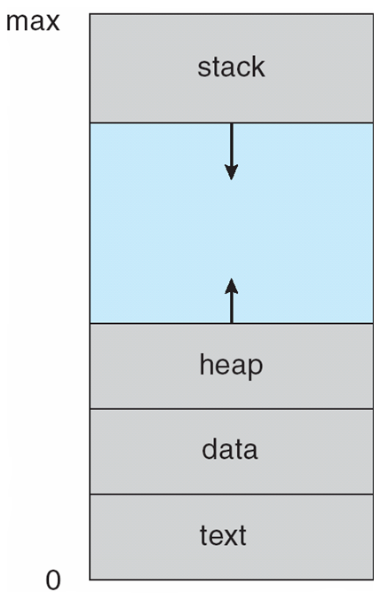
Process in Memory
Multiple parts
The program code, also called text section
Current activity including program counter, processor registers
Stack containing temporary data
Function parameters, return addresses, local variables
Data section containing global variables
Heap containing memory dynamically allocated during run time

Slide 5
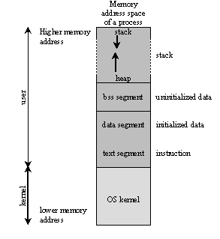
Process Address Space

Slide 6
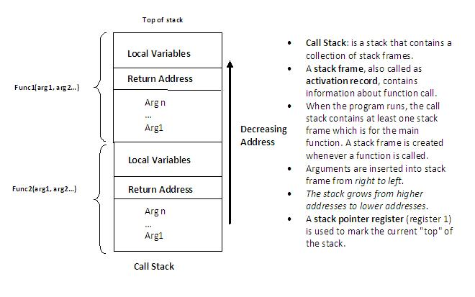
Call Stack / Activation Record

Slide 7
Process State
As a process executes, it changes state
new: The process is being created
running: Instructions are being executed
waiting: The process is waiting for some event to occur
ready: The process is waiting to be assigned to a processor
terminated: The process has finished execution

Slide 8
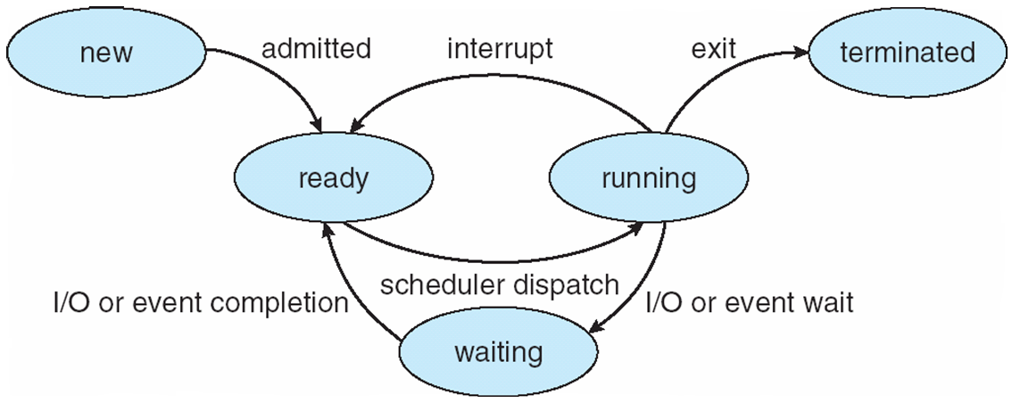
Diagram of Process State

Slide 9
Process Creation
Events which can cause process creation
System initialization.
Execution of a process creation system call by a running process.
A user request to create a new process.
Initiation of a batch job.
Tanenbaum, Modern Operating Systems 3 e, (c) 2008 Prentice-Hall, Inc. All rights reserved. 0-13-6006639

Slide 10
Process Termination
Events which cause process termination:
Normal exit (voluntary).
Error exit (voluntary).
Fatal error (involuntary).
Killed by another process (involuntary).
Tanenbaum, Modern Operating Systems 3 e, (c) 2008 Prentice-Hall, Inc. All rights reserved. 0-13-6006639

Slide 11
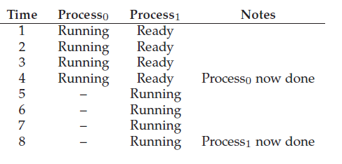
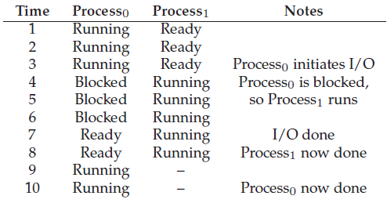
Tracing Process State

Slide 12
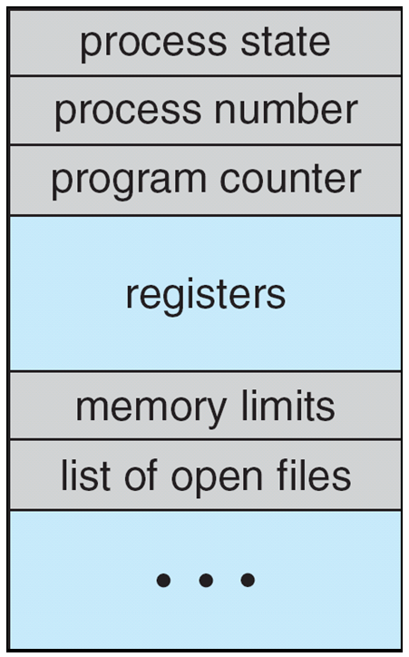
Process Control Block (PCB)
Information associated with each process
(also called task control block)
Process state – running, waiting, etc
Program counter – location of instruction to next execute
CPU registers – contents of all process-centric registers
CPU scheduling information- priorities, scheduling queue pointers
Memory-management information – memory allocated to the process
Accounting information – CPU used, clock time elapsed since start, time limits
I/O status information – I/O devices allocated to process, list of open files

Slide 13
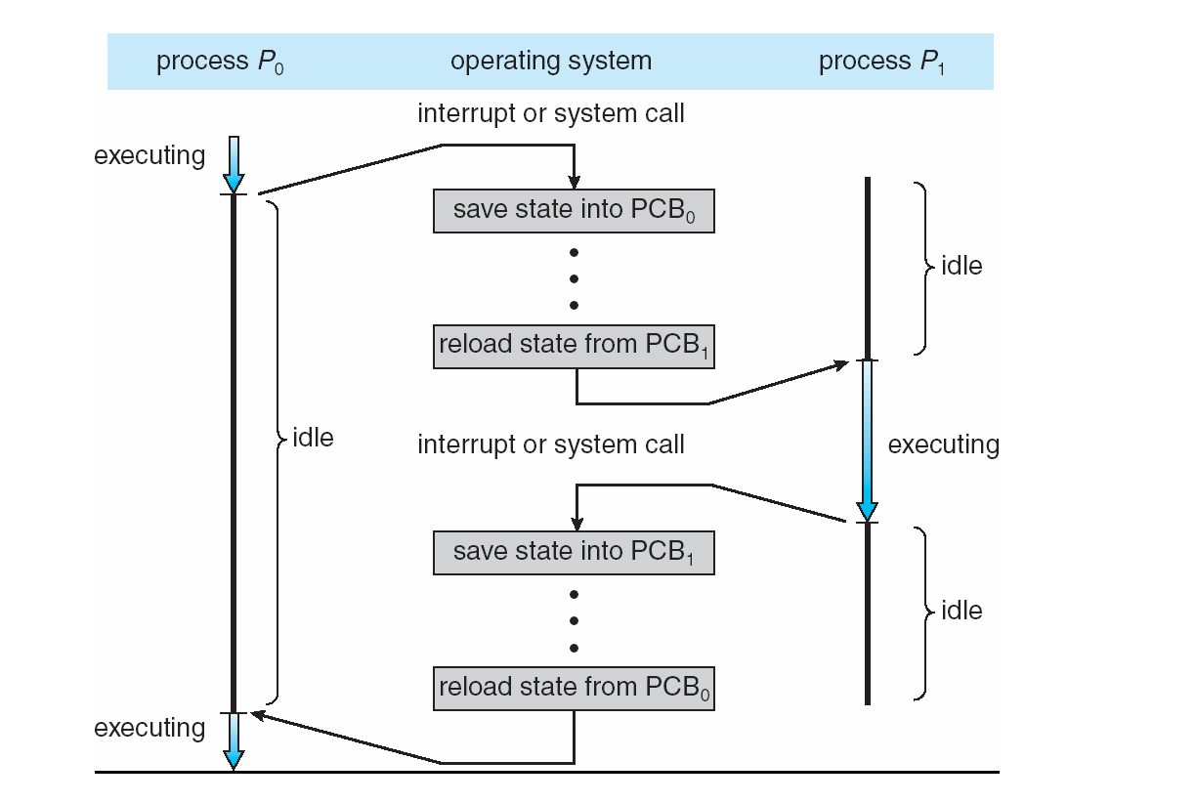
CPU Switch From Process to Process

Slide 14
Threads
So far, process has a single thread of execution
Consider having multiple program counters per process
Multiple locations can execute at once
Need Multiple threads of control -> Use threads
Must then have storage for thread details, multiple program counters in PCB

Slide 15
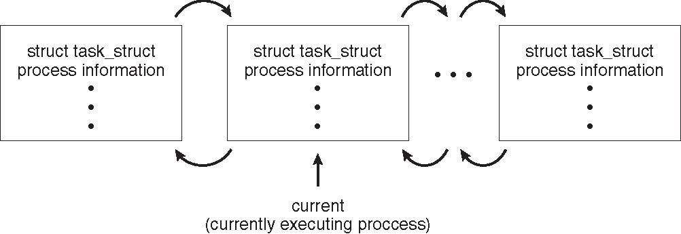
Process Representation in Linux
Represented by the C structure task_struct
pid t_pid; /* process identifier */ long state; /* state of the process */ unsigned int time_slice /* scheduling information */ struct task_struct *parent; /* this process’s parent */ struct list_head children; /* this process’s children */ struct files_struct *files; /* list of open files */ struct mm_struct *mm; /* address space of this process */

Slide 16
Process Scheduling
Maximize CPU use, quickly switch processes onto CPU for time sharing
Process scheduler selects among available processes for next execution on CPU
Maintains scheduling queues of processes
Job queue – set of all processes in the system
Ready queue – set of all processes residing in main memory, ready and waiting to execute
Device queues – set of processes waiting for an I/O device
Processes migrate among the various queues

Slide 17
Process Scheduling
The objective of multiprogramming is to have some process running at all times, to maximize CPU utilization.
The objective of time sharing is to switch the CPU among processes so frequently that users can interact with each program while it is running
To meet these objectives, the process scheduler selects an available process (possibly from a set of several available processes) for program execution on the CPU.
For a single-processor system, there will never be more than one running process.

Slide 18
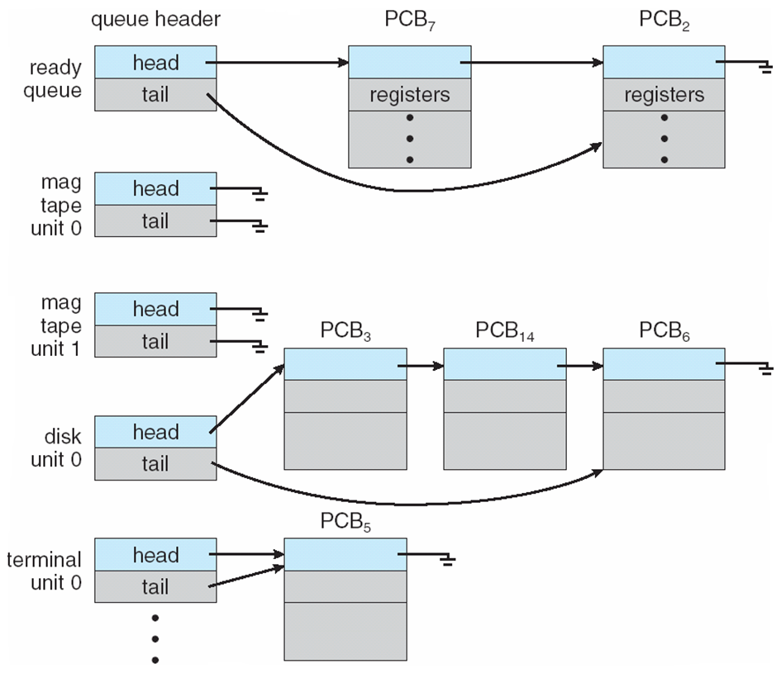
Ready Queue And Various I/O Device Queues

Slide 19
After Process is Dispatched
Once the process is allocated the CPU and is executing, one of several events could occur:
The process could issue an I/O request and then be placed in an I/O queue.
The process could create a new child process and wait for the child’s termination.
The process could be removed forcibly from the CPU, as a result of an interrupt, and be put back in the ready queue.

Slide 20
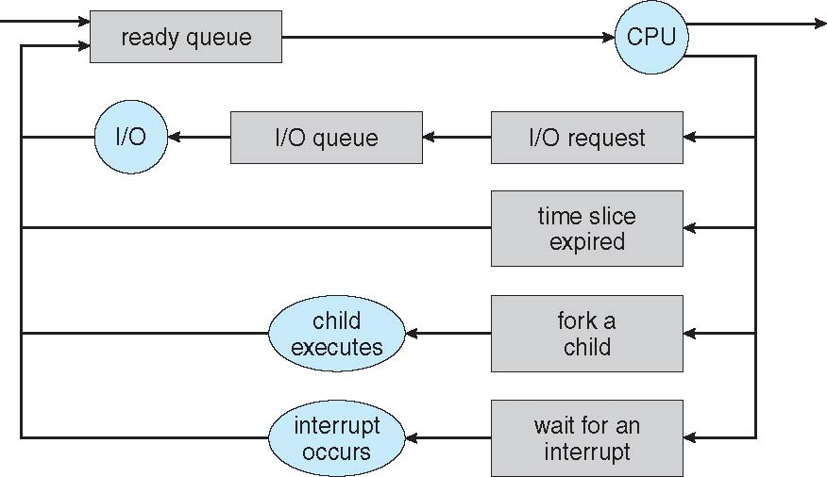
Representation of Process Scheduling
Queuing diagram represents queues, resources, flows

Slide 21
Question
What happens when a process terminates?
Ans: At this time it is removed from all queues and has its PCB and resources deallocated

Slide 22
Schedulers
The operating system must select, for scheduling purposes, processes from various queues in some fashion.
The selection process is carried out by the appropriate scheduler

Slide 23
Schedulers
Long-term scheduler (or job scheduler) – Selects which processes should be brought into the ready queue
Long-term scheduler is invoked infrequently (seconds, minutes) ⇒ (may be slow)
The long-term scheduler controls the degree of multiprogramming

Slide 24
Short-term scheduler
(Or CPU scheduler) – Selects which process should be executed next and allocates CPU
Sometimes the only scheduler in a system
Short-term scheduler is invoked frequently (milliseconds) ⇒ (must be fast)

Slide 25
Long Term Scheduler
Processes can be described as either:
I/O-bound process – spends more time doing I/O than computations, many short CPU bursts
CPU-bound process – spends more time doing computations; few very long CPU bursts
Long-term scheduler strives for good process mix

Slide 26
Long Term Scheduler
If the degree of multiprogramming is stable, then the average rate of process creation must be equal to the average departure rate of processes leaving the system.
Thus, the long-term scheduler may need to be invoked only when a process leaves the system.
Because of the longer interval between executions, the long-term scheduler can afford to take more time to decide which process should be selected for execution.

Slide 27
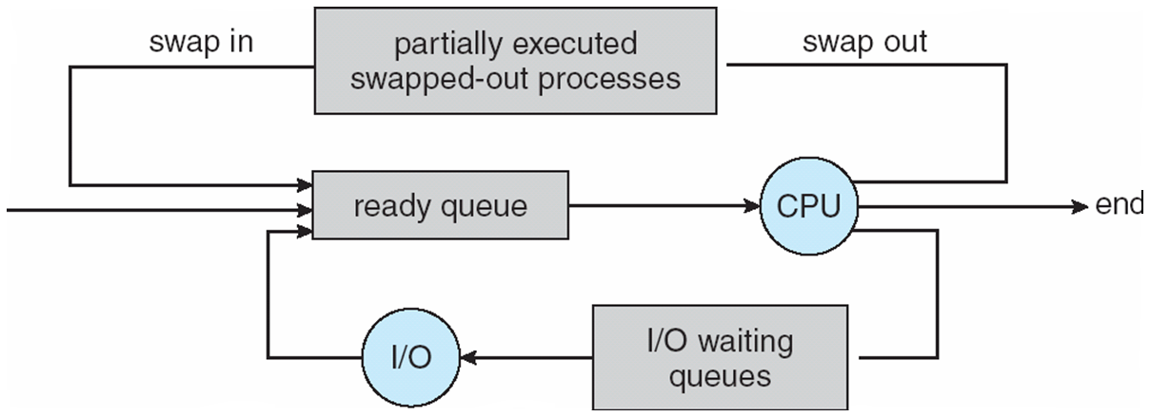
Addition of Medium Term Scheduling
Medium-term scheduler can be added if degree of multiple programming needs to decrease
Remove process from memory, store on disk, bring back in from disk to continue execution: swapping

Slide 28
Multitasking in Mobile Systems
Some mobile systems (e.g., early version of iOS) allow only one process to run, others suspended
Due to user interface limits iOS provides for a
Single foreground process- controlled via user interface
Multiple background processes– in memory, running, but not on the display, and with limits
Limits include single, short task, receiving notification of events, specific long-running tasks like audio playback
Android runs foreground and background, with fewer limits
Background process uses a service to perform tasks
Service can keep running even if background process is suspended
Service has no user interface, small memory use

Slide 29
Context Switch
When CPU switches to another process, the system must save the state of the old process and load the saved state for the new process via a context switch
Context of a process represented in the PCB
Switching speed varies from machine to machine, depending on the memory speed, the number of registers that must be copied, and the existence of special instructions (such as a single instruction to load or store all registers)

Slide 30
Context Switch
Context-switch time is overhead; the system does no useful work while switching
The more complex the OS and the PCB
➔ the longer the context switch
Time dependent on hardware support
Some hardware provides multiple sets of registers per CPU
➔ multiple contexts loaded at once

Slide 31
Operations on Processes
System must provide mechanisms for:
process creation,
process termination,
and so on

Slide 32
Process Creation
Parent process creates children processes, which, in turn create other processes, forming a tree of processes
Generally, process identified and managed via a process identifier (also called its pid)
Resource sharing options
Parent and children share all resources
Children share subset of parent’s resources
Parent and child share no resources
Execution options
Parent and children execute concurrently
Parent waits until children terminate

Slide 33
A Tree of Processes in Linux

Slide 34
Process Creation …
When a process creates a child process, that child process will need certain resources (CPU time, memory, files, I/O devices) to accomplish its task.
A child process may be able to obtain its resources directly from the operating system, or it may be constrained to a subset of the resources of the parent process.

Slide 35
Process Creation …
The parent may have to partition its resources among its children, or it may be able to share some resources (such as memory or files) among several of its children.
Restricting a child process to a subset of the parent’s resources prevents any process from overloading the system by creating too many child processes.

Slide 36
Process Creation …
In addition to supplying various physical and logical resources, the parent process may pass along initialization data (input) to the child process.
For example, consider a process whose function is to display the contents of a file —say, image.jpg—on the screen of a terminal.
When the process is created, it will get, as an input from its parent process, the name of the file image.jpg.
Using that file name, it will open the file and write the contents out.
It may also get the name of the output device.
Alternatively, some operating systems pass resources to child processes.
On such a system, the new process may get two open files, image.jpg and the terminal device, and may simply transfer the datum between the two.

Slide 37
Process Creation - Conclusion
When a process creates a new process, two possibilities for execution exist:
The parent continues to execute concurrently with its children.
The parent waits until some or all of its children have terminated

Slide 38
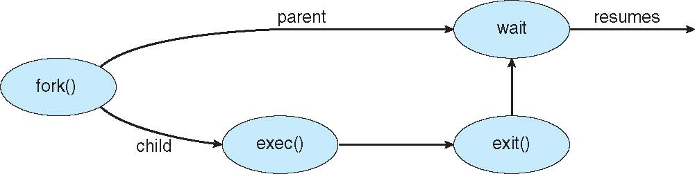
Process Creation (Cont.)
Address space
Child duplicate of parent
Child has a program loaded into it
UNIX examples
fork() system call creates new process
The new process consists of a copy of the address space of the original process
exec() system call used after a fork() to replace the process’ memory space with a new program

Slide 39
fork( )
1 #include <stdio.h>
2 #include <stdlib.h>
3 #include <unistd.h>
4
5 int main(int argc, char *argv[]) {
6 printf("hello world (pid:%d)\n", (int) getpid());
7 int rc = fork();
8 if (rc < 0) { // fork failed; exit
9 fprintf(stderr, "fork failed\n");
10 exit(1);
11 } else if (rc == 0) { // child (new process)
12 printf("hello, I am child (pid:%d)\n", (int) getpid());
13 } else { // parent goes down this path (main)
14 printf("hello, I am parent of %d (pid:%d)\n",
15 rc, (int) getpid());
16 }
17 return 0;
18 }
19

Slide 40
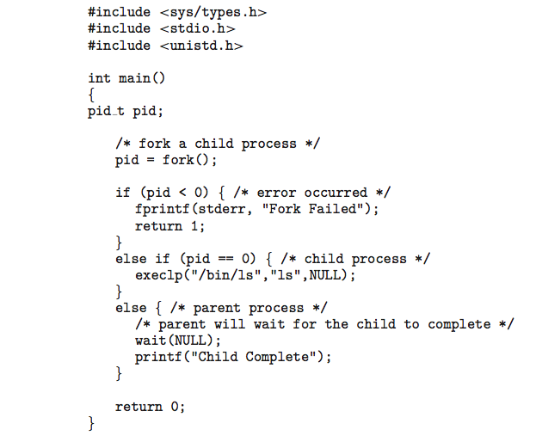
C Program Forking Separate Process

Slide 41
Process Termination
Process executes last statement and then asks the operating system to delete it using the exit() system call.
Returns status data from child to parent (via wait())
Process’ resources are deallocated by operating system

Slide 42
fork with wait
1 #include <stdio.h>
2 #include <stdlib.h>
3 #include <unistd.h>
4 #include <sys/wait.h>
5
6 int main(int argc, char *argv[]) {
7 printf("hello world (pid:%d)\n", (int) getpid());
8 int rc = fork();
9 if (rc < 0) { // fork failed; exit
10 fprintf(stderr, "fork failed\n");
11 exit(1);
12 } else if (rc == 0) { // child (new process)
13 printf("hello, I am child (pid:%d)\n", (int) getpid());
14 } else { // parent goes down this path (main)
15 int rc_wait = wait(NULL);
16 printf("hello, I am parent of %d (rc_wait:%d) (pid:%d)\n",
17 rc, rc_wait, (int) getpid());
18 }
19 return 0;
20 }
21

Slide 43
Process Termination
Parent may terminate the execution of children processes using the abort() system call.
Some reasons for doing so:
Child has exceeded allocated resources
Task assigned to child is no longer required
The parent is exiting and the operating systems does not allow a child to continue if its parent terminates

Slide 44
Process Termination
Some operating systems do not allow child to exist if its parent has terminated.
If a process terminates, then all its children must also be terminated.
cascading termination. All children, grandchildren, etc. are terminated.
The termination is initiated by the operating system.

Slide 45
Process Termination
The parent process may wait for termination of a child process by using the wait()system call.
The call returns status information and the pid of the terminated process
pid = wait(&status);
If no parent waiting (did not invoke wait()) process is a zombie.
If parent terminated without invoking wait, process is an orphan.

Slide 46
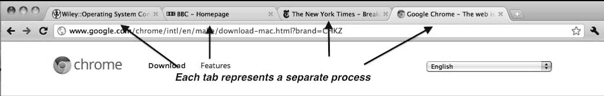
Multiprocess Architecture – Chrome Browser
Many web browsers ran as single process (some still do)
If one web site causes trouble, entire browser can hang or crash
Google Chrome Browser is multiprocess with 3 different types of processes:
Browser process manages user interface, disk and network I/O
Renderer process renders web pages, deals with HTML, Javascript. A new renderer created for each website opened
Runs in sandbox restricting disk and network I/O, minimizing effect of security exploits
Plug-in process for each type of plug-in

Slide 47
Exercise
Find out the current design (processes / threads etc.) of
Google Chrome
Mozilla Firefox
Microsoft Edge
Chromium

Slide 48
Interprocess Communication
Processes within a system may be independent or cooperating
Cooperating process can affect or be affected by other processes, including sharing data
Reasons for cooperating processes:
Information sharing
Computation speedup
Modularity
Convenience

Slide 49
Interprocess Communication
Cooperating processes need interprocess communication (IPC)
Two models of IPC
Shared memory
Message passing

Slide 50
Communications Models
(a) Message passing. (b) Shared memory.

Slide 51
Communications Models
Message passing is easier to implement in a distributed system than shared memory.
Shared memory can be faster than message passing, since message-passing systems are typically implemented using system calls (therefore slower)
In shared-memory systems, system calls are required only to establish shared memory regions.
Once shared memory is established, all accesses are treated as routine memory accesses, and no assistance from the kernel is required.
Shared memory suffers from cache coherency issues, which arise because shared data migrate among the several caches.

Slide 52
Cooperating Processes
Independent process cannot affect or be affected by the execution of another process
Cooperating process can affect or be affected by the execution of another process
Advantages of process cooperation
Information sharing
Computation speed-up
Modularity
Convenience

Slide 53
Producer-Consumer Problem
Paradigm for cooperating processes, producer process produces information that is consumed by a consumer process
unbounded-buffer places no practical limit on the size of the buffer
bounded-buffer assumes that there is a fixed buffer size

Slide 54
Bounded-Buffer – Shared-Memory Solution
Shared data
#define BUFFER_SIZE 10
typedef struct {
. . .
} item;
item buffer[BUFFER_SIZE];
int in = 0;
int out = 0;
Solution is correct, but can only use BUFFER_SIZE-1 elements

Slide 55
Bounded-Buffer – Producer
item next_produced;
while (true) {
/* produce an item in next_produced */
while (((in + 1) % BUFFER_SIZE) == out)
; /* do nothing */
buffer[in] = next_produced;
in = (in + 1) % BUFFER_SIZE;
}

Slide 56
Bounded Buffer – Consumer
item next_consumed;
while (true) { while (in == out)
; /* do nothing */ next_consumed = buffer[out];
out = (out + 1) % BUFFER_SIZE;
/* consume the item in next_consumed */
}

Slide 57
Interprocess Communication – Shared Memory
An area of memory shared among the processes that wish to communicate
The communication is under the control of the users processes not the operating system.
Major issues is to provide mechanism that will allow the user processes to synchronize their actions when they access shared memory.

Slide 58
Interprocess Communication – Message Passing
Mechanism for processes to communicate and to synchronize their actions
Message system – processes communicate with each other without resorting to shared variables
IPC facility provides two operations:
send(message)
receive(message)
The message size is either fixed or variable

Slide 59
Message Passing (Cont.)
If processes P and Q wish to communicate, they need to:
Establish a communication link between them
Exchange messages via send/receive
Implementation issues:
How are links established?
Can a link be associated with more than two processes?
How many links can there be between every pair of communicating processes?
What is the capacity of a link?
Is the size of a message that the link can accommodate fixed or variable?
Is a link unidirectional or bi-directional?

Slide 60
Message Passing (Cont.)
Implementation of communication link
Physical:
Shared memory
Hardware bus
Network
Logical:
Direct or indirect
Synchronous or asynchronous
Automatic or explicit buffering

Slide 61
Direct Communication
Processes must name each other explicitly:
send (P, message) – send a message to process P
receive(Q, message) – receive a message from process Q
Properties of communication link
Links are established automatically
A link is associated with exactly one pair of communicating processes
Between each pair there exists exactly one link
Link may be unidirectional, but is usually bi-directional

Slide 62
Indirect Communication
Messages are directed and received from mailboxes (also referred to as ports)
Each mailbox has a unique id
Processes can communicate only if they share a mailbox
Properties of communication link
Link established only if processes share a common mailbox
A link may be associated with many processes
Each pair of processes may share several communication links
Link may be unidirectional or bi-directional

Slide 63
Indirect Communication
Operations
create a new mailbox (port)
send and receive messages through mailbox
destroy a mailbox
Primitives are defined as:
send(A, message) – send a message to mailbox A
receive(A, message) – receive a message from mailbox A

Slide 64
Indirect Communication
Mailbox sharing
P₁, P₂, and P₃ share mailbox A
P₁, sends; P₂ and P₃ receive
Who gets the message?
Solutions
Allow a link to be associated with at most two processes
Allow only one process at a time to execute a receive operation
Allow the system to select arbitrarily the receiver. Sender is notified who the receiver was.

Slide 65
Mailbox Ownership
A mailbox may be owned either by a process or by the operating system.
If the mailbox is owned by a process (that is, the mailbox is part of the address space of the process), then we distinguish between the owner (which can only receive messages through this mailbox) and the user (which can only send messages to the mailbox).
Since each mailbox has a unique owner, there can be no confusion about which process should receive a message sent to this mailbox.
When a process that owns a mailbox terminates, the mailbox disappears.
Any process that subsequently sends a message to this mailbox must be notified that the mailbox no longer exists.

Slide 66
Mailbox Ownership …
A mailbox that is owned by the operating system has an existence of its own.
It is independent and is not attached to any particular process.
The operating system then must provide a mechanism that allows a process to do the following:
Create a new mailbox.
Send and receive messages through the mailbox.
Delete a mailbox.

Slide 67
Mailbox Ownership …
The process that creates a new mailbox is that mailbox’s owner by default.
Initially, the owner is the only process that can receive messages through this mailbox.
However, the ownership and receiving privilege may be passed to other processes through appropriate system calls.
Of course, this provision could result in multiple receivers for each mailbox

Slide 68
Synchronization
Communication between processes takes place through calls to send() and receive() primitives.
Message passing may be either blocking or non-blocking also known as synchronous and asynchronous.

Slide 69
Synchronization
Blocking is considered synchronous
Blocking send -- the sender is blocked until the message is received
Blocking receive -- the receiver is blocked until a message is available
Non-blocking is considered asynchronous
Non-blocking send -- the sender sends the message and continue
Non-blocking receive -- the receiver receives:
A valid message, or
Null message
Different combinations possible
If both send and receive are blocking, we have a rendezvous

Slide 70
Synchronization (Cont.)
Producer-consumer becomes trivial
message next_produced;
while (true) {
/* produce an item in next produced */
send(next_produced);
}
message next_consumed;
while (true) {
receive(next_consumed);
/* consume the item in next consumed */
}

Slide 71
Buffering
Whether communication is direct or indirect, messages exchanged by communicating processes reside in a temporary queue (Queue of messages attached to the link)
These queue are implemented in one of three ways
Zero capacity – The queue has a maximum length of zero. No messages are queued on a link. Sender must wait for receiver (rendezvous).
Bounded capacity – finite length of n messages. If the queue is not full when a new message is sent, the message is placed in the queue. Sender must wait if link full
Unbounded capacity – infinite length. Sender never waits

Slide 72
POSIX
Portable Operating System Interface, formerly IEEE-IX
Portable Operating System Interface (POSIX) is a family of standards specified by the IEEE Computer Society for maintaining compatibility between operating systems.
POSIX defines the application programming interface (API), along with command line shells and utility interfaces, for software compatibility with variants of Unix and other operating systems

Slide 73
POSIX
Each standard in the POSIX set is defined by a decimal following the POSIX.
Thus, POSIX.1 is the standard for an application program interface in the C language.
POSIX.2 is the standard shell and utility interface.
These are the main two interfaces, but additional interfaces, such as POSIX.4 for thread management, have been developed or are being developed.

Slide 74
POSIX Shared Memory
POSIX shared memory is organized using memory-mapped files, which associate the region of shared memory with a file.
A process must first create a shared-memory object using the shm open() system call:
shm fd = shm open(name, O CREAT | O RDRW, 0666);
A successful call to shm open() returns an integer file descriptor for the shared-memory object.
mmap() function establishes a memory-mapped file containing the shared-memory object

