Slide 1
Threads

Slide 2
Threads: Motivation
Most modern applications including modern kernels are multithreaded.
A thread is a basic unit of CPU utilization; it comprises a thread ID, a program counter, a register set, and a stack.

Slide 3
Threads: Motivation
Multithreading refers to the ability of an operating system to support multiple, concurrent paths of execution within a single process.
Threads run within application.
Multiple tasks with the application can be implemented by separate threads
Update display
Fetch data
Spell checking
Answer a network request

Slide 4
Thread
Process creation is heavy-weight while thread creation is light-weight
Can simplify code, increase efficiency.
It shares with other threads belonging to the same process its code section, data section, and other operating-system resources, such as open files and signals.
A traditional (also called heavyweight) process has a single thread of control.
If a process has multiple threads of control, it can perform more than one task at a time.

Slide 5
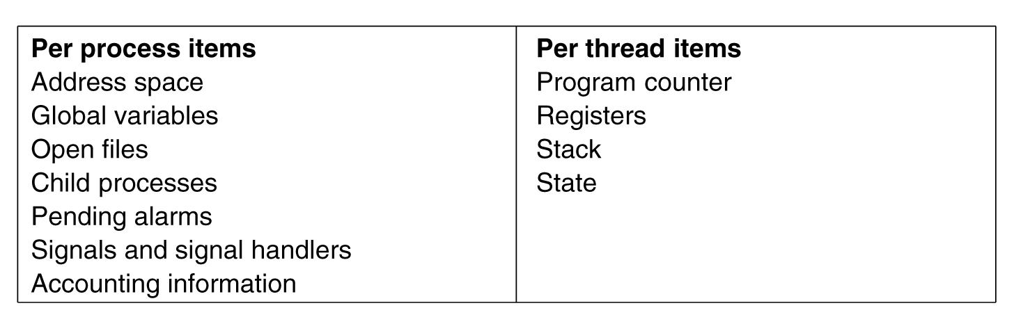
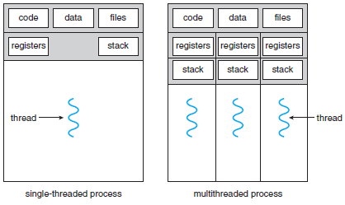
Threads are lightweight

Slide 6
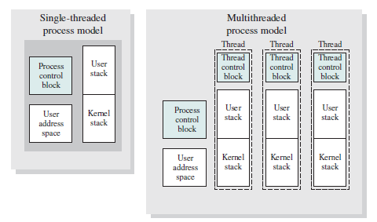
Another View

Slide 7
Key benefits of threads
It takes far less time to create a new thread in an existing process, than to create a brand-new process.
Studies done by the Mach developers show that thread creation is ten times faster than process creation in UNIX
It takes less time to terminate a thread than a process.
It takes less time to switch between two threads within the same process than to switch between processes.
Threads enhance efficiency in communication between different executing programs.
In most operating systems, communication between independent processes requires the intervention of the kernel to provide protection and the mechanisms needed for communication.
However, because threads within the same process share memory and files, they can communicate with each other without invoking the kernel.

Slide 8
Threads
A multithreaded application is implemented typically as a separate process with several threads of control.
A word processor may have a thread for displaying graphics, another thread for responding to keystrokes from the user, and a third thread for performing spelling and grammar checking in the background.

Slide 9
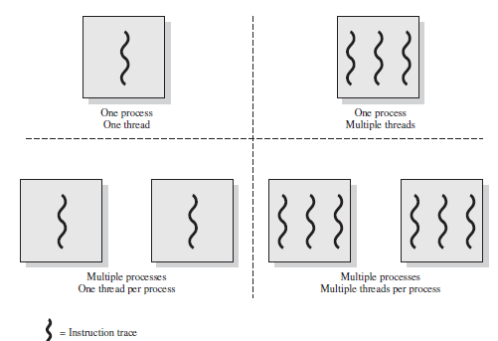
Threads and Processes
JRE is an example

Slide 10
Threads are like processes
Have same states (after spawning)
Running
Ready
Blocked
Have their own stacks –same as processes
Stacks contain frames for (un-returned) procedure calls
Local variables
Return address to use when procedure comes back
Tanenbaum, Modern Operating Systems 3 e, (c) 2008 Prentice-Hall, Inc. All rights reserved. 0-13-6006639

Slide 11
General Concept of Multithreading
In a multithreaded environment, a process is the unit of resource allocation and a unit of protection. Process has
A virtual address space that holds the process image
Protected access to processors, other processes (for IPC), files, and I/O resources (devices and channels)
Within a process, there may be one or more threads, each with the following:
A thread execution state (Running, Ready, etc.)
A saved thread context when not running; one way to view a thread is as an independent program counter operating within a process
An execution stack
Some per-thread static storage for local variables
Access to the memory and resources of its process, shared with all other threads in that process

Slide 12
How do threads work?
Start with one thread in a process
Thread contains (id, registers, attributes)
Use library call to create new threads and to use threads
Thread_create includes parameter indicating what procedure to run
Thread_exit causes thread to exit and disappear (can’t schedule it)
Thread_join Thread blocks until another thread finishes its work
Thread_yield

Slide 13
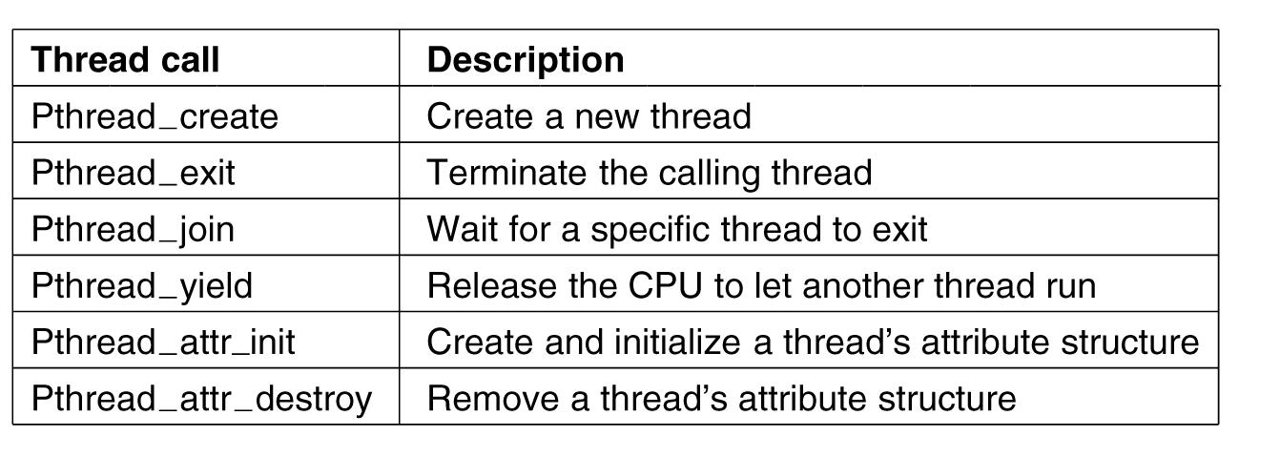
POSIX Threads (Pthreads)
Pthreads are IEEE Unix standard library calls
Tanenbaum, Modern Operating Systems 3 e, (c) 2008 Prentice-Hall, Inc. All rights reserved. 0-13-6006639

Slide 14
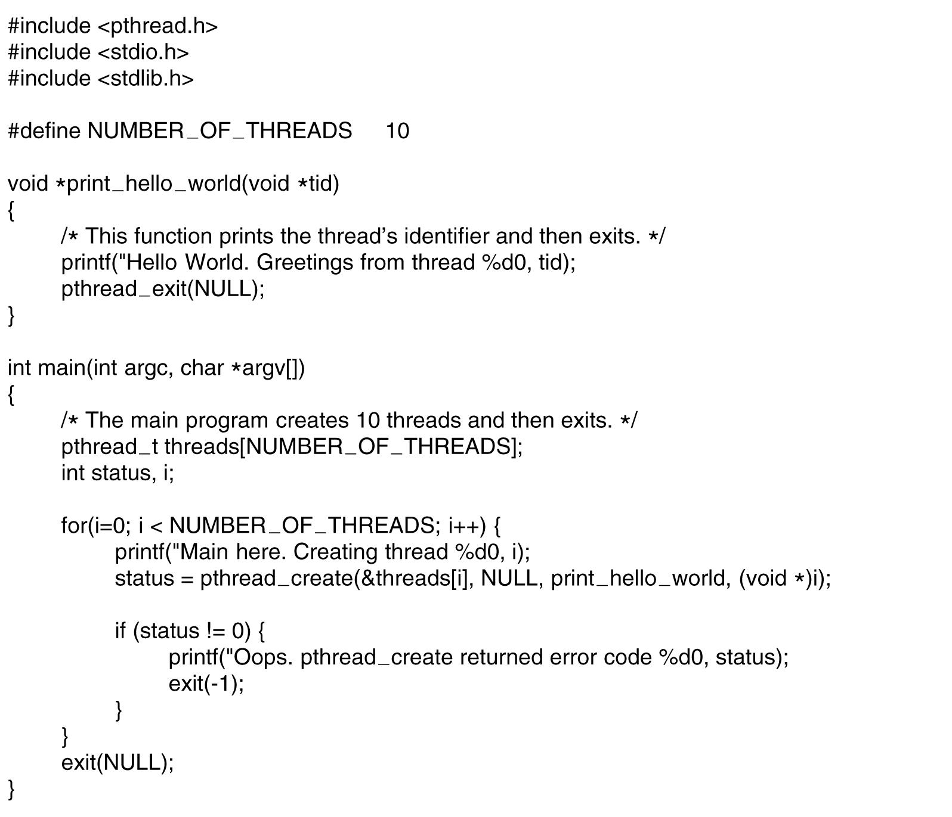
Pthreads Example:“Hello,world”
Tanenbaum, Modern Operating Systems 3 e, (c) 2008 Prentice-Hall, Inc. All rights reserved. 0-13-6006639

Slide 15
Multithreaded Server Architecture

Slide 16
Benefits
Responsiveness – may allow continued execution if part of process is blocked, especially important for user interfaces.
Resource Sharing – threads share resources of process, easier than shared memory or message passing.
Economy – cheaper than process creation, thread switching lower overhead than context switching.
Scalability – process can take advantage of multiprocessor architectures.

Slide 17
Multicore Programming
Multicore or multiprocessor systems putting pressure on programmers, challenges include:
Dividing activities
Balance
Data splitting
Data dependency
Testing and debugging
Parallelism implies a system can perform more than one task simultaneously
Concurrency supports more than one task making progress
Single processor / core, scheduler providing concurrency

Slide 18
Multicore Programming (Cont.)
Types of parallelism
Data parallelism – distributes subsets of the same data across multiple cores, same operation on each
Task parallelism – distributing threads across cores, each thread performing unique operation
As number of threads grows, so does architectural support for threading
CPUs have cores as well as hardware threads
Consider Oracle SPARC T4 processor with 8 cores, and 8 hardware threads per core

Slide 19
Concurrency vs. Parallelism
Concurrent execution on single-core system:
Parallelism on a multi-core system:

Slide 20
Single and Multithreaded Processes

Slide 21
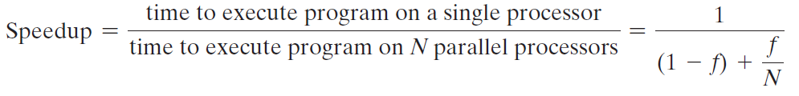
Amdahl’s Law
Identifies performance gains from adding additional cores to an application that has both serial and parallel components.
The law assumes a program in which a fraction (1 - f) of the execution time involves code that is inherently serial, and a fraction f that involves code that is infinitely parallelizable with no scheduling overhead.
This law appears to make a multicore organization attractive.

Slide 22
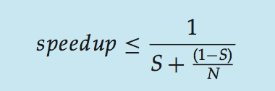
Amdahl’s Law
S is serial portion
N processing cores
That is, if application is 75% parallel / 25% serial, moving from 1 to 2 cores results in speedup of 1.6 times
As N approaches infinity, speedup approaches 1 / S
Serial portion of an application has disproportionate effect on performance gained by adding additional cores

Slide 23
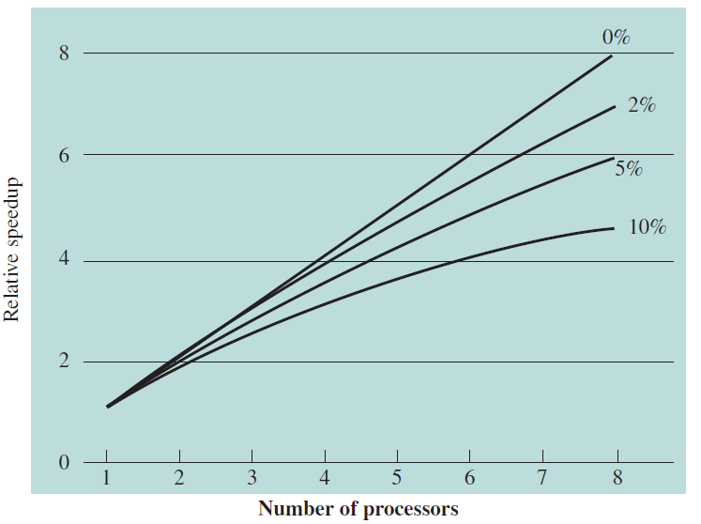
Speedup with 0%, 2%, 5%, and 10% sequential portions

Slide 24
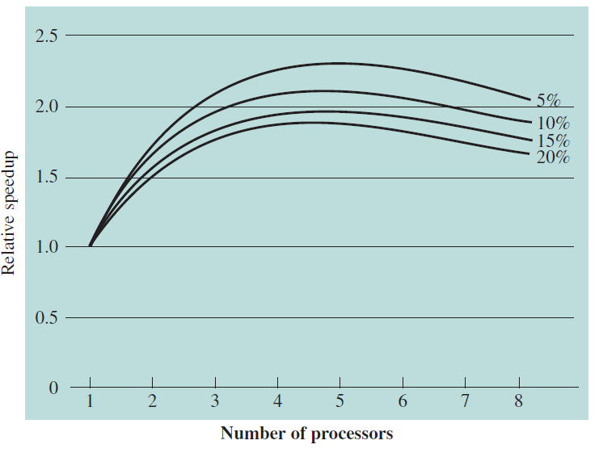
Speedup with overheads

Slide 25
User Threads and Kernel Threads
User threads - management done by user-level threads library
Three primary thread libraries:
POSIX Pthreads
Windows threads
Java threads
Kernel threads - Supported by the Kernel
Examples – virtually all general purpose operating systems, including:
Windows
Solaris
Linux
Tru64 UNIX
Mac OS X

Slide 26
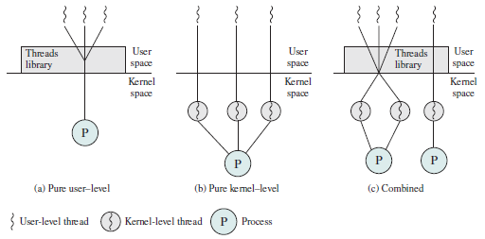
User-Level and Kernel-Level Threads

Slide 27
Threads in user space-the good
Thread table contains information about threads (program counter, stack pointer...) so that run time system can manage them
If thread blocks, run time system stores thread information in table and finds new thread to run.
State save and scheduling are invoked faster than kernel call (no trap, no cache flush)
Tanenbaum, Modern Operating Systems 3 e, (c) 2008 Prentice-Hall, Inc. All rights reserved. 0-13-6006639

Slide 28
Threads in user space-the bad
Can’t let thread execute system call which blocks because it will block all of the other threads
No elegant solution
Manage some how system library to avoid blocking calls
Could use select system calls-in some versions of Unix which do same thing
Threads don’t voluntarily give up CPU
Could interrupt periodically to give control to run time system
Overhead of this solution is a problem
Tanenbaum, Modern Operating Systems 3 e, (c) 2008 Prentice-Hall, Inc. All rights reserved. 0-13-6006639

Slide 29
Threads in kernel space-the good
Kernel keeps same thread table as user table
If thread blocks, kernel just picks another one
Not necessarily from same process!
Tanenbaum, Modern Operating Systems 3 e, (c) 2008 Prentice-Hall, Inc. All rights reserved. 0-13-6006639

Slide 30
Threads in kernel space-the bad
Expensive to manage the threads in the kernel and takes valuable kernel space
How do we get the advantages of both approaches, without the disadvantages?
Tanenbaum, Modern Operating Systems 3 e, (c) 2008 Prentice-Hall, Inc. All rights reserved. 0-13-6006639

Slide 31
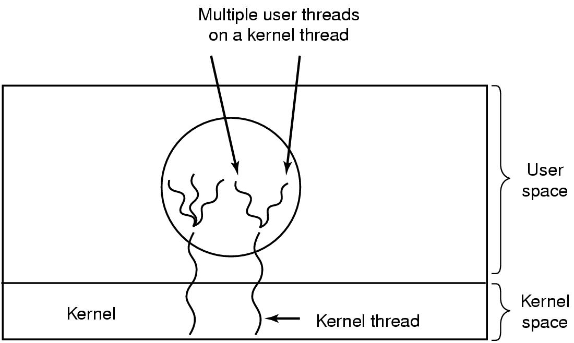
Hybrid approach
Multiplex user-level threads onto kernel level threads
Tanenbaum, Modern Operating Systems 3 e, (c) 2008 Prentice-Hall, Inc. All rights reserved. 0-13-6006639

Slide 32
Hybrid
Kernel is aware of kernel threads only
User level threads are scheduled, created, destroyed independently of kernel thread
Programmer determines how many user level and how many kernel level threads to use
Tanenbaum, Modern Operating Systems 3 e, (c) 2008 Prentice-Hall, Inc. All rights reserved. 0-13-6006639

Slide 33
Multithreading Models
Many-to-One
One-to-One
Many-to-Many

Slide 34
Many-to-One
Many user-level threads mapped to single kernel thread
One thread blocking causes all to block
Multiple threads may not run in parallel on multicore system because only one may be in kernel at a time
Few systems currently use this model
Examples:
Solaris Green Threads
GNU Portable Threads

Slide 35
One-to-One
Each user-level thread maps to kernel thread
Creating a user-level thread creates a kernel thread
More concurrency than many-to-one
Number of threads per process sometimes restricted due to overhead
Examples
Windows
Linux
Solaris 9 and later

Slide 36
Many-to-Many Model
Allows many user level threads to be mapped to many kernel threads
Allows the operating system to create a sufficient number of kernel threads
Solaris prior to version 9
Windows with the ThreadFiber package

Slide 37
Thread Libraries
Thread library provides programmer with API for creating and managing threads
Two primary ways of implementing
Library entirely in user space
Kernel-level library supported by the OS

Slide 38
Pthreads
May be provided either as user-level or kernel-level
A POSIX standard (IEEE 1003.1c) API for thread creation and synchronization
Specification, not implementation
API specifies behavior of the thread library, implementation is up to development of the library
Common in UNIX operating systems (Solaris, Linux, Mac OS X)

Slide 39
POSIX Threads (Pthreads)
Pthreads are IEEE Unix standard library calls
Tanenbaum, Modern Operating Systems 3 e, (c) 2008 Prentice-Hall, Inc. All rights reserved. 0-13-6006639

Slide 40
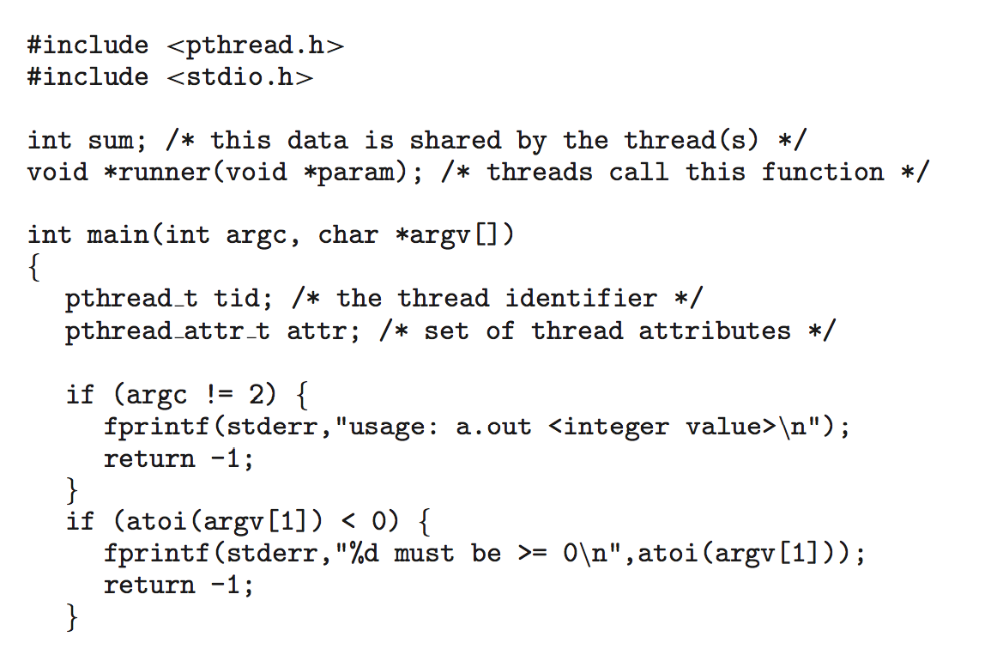
Pthreads Example

Slide 41
Pthreads Example (Cont.)

Slide 42
Pthreads Code for Joining 10 Threads

Slide 43
Implicit Threading
Growing in popularity as numbers of threads increase, program correctness more difficult with explicit threads
Creation and management of threads done by compilers and run-time libraries rather than programmers
Three methods explored
Thread Pools
OpenMP
Grand Central Dispatch
Other methods include Microsoft Threading Building Blocks (TBB), java.util.concurrent package

Slide 44
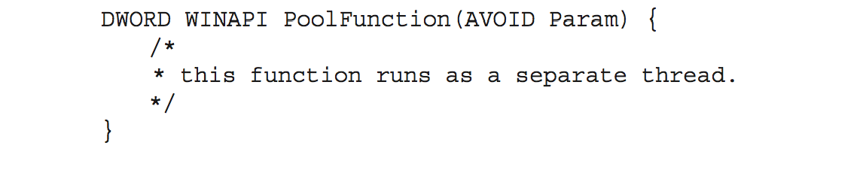
Thread Pools
Create a number of threads in a pool where they await work
Advantages:
Usually slightly faster to service a request with an existing thread than create a new thread
Allows the number of threads in the application(s) to be bound to the size of the pool
Separating task to be performed from mechanics of creating task allows different strategies for running task
i.e.Tasks could be scheduled to run periodically
Windows API supports thread pools:

Slide 45
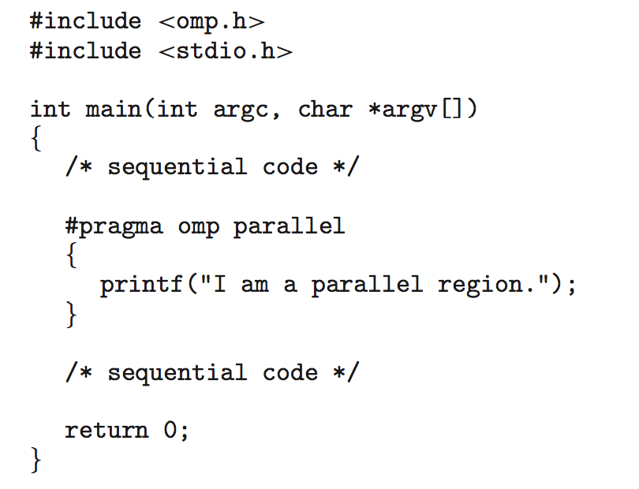
OpenMP
Set of compiler directives and an API for C, C++, FORTRAN
Provides support for parallel programming in shared-memory environments
Identifies parallel regions – blocks of code that can run in parallel
#pragma omp parallel
Create as many threads as there are cores
#pragma omp parallel for for(i=0;i<N;i++) {
c[i] = a[i] + b[i];
}
Run for loop in parallel

Slide 46
Grand Central Dispatch
Apple technology for Mac OS X and iOS operating systems
Extensions to C, C++ languages, API, and run-time library
Allows identification of parallel sections
Manages most of the details of threading
Block is in “^{ }” - ˆ{printf("I am a block"); }
Blocks placed in dispatch queue
Assigned to available thread in thread pool when removed from queue

Slide 47
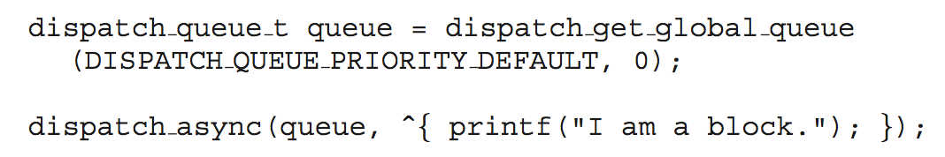
Grand Central Dispatch
Two types of dispatch queues:
Serial – blocks removed in FIFO order, queue is per process, called main queue
Programmers can create additional serial queues within program
Concurrent – removed in FIFO order but several may be removed at a time
Three system wide queues with priorities low, default, high

Slide 48
Threading Issues
Semantics of fork() and exec() system calls
Signal handling
Synchronous and asynchronous
Thread cancellation of target thread
Asynchronous or deferred
Thread-local storage
Scheduler Activations

Slide 49
Semantics of fork() and exec()
Does fork()duplicate only the calling thread or all threads from the parent?
Some UNIXes have two versions of fork
exec() usually works as normal – replace the running process including all threads

Slide 50
Signal Handling
Signals are used in UNIX systems to notify a process that a particular event has occurred.
A signal handler is used to process signals
Signal is generated by particular event
Signal is delivered to a process
Signal is handled by one of two signal handlers:
default
user-defined
Every signal has default handler that kernel runs when handling signal
User-defined signal handler can override default
For single-threaded, signal delivered to process

Slide 51
Signal Handling (Cont.)
Where should a signal be delivered for multi-threaded?
Deliver the signal to the thread to which the signal applies
Deliver the signal to every thread in the process
Deliver the signal to certain threads in the process
Assign a specific thread to receive all signals for the process

Slide 52
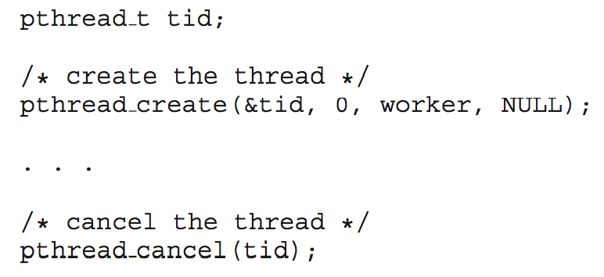
Thread Cancellation
Terminating a thread before it has finished
Thread to be canceled is target thread
Two general approaches:
Asynchronous cancellation terminates the target thread immediately
Deferred cancellation allows the target thread to periodically check if it should be cancelled
Pthread code to create and cancel a thread:

Slide 53
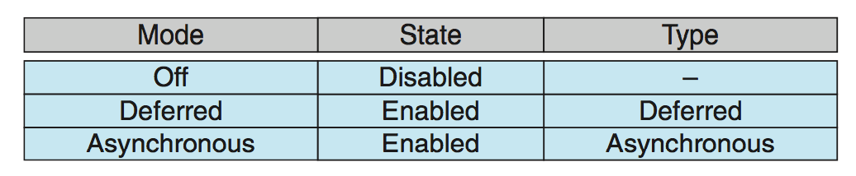
Thread Cancellation (Cont.)
Invoking thread cancellation requests cancellation, but actual cancellation depends on thread state
If thread has cancellation disabled, cancellation remains pending until thread enables it
Default type is deferred
Cancellation only occurs when thread reaches cancellation point
I.e. pthread_testcancel()
Then cleanup handler is invoked
On Linux systems, thread cancellation is handled through signals

Slide 54
Thread-Local Storage
Thread-local storage (TLS) allows each thread to have its own copy of data
Useful when you do not have control over the thread creation process (i.e., when using a thread pool)
Different from local variables
Local variables visible only during single function invocation
TLS visible across function invocations
Similar to static data
TLS is unique to each thread

Slide 55
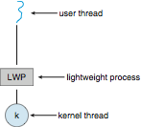
Scheduler Activations
Both M:M and Two-level models require communication to maintain the appropriate number of kernel threads allocated to the application
Typically use an intermediate data structure between user and kernel threads – lightweight process (LWP)
Appears to be a virtual processor on which process can schedule user thread to run
Each LWP attached to kernel thread
How many LWPs to create?
Scheduler activations provide upcalls - a communication mechanism from the kernel to the upcall handler in the thread library
This communication allows an application to maintain the correct number kernel threads

Slide 56
Linux Threads
Linux refers to them as tasks rather than threads
Thread creation is done through clone() system call
clone() allows a child task to share the address space of the parent task (process)
Flags control behavior
struct task_struct points to process data structures (shared or unique)

