Slide 1
Synchronization
Process Synchronization and
Coordination among cooperating processes

Slide 2
Concurrency
The central themes of operating system design are all concerned with the management of processes and threads:
Multiprogramming: Management of multiple processes within a uniprocessor system
Multiprocessing: Management of multiple processes within a multiprocessor
Distributed processing: Management of multiple processes executing on multiple, distributed computer systems.
Fundamental to all of these areas, and fundamental to OS design, is concurrency.

Slide 3
Concurrency
Concurrency encompasses a host of design issues, including
Communication among processes,
Sharing of and competing for resources (such as memory, files, and I/O access),
Synchronization of the activities of multiple processes, and
Allocation of processor time to processes.

Slide 4
Concurrency Contexts
Multiple applications: Multiprogramming was invented to allow processing time to be dynamically shared among a number of active applications.
Structured applications: As an extension of the principles of modular design and structured programming, some applications can be effectively programmed as a set of concurrent processes.
Operating system structure: The same structuring advantages apply to systems programs, and operating systems are themselves often implemented as a set of processes or threads.

Slide 5
Interprocess Communication (IPC) (Recap)
Processes within a system may be independent or cooperating
Cooperating process can affect or be affected by other processes, including sharing data
Two communication models of IPC
Shared memory
Message passing

Slide 6
Cooperating Processes (recap)
Independent process cannot affect or be affected by the execution of another process
Cooperating process can affect or be affected by the execution of another process

Slide 7
Communications Models
Message passing is easier to implement in a distributed system than shared memory.
Shared memory can be faster than message passing, since message-passing systems are typically implemented using system calls (therefore slower)

Slide 8
Synchronization (recap)
Message passing may be either blocking or non-blocking
Blocking is considered synchronous
Blocking send -- the sender is blocked until the message is received
Blocking receive -- the receiver is blocked until a message is available
Non-blocking is considered asynchronous
Non-blocking send -- the sender sends the message and continues
Non-blocking receive -- the receiver receives:
A valid message, or
Null message
Different combinations possible
If both send and receive are blocking, we have a rendezvous

Slide 9
Synchronization (Cont.)
Producer-consumer scenario
message next_produced;
while (true) { /* produce an item in next produced */
send(next_produced);
}
message next_consumed;
while (true) {
receive(next_consumed);
/* consume the item in next consumed */
}

Slide 10
Operating System Concerns
The OS must be able to keep track of the various processes.
This is done with the use of PCBs.
The OS must allocate and deallocate various resources for each active process.
At times, multiple processes want access to the same resource.
These resources include Processor time, Memory, Files, I/O devices.

Slide 11
Operating System Concerns …
The OS must protect the data and physical resources of each process against unintended interference by other processes.
This involves techniques that relate to memory, files, and I/O devices.
The functioning of a process, and the output it produces, must be independent of the speed at which its execution is carried out relative to the speed of other concurrent processes

Slide 12
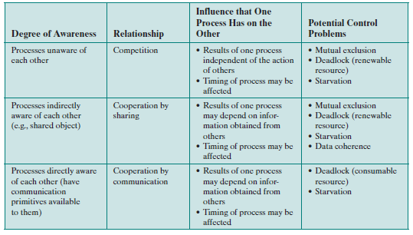
Process Interaction

Slide 13
Background
Processes can execute concurrently
May be interrupted at any time, partially completing the execution
Concurrent access to shared data may result in data inconsistency → Race Condition (Order of execution!!)
Maintaining data consistency requires mechanisms to ensure the orderly execution of cooperating processes

Slide 14
Bounded-Buffer – Shared-Memory Solution
Shared data
#define BUFFER_SIZE 10
typedef struct {
. . .
} item;
item buffer[BUFFER_SIZE];
int in = 0;
int out = 0;

Slide 15
Bounded-Buffer – Producer
item next_produced;
while (true) {
/* produce an item in next produced */
while (((in + 1) % BUFFER_SIZE) == out)
; /* do nothing */
buffer[in] = next_produced;
in = (in + 1) % BUFFER_SIZE;
}

Slide 16
Bounded Buffer – Consumer
item next_consumed;
while (true) { while (in == out)
; /* do nothing */ next_consumed = buffer[out];
out = (out + 1) % BUFFER_SIZE;
/* consume the item in next_consumed */
}

Slide 17
Illustration of the problem (Bounded Buffer)
Original solution allowed at most BUFFER SIZE − 1 items in the buffer at the same time.
Suppose we want to modify the algorithm to remedy this deficiency.
One possibility is to add an integer variable, count, initialized to 0.
count is incremented every time we add a new item to the buffer and is decremented every time we remove one item from the buffer.
Incremented by producer after it producing and decremented by the consumer after consuming.

Slide 18
Producer
while (true) { /* produce an item in next_produced */
while (count == BUFFER_SIZE) ;
/* do nothing */
buffer[in] = next_produced;
in = (in + 1) % BUFFER_SIZE;
count++;
}

Slide 19
Consumer
while (true) {
while (count == 0)
; /* do nothing */
next_consumed = buffer[out];
out = (out + 1) % BUFFER_SIZE;
count--;
/* consume the item in next_consumed */
}

Slide 20
Race Condition
count++ could be implemented as register1 = count register1 = register1 + 1 count = register1
count- - could be implemented as register2 = count register2 = register2 - 1 count = register2
register1 and register2 are the local CPU registers

Slide 21
Interleaving in Arbitrary Order
Consider this execution interleaving with “count = 5” initially:
T0: producer execute register1 = counter {register1 = 5} T1: producer execute register1 = register1 + 1 {register1 = 6} T2: consumer execute register2 = counter {register2 = 5} T3: consumer execute register2 = register2 – 1 {register2 = 4} T4: producer execute counter = register1 {counter = 6 } T5: consumer execute counter = register2 {counter = 4}
We have arrived at the incorrect state “counter == 4”, indicating that four buffers are full, when, in fact, five buffers are full.
If we reversed the order of the statements at T4 and T5, what would be the order?

Slide 22
Incorrect State?
Because we allowed both processes to manipulate the variable counter concurrently.
A situation like this, where several processes access and manipulate the same data concurrently and the outcome of the execution depends on the particular order in which the access takes place, is called a race condition.
To guard against the race condition, we need to ensure that only one process at a time can be manipulating the variable counter.
To make such a guarantee, we require that the processes be synchronized in some way.

Slide 23
Critical section
A section of code within a process that requires access to shared resources, and that must not be executed while another process is in a corresponding section of code.
Race condition (recap): A situation in which multiple threads or processes read and write a shared data item, and the final result depends on the relative timing of their execution.

Slide 24
How to avoid races?
Mutual exclusion – Only one process at a time can use a shared variable/file
Critical region – Shared memory which leads to races
Solution
Ensure that two processes can’t be in the critical region / section at the same time
Tanenbaum, Modern Operating Systems 3 e, (c) 2008 Prentice-Hall, Inc. All rights reserved. 0-13-6006639

Slide 25
Critical Section Problem
Consider system of n processes {p₀, p₁, … p_{n-1}}
Each process has critical section segment of code
Process may be changing common variables, updating table, writing file, etc
When one process in critical section, no other may be in its critical section
Critical section problem is to design protocol to solve this.
We have to design a protocol that the processes can use to cooperate.

Slide 26
Critical Section Problem …
Each process must ask permission to enter critical section in entry section, the process may follow the critical section with an exit section, then code in the remainder section will be executed.

Slide 27
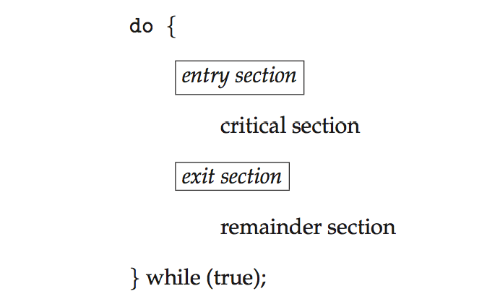
Critical Section
General structure of process P_{i}

Slide 28
Solution to Critical-Section Problem
A solution to the critical-section problem must satisfy the following three requirements:
Mutual Exclusion - If process P_{i} is executing in its critical section, then no other processes can be executing in their critical sections
Progress - If no process is executing in its critical section and there exist some processes that wish to enter their critical section, then the selection of the processes that will enter the critical section next cannot be postponed indefinitely
Bounded Waiting - A bound must exist on the number of times that other processes are allowed to enter their critical sections after a process has made a request to enter its critical section and before that request is granted
Assume that each process executes at a nonzero speed
No assumption concerning relative speed of the n processes

Slide 29
Race Condition – Affects?
At a given point in time, many kernel-mode processes may be active in the operating system.
As a result, the code implementing an operating system (kernel code) is subject to several possible race conditions.
Examples of Kernel Data Structures that are prone to race conditions include those required for:
maintaining a list of all open files in the system
maintaining memory allocation,
maintaining process lists,
and for interrupt handling

Slide 30
Critical-Section Handling in OS
Two approaches depending on if the kernel is preemptive or non-preemptive
Preemptive – allows preemption of process when running in kernel mode
Non-preemptive – does not allow a process running in kernel mode to be preempted. The process runs until it exits kernel mode, blocks, or voluntarily yields CPU
Essentially free of race conditions in kernel mode as only one process is active in the kernel at a time
Same cannot be said about preemptive kernels
Responsive and more suitable for real-time programming

Slide 31
Critical Sections Properties of a good solution: Summary
Necessary to avoid race conditions
Mutual exclusion: No two processes may be simultaneously inside their critical regions
No assumptions may be made about speeds or the number of CPUs.
No process running outside its critical region may block other processes.
No starvation: No process should have to wait forever to enter its critical region.

Slide 32
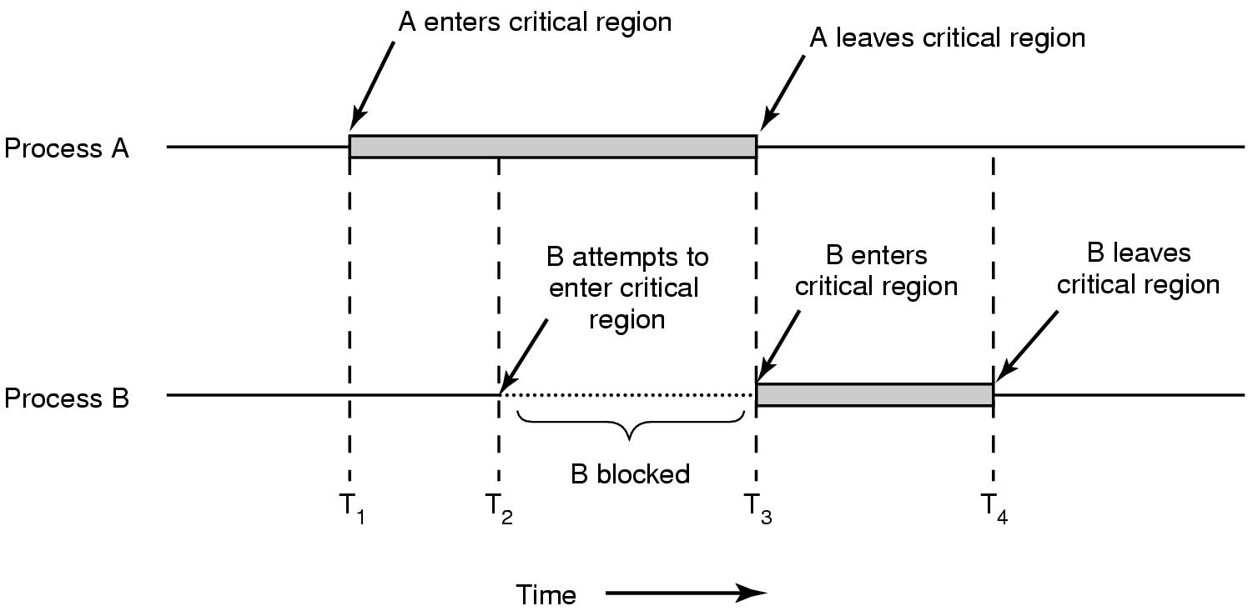
Mutual Exclusion with Busy Waiting
Mutual exclusion using critical regions

Slide 33
Two-Process Solutions: Algorithm 1
Algorithm for Process P_{i}
do {
while (turn != i); // j=1-i
// turn variable indicates whose turn it is //to enter its critical section
critical section
turn = j;
remainder section
} while (true);
Solution ensures only one process is allowed to execute its Critical Section
Does not satisfy progress requirement (even if the other process is in its CS – it alternates)

Slide 34
Problem of Algorithm 1
Does not retain sufficient information about state of each process.
It remembers only which process is allowed to enter its critical section
Replace turn variable with boolean flag[2] initialized to false
Array flag[i] indicates if a process is ready to enter the critical section.
flag[i] = true implies that process P_{i} is ready to enter the critical section!

Slide 35
Algorithm 2
Process P_{i} first sets flag[i] to true signaling it is ready
Then, P_{i} checks to verify that process P_{j} is not also ready to enter its critical section
If P_{j} were ready then P_{i} would wait until P_{j} had indicated that it no longer needed to be in the critical section
i.e. wait until flag[j]becomes false
At this point P_{i} would enter its critical section
On exiting P_{i} would set its flag[i]to false

Slide 36
Algorithm 2: Structure of Process P_{i}
do {
flag[i] = true;
while (flag[j]);
critical section
flag[i] = false;
remainder section
} while (true);
Unfortunately progress requirement is not met

Slide 37
Problem in Algorithm 2
Consider the following execution sequence
T₀: P₀ sets flag[0] = true
T₁: P₁ sets flag[1] = true
Now, P₀ and P₁ will loop forever in their respective while statements

Slide 38
Algorithm 3: Peterson’s Solution Meets all three requirements
Use turn and flag[2] both
Initially flag[0]=flag[1]=false, turn is either 0 or 1
Provable that the three CS requirement are met:
1. Mutual exclusion is preserved
P_{i} enters CS only if:
either flag[j] = false or turn = i
2. Progress requirement is satisfied
3. Bounded-waiting requirement is met

Slide 39
Algorithm 3 for Process P_{i}
do {
flag[i] = true;
turn = j;
while (flag[j] && turn = = j);
critical section
flag[i] = false;
remainder section
} while (true);
Prove that the algorithm is correct

Slide 40
Multiple Process Solution: Bakery Algorithm
On entering the store, each customer receives a number
Customer with lowest number is served next
If P_{i} and P_{j} receive the same number and if i<j then P_{i} is served first
Process names are unique and totally ordered
Common data structures
boolean choosing[n]; //initialized to false
int number[n]; //initialized to 0
Two Notations:(a,b)<(c,d) if a<c or if a==c and b<d
max(a₀,…,a_{n-1}) is a number k such that k >= a_{i} for i = 0, 1, … n-1

Slide 41
Bakery Algorithm: Structure of Process P_{i}
do {
choosing[i] = true;
number[i] = max(number[0],number[1],…, number[n-1]) +1;
choosing[i] = false;
for(j=0; j<n; j++) {
while(choosing[j]);
while((number[j]!=0)&&(number[j],j]<number[i],i));
}
critical section
number[i] = 0;
remainder section
} while(1);

Slide 42
Synchronization Hardware
Many systems provide hardware support for implementing the critical section code.
All solutions are based on idea of locking
Protecting critical regions via locks
Uniprocessors – could disable interrupts
Currently running code would execute without preemption
Generally too inefficient on multiprocessor systems
Operating systems using this not broadly scalable
Modern machines provide special atomic hardware instructions
Atomic = non-interruptible
Either test memory word and set value
Or swap contents of two memory words

Slide 43
test_and_set Instruction
Definition:
boolean test_and_set (boolean *target)
{
boolean rv = *target;
*target = TRUE;
return rv:
}
Executed atomically
Returns the original value of passed parameter
Set the new value of passed parameter to “TRUE”.

Slide 44
Solution using test_and_set()
Shared Global Boolean variable lock, initialized to FALSE
test_and_set() executes atomically
Solution:
do { while (test_and_set(&lock)); /* do nothing */
critical section
lock = false;
remainder section
} while (true);
Does it satisfy bounded-waiting requirement?

Slide 45
Mutual Exclusion Implementation with Swap
Global boolean variable lock (initialized to false)
Local boolean variable key
do { key = true;
while(key == true)
swap(lock, key);
critical section
lock = false;
remainder section
} while (true);
Does it satisfy bounded-waiting requirement?

Slide 46
compare_and_swap Instruction
Definition:
int compare_and_swap(int *value, int expected, int new_value) {
int temp = *value;
if (*value == expected)
*value = new_value;
return temp;
}
Executed atomically
Returns the original value of passed parameter “value”
Set the variable “value” the value of the passed parameter “new_value” but only if “value” ==“expected”. That is, the swap takes place only under this condition.

Slide 47
Solution using compare_and_swap
Shared integer “lock” initialized to 0
Solution:
do {
while(compare_and_swap(&lock,0,1)!=0);/*do nothing */
critical section
lock = 0;
remainder section
} while (true);

Slide 48
Solution using test_and_set()
Common data structures initialized to false
boolean waiting[n];
boolean lock;
Process P_{i} can enter its critical section only if either waiting[i] == false or key == false
The value of key can become false only if the test_and_set is executed

Slide 49
Bounded-waiting Mutual Exclusion with test_and_set
do { waiting[i] = true; key = true; while (waiting[i] && key)
key = test_and_set(&lock);
waiting[i] = false;
critical section
j = (i + 1) % n;
while ((j != i) && !waiting[j])
j = (j + 1) % n;
if (j == i)
lock = false;
else
waiting[j] = false;
remainder section
} while (true);

Slide 50
Does it satisfy all requirements?
Mutual Exclusion:
First process to find lock false will have key == false and so it will enter its critical section
At this moment only one waiting[i] is false
Progress: A process exiting the critical section will set either lock = false or waiting[j] to false, allowing some other process to enter critical section
Bounded-waiting: Due to cyclical scan, the exiting process will designate one of the other processes to enter into critical section (first one in scan e.g. i+1th).
And it is done in maximum of n-1 turns

Slide 51
Mutex Locks
Previous solutions are complicated and generally inaccessible to application programmers
OS designers build software tools to solve critical section problem
Simplest tool is mutex lock
Protect a critical section by first acquire() a lock then release() the lock
A mutex lock has a boolean variable available whose value indicates if the lock is available or not.
If the lock is available, a call to acquire() succeeds, and the lock is then considered unavailable.

Slide 52
acquire() and release()
acquire() { while (!available)
; /* busy wait */
available = false;
}
release() {
available = true;
}
do {
acquire lock
critical section
release lock
remainder section
} while (true);

Slide 53
Spinlocks
A process that attempts to acquire an unavailable lock is blocked until the lock is released
Calls to acquire() and release() must be atomic
Usually implemented via hardware atomic instructions or CAS
But the mutex solution requires busy waiting
This lock therefore called a spinlock
Spinlocks are often identified as the locking mechanism of choice on multiprocessor systems when the lock is to be held for a short duration.

Slide 54
Lock Contention
Locks are either contended or uncontended.
A lock is considered contended if a thread blocks while trying to acquire the lock.
If a lock is available when a thread attempts to acquire it, the lock is considered uncontended.
Contended locks can experience either high contention (a relatively large number of threads attempting to acquire the lock) or low contention.

Slide 55
Semaphore
Synchronization tool that provides more sophisticated ways (than Mutex locks) for process to synchronize their activities.
Semaphore S is an integer variable
Can only be accessed via two indivisible (atomic) operations
wait() and signal()
Originally called P() and V() (concept given by Dijkstra)
Definition of the wait() operation
wait(S) {
while (S <= 0)
; // busy wait , no operation
S--;
}
Definition of the signal() operation
signal(S) {
S++;
}
Test and modification executed without interruption

Slide 56
Semaphore Usage
Counting semaphore – integer value can range over an unrestricted domain
Binary semaphore – integer value can range only between 0 & 1
Same as a mutex lock
Can solve various synchronization problems
For both counting semaphores and binary semaphores, a queue is used to hold processes waiting on the semaphore.
Consider P₁ and P₂ that require S₁ to happen before S₂
Create a semaphore “synch” initialized to 0
P1:
S₁;
signal(synch);
P2:
wait(synch);
S₂;

Slide 57
Semaphore Implementation
Must guarantee that no two processes can execute the wait() and signal() on the same semaphore at the same time
Thus, implementation becomes the critical section problem where the wait and signal code are placed in the critical section
Could now have busy waiting in critical section implementation
But implementation code is short
Little busy waiting if critical section rarely occupied
Applications may spend lots of time in critical sections and therefore this is not a good solution

Slide 58
Spinlock
Processes loop while trying to enter critical section
Loop continuously
Waste CPU cycles
This type of locking is called spinlock
Useful in multiprocessor systems
No context switching is required
Useful when locks are required to be held for short times
Modify the definition of wait and signal
When a process executes the wait operation and finds that semaphore value is not positive, it must wait
However, rather than busy waiting, process blocks itself

Slide 59
Semaphore Implementation with no Busy waiting
With each semaphore there is an associated waiting queue.
Each entry in a waiting queue has two data items:
value (of type integer)
pointer to next record in the list

Slide 60
Strong / Weak Semaphore
A queue is used to hold processes waiting on the semaphore
In what order are processes removed from the queue?
Strong Semaphores use FIFO
Weak Semaphores don’t specify the order of removal from the queue

Slide 61
Semaphore Implementation with no Busy waiting
Block operation places a process into waiting queue associated with the semaphore and state of the process becomes ‘waiting’
A process that is blocked, waiting on a semaphore S, should be restarted when some other process executes a signal() operation.
The process is restarted by a wakeup() operation, which changes the process from the waiting state to the ready state.
The process is then placed in the ready queue.

Slide 62
Semaphore Implementation with no Busy waiting (Cont.)
Two operations available as system calls:
sleep operation blocks the process that invokes it. Places the process invoking the operation on the appropriate waiting queue
wakeup operation resumes the execution of a blocked process. Changes the process from the waiting state to the ready state .
i.e. remove (awakens) one of processes in the waiting queue and place it in the ready queue

Slide 63
Semaphore Implementation with no Busy waiting (Cont.)
Each semaphore has an integer value and a list of processes
Waiting process is added and later removed from this list
typedef struct{
int value;
struct process *list; // pointer to list of PCBs
} semaphore;

Slide 64
Implementation with no Busy waiting (Cont.)
Atomic Operations: Semaphore operations must be executed atomically.
We must guarantee that no two processes can execute wait()and signal()operations on the same semaphore at the same time.
This becomes a critical-section problem;
In a single-processor environment, solve it by inhibiting interrupts during the time the wait() and signal() operations are executing.

Slide 65
Semaphore operations
wait(semaphore *S) {
S->value--;
if (S->value < 0) { add this process to S->list;
sleep();
}
} //no busy waiting here but process suspends it self
signal(semaphore *S) {
S->value++;
if (S->value <= 0) { remove a process P from S->list;
wakeup(P);
}
}

Slide 66
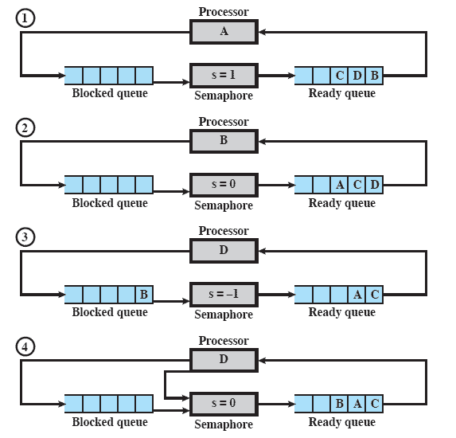
Example of Semaphore Mechanism
Processes A, B, and C depend on a result from process D.
Initially A is running and the semaphore count is 1, indicating that one of D’s results is available.
When D completes a new result, it issues a Signal instruction
Notes:
Animated Slide – animation shows sections of the diagram to focus and remove distraction
Processes A, B, and C depend on a result from process D.
Initially (1), A is running;
B, C, and D are ready;
the semaphore count is 1, indicating that one of D’s results is available.
When A issues a semWait instruction on semaphore s, the semaphore decrements to 0, and A can continue to execute;
subsequently it rejoins the ready queue.
Then B runs (2), eventually issues a semWait instruction, and is blocked, allowing D to run (3).
When D completes a new result, it issues a semSignal instruction, which allows B to move to the ready queue (4).
D rejoins the ready queue and …

Slide 67
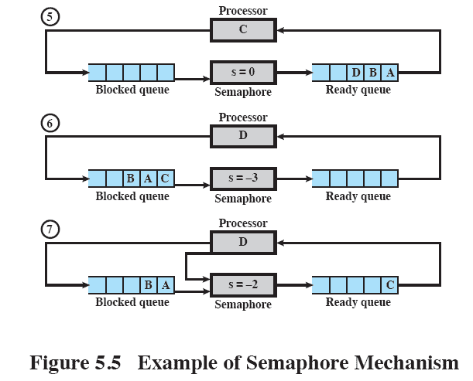
Example of Semaphore Mechanism
Notes:
C begins to run (5)
but is blocked when it issues a semWait instruction.
Similarly, A and B run and are blocked on the semaphore,
allowing D to resume execution (6).
When D has a result, it issues a semSignal, which transfers C to the ready queue.
Later cycles of D will release A and B from the Blocked state.

Slide 68
Deadlock and Starvation
Deadlock – two or more processes are waiting indefinitely for an event that can be caused by only one of the waiting processes
Let S and Q be two semaphores initialized to 1
P₀ P₁
wait(S); wait(Q);
wait(Q); wait(S);
... ...
signal(S); signal(Q);
signal(Q); signal(S);
Starvation – Indefinite blocking
A process may never be removed from the semaphore queue in which it is suspended
A situation in which processes wait indefinitely within the semaphore.
Indefinite blocking may occur if we remove processes from the list associated with a semaphore in LIFO (last-in, first-out) order.

Slide 69
Priority Inversion
A scheduling challenge arises when a higher-priority process needs to read or modify kernel data that are currently being accessed by a lower-priority process—or a chain of lower-priority processes.
Kernel data are protected with a lock and therefore, the higher-priority process will have to wait for a lower-priority one to finish with the resource.
The situation becomes more complicated if the lower-priority process is preempted in favor of another process with a higher priority.
Solved via priority-inheritance protocol

Slide 70
Priority Inversion
Three processes - L, M, and H whose priorities follow the order L < M < H
Process H requires resource R, which is currently being accessed by process L.
Ordinarily, process H would wait for L to finish using resource R.
However, now suppose that process M becomes runnable, thereby preempting process L.
Indirectly, a process with a lower priority—process M—has affected how long process H must wait for L to relinquish resource R.

Slide 71
Priority-inheritance Protocol
All processes that are accessing resources needed by a higher-priority process inherit the higher priority until they are finished with the resources in question.
When they are finished, their priorities revert to their original values.
Therefore, a priority-inheritance protocol would allow process L to temporarily inherit the priority of process H, thereby preventing process M from preempting its execution.
When process L had finished using resource R, it would relinquish its inherited priority from H and assume its original priority.
Because resource R would now be available, process H—not M—would run next.

Slide 72
Classical Problems of Synchronization
Classical problems used to test newly-proposed synchronization schemes
Bounded-Buffer Problem
Readers and Writers Problem
Dining-Philosophers Problem

Slide 73
Bounded-Buffer Problem
The producer and consumer processes share the following data structures:
n buffers, each capable of holding one item.
Semaphore mutex semaphore provides mutual exclusion for accesses to the buffer pool and is initialized to the value 1.
Semaphores empty and full count the number of empty and full buffers.
Semaphore empty is initialized to the value n;
Semaphore full is initialized to the value 0.

Slide 74
Bounded Buffer Problem (Cont.)
The structure of the producer process
do {
... /* produce an item in next_produced */
...
wait(empty);
wait(mutex);
... /* add next_produced to the buffer */
...
signal(mutex);
signal(full);
} while (true);

Slide 75
Bounded Buffer Problem (Cont.)
The structure of the consumer process
do {
wait(full);
wait(mutex);
... /* remove an item from buffer to next_consumed */
...
signal(mutex);
signal(empty);
... /* consume the item in next_consumed */
... } while (true);

Slide 76
Readers-Writers Problem
A data set is shared among a number of concurrent processes
Reader processes – only read the data set; they do not perform any updates
Writer processes – can both read and write
The data area could be a file, a block of main memory, or even a bank of processor registers.
Problem
Allow multiple readers to read at the same time
Only one single writer can access the shared data at the same time
We require that the writers have exclusive access to the shared database while writing to the database.

Slide 77
Readers-Writers Problem
Several variations of how readers and writers are considered
First, the readers–writers problem requires that no reader be kept waiting unless a writer has already obtained permission to use the shared object.
In other words, no reader should wait for other readers to finish simply because a writer is waiting.
For example, suppose that the shared area is a library catalog
Ordinary users of the library read the catalog to locate a book
One or more librarians are able to update the catalog

Slide 78
Readers-Writers Problem …
The second readers–writers (variation) problem requires that, once a writer is ready, that writer perform its write as soon as possible.
In other words, if a writer is waiting to access the object, no new readers may start reading.
A solution to either problem may result in starvation.
In the first case, writers may starve; in the second case, readers may starve.

Slide 79
Readers-Writers Problem (Cont.)
Shared Data
Data set
Common Semaphore rw_mutex initialized to 1
Semaphore mutex initialized to 1
Integer read_count (counting semaphore) initialized to 0

Slide 80
Readers-Writers Problem (Cont.)
The mutex semaphore is used to ensure mutual exclusion when the variable read_count is updated.
The read_count variable keeps track of how many processes are currently reading the object.
The semaphore rw_mutex functions as a mutual exclusion semaphore for the writers.
It is also used by the first or last reader that enters or exits the critical section.
It is not used by readers who enter or exit while other readers are in their critical sections.

Slide 81
Readers-Writers Problem (Cont.)
The structure of a writer process
do { wait(rw_mutex);
... /* writing is performed */
...
signal(rw_mutex);
} while (true);

Slide 82
Structure of a Reader Process
do { wait(mutex); read_count++; if (read_count == 1)
wait(rw_mutex);
signal(mutex);
... /* reading is performed */
...
wait(mutex); read count--; if (read_count == 0)
signal(rw_mutex);
signal(mutex);
} while (true);

Slide 83
Readers-Writers Problem Variations
First variation – no reader kept waiting unless writer has permission to use shared object
Second variation – once writer is ready, it performs the write ASAP
Both may have starvation leading to even more variations
Problem is solved on some systems by kernel providing reader-writer locks

Slide 84
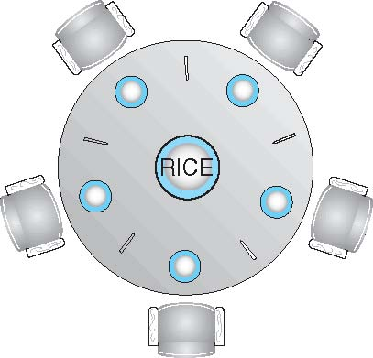
Dining-Philosophers Problem
Philosophers spend their lives alternating thinking and eating
Do not interact with their neighbors but, occasionally try to pick up 2 chopsticks (one at a time) to eat from bowl
Need both to eat, then release both when done
In the case of 5 philosophers
Shared data
Bowl of rice (data set)
Semaphore chopstick [5] initialized to 1

Slide 85
Semaphore Solution
Dining-philosophers problem is considered a classic synchronization problem because it is an example of a large class of concurrency-control problems.
One simple solution is to represent each chopstick with a semaphore.
A philosopher tries to grab a chopstick by executing a wait() operation on that semaphore.
She releases her chopsticks by executing the signal() operation on the appropriate semaphores.
Thus, the shared data are semaphore chopstick[5]; where all the elements of chopstick are initialized to 1.

Slide 86
Dining-Philosophers Problem Algorithm
The structure of Philosopher i:
do {
wait (chopstick[i] );
wait (chopStick[ (i + 1) % 5] );
// eat
signal (chopstick[i] );
signal (chopstick[ (i + 1) % 5] );
// think
} while (TRUE);
What is the problem with this algorithm?

Slide 87
Possible Remedies to the Deadlock Problem
Deadlock handling
Allow at most 4 philosophers to be sitting simultaneously at the table.
Allow a philosopher to pick up the forks only if both are available (picking must be done in a critical section).
Use an asymmetric solution -- an odd-numbered philosopher picks up first the left chopstick and then the right chopstick.
Even-numbered philosopher picks up first the right chopstick and then the left chopstick.

Slide 88
Problems with Semaphores
Incorrect use of semaphore operations:
signal (mutex)
….
wait (mutex)
wait (mutex)
…
wait (mutex)
Omitting of wait (mutex) or signal (mutex) (or both)
Deadlock and starvation are possible.

Slide 89
The Dining Philosophers Problem (3)
. . .

Slide 90
The Dining Philosophers Problem (4)
. . .
. . .

Slide 91
The Dining Philosophers Problem (5)
. . .

Slide 92
Monitors
Semaphores is a powerful tool but its wait and signal operations may be scattered throughout a program
Monitor is a programming language construct which enforces mutual exclusion and blocking mechanism
Provides equivalent functionality to that of semaphores and that is easier to control.
Implemented in a number of programming languages, including
Concurrent Pascal, Pascal-Plus,
Modula-2, Modula-3, and Java.

Slide 93
Monitors
Monitor consists of {one or more procedures, an initialization sequence, and local data} grouped together in a “module”.
A process can call procedures inside the monitor, but cannot directly access the code/variables inside the monitor.

Slide 94
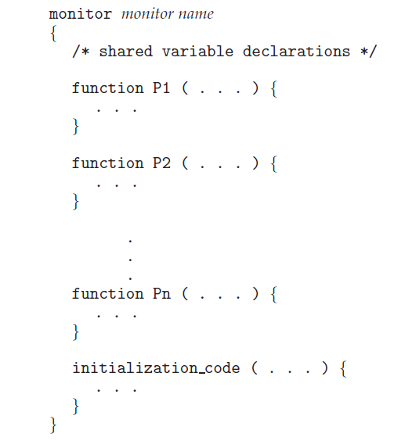
Monitors

Slide 95
Monitors
A monitor is an ADT that includes a set of programmer defined operations that are provided with mutual exclusion within the monitor.
A process enters the monitor by invoking one of its functions.
A function defined within a monitor can access only those variables declared locally within the monitor and its formal parameters.

Slide 96
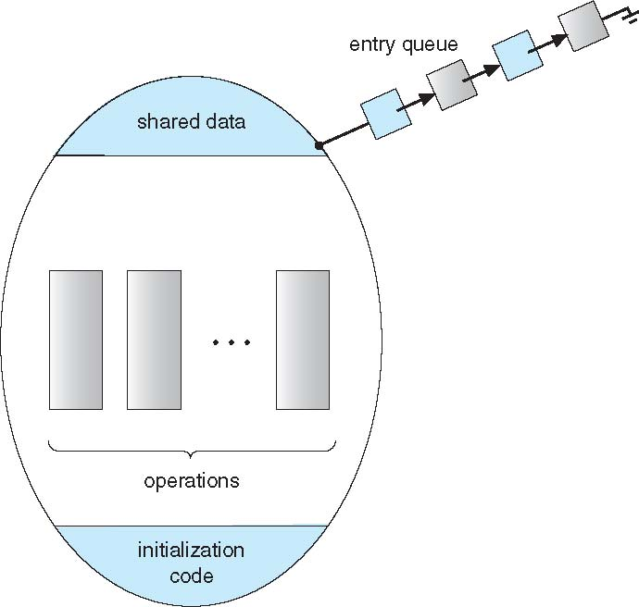
Schematic view of a Monitor
The monitor construct ensures that only one process at a time is active within the monitor.
Any other process that has invoked the monitor is blocked, waiting for the monitor to become available

Slide 97
Monitor Characteristics
Local data variables are accessible only by the monitor’s procedures and not by any external procedure
Process enters monitor by invoking one of its procedures
Only one process may be executing in the monitor at a time
Copyright © 2018 Pearson India Education Services Pvt. Ltd
Notes:
The chief characteristics of a monitor are the following:
1. The local data variables are accessible only by the monitor’s procedures and
not by any external procedure.
2. A process enters the monitor by invoking one of its procedures.
3. Only one process may be executing in the monitor at a time; any other processes
that have invoked the monitor are blocked, waiting for the monitor to become available.
The first two characteristics are reminiscent of those for objects in object-oriented software. Indeed, an object-oriented OS or programming language can readily implement a monitor as an object with special characteristics.
By enforcing the discipline of one process at a time, the monitor is able to provide a mutual exclusion facility. The data variables in the monitor can be accessed by only one process at a time. Thus, a shared data structure can be protected by placing it in a monitor. If the data in a monitor represent some resource, then the monitor provides a mutual exclusion facility for accessing the resource.
To be useful for concurrent processing, the monitor must include synchronization tools. For example, suppose a process invokes the monitor and, while in the
monitor, must be blocked until some condition is satisfied. A facility is needed by which the process is not only blocked but releases the monitor so that some other process may enter it. Later, when the condition is satisfied and the monitor is again available, the process needs to be resumed and allowed to reenter the monitor at the point of its suspension.

Slide 98
Monitors…
A shared data structure can be protected by placing it in a monitor
Data variables in a monitor can be accessed by only one process at a time
To be useful for concurrent processing, the monitor must include synchronization tools
A monitor supports synchronization by the use of condition variables that are contained within the monitor and accessible only within the monitor

Slide 99
Monitor with Condition Variables
Condition variables are the special data type in monitors, which are operated on by two functions:
wait(c) and signal(c) where c is the condition
The only operations that can be invoked on a condition variable are wait()and signal()
wait suspends execution of the calling process on condition
signal resumes execution of some process blocked after a wait on the same condition
These operations are different from those for the semaphore
If a process in a monitor signals and no task is waiting on the condition variable, the signal is lost

Slide 100
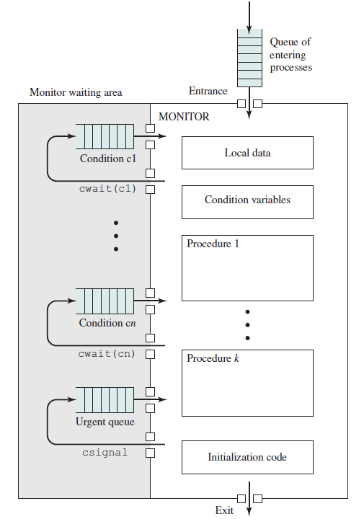
Structure of a Monitor

Slide 101
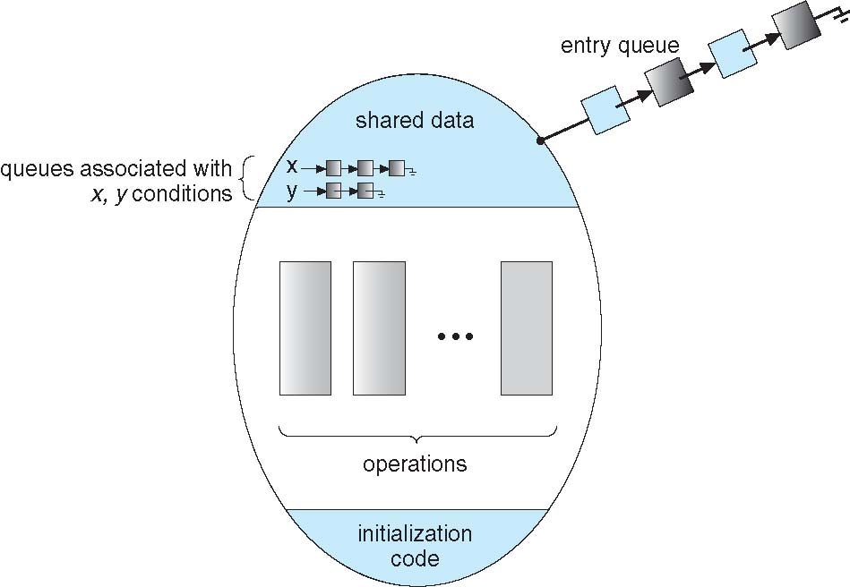
Monitor with Condition Variables

Slide 102
Monitor with Condition Variables
Operation x.wait() means that the process invoking this operation is suspended until another process executing in monitor invokes x.signal();
Invoke will be when detecting change in condition variable
The x.signal()operation resumes exactly one suspended process.
If no process is suspended, then the signal() operation has no effect; that is, the state of x is the same as if the operation had never been executed

Slide 103
Condition Variables Choices
If process P executing the monitor invokes x.signal(), and there exists a process Q, which is suspended in x.wait(), what should happen next?
Both P and Q cannot execute in parallel. If Q is resumed, then P must wait
Options include
Signal and wait – P waits until Q either leaves the monitor or it waits for another condition
Signal and continue – Q waits until P either leaves the monitor or it waits for another condition
Both have pros and cons – language implementer can decide
Monitors implemented in Concurrent Pascal compromise
P executing signal immediately leaves the monitor, Q is resumed
Implemented in other languages including Mesa, C#, Java

Slide 104
Dining-Philosophers Solution Using Monitors
Solution imposes the restriction that a philosopher may pick up her chopsticks only if both of them are available
enum {THINKING, HUNGRY, EATING} state[5];
Philosopher i can set the variable state[i] = EATING only if her two neighbors are not eating:
(state[(i+4) % 5] != EATING)
and
(state[(i+1)% 5] != EATING)
Each philosopher, before starting to eat, must invoke the operation pickup(). This act may result in the suspension of the philosopher process.

Slide 105
Dining-Philosophers Solution Using Monitors
Condition variable self[5] allows philosopher i to delay herself when she is hungry but is unable to obtain the chopsticks
After the successful completion of the pickup operation, the philosopher may eat.
Following this, the philosopher invokes the putdown() operation.
Philosopher i must invoke the operations pickup() and putdown() in the following sequence
DiningPhilosophers.pickup(i);
...
eat
...
DiningPhilosophers.putdown(i);
Deadlock? Starvation?

Slide 106
Monitor Solution to Dining Philosophers
monitor DiningPhilosophers
{
enum { THINKING; HUNGRY, EATING} state [5] ;
condition self [5];
void pickup (int i) {
state[i] = HUNGRY;
test(i);
if (state[i] != EATING) self[i].wait;
}
void putdown (int i) {
state[i] = THINKING;
// test left and right neighbors
test((i + 4) % 5);
test((i + 1) % 5);
}

Slide 107
Solution to Dining Philosophers (Cont.)
void test (int i) {
if ((state[(i + 4) % 5] != EATING) &&
(state[i] == HUNGRY) &&
(state[(i + 1) % 5] != EATING) )
{
state[i] = EATING ;
self[i].signal () ;
}
}
initialization_code() {
for (int i = 0; i < 5; i++)
state[i] = THINKING;
}
}

Slide 108
Monitor Implementation Using Semaphores
Variables
semaphore mutex; // (initially = 1)
semaphore next; // (initially = 0)
int next_count = 0;
Each procedure F will be replaced by
wait(mutex);
…
body of F;
…
if (next_count > 0)
signal(next)
else
signal(mutex);
Mutual exclusion within a monitor is ensured

Slide 109
Monitor Implementation – Condition Variables
For each condition variable x, we have:
semaphore x_sem;//(initially = 0)
int x_count = 0;
The operation x.wait can be implemented as:
x_count++;
if (next_count > 0)
signal(next);
else
signal(mutex);
wait(x_sem);
x_count--;

Slide 110
Monitor Implementation (Cont.)
The operation x.signal can be implemented as:
if (x_count > 0) {
next_count++;
signal(x_sem);
wait(next);
next_count--;
}

