Slide 1
Deadlocks

Slide 2
Definition
In a multiprogramming environment, several processes may compete for a finite number of resources.
A process requests resources; if the resources are not available at that time, the process enters a waiting state.
Sometimes, a waiting process is never again able to change state, because the resources it has requested are held by other waiting processes.
This permanent situation is called a deadlock.

Slide 3
Resource Categories
Reusable
Can be safely used by only one process at a time and is not depleted by that use
Processors, I/O channels, main and secondary memory, devices, and data structures such as files, databases, and semaphores
Consumable
One that can be created (produced) and destroyed (consumed)
Interrupts, signals, messages, and information
In I/O buffers
Copyright © 2018 Pearson India Education Services Pvt. Ltd
Notes:
Two general categories of resources can be distinguished: reusable and consumable. A reusable resource is one that can be safely used by only one process at a time and is not depleted by that use. Processes obtain resource units that they later release for reuse by other processes. Examples of reusable resources include processors; I/O channels; main and secondary memory; devices; and data structures such as files, databases, and semaphores.
A consumable resource is one that can be created (produced) and destroyed (consumed). Examples of consumable resources are interrupts, signals, messages, and information in I/O buffers.

Slide 4
Example: Memory Request
Space is available for allocation of 200Kbytes, and the following sequence of events occur:
Deadlock occurs if both processes progress to their second request
P1
P2
. . .
. . .
Request 80 Kbytes;
Request 70 Kbytes;
. . .
. . .
Request 60 Kbytes;
Request 80 Kbytes;
Copyright © 2018 Pearson India Education Services Pvt. Ltd
Notes:
Another example of deadlock with a reusable resource has to do with requests for main memory. Suppose the space available for allocation is 200 Kbytes, and the following sequence of requests occurs: (see diagram)
Deadlock occurs if both processes progress to their second request. If the amount of memory to be requested is not known ahead of time, it is difficult to deal with this type of deadlock by means of system design constraints. The best way to deal with this particular problem is, in effect, to eliminate the possibility by using virtual memory, which is discussed in Chapter 8 .

Slide 5
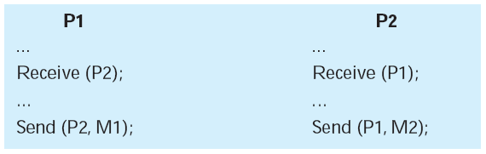
Consumable Resources Deadlock
Consider a pair of processes, in which each process attempts to receive a message from the other process and then send a message to the other process:
Deadlock occurs if the Receive is blocking
Copyright © 2018 Pearson India Education Services Pvt. Ltd
Notes:
As an example of deadlock involving consumable resources, consider the following pair of processes, in which each process attempts to receive a message
from the other process and then send a message to the other process: (see diagram)
Deadlock occurs if the Receive is blocking (i.e., the receiving process is blocked until the message is received). Once again, a design error is the cause of the deadlock. Such errors may be quite subtle and difficult to detect. Furthermore, it may take a rare combination of events to cause the deadlock; thus a program could be in use for a considerable period of time, even years, before the deadlock actually occurs.

Slide 6
System Model
System consists of resources
Resource types R₁, R₂, . . ., R_{m}
CPU cycles, memory space, I/O devices
Each resource type R_{i} has W_{i} instances.
If a process requests an instance of a resource type, the allocation of any instance of the type should satisfy the request.
If it does not, then the instances are not identical, and the resource type classes have not been defined properly.
The number of resources requested may not exceed the total number of resources available in the system.

Slide 7
System Model
Each process utilizes a resource as follows:
Request: If the request cannot be granted immediately, the requesting process must wait until it can acquire the resource
Use: The process can operate on the resource
Release: The process releases the resource
A mutex lock may be used to protect critical sections of code i.e., a thread acquires the lock before entering a critical section and releases it upon exiting the critical section.

Slide 8
Mutex locks
#include <pthread.h>
pthread_mutex_t mutex;
/* create the mutex lock */
pthread_mutex_init(&mutex,NULL);
/* acquire the mutex lock */
pthread_mutex_lock(&mutex);
/* critical section */
/* release the mutex lock */
pthread_mutex_unlock(&mutex);
We also have pthread_mutex_trylock(&mutex)
If the mutex is available, pthread_mutex_trylock locks the mutex and returns 0.
If the mutex is not available
(that is, if it is locked by another thread), pthread_mutex_trylock returns a nonzero error code (EBUSY).

Slide 9
Order of mutexes
proc1( ) {
pthread_mutex_lock(&m1);
/* use object 1 */
pthread_mutex_lock(&m2);
/* use objects 1 and 2 */
pthread_mutex_unlock(&m2);
pthread_mutex_unlock(&m1);
}
---------------------------------------------------
proc2( ) {
while (1) {
pthread_mutex_lock(&m2);
if (!pthread_mutex_trylock(&m1))break;
pthread_mutex_unlock(&m2);
}
/* use objects 1 and 2 */
pthread_mutex_unlock(&m1);
pthread_mutex_unlock(&m2);
}

Slide 10
Deadlock Example
The pthread_mutex_init() function initializes an unlocked mutex.
Mutex locks are acquired and released using pthread_mutex_lock() and pthread_mutex_unlock(), respectively.
If a thread attempts to acquire a locked mutex, the call to pthread_mutex_lock() blocks the thread until the owner of the mutex lock invokes pthread_mutex_unlock().
Two mutex locks created below:
/* Create and initialize the mutex locks */
pthread mutex_t first_mutex;
pthread mutex_t second_mutex;
pthread mutex_init(&first_mutex,NULL);
pthread mutex_init(&second_mutex,NULL);
Next, two threads—thread_one and thread_two—are created, and both these threads have access to both mutex locks.

Slide 11
Deadlock Example
/* thread one runs in this function */
void *do_work_one(void *param) {
pthread_mutex_lock(&first_mutex);
pthread_mutex_lock(&second_mutex);
/** * Do some work */ pthread_mutex_unlock(&second_mutex);
pthread_mutex_unlock(&first_mutex);
pthread_exit(0);
}
/* thread two runs in this function */
void *do_work_two(void *param) {
pthread_mutex_lock(&second_mutex);
pthread_mutex_lock(&first_mutex);
/** * Do some work */ pthread_mutex_unlock(&first_mutex);
pthread_mutex_unlock(&second_mutex);
pthread_exit(0);
}

Slide 12
Deadlock Approaches
There is no single effective strategy that can deal with all types of deadlock
Three approaches are common:
Deadlock avoidance
Do not grant a resource request if this allocation might lead to deadlock
Deadlock detection
Grant resource requests when possible, but periodically check for the presence of deadlock and take action to recover
Deadlock prevention
Disallow one of the three necessary conditions for deadlock occurrence, or prevent circular wait condition from happening
Copyright © 2018 Pearson India Education Services Pvt. Ltd
Notes:
There is no single effective strategy that can deal with all types of deadlock.
Three approaches are common:
• Deadlock prevention: Disallow one of the three necessary conditions for deadlock
occurrence, or prevent circular wait condition from happening.
• Deadlock avoidance: Do not grant a resource request if this allocation might
lead to deadlock.
• Deadlock detection: Grant resource requests when possible, but periodically
check for the presence of deadlock and take action to recover.
We examine each of these in turn, after first introducing resource allocation graphs and then discussing the conditions for deadlock.

Slide 13
Deadlock Characterization
Deadlock can arise if four conditions hold simultaneously:
Mutual exclusion: Only one process at a time can use a resource.
Hold and wait: A process holding at least one resource is waiting to acquire additional resources held by other processes.
No preemption: A resource can be released only voluntarily by the process holding it, after that process has completed its task.
Circular wait: ⱻ a set {P₀, P₁, …, P_{n}} of waiting processes such that P₀ is waiting for a resource that is held by P₁, P₁ is waiting for a resource that is held by P₂, …, P_{n–1} is waiting for a resource that is held by P_{n}, and P_{n} is waiting for a resource that is held by P₀.

Slide 14
Resource-Allocation Graph
A set of vertices V and a set of edges E.
V is partitioned into two types:
P = {P₁, P₂, …, P_{n}}, the set consisting of all the processes in the system
R = {R₁, R₂, …, R_{m}}, the set consisting of all resource types in the system
Request edge – directed edge P_{i} → R_{j}
Assignment edge – directed edge R_{j} → P_{i}

Slide 15
Resource-Allocation Graph (Cont.)
Process
Resource Type with 4 instances
P_{i} requests instance of R_{j}
P_{i} is holding an instance of R_{j}
P_{i}
R_{j}
P_{i}
R_{j}

Slide 16
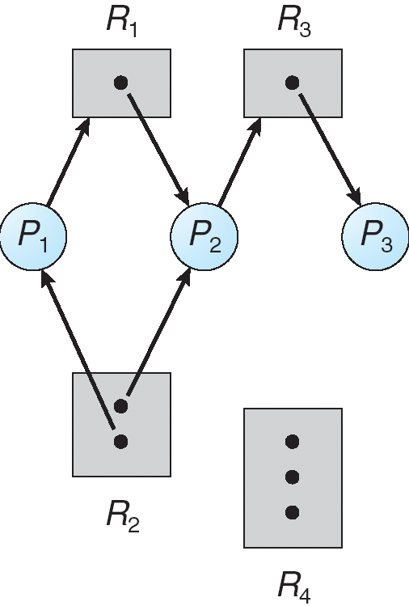
Example of a Resource Allocation Graph
R = {R1, R2, R3, R4}
E = {P1 → R1, P2 → R3, R1 → P2, R2 → P2, R2 → P1, R3 → P3}

Slide 17
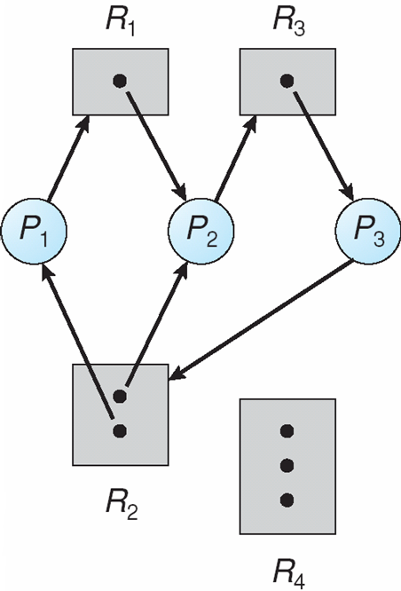
Resource Allocation Graph With A Deadlock
Given the definition of a resource-allocation graph, if the graph contains no cycles, then no process in the system is deadlocked.
If the graph does contain a cycle, then a deadlock may exist.

Slide 18
Resource Allocation Graph With A Deadlock
At this point, two minimal cycles exist in the system:
P1 → R1 → P2 → R3 → P3 → R2 → P1
P2 → R3 → P3 → R2 → P2
Processes P1, P2, and P3 are deadlocked. Why?

Slide 19
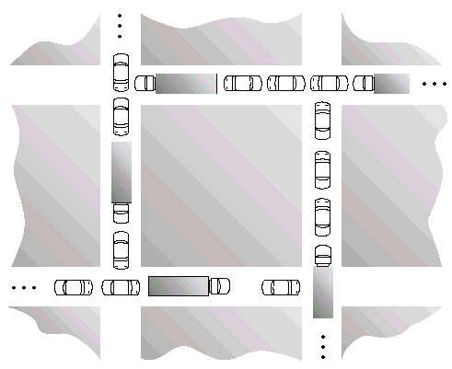
Traffic Deadlock Example

Slide 20
Why it results in Deadlock
Consider each section of the street as a resource.
Mutual exclusion condition applies, since only one vehicle can be on a section of the street at a time.
Hold-and-wait condition applies, since each vehicle is occupying a section of the street, and waiting to move on to the next section of the street.
No-preemptive condition applies, since a section of the street that is a section of the street that is occupied by a vehicle cannot be taken away from it.
Circular wait condition applies, since each vehicle is waiting on the next vehicle to move. That is, each vehicle in the traffic is waiting for a section of street held by the next vehicle in the traffic.
The simple rule to avoid traffic deadlock is that a vehicle should enter if it is sure that it will not have to stop at the intersection.

Slide 21
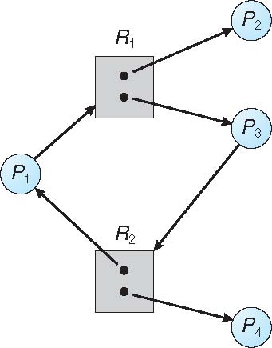
Graph With A Cycle But No Deadlock
We have a cycle: P1 → R1 → P3 → R2 → P1
However, there is no deadlock.
Process P4 may release its instance of resource type R2.
That resource can then be allocated to P3, breaking the cycle.

Slide 22
Basic Facts
If graph contains no cycles ⇒ no deadlock
If graph contains a cycle ⇒
if only one instance per resource type, then deadlock
if several instances per resource type, possibility of deadlock

Slide 23
Methods for Handling Deadlocks
Ensure that the system will never enter a deadlock state
Allow the system to enter a deadlock state and then recover
Ignore the problem and pretend that deadlocks never occur in the system; used by most operating systems, including UNIX

Slide 24
Methods for Handling Deadlocks
Deadlock prevention provides a set of methods to ensure that at least one of the necessary conditions cannot hold.
These methods prevent deadlocks by constraining how requests for resources can be made.

Slide 25
Methods for Handling Deadlocks
Deadlock avoidance requires that the operating system be given additional information in advance concerning which resources a process will request and use during its lifetime.
With this additional knowledge, the operating system can decide for each request whether or not the process should wait.
To decide whether the current request can be satisfied or must be delayed, the system must consider
the resources currently available,
the resources currently allocated to each process, and
the future requests and releases of each process.

Slide 26
Deadlock Prevention
Restrain the ways request can be made
Mutual Exclusion – Not required for sharable resources; must hold for non-sharable resources
In general, however, we cannot prevent deadlocks by denying the mutual-exclusion condition, because some resources are intrinsically non-sharable.
For example, a mutex lock cannot be simultaneously shared by several processes.

Slide 27
Deadlock Prevention
Hold and Wait – must guarantee that whenever a process requests a resource, it does not hold any other resources
Require process to request and be allocated all its resources before it begins execution,
Or allow process to request resources only when the process has none
Low resource utilization; starvation possible

Slide 28
Deadlock Prevention (Cont.)
No Preemption – How to ensure that this condition never holds
If a process that is holding some resources requests another resource that cannot be immediately allocated to it, then all resources currently being held are released.
Preempted resources are added to the list of resources for which the process is waiting.
Process will be restarted only when it can regain its old resources, as well as the new ones that it is requesting.
Alternatively, if a process requests some resources, we first check whether they are available.
If they are, we allocate them.
If they are not, we check
whether they are allocated to some other process that is waiting for additional resources.
If so, we preempt the desired resources from the waiting process and allocate them to the requesting process.
Otherwise wait

Slide 29
Deadlock Prevention (Cont.)
Circular Wait – How to ensure that this condition never holds
Impose a total ordering of all resource types, and require that each process requests resources in an increasing order of enumeration
Each process can request resources only in an increasing order of enumeration.

Slide 30
Circular Wait
Let R = {R₁, R₂, ..., R_{m}} be the set of resource types.
We assign to each resource type a unique integer number, which allows us to compare two resources and to determine whether one precedes another in our ordering.
Formally, we define a one-to-one function F: R→N, where N is the set of natural numbers.
For example, if the set of resource types R includes tape drives, disk drives, and printers, then the function F might be defined as follows:
F(tape drive) = 1
F(disk drive) = 5
F(printer) = 12

Slide 31
Circular Wait …
A process can initially request any number of instances of a resource type —say, R_{i} .
After that, the process can request instances of resource type R_{j} if and only if F(R_{j} ) > F(R_{i} ).
A process that wants to use the tape drive(1) and printer(12) at the same time must first request the tape drive and then request the printer.
Or we can require that a process requesting an instance of resource type R_{j} must have released any resources R_{i} such that F(R_{i} ) ≥ F(R_{j} ).
If several instances of the same resource type are needed, a single request for all of them must be issued.

Slide 32
Deadlock Example
/* thread one runs in this function */
void *do_work_one(void *param) {
pthread_mutex_lock(&first_mutex);
pthread_mutex_lock(&second_mutex);
/** * Do some work */ pthread_mutex_unlock(&second_mutex);
pthread_mutex_unlock(&first_mutex);
pthread_exit(0);
}
/* thread two runs in this function */
void *do_work_two(void *param) {
pthread_mutex_lock(&second_mutex);
pthread_mutex_lock(&first_mutex);
/** * Do some work */ pthread_mutex_unlock(&first_mutex);
pthread_mutex_unlock(&second_mutex);
pthread_exit(0);
}

Slide 33
Deadlock Example with Lock Ordering
void transaction(Account from, Account to, double amount)
{
mutex lock1, lock2;
lock1 = get_lock(from);
lock2 = get_lock(to);
acquire(lock1);
acquire(lock2);
withdraw(from, amount);
deposit(to, amount);
release(lock2);
release(lock1);
}
Deadlock is possible if two threads simultaneously invoke the transaction() function, transposing different accounts.
Transactions 1 and 2 execute concurrently.
Transaction 1 transfers $25 from account A to account B, and Transaction 2 transfers $50 from account B to account A

Slide 34
Livelock
/* thread_one runs here */
void *do_work_one(void *param)
{
int done = 0;
while (!done) {
pthread_mutex_lock(&first_mutex);
if (pthread_mutex_trylock(&second_mutex)) {
/**
* Do some work
*/
pthread_mutex_unlock(&second_mutex);
pthread_mutex_unlock(&first_mutex);
done = 1; }
else
pthread_mutex_unlock(&first_mutex);
}
pthread_exit(0);
}
/* thread_two runs here */
void *do_work_two(void *param)
{
int done = 0;
while (!done) {
pthread_mutex_lock(&second_mutex);
if (pthread_mutex_trylock(&first_mutex)) {
/*** Do some work*/
pthread_mutex_unlock(&first_mutex);
pthread_mutex_unlock(&second_mutex);
done = 1;}
else
pthread_mutex_unlock(&second_mutex);
}
pthread_exit(0);
}

Slide 35
Livelock
It is similar to deadlock; both prevent two or more threads from proceeding, but the threads are unable to proceed for different reasons.
Whereas deadlock occurs when every thread in a set is blocked waiting for an event that can be caused only by another thread in the set, livelock occurs when a thread continuously attempts an action that fails.
Livelock typically occurs when threads retry failing operations at the same time.
It thus can generally be avoided by having each thread retry the failing operation at random times.

Slide 36
Deadlock Avoidance
Possible side effects of preventing deadlocks are low device utilization and reduced system throughput
Avoidance requires that the system has some additional a priori information available
Simplest and most useful model requires that each process declare the maximum number of resources of each type that it may need
Deadlock-avoidance algorithm dynamically examines the resource-allocation state to ensure that there can never be a circular-wait condition
Resource-allocation state is defined by the number of available and allocated resources, and the maximum demands of the processes

Slide 37
Witness
Although ensuring that resources are acquired in the proper order is the responsibility of application developers, certain software can be used to verify that locks are acquired in the proper order and to give appropriate warnings when locks are acquired out of order and deadlock is possible.
One lock-order verifier, which works on BSD versions of UNIX such as FreeBSD, is known as witness.
Witness uses mutual-exclusion locks to protect critical sections
It works by dynamically maintaining the relationship of lock orders in a system.

Slide 38
Safe State
When a process requests an available resource, system must decide if immediate allocation leaves the system in a safe state
System is in safe state if there exists a sequence <P₁, P₂, …, P_{n}> of ALL the processes in the systems such that for each P_{i}, the resource requests that P_{i} can still make can be satisfied by currently available resources + resources held by all the P_{j}, with j < i

Slide 39
Safe State
If P_{i} resource needs are not immediately available, then P_{i} can wait until all P_{j} have finished
When P_{j} is finished, P_{i} can obtain needed resources, execute, return allocated resources, and terminate
When P_{i} terminates, P_{i+1} can obtain its needed resources, and so on

Slide 40
Basic Facts
If a system is in safe state ⇒ no deadlocks
If a system is in unsafe state ⇒ possibility of deadlock
Avoidance ⇒ ensure that a system will never enter an unsafe state.

Slide 41
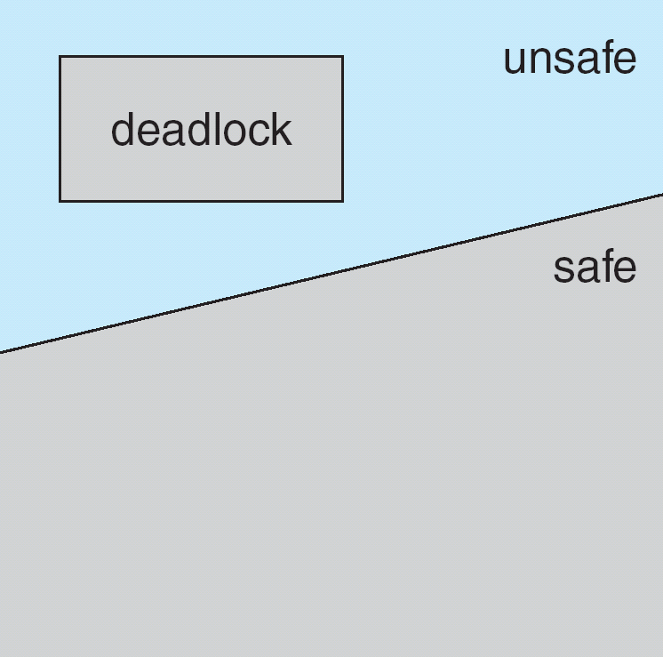
Safe, Unsafe, Deadlock State
A safe state is not a deadlocked state.
A deadlocked state is an unsafe state.
Not all unsafe states are deadlocks.
An unsafe state may lead to a deadlock.

Slide 42
Safe, Unsafe, Deadlock State
As long as the state is safe, the operating system can avoid unsafe and deadlocked states.
In an unsafe state, the operating system cannot prevent processes from requesting resources in such a way that a deadlock occurs.
The behavior of the processes controls unsafe states.

Slide 43
Avoidance Algorithms
Single instance of a resource type
Use a resource-allocation graph
Multiple instances of a resource type
Use the banker’s algorithm

Slide 44
Resource-Allocation Graph Scheme
Claim edge P_{i} → R_{j} indicated that process P_{j} may request resource R_{j} at sometime in future; represented by a dashed line
Claim edge converts to request edge when a process requests a resource
Request edge converted to an assignment edge when the resource is allocated to the process
When a resource is released by a process, assignment edge reconverts to a claim edge
Resources must be claimed a priori in the system

Slide 45
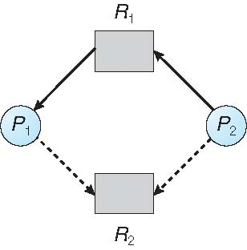
Resource-Allocation Graph
Now suppose that process Pi requests resource Rj.
Request can be granted only if converting the request edge Pi → Rj to an assignment edge Rj → Pi does not result in the formation of a cycle in the resource-allocation graph.
Safety is checked by using a cycle-detection algorithm.

Slide 46
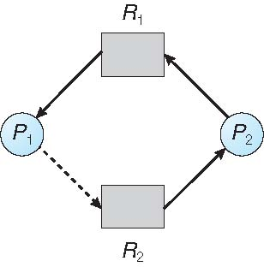
Unsafe State In Resource-Allocation Graph
If P1 requests R2, and P2 requests R1, then a deadlock will occur

Slide 47
Resource-Allocation Graph Algorithm
Suppose that process P_{i} requests a resource R_{j}
Request can be granted only if converting the request edge to an assignment edge does not result in the formation of a cycle in the resource allocation graph

Slide 48
Banker’s Algorithm
The resource-allocation-graph algorithm is not applicable to a resource allocation system with multiple instances of each resource type.

Slide 49
Banker’s Algorithm
When a new process enters the system, it must declare the maximum number of instances of each resource type that it may need.
This number may not exceed the total number of resources in the system.
When a user requests a set of resources, the system must determine whether the allocation of these resources will leave the system in a safe state.
If it will, the resources are allocated; otherwise, the process must wait until some other process releases enough resources.

Slide 50
Banker’s Algorithm
Multiple instances
Each process must a priori claim maximum use
When a process requests a resource it may have to wait
When a process gets all its resources it must return them in a finite amount of time

Slide 51
Data Structures for the Banker’s Algorithm
Let n = number of processes, and m = number of resources types.
Available: Vector of length m. If available[j] = k, there are k instances of resource type R_{j} available
Max: n x m matrix. If Max [i,j] = k, then process P_{i} may request at most k instances of resource type R_{j}
Allocation: n x m matrix. If Allocation[i,j] = k then P_{i} is currently allocated k instances of R_{j}
Need: n x m matrix. If Need[i,j] = k, then P_{i} may need k more instances of R_{j} to complete its task
Need [i,j] = Max[i,j] – Allocation [i,j]

Slide 52
Safety Algorithm
1. Let Work and Finish be vectors of length m and n, respectively. Initialize:
Work = Available
Finish [i] = false for i = 0, 1, …, n- 1
2. Find an i such that both:
(a) Finish [i] = false
(b) Need_{i} ≤ Work
If no such i exists, go to step 4
Work = Work + Allocation_{i} Finish[i] = true go to step 2
If Finish [i] == true for all i, then the system is in a safe state

Slide 53
Notation
Let X and Y be vectors of length n.
We say that X ≤ Y if and only if X[i] ≤ Y[i] for all i = 1, 2, ..., n.
For example, if X = (1,7,3,2) and Y =(0,3,2,1), then Y ≤ X.
In addition, Y < X if Y ≤ X and Y = X.

Slide 54
Resource-Request Algorithm for Process P_{i}
Request_{i} = request vector for process P_{i}. If Request_{i} [j] = k then process P_{i} wants k instances of resource type R_{j}
1. If Request_{i} ≤ Need_{i} go to step 2. Otherwise, raise error condition, since process has exceeded its maximum claim
2. If Request_{i} ≤ Available, go to step 3. Otherwise P_{i} must wait, since resources are not available
3. Pretend to allocate requested resources to P_{i} by modifying the state as follows:
Available = Available – Request_{i};
Allocation_{i} = Allocation_{i} + Request_{i};
Need_{i} = Need_{i} – Request_{i};
If safe ⇒ the resources are allocated to P_{i}
If unsafe ⇒ P_{i} must wait, and the old resource-allocation state is restored

Slide 55
Example of Banker’s Algorithm
5 processes P₀ through P₄; 3 resource types:
A (10 instances), B (5 instances), and C (7 instances)
Snapshot at time T₀:
Allocation Max Available
A B C A B C A B C
P₀ 0 1 0 7 5 3 3 3 2
P₁ 2 0 0 3 2 2
P₂ 3 0 2 9 0 2
P₃ 2 1 1 2 2 2
P₄ 0 0 2 4 3 3

Slide 56
Example (Cont.)
The content of the matrix Need =Max – Allocation
Need Available
A B C A B C
P₀ 7 4 3 3 3 2
P₁ 1 2 2
P₂ 6 0 0
P₃ 0 1 1
P₄ 4 3 1
The system is in a safe state since the sequence
< P₁, P₃, P₄, P₂, P₀> satisfies safety criteria

Slide 57
Example: P₁ Requests (1,0,2)
Check that Request ≤ Available (that is, (1,0,2) ≤ (3,3,2) ⇒ true
Allocation Need Available
A B C A B C A B C
P₀ 0 1 0 7 4 3 2 3 0
P₁ 3 0 2 0 2 0
P₂ 3 0 2 6 0 0
P₃ 2 1 1 0 1 1
P₄ 0 0 2 4 3 1
Executing safety algorithm shows that sequence <P₁, P₃, P₄, P₀, P₂> satisfies safety requirement
Can request for (3,3,0) by P₄ be granted?
Can request for (0,2,0) by P₀ be granted?

Slide 58
Deadlock Detection
If a system does not employ either a deadlock-prevention or a deadlock avoidance algorithm, then a deadlock situation may occur.
So, deadlock Detection algorithm needed
Recovery algorithm to recover from the deadlock needed

Slide 59
1. Single Instance of Each Resource Type
Maintain wait-for graph (A variant of RA graph)
Nodes are processes
P_{i} → P_{j} if P_{i} is waiting for P_{j}
Periodically invoke an algorithm that searches for a cycle in the graph. If there is a cycle, there exists a deadlock
An algorithm to detect a cycle in a graph requires an order of n² operations, where n is the number of vertices in the graph

Slide 60
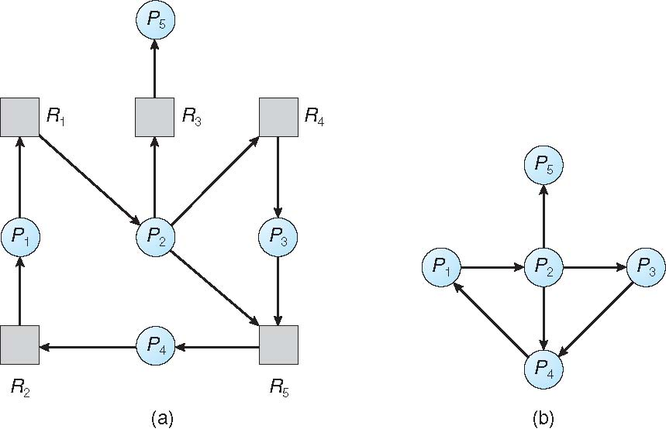
Resource-Allocation Graph and Wait-for Graph
Resource-Allocation Graph
Corresponding wait-for graph

Slide 61
2. Several Instances of a Resource Type
Available: A vector of length m indicates the number of available resources of each type
Allocation: An n x m matrix defines the number of resources of each type currently allocated to each process
Request: An n x m matrix indicates the current request of each process. If Request [i][j] = k, then process P_{i} is requesting k more instances of resource type R_{j}.

Slide 62
Detection Algorithm
Let Work and Finish be vectors of length m and n, respectively
Initialize (a) Work = Available
(b) For i = 1, 2, …, n, if Allocation_{i} ≠ 0, then Finish[i] = false; otherwise, Finish[i] = true
2. Find an index i such that both:
(a) Finish[i] == false
Request_{i} ≤ Work
If no such i exists, go to step 4
Work = Work + Allocation_{i}
Finish[i] = true
go to step 2
If Finish[i] == false, for some i, 1 ≤ i ≤ n, then the system is in deadlock state. Moreover, if Finish[i] == false, then P_{i} is deadlocked
O(m x n²)

Slide 63
Example of Detection Algorithm
Five processes P₀ through P₄; three resource types A (7 instances), B (2 instances), and C (6 instances)
Snapshot at time T₀:
Allocation Request Available A B C A B C A B C
P₀ 0 1 0 0 0 0 0 0 0
P₁ 2 0 0 2 0 2
P₂ 3 0 3 0 0 0
P₃ 2 1 1 1 0 0
P₄ 0 0 2 0 0 2
Sequence <P₀, P₂, P₃, P₁, P₄> results in Finish[i] = true for all i -> system is not in deadlocked state

Slide 64
Example (Cont.)
P₂ requests an additional instance of type C
Request
A B C
P₀ 0 0 0
P₁ 2 0 2
P₂ 0 0 1
P₃ 1 0 0
P₄ 0 0 2
State of system?

Slide 65
Detection-Algorithm Usage
When, and how often, to invoke depends on:
How often a deadlock is likely to occur?
How many processes will need to be rolled back?
one for each disjoint cycle
If detection algorithm is invoked arbitrarily, there may be many cycles in the resource graph and so we would not be able to tell which of the many deadlocked processes “caused” the deadlock.

Slide 66
Recovery from Deadlock: Process Termination
Abort all deadlocked processes
Abort one process at a time until the deadlock cycle is eliminated
In which order should we choose to abort?
Priority of the process
How long process has computed, and how much longer to completion
Resources the process has used
Resources process needs to complete
How many processes will need to be terminated
Is process interactive or batch?

Slide 67
Recovery from Deadlock: Resource Preemption
Selecting a victim – minimize cost
Rollback – return to some safe state, restart process for that state
Starvation – same process may always be picked as victim, include number of rollback in cost factor

