Slide 1
File-System

Slide 2
File-System Structure
File structure
Logical storage unit
Collection of related information
File system resides on secondary storage (disks)
Provide user interface to storage, mapping logical file system to physical storage devices
Provides efficient and convenient access to disk by allowing data to be stored, located retrieved easily
Disk provides in-place rewrite and random access
I/O transfers performed in blocks of sectors (usually 512 bytes)
Notes:
<number>

Slide 3
File-System Structure
File control block – storage structure consisting of information about a file
Device driver controls the physical device
File system organized into layers or levels

Slide 4
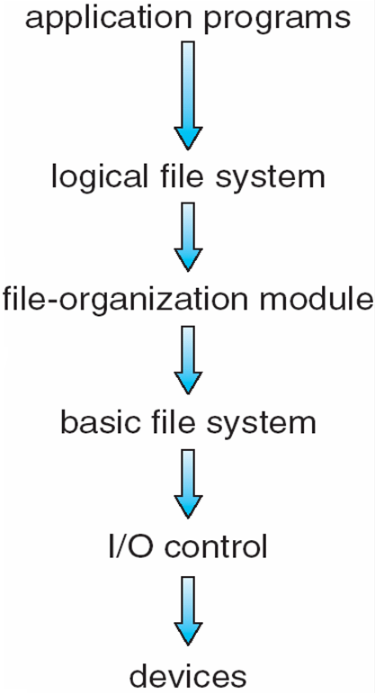
Layered File System
Notes:
<number>

Slide 5
File System Layers
I/O Control Level consists of device drivers and interrupt handlers to transfer information between the main memory and the disk system.
Device drivers manage I/O devices at the I/O control layer
A device driver can be thought of as a translator.
Given input commands like “read drive1, cylinder 72, track 2, sector 10, into memory location 1060” outputs low-level hardware specific commands to hardware controller
Basic file system issues generic commands to the appropriate device driver to read and write physical blocks on the disk.
Also manages memory buffers and caches (allocation, freeing, replacement)

Slide 6
File System Layers
File organization module understands files, logical address, and physical blocks
Translates logical block # to physical block #
Manages free space, disk allocation that tracks unallocated blocks and provides these blocks to the file-organization module when requested.

Slide 7
File System Layers (Cont.)
Logical file system manages metadata information
Translates file name into file number, file handle, location by maintaining file control blocks (inodes in UNIX)
FCB contains information about the file, including ownership, permissions, and location of the file contents
Directory management
Protection
Layering useful for reducing complexity and redundancy, but adds overhead and can decrease performance
Logical layers can be implemented by any coding method

Slide 8
File System Layers (Cont.)
Many file systems, sometimes many within an operating system
Each with its own format (CD-ROM is ISO 9660; Unix has UFS, FFS; Windows has FAT, FAT32, NTFS as well as floppy, CD, USB, Linux has more than 40 types, with extended file system ext2 and ext3, ReiserFS; plus distributed file systems, etc.)
New ones still arriving – ZFS, GoogleFS, Oracle ASM, FUSE

Slide 9
File-System Implementation
We have system calls at the API level, but how do we implement their functions?
On-disk and in-memory structures
Boot control block contains information needed by system to boot OS from that volume
Needed if volume contains OS, usually first block of volume
Volume control block contains volume details
such as the number of blocks in the partition, the size of the blocks, a free-block count and free-block pointers, and a free-FCB count and FCB pointers.
In Unix, this is called a superblock
Directory structure per file system organizes the files
Names and inode numbers, master file table

Slide 10
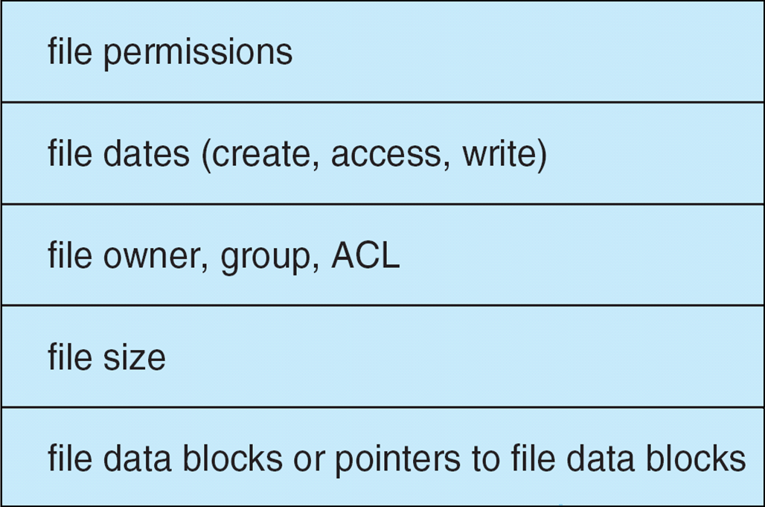
File-System Implementation (Cont.)
Per-file File Control Block (FCB) contains many details about the file
inode number, permissions, size, dates
May store file information into in master file table using relational DB structures

Slide 11
File Implementation
Files stored on disks.
Disks broken up into one or more partitions, with separate file system (fs) on each partition
Sector 0 of disk is the Master Boot Record
Is used to boot the computer
End of MBR has partition table.
Has starting and ending addresses of each partition.
One of the partitions is marked active in the master boot table
Tanenbaum, Modern Operating Systems 3 e, (c) 2008 Prentice-Hall, Inc. All rights reserved. 0-13-6006639

Slide 12
File Implementation
Boot computer => BIOS reads/executes MBR
MBR finds active partition and reads in first block (boot block)
Program in boot block locates the OS for that partition and reads it in
All partitions start with a boot block
Tanenbaum, Modern Operating Systems 3 e, (c) 2008 Prentice-Hall, Inc. All rights reserved. 0-13-6006639

Slide 13
A Possible File System Layout
Tanenbaum, Modern Operating Systems 3 e, (c) 2008 Prentice-Hall, Inc. All rights reserved. 0-13-6006639

Slide 14
File System Layout
Superblock contains info about the fs (e.g. type of fs, number of blocks, …)
i-nodes contain info about files
Tanenbaum, Modern Operating Systems 3 e, (c) 2008 Prentice-Hall, Inc. All rights reserved. 0-13-6006639

Slide 15
Structures for file system operations
An in-memory mount table contains information about each mounted volume.
An in-memory directory-structure cache holds the directory information of recently accessed directories.
For directories at which volumes are mounted, it can contain a pointer to the volume table.
System-wide open-file table contains a copy of the FCB of each open file, as well as other information.
Per-process open-file table contains a pointer to the appropriate entry in the system-wide open-file table, as well as other information.
Buffers hold file-system blocks when they are being read from disk or written to disk.

Slide 16
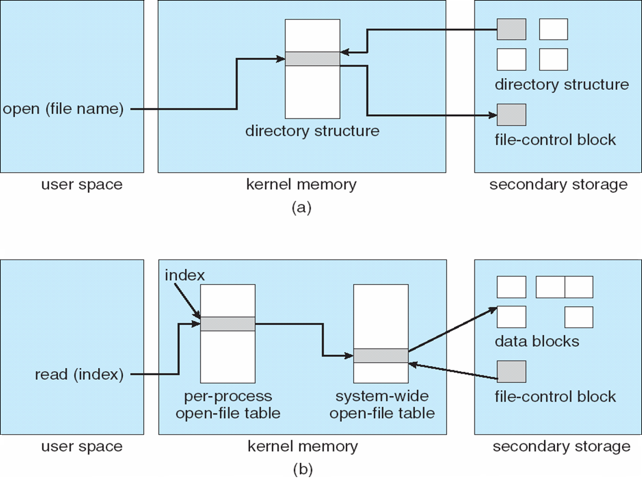
In-Memory File System Structures
Notes:
<number>

Slide 17
In-Memory File System Structures
When a process closes the file, the per-process table entry is removed, and the system-wide entry’s open count is decremented.
When all users that have opened the file close it, any updated metadata is copied back to the disk-based directory structure, and the system-wide open-file table entry is removed.
System-wide open-file table may also hold similar information for network connections and devices.
In this way, one mechanism can be used for multiple purposes.

Slide 18
Partitions and Mounting
Partition can be a volume containing a file system (“cooked”) or raw – just a sequence of blocks with no file system
Boot block can point to boot volume or boot loader set of blocks that contain enough code to know how to load the kernel from the file system
Or a boot management program for multi-os booting
Root partition contains the OS, other partitions can hold other OSs, other file systems, or be raw
Mounted at boot time
Other partitions can mount automatically or manually
At mount time, file system consistency checked
Is all metadata correct?
If not, fix it, try again
If yes, add to mount table, allow access

Slide 19
Virtual File Systems
Virtual File Systems (VFS) on Unix provide an object-oriented way of implementing file systems
VFS allows the same system call interface (the API) to be used for different types of file systems
Separates file-system generic operations from implementation details
Implementation can be one of many file systems types, or network file system
Implements vnodes which hold inodes or network file details
Then dispatches operation to appropriate file system implementation routines
Notes:
<number>

Slide 20
Virtual File Systems (1)
Have multiple fs on same machine
Windows specifies fs (drives)
Unix integrates into VFS
VFS calls from user
Lower calls to actual fs
Supports Network File System-file can be on a remote machine
Tanenbaum, Modern Operating Systems 3 e, (c) 2008 Prentice-Hall, Inc. All rights reserved. 0-13-6006639

Slide 21
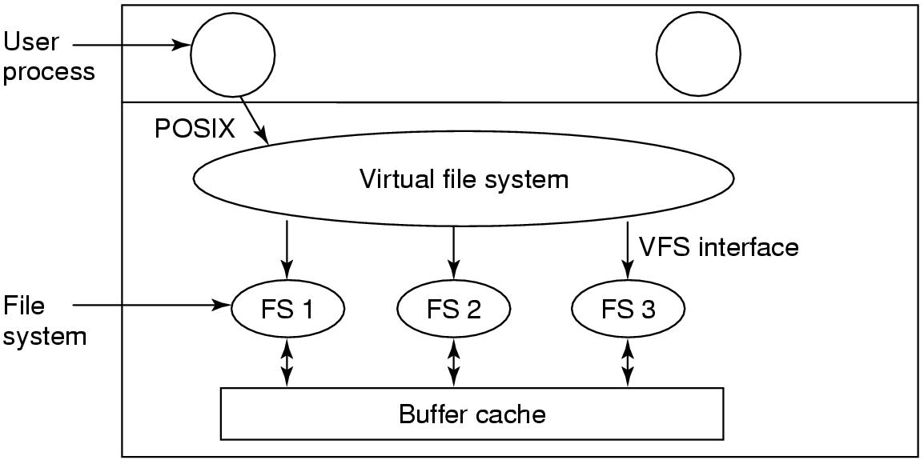
Virtual File Systems (2)
Tanenbaum, Modern Operating Systems 3 e, (c) 2008 Prentice-Hall, Inc. All rights reserved. 0-13-6006639

Slide 22
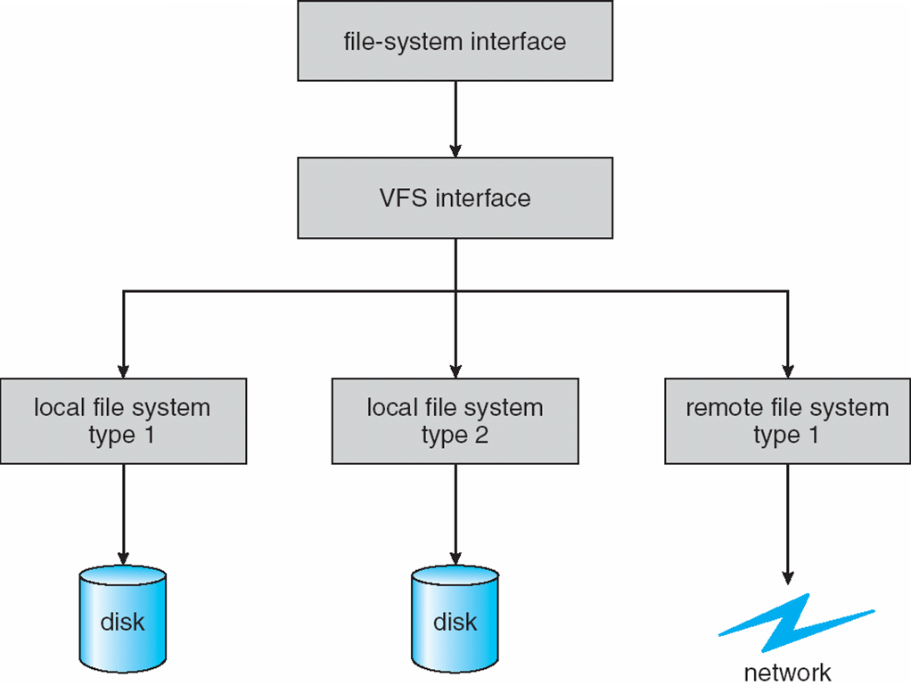
Virtual File Systems (Cont.)
The API is to the VFS interface, rather than any specific type of file system
Notes:
<number>

Slide 23
VFS Implementation
For example, Linux has four object types:
inode, file (open file), superblock (entire fs), dentry
For each of these four objects, VFS defines set of operations on the objects that must be implemented
Every object has a pointer to a function table
Function table has addresses of routines to implement that function on that object
For example:
int open(. . .)—Open a file
int close(. . .)—Close an already-open file
ssize t read(. . .)—Read from a file
ssize t write(. . .)—Write to a file
int mmap(. . .)—Memory-map a file

Slide 24
VFS-how it works
File system registers with VFS (e.g. at boot time)
At registration time, fs provides list of addresses of function calls the vfs wants
VFS gets info from the new file system i-node and puts it in a v-node
Makes entry in fd table for process
When process issues a call (e.g. read), function pointers point to concrete function calls
Tanenbaum, Modern Operating Systems 3 e, (c) 2008 Prentice-Hall, Inc. All rights reserved. 0-13-6006639

Slide 25
Directory Implementation
Linear list of file names with pointer to the data blocks
Simple to program
Time-consuming to execute
Linear search time
Could keep ordered alphabetically via linked list or use B+ tree
Hash Table – linear list with hash data structure
Decreases directory search time
Collisions – situations where two file names hash to the same location
Only good if entries are fixed size, or use chained-overflow method
Notes:
<number>

Slide 26
Allocation Methods - Contiguous
An allocation method refers to how disk blocks are allocated for files:
Contiguous allocation – each file occupies set of contiguous blocks
Best performance in most cases
Simple – only starting location (block #) and length (number of blocks) are required
Problems include finding space for file, knowing file size, external fragmentation, need for compaction off-line (downtime) or on-line
Notes:
<number>

Slide 27
Contiguous Allocation
Mapping from logical to physical
Q
LA/512
R
Block to be accessed = Q + starting address
Displacement into block = R
Notes:
<number>

Slide 28
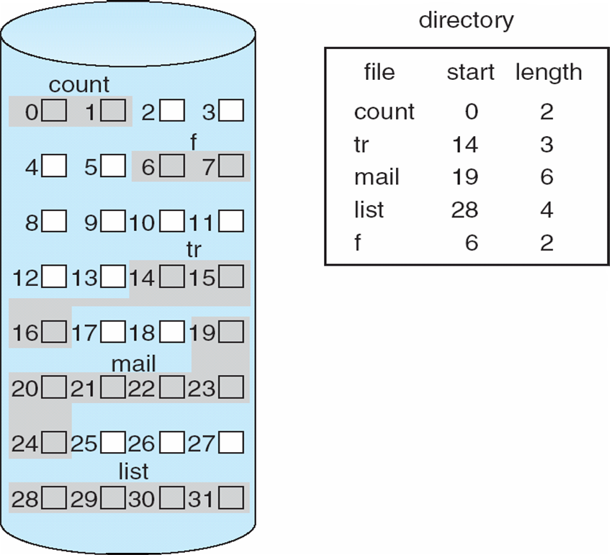
Contiguous Allocation of Disk Space
Notes:
<number>

Slide 29
Extent-Based Systems
Many newer file systems (i.e., Veritas File System) use a modified contiguous allocation scheme
Extent-based file systems allocate disk blocks in extents
An extent is a contiguous block of disks
Extents are allocated for file allocation
A file consists of one or more extents
Notes:
<number>

Slide 30
Allocation Methods - Linked
Linked allocation – each file a linked list of blocks
File ends at nil pointer
No external fragmentation
Each block contains pointer to next block
No compaction, external fragmentation
Free space management system called when new block needed
Improve efficiency by clustering blocks into groups but increases internal fragmentation
Reliability can be a problem
Locating a block can take many I/Os and disk seeks
FAT (File Allocation Table) variation
Beginning of volume has table, indexed by block number
Much like a linked list, but faster on disk and cacheable
New block allocation simple

Slide 31
Linked Allocation
Each file is a linked list of disk blocks: blocks may be scattered anywhere on the disk
block =
pointer
Notes:
<number>

Slide 32
Linked Allocation
Mapping
Q
LA/511
R
Block to be accessed is the Qth block in the linked chain of blocks representing the file.
Displacement into block = R + 1
Notes:
<number>

Slide 33
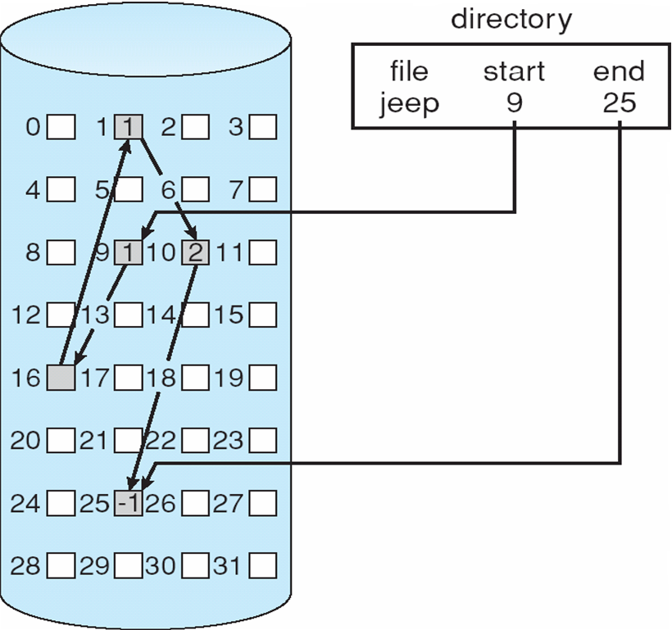
Linked Allocation
Notes:
<number>

Slide 34
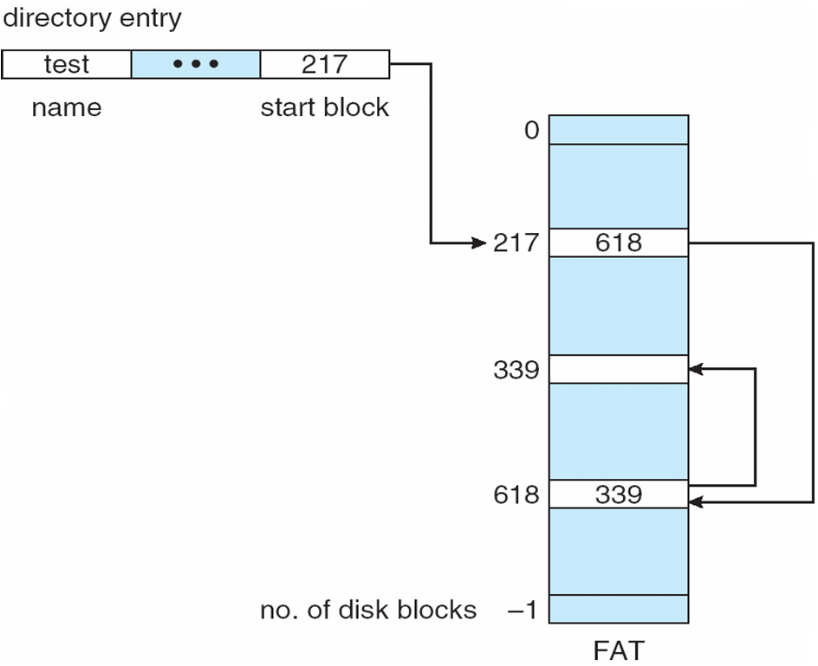
File-Allocation Table
Notes:
<number>

Slide 35
Allocation Methods - Indexed
Indexed allocation
Each file has its own index block(s) of pointers to its data blocks
Logical view
index table

Slide 36
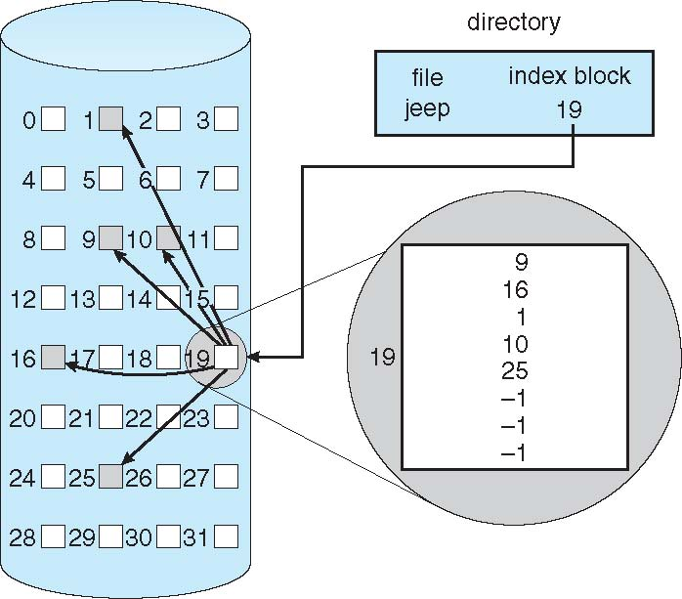
Example of Indexed Allocation
Notes:
<number>

Slide 37
Indexed Allocation (Cont.)
Need index table
Random access
Dynamic access without external fragmentation, but have overhead of index block
Mapping from logical to physical in a file of maximum size of 256K bytes and block size of 512 bytes. We need only 1 block for index table
Q
LA/512
R
Q = displacement into index table
R = displacement into block
Notes:
<number>

Slide 38
Indexed Allocation – Mapping (Cont.)
Mapping from logical to physical in a file of unbounded length (block size of 512 words)
Linked scheme – Link blocks of index table (no limit on size)
Q₁
LA / (512 x 511)
R₁
Q₁ = block of index table
R₁ is used as follows:
Q₂
R₁ / 512
R₂
Q₂ = displacement into block of index table
R₂ displacement into block of file:
Notes:
<number>

Slide 39
Indexed Allocation – Mapping (Cont.)
Two-level index (4K blocks could store 1,024 four-byte pointers in outer index -> 1,048,567 data blocks and file size of up to 4GB)
Q₁
LA / (512 x 512)
R₁
Q₁ = displacement into outer-index
R₁ is used as follows:
Q₂
R₁ / 512
R₂
Q₂ = displacement into block of index table
R₂ displacement into block of file:
Notes:
<number>

Slide 40
Indexed Allocation – Mapping (Cont.)

outer-index
index table
file
Notes:
<number>

Slide 41
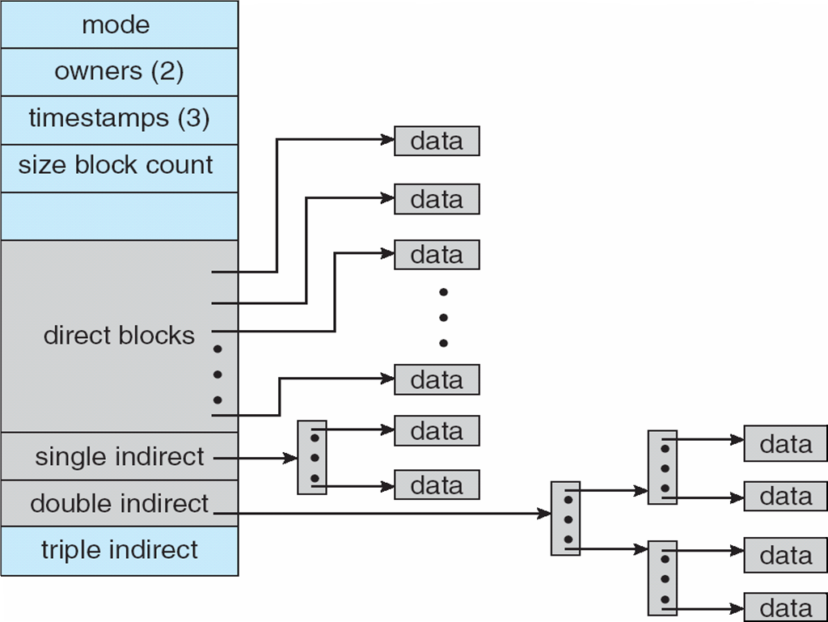
Combined Scheme: UNIX UFS (4K bytes per block, 32-bit addresses)
Note: More index blocks than can be addressed with 32-bit file pointer
Notes:
<number>

Slide 42
Performance
Best method depends on file access type
Contiguous great for sequential and random
Linked good for sequential, not random
Declare access type at creation -> select either contiguous or linked
Indexed more complex
Single block access could require 2 index block reads then data block read
Clustering can help improve throughput, reduce CPU overhead

Slide 43
Performance (Cont.)
Adding instructions to the execution path to save one disk I/O is reasonable
Intel Core i7 Extreme Edition 990x (2011) at 3.46Ghz = 159,000 MIPS
http://en.wikipedia.org/wiki/Instructions_per_second
Typical disk drive at 250 I/Os per second
159,000 MIPS / 250 = 630 million instructions during one disk I/O
Fast SSD drives provide 60,000 IOPS
159,000 MIPS / 60,000 = 2.65 millions instructions during one disk I/O

Slide 44
Free-Space Management
File system maintains free-space list to track available blocks/clusters
(Using term “block” for simplicity)
Bit vector or bit map (n blocks)
Block number calculation
(number of bits per word) *
(number of 0-value words) +
offset of first 1 bit
CPUs have instructions to return offset within word of first “1” bit
0
1
2
n-1
…
1 ⇒ block[i] free
0 ⇒ block[i] occupied
bit[i] =

Notes:
<number>

Slide 45
Free-Space Management (Cont.)
Bit map requires extra space
Easy to get contiguous files
Notes:
<number>

Slide 46
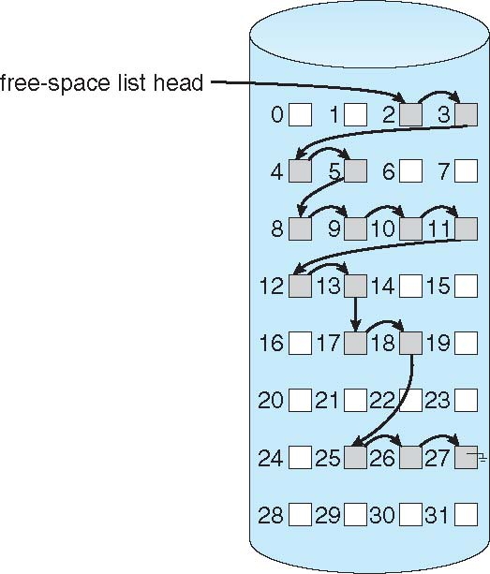
Linked Free Space List on Disk
Linked list (free list)
Cannot get contiguous space easily
No waste of space
No need to traverse the entire list (if # free blocks recorded)
Notes:
<number>

Slide 47
Free-Space Management (Cont.)
Grouping
Modify linked list to store address of next n-1 free blocks in first free block, plus a pointer to next block that contains free-block-pointers (like this one)
Counting
Because space is frequently contiguously used and freed, with contiguous-allocation allocation, extents, or clustering
Keep address of first free block and count of following free blocks
Free space list then has entries containing addresses and counts

Slide 48
Free-Space Management (Cont.)
Space Maps
Used in ZFS
Consider meta-data I/O on very large file systems
Full data structures like bit maps couldn’t fit in memory -> thousands of I/Os
Divides device space into metaslab units and manages metaslabs
Given volume can contain hundreds of metaslabs
Each metaslab has associated space map
Uses counting algorithm
But records to log file rather than file system
Log of all block activity, in time order, in counting format
Metaslab activity -> load space map into memory in balanced-tree structure, indexed by offset
Replay log into that structure
Combine contiguous free blocks into single entry

Slide 49
Efficiency and Performance
Efficiency dependent on:
Disk allocation and directory algorithms
Types of data kept in file’s directory entry
Pre-allocation or as-needed allocation of metadata structures
Fixed-size or varying-size data structures
Notes:
<number>

